Slide 1
Dummy Cursor on Smartphone
Haruto Miura, Yugo Matsumoto

Slide 2
Background
Through Multiple Dummy Cursors experiment, it is clear that the users can easily recognize a self-controlled cursor and people observing the users experienced difficulty recognizing the user-controlled cursor from the dummy cursors.

Slide 3
Question
Does the phenomenon apply to smartphone as well?

Slide 4
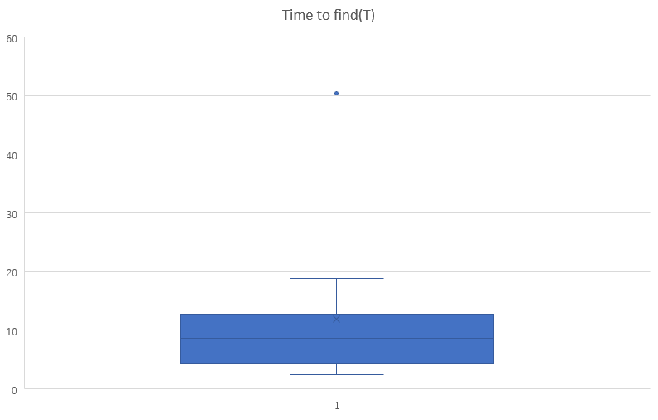
Figure

Slide 5
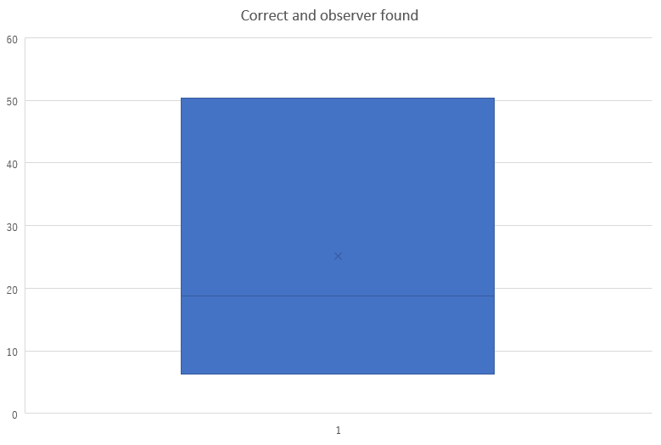
Figure

Slide 6
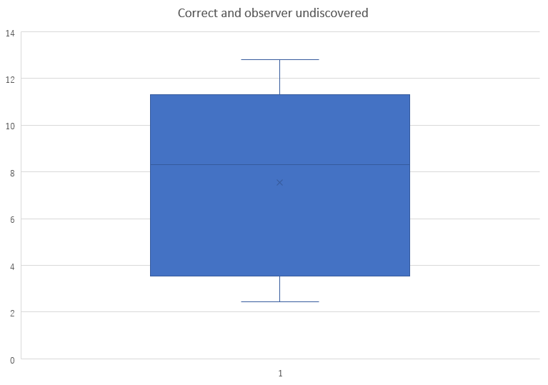
Figure

