Slide 1
The Experiment of Dummy Cursor on Smartphone
Mid term
Haruto Mirura Yugo Matsumoto

Slide 2
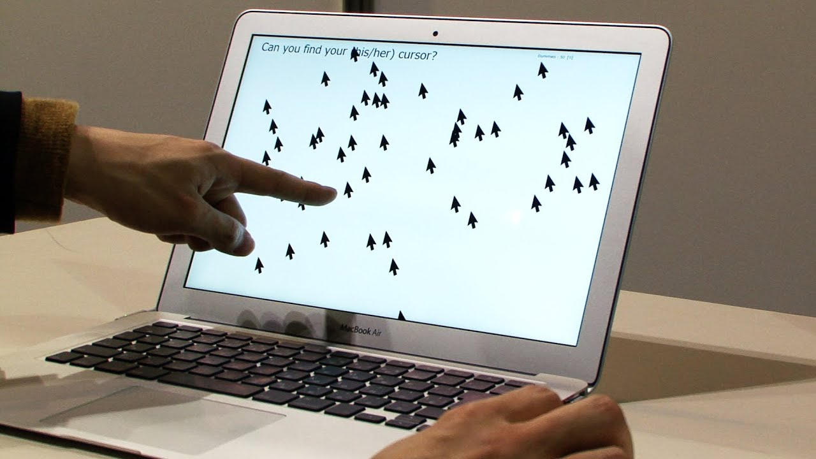
Background
Through Multiple Dummy Cursors experiment, it is clear that the users can easily identify a self-controlled cursor and people who is trying to identify the user-controlled cursor experienced difficulty identifying the user-controlled cursor from the dummy cursors.

Slide 3
Question
Does the phenomenon apply
to smartphone as well?

Slide 4

Method
Experiment environment
16 cursors including 15 dummies are displayed at the top of the screen.
The bottom part of the screen is swiped to control the cursors.
Real cursors move in conjunction with finger movement.
While the operator moves the cursor, each dummy cursor moves in its own way.

Slide 5
Method
Controllers
First, tap the start button. Then, swipe the screen and find real cursor. When they think they've found the real cursor, triple-tap it.
Observers
Find the real cursor next to the controllers.
Notes:
Experiments are done in pairs.
Controllers and observers take turns.
The controller first taps the Start button. Next, swipe the screen to find the real cursor. When you think you have found a real cursor, triple-tap it.
The observer Find the real cursor next to the controllers.

Slide 6
Results
The time the controllers found
Average: 8.45s
Median: 8.64s
The number of times the observers found it first
3 / 14 (right side: 1, left side: 2)
Gender differences
men: 8.22s
women: 8.84s
Notes:
We get these result by this experiment.
The average time for the controller to find the cursor was 8.45s and the median was 8.64s
The observer found it first in 3 out of 14 cases
The average time for men and women was 8.22s and 8.84s, respectively.

Slide 7
Discussion
In this experiment, we only researched about effectiveness of the Dummy Cursors. So, our next goal is to research whether it helps prevent PIN peeping on smartphone as well as PC. Because 3 out of 14 people were able to find the real cursor, it can be evaluated as inadequate in terms of security.
Another possible reason for the observer's ability to find the operator's cursor may be that the finger manipulation is more linked to the cursor movement than the mouse cursor manipulation
Notes:
In this experiment, we only researched about effectiveness of the Dummy Cursors. So, our next goal is to research whether it helps prevent PIN peeping on smartphone as well as PC. Because 3 out of 14 people were able to find the real cursor, it can be evaluated as inadequate in terms of security.
Another possible reason for the observer's ability to find the operator's cursor may be that the finger manipulation is more linked to the cursor movement than the mouse cursor manipulation

Slide 8
Discussion
How does this change with screen size, number of dummies, and size?
Almost no age or gender differences
Notes:
It is necessary to experiment with different environments, which was not possible in this experiment.
Since there was no significant difference in the values, it can be said that there is no age difference and Difference between male and female

Slide 9
Conclusion
A sense of self-possession exists even with the manipulation of fingers on a smartphone.
There were things that observers found first.
Notes:
In conclusion, we found that the operators had a greater sense of body ownership than the observers, even when operating with their fingers on a smartphone.
In addition, we found that in some cases, the observer found the object first.

Slide 10
Reference
KeitaWatanabe, Fumito Higuchi, Masahiko Inami, Takeo Igarashi (2013). Identification of Own Cursor from Multiple Dummy Cursors. IPSJ Interaction 2013. pp.25-31.

