Slide 1
The Experiment of Dummy Cursor on Smartphone
Mid term
Haruto Mirura Yugo Matsumoto

Slide 2
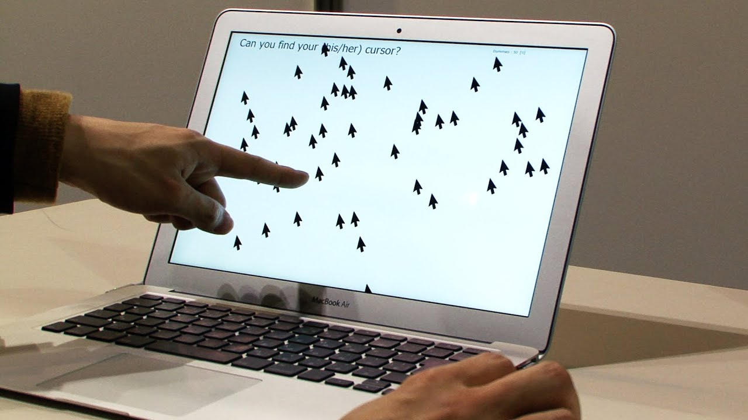
Background
Through Multiple Dummy Cursors experiment, it is clear that the users can easily identify a self-controlled cursor and people who is trying to identify the user-controlled cursor experienced difficulty identifying the user-controlled cursor from the dummy cursors.

Slide 3
Question
Does the phenomenon apply
to smartphone as well?

Slide 4

Method
Experiment environment
16 cursors including 15 dummies are displayed at the top of the screen.
The bottom part of the screen is swiped to control the cursors.
Real cursors move in conjunction with finger movement.
While the operator moves the cursor, each dummy cursor moves in its own way.

Slide 5
Method
Controllers
First, tap the start button. Then, swipe the screen and find real cursor. When they think they've found the real cursor, triple-tap it.
Observers
Find the real cursor next to the controllers.

Slide 6
Results
The time the controllers found
Average: 8.45s
Median: 8.64s
The number of times the observers found it first
3 / 14 (right side: 1, left side: 2)

Slide 7
Discussion
In this experiment, we only researched about effectiveness of the Dummy Cursors. So, our next goal is to research whether it helps prevent PIN peeping on smartphone as well as PC. Because 3 out of 14 people were able to find the real cursor, it can be evaluated as inadequate in terms of security.

Slide 8
Conclusion

Slide 9
Reference
KeitaWatanabe, Fumito Higuchi, Masahiko Inami, Takeo Igarashi (2013). Identification of Own Cursor from Multiple Dummy Cursors. IPSJ Interaction 2013. pp.25-31.

