Slide 1
Financial KPI Report
Generated from Streamlit dashboard

Slide 2
Key KPIs
Revenue: 6177573.18
Expenses: 4336795.65
Profit_margin: 0.30
Cash_flow: 1840777.53
Growth_rate: -9.17

Slide 3
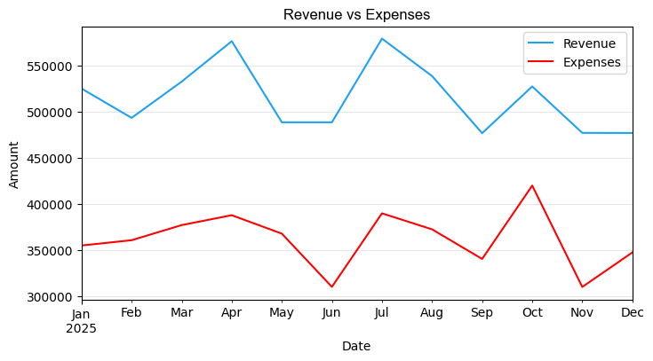
Revenue vs Expenses

Slide 4
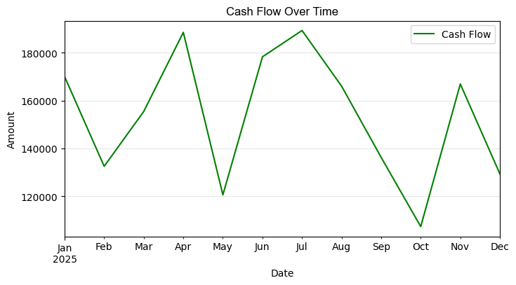
Cash Flow

