Slide 1
STAR
Laboratory of Advanced Research on Software Technology
Using Mind Mapping to Design Test Cases
W. Eric Wong
Department of Computer Science
The University of Texas at Dallas
ewong@utdallas.edu
http://www.utdallas.edu/~ewong
Using Mind Mapping to Design Test Cases (© 2013-2015 Professor W. Eric Wong, The University of Texas at Dallas)

Slide 2

Speaker Biographical Sketch
Senior Research Scientist & Project Manager
Bellcore (Bell Communications Research)
  Formerly part of AT&T Bell Labs
  Now Telcordia Technologies
Professor & Director of International Outreach
Department of Computer Science
University of Texas at Dallas
Guest Researcher
Computer Security Division
National Institute of Standards and Technology (NIST)
Vice President, IEEE Reliability Society
Secretary, ACM SIGAPP (Special Interest Group on Applied Computing)
Founder & Steering Committee Chair for the SERE conference
(IEEE International Conference on Software Security and Reliability)
(http://paris.utdallas.edu/sere13)
Using Mind Mapping to Design Test Cases (© 2013-2015 Professor W. Eric Wong, The University of Texas at Dallas)

Slide 3
Test Generation
Program Specifications
Clues
Expected behavior
Program output
is correct
Test requirements
Oracle
or
Test specifications
Test driver
Actual behavior
Program execution
failed; make a
note and proceed
with testing or get
into the debugging
mode.
Until specifications
exhausted
Program
Using Mind Mapping to Design Test Cases (© 2013-2015 Professor W. Eric Wong, The University of Texas at Dallas)

Slide 4
Mind Map: Overview
A mind map is a diagram used to visually outline information.
  It is often created around a single word or text, placed in the center, to which associated ideas, words, and concepts are added.
Elements of a mind map
  arranged intuitively according to the importance of the concepts
  classified into groups, branches, or areas
  aimed at representing semantic or other connections between portions
  of information
Mind maps can be used to generate, visualize, structure, and classify ideas.
Using Mind Mapping to Design Test Cases (© 2013-2015 Professor W. Eric Wong, The University of Texas at Dallas)

Slide 5
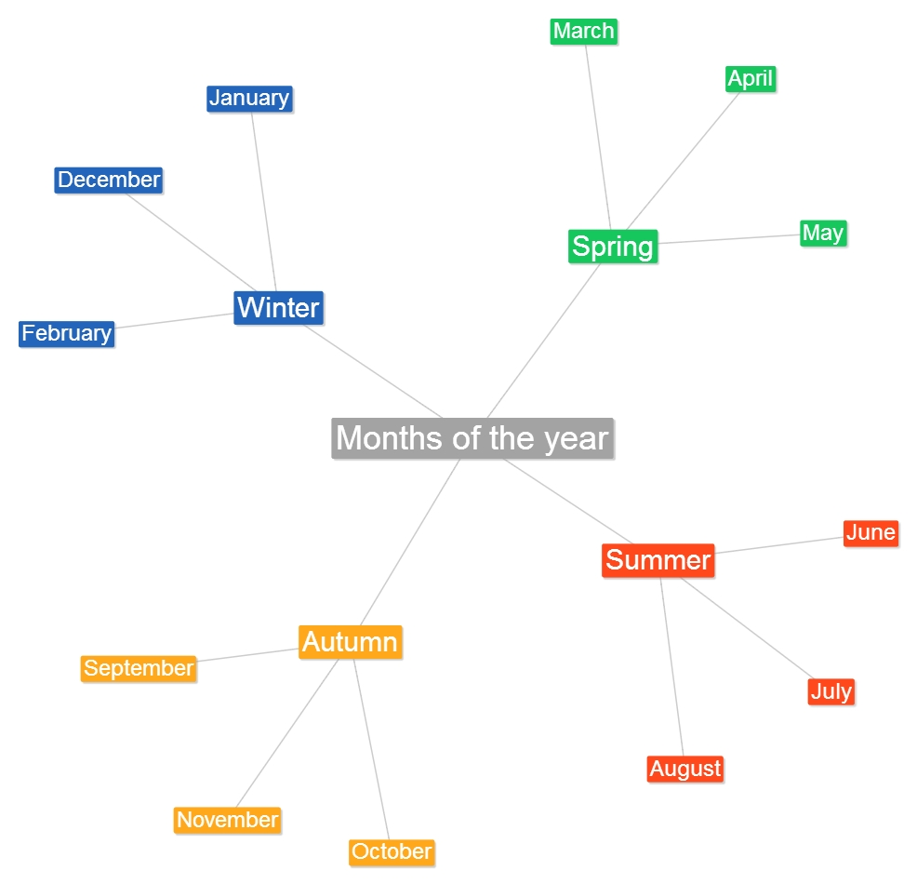
Mind Map: An Example (1)
Using a mind map to classify the months of a year
Using Mind Mapping to Design Test Cases (© 2013-2015 Professor W. Eric Wong, The University of Texas at Dallas)

Slide 6
Mind Map: An Example (2)
Using a mind map to classify the months of a year
Using Mind Mapping to Design Test Cases (© 2013-2015 Professor W. Eric Wong, The University of Texas at Dallas)

Slide 7
Test Generation using Mind Map (1)
Suppose we have a computer program to compute the cost of each phone call, using the following scheme
  If an invalid country code or an invalid phone number is used, there will be no charge
  If no country code is given or it equals “USA”, then the charge is based on a domestic call
  If the country code equals “Canada,” “Mexico,” or “Brazil,” then the charge is based
  on an international call.
  If the country code equals any other valid country names, the call cannot go through and there will be no charge
  The duration of each call is rounded up to the next highest time unit
 | Standard | Evening/Weekend | Time unit (second)
Domestic | $0.05 | $0.01 | 1
International | $1.00 | $0.30 | 20
Using Mind Mapping to Design Test Cases (© 2013-2015 Professor W. Eric Wong, The University of Texas at Dallas)
Notes:
http://rvg.web.cse.unsw.edu.au/eptcs/Published/MBT2012/Papers/910539/arXiv.pdf

Slide 8
Test Generation using Mind Map (2)
  The maximal duration of each call is 24 hours
    86,400 units for a domestic call
    4,320 units for an international call
  The “evening” rate applies between 8 pm and 6 am
  The “weekend” rate applies on Saturday and Sunday
  . . . . . . . . . . .
Using Mind Mapping to Design Test Cases (© 2013-2015 Professor W. Eric Wong, The University of Texas at Dallas)

Slide 9
Test Generation using Mind Map (3)
Build a mind map
Less than 1 second
1 second
Invalid phone number
Duration
1 − 20 second
20 − 40 second
Exceed
time limit
Bad Calls
Price
Good Calls
10 minutes
24 hours
Bad country code
Destination
Rate
Country code
(not supported)
Invalid country code
Weekend
International
Domestic
Weekday
Canada
Mexico
No country code
Evening
With country code: USA
Standard
Brazil
Using Mind Mapping to Design Test Cases (© 2013-2015 Professor W. Eric Wong, The University of Texas at Dallas)

Slide 10
Test Generation using Mind Map (4)
Create equivalence classes based on a mind map
  Phone number:
    {valid phone number}, {invalid phone number}
  Country code:
    {invalid country code}, {valid country code (supported)}, {valid country code (not supported)}, {no country code}, {USA}
  Rate
    {Weekday, Standard}, {Weekday, Evening}, {Weekend}
  Duration
    {less than 1 second}, {1 second}, {1 − 20 seconds}, {20 − 40 seconds}, {40 seconds − 10 minutes}, {10 minutes to 24 hours}, {24 hours}
Apply unidimensional or multidimensional partitioning for test generation
Using Mind Mapping to Design Test Cases (© 2013-2015 Professor W. Eric Wong, The University of Texas at Dallas)

Slide 11
Test Generation using Mind Map (5)
Mind maps provide a visualization approach to classify the input domain.
It can be easily combined with
  ECP (Equivalence Class Partitioning)
  BVA (Boundary Value Analysis)
  etc.
Using Mind Mapping to Design Test Cases (© 2013-2015 Professor W. Eric Wong, The University of Texas at Dallas)

Slide 12
Tool Support
There are tools to help users generate mind maps
  CAM editor (http://www.cameditor.org)
  FreeMind (http://freemind.sourceforge.net/wiki/index.php/Main_Page)
  Docear (http://www.docear.org/)
Using Mind Mapping to Design Test Cases (© 2013-2015 Professor W. Eric Wong, The University of Texas at Dallas)

