Slide 1
STAR
Laboratory of Advanced Research on Software Technology
Requirements-based Test Generation
for
Functional Testing
W. Eric Wong
Department of Computer Science
The University of Texas at Dallas
ewong@utdallas.edu
http://www.utdallas.edu/~ewong
Requirements-based Test Generation for Functional Testing (© 2012 Professor W. Eric Wong, The University of Texas at Dallas)

Slide 2

Speaker Biographical Sketch
Professor & Director of International Outreach
Department of Computer Science
University of Texas at Dallas
Guest Researcher
Computer Security Division
National Institute of Standards and Technology (NIST)
Vice President, IEEE Reliability Society
Secretary, ACM SIGAPP (Special Interest Group on Applied Computing)
Principal Investigator, NSF TUES (Transforming Undergraduate Education in Science, Technology, Engineering and Mathematics) Project
  Incorporating Software Testing into Multiple Computer Science and Software Engineering Undergraduate Courses
Founder & Steering Committee co-Chair for the SERE conference
(IEEE International Conference on Software Security and Reliability)
(http://paris.utdallas.edu/sere13)
Requirements-based Test Generation for Functional Testing (© 2012 Professor W. Eric Wong, The University of Texas at Dallas)

Slide 3
Two Techniques for Test Generation
Essential black-box techniques for generating tests for functional testing
Equivalence Class partitioning
Boundary value analysis
Requirements-based Test Generation for Functional Testing (© 2012 Professor W. Eric Wong, The University of Texas at Dallas)

Slide 4
Functional Testing
Testing a program/sub-program to determine whether it functions as planned
A black-box based testing against the operational (i.e., functional) requirements.
Testing the advertised features for correct operation
Verifying a program for its conformance to all functional specifications
Entailing the following tasks
  Test generation
  Test execution
  Test assessment
Requirements-based Test Generation for Functional Testing (© 2012 Professor W. Eric Wong, The University of Texas at Dallas)

Slide 5

Equivalence Class Partitioning

Slide 6
Example I (1)
Consider an application that takes an integer as input
Let us suppose that the only legal values are in the range [1..100]
Which input value(s) will you use to test this application?
Requirements-based Test Generation for Functional Testing (© 2012 Professor W. Eric Wong, The University of Texas at Dallas)

Slide 7
Example I (2)
The set of input values can be divided into
  A set of expected, or legal, inputs (E) containing all integers in the range [1..100]
  A set of unexpected, or illegal, inputs (U ) containing the remaining integers
All integers
U: Other integers
E: [1..100]
Requirements-based Test Generation for Functional Testing (© 2012 Professor W. Eric Wong, The University of Texas at Dallas)

Slide 8
Example I (3)
Assume that the application is required to process all values in the range [1..50] in accordance with requirement R₁ and those in the range [51..100] according to requirement R₂.
  E is divided into two regions depending on the expected behavior.
Also assume that all invalid inputs less than 1 are to be treated in one way while all greater than 100 are to be treated differently.
  This leads to a subdivision of U into two categories.
All integers
<1
[51..100]
>100
[1..50]
Requirements-based Test Generation for Functional Testing (© 2012 Professor W. Eric Wong, The University of Texas at Dallas)

Slide 9
Example I (4)
How many input values should we use for testing the application ?
Requirements-based Test Generation for Functional Testing (© 2012 Professor W. Eric Wong, The University of Texas at Dallas)

Slide 10
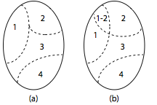
Equivalence Partitioning
Test selection using equivalence partitioning allows a tester to divide the input domain into a relatively small number of sub-domains.
The sub-domains are disjoint.
Each subset is known as an equivalence class.
The four subsets shown in (a) constitute a partition of the input domain while the subsets in (b) are not.
Requirements-based Test Generation for Functional Testing (© 2012 Professor W. Eric Wong, The University of Texas at Dallas)

Slide 11
Quiz
What if there is more than one input variable ?
Requirements-based Test Generation for Functional Testing (© 2012 Professor W. Eric Wong, The University of Texas at Dallas)

Slide 12
Unidimensional Partitioning
One way to partition the input domain is to consider one input variable at a time. Thus each input variable leads to a partition of the input domain.
We refer to this style of partitioning as unidimensional equivalence partitioning or simply unidimensional partitioning.
This type of partitioning is commonly used.
Requirements-based Test Generation for Functional Testing (© 2012 Professor W. Eric Wong, The University of Texas at Dallas)

Slide 13
Multidimensional Partitioning
Another way is to consider the input domain I as the set product of the input variables and define a relation on I. This procedure creates one partition consisting of several equivalence classes.
We refer to this method as multidimensional equivalence partitioning or simply multidimensional partitioning.
Requirements-based Test Generation for Functional Testing (© 2012 Professor W. Eric Wong, The University of Texas at Dallas)

Slide 14
Example II (1)
Consider an application that requires two integer inputs x and y. Each of these inputs is expected to lie in the following ranges: 3≤ x≤7 and 5≤y≤9.
How many pairs of (x, y) should we use to test this application?
Requirements-based Test Generation for Functional Testing (© 2012 Professor W. Eric Wong, The University of Texas at Dallas)

Slide 15
Example II (2)
Using Unidimensional Partitioning
E1: x<3
E2: 3≤x≤7
E3: x>7
y ignored.
E4: y<5
E5: 5≤y≤9
E6: y>9
x ignored.
Requirements-based Test Generation for Functional Testing (© 2012 Professor W. Eric Wong, The University of Texas at Dallas)

Slide 16
Example II (3)
Using Multidimensional Partitioning
E1: x<3, y<5
E2: x<3, 5≤y≤9
E3: x<3, y>9
E4: 3≤x≤7, y<5
E5: 3≤x≤7, 5≤y≤9
E6: 3≤x≤7, y>9
E7: x>7, y<5
E8: x>7, 5≤y≤9
E9: x>7, y>9
Requirements-based Test Generation for Functional Testing (© 2012 Professor W. Eric Wong, The University of Texas at Dallas)

Slide 17
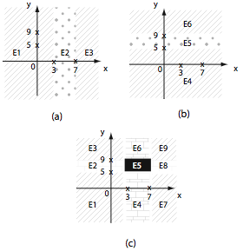
Example II (4)
Requirements-based Test Generation for Functional Testing (© 2012 Professor W. Eric Wong, The University of Texas at Dallas)

Slide 18
Equivalence Classes based on Program Output (1)
In some cases the equivalence classes are based on the output generated by the program.
For example, suppose that a program outputs an integer.
It is worth asking: “Does the program ever generate a 0? What are the maximum and minimum possible values of the output?”
These two questions lead to two the following equivalence classes based on outputs:
Requirements-based Test Generation for Functional Testing (© 2012 Professor W. Eric Wong, The University of Texas at Dallas)

Slide 19
Equivalence Classes based on Program Output (2)
E1: Output value v is 0
E2: Output value v is the maximum possible
E3: Output value v is the minimum possible
E4: All other output values
Based on the output equivalence classes one may now derive equivalence classes for the inputs. Thus each of the four classes given above might lead to one equivalence class consisting of inputs.
More examples . . . . . . . . .
Requirements-based Test Generation for Functional Testing (© 2012 Professor W. Eric Wong, The University of Texas at Dallas)

Slide 20
Equivalence Classes for variables : Range
Equivalence Classes | Example
One class with values inside the range and two with values outside the range. | speed ∈[60..90] | {50}, {75}, {92}
 | area: float area≥0.0 | {{-1.0}, {15.52}}
 | age: int | {{-1}, {56}, {0}}
Constraints
Classes
Requirements-based Test Generation for Functional Testing (© 2012 Professor W. Eric Wong, The University of Texas at Dallas)

Slide 21
Equivalence Classes for variables : String
Equivalence Classes | Example
At least one containing all legal strings and one all illegal strings based on any constraints. | firstname: string | {{ε}, {Sue}, {Loooong Name}}
Constraints
Classes
Requirements-based Test Generation for Functional Testing (© 2012 Professor W. Eric Wong, The University of Texas at Dallas)

Slide 22
Equivalence Classes for variables : Enumeration
Equivalence Classes | Example
Each value in a separate class | autocolor:{red, blue, green} | {{red,} {blue}, {green}}
 | X:boolean | {{true}, {false}}
Constraints
Classes
Requirements-based Test Generation for Functional Testing (© 2012 Professor W. Eric Wong, The University of Texas at Dallas)

Slide 23
Equivalence Classes for variables : Array
Equivalence Classes | Example
One class containing all legal arrays, one containing the empty array, and one containing a larger than expected array. | int [ ] aName = new int[3]; | {[ ]}, {[-10, 20]}, {[-9, 0, 12, 15]}
Constraints
Classes
Requirements-based Test Generation for Functional Testing (© 2012 Professor W. Eric Wong, The University of Texas at Dallas)

Slide 24
Equivalence Classes for Compound Data Type (1)
Arrays in Java and structures in C++/C, are compound types. Such input types may arise while testing components of an application such as a function or an object.
While generating equivalence classes for such inputs, one must consider legal and illegal values for each component of the structure.
The next two examples illustrate the derivation of equivalence classes for an input variable that has a compound type.
Requirements-based Test Generation for Functional Testing (© 2012 Professor W. Eric Wong, The University of Texas at Dallas)

Slide 25
Equivalence Classes for Compound Data Type (2)
struct transcript
{
string fName; // First name
string lName; // Last name
string studentID // 9 digits
string cTitle [200]; // Course titles
char grades [200]; // Letter grades corresponding to course titles
}
Derive equivalence classes for each component of R and combine them!
Requirements-based Test Generation for Functional Testing (© 2012 Professor W. Eric Wong, The University of Texas at Dallas)

Slide 26
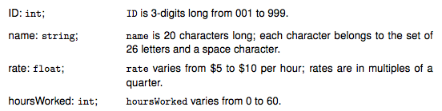
Equivalence Classes for Compound Data Type (3)
Consider a procedure P in a payroll processing system that takes an employee record as input and computes the weekly salary. For simplicity, assume that the employee record consists of the following items with their respective types and constraints:
Calculate the size of the input domain
Requirements-based Test Generation for Functional Testing (© 2012 Professor W. Eric Wong, The University of Texas at Dallas)

Slide 27
Systematic Procedure for Equivalence Partitioning
1. Identify the input domain: Read the requirements carefully and identify all input and output variables, their types, and any conditions associated with their use.
2. Equivalence classing: Partition the set of values of each variable into disjoint subsets
3. Combine equivalence classes: This step is usually omitted and the equivalence classes defined for each variable are directly used to select test cases. However, by not combining the equivalence classes, one misses the opportunity to generate useful tests.
4. Identify infeasible equivalence classes: An infeasible equivalence class is one that contains a combination of input data that cannot be generated during test. Such an equivalence class might arise due to several reasons.
Requirements-based Test Generation for Functional Testing (© 2012 Professor W. Eric Wong, The University of Texas at Dallas)

Slide 28
Example III (1)
Consider that wordcount method takes a word w and a filename f as input and returns the number of occurrences of w in the text contained in the file named f. An exception is raised if there is no file with name f. Using the partitioning method described in the previous example, we obtain the following equivalence classes.
Requirements-based Test Generation for Functional Testing (© 2012 Professor W. Eric Wong, The University of Texas at Dallas)

Slide 29
Example III (2)
Equivalence class | w | f
E₁ | non-null | exists, not empty
E₂ | non-null | does not exist
E₃ | non-null | exists, empty
E₄ | null | exists, not empty
E₅ | null | does not exist
E₆ | null | exists, empty
Requirements-based Test Generation for Functional Testing (© 2012 Professor W. Eric Wong, The University of Texas at Dallas)

Slide 30
Example III (3)
The number of equivalence classes without any knowledge of the program code is 2, whereas the number of equivalence classes on the previous slide is 6.
An experienced tester will likely derive the six equivalence classes given above, and perhaps more, even before the code is available
Requirements-based Test Generation for Functional Testing (© 2012 Professor W. Eric Wong, The University of Texas at Dallas)

Slide 31
Quiz
How many equivalence classes do we need for the wordcount program?
Requirements-based Test Generation for Functional Testing (© 2012 Professor W. Eric Wong, The University of Texas at Dallas)

Slide 32
GUI Design and Equivalence Classes (1)
While designing equivalence classes for programs that obtain input exclusively from a keyboard, one must account for the possibility of errors in data entry.
Example: An application places a constraint on an input variable x such that it can assume integral values in the range 3..7. However, testing must account for the possibility that a user may inadvertently enter a value for x that is out of range.
Requirements-based Test Generation for Functional Testing (© 2012 Professor W. Eric Wong, The University of Texas at Dallas)

Slide 33
GUI Design and Equivalence Classes (2)
Suppose that all data entry to the application is via a GUI front end. Suppose also that the GUI offers exactly five correct choices to the user for x.
In such a situation it is impossible to test the application with a value of x that is out of range. Hence only the correct values of x will be input. See figures on the next slide.
Requirements-based Test Generation for Functional Testing (© 2012 Professor W. Eric Wong, The University of Texas at Dallas)

Slide 34
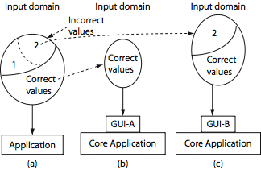
GUI Design and Equivalence Classes (3)
Requirements-based Test Generation for Functional Testing (© 2012 Professor W. Eric Wong, The University of Texas at Dallas)

Slide 35
Program Behavior and Equivalence Classes
The equivalence classes are created assuming that the program behaves the same on all elements (i.e., tests) within a class.
This assumption allows the tester to select exactly one test case from each equivalence class to test the program.
Is this assumption correct?
If yes, why?
If no, how to improve the test set?
Requirements-based Test Generation for Functional Testing (© 2012 Professor W. Eric Wong, The University of Texas at Dallas)

Slide 36
Boundary Value Analysis

Slide 37
Errors at the Boundaries
Experience indicates that programmers make mistakes in processing values at and near the boundaries of equivalence classes.
For example, suppose that method M is required to compute a function f₁
when x ≤ 0 is true and function f₂ otherwise. Also assume that f₁(0) ≠ f₂(0)
However, M has an error due to which it computes f₁ for x <0 and f₂ otherwise.
Obviously, this fault can be revealed when M is tested against x = 0, but not if the input test set is, for example, {-4, 7} derived using equivalence partitioning.
In this example, the value x=0, lies at the boundary of the equivalence classes x≤0 and x>0.
Requirements-based Test Generation for Functional Testing (© 2012 Professor W. Eric Wong, The University of Texas at Dallas)

Slide 38
Equivalence Partitioning & Boundary Value Analysis
While equivalence partitioning selects tests from within equivalence classes, boundary value analysis focuses on tests at and near the boundaries of equivalence classes.
  Boundary value analysis is a test selection technique that targets faults in applications at the boundaries of equivalence classes.
Certainly, tests derived using either of the two techniques may overlap.
Requirements-based Test Generation for Functional Testing (© 2012 Professor W. Eric Wong, The University of Texas at Dallas)

Slide 39
Boundary Value Analysis : Procedures
Partition the input domain using unidimensional partitioning. Alternately, a single partition of an input domain can be created using multidimensional partitioning. We will generate several sub-domains in this step.
Identify the boundaries for each partition. Boundaries may also be identified using special relationships among the inputs.
Select test data such that each boundary value occurs in at least one test input.
Requirements-based Test Generation for Functional Testing (© 2012 Professor W. Eric Wong, The University of Texas at Dallas)

Slide 40
BVA Example : Step 1 – Create Equivalence Classes
Assuming that a program takes two variables as input: code must be in the range 99..999 and quantity in the range 1..100
  Equivalence classes for code
    E1: values less than 99
    E2: values in the range
    E3: values greater than 999
  Equivalence classes for quantity
    E4: values less than 1
    E5: values in the range
    E6: values greater than 100
Requirements-based Test Generation for Functional Testing (© 2012 Professor W. Eric Wong, The University of Texas at Dallas)

Slide 41
BVA Example : Step 2 – Identify Boundaries
Boundaries are indicated with an x.
98
100
998
1000
*
x
*
*
x
*
99
999
E1
E2
E3
0
2
99
101
*
x
*
**
x
**
1
100
E4
E5
E6
Requirements-based Test Generation for Functional Testing (© 2012 Professor W. Eric Wong, The University of Texas at Dallas)

Slide 42
BVA Example : Step 3 – Construct Test Set
Test selection based on the boundary value analysis technique requires that tests must include, for each variable, values at and around the boundary.
Quiz: unidimensional partitioning versus multidimensional partitioning
T={ t₁: (code=98, quantity=0),
t₂: (code=99, quantity=1),
t₃: (code=100, quantity=2),
t₄: (code=998, quantity=99),
t₅: (code=999, quantity=100),
t₆: (code=1000, quantity=101)
}
Illegal values of code and quantity included
Requirements-based Test Generation for Functional Testing (© 2012 Professor W. Eric Wong, The University of Texas at Dallas)

Slide 43
Equivalence Class Partitioning
versus
Statement Coverage

Slide 44
Example: Identify the Type of a Triangle (1)
A program P takes an input of three integers a, b and c, and returns the type of the triangle corresponding to three sides of length a, b, and c, respectively.
Quiz:
  How to generate a test set based on Equivalence Class Partitioning to achieve the highest statement coverage possible?
Requirements-based Test Generation for Functional Testing (© 2012 Professor W. Eric Wong, The University of Texas at Dallas)

Slide 45
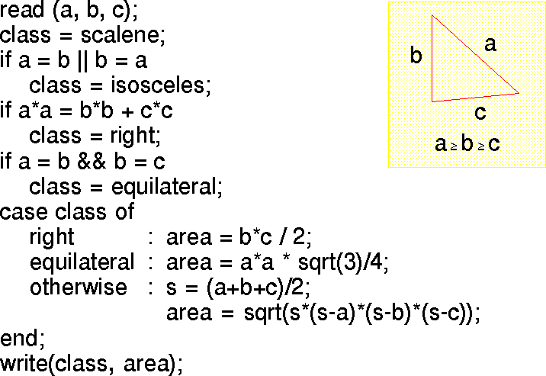
Example: Identify the Type of a Triangle (2)
Question:
What is the statement coverage of your test set?
Requirements-based Test Generation for Functional Testing (© 2012 Professor W. Eric Wong, The University of Texas at Dallas)

Slide 46
Boundary Value Analysis
Versus
Decision Coverage

Slide 47
Complement between BVA and Decision Coverage
Test cases generated based on Boundary Value Analysis improve decision coverage.
Similarly, test cases that achieve high decision coverage also cover some boundary values.
Examples
  If (x ≤ 0) {…..}
    BVA: {x₁ = 0; x₂ = 1; x₃ = –1}
    Together, x₁, x₂ and x₃ give 100% decision coverage.
  If (y = = 3) {…..}
    {y₁ = 3 and y₂ = a value different from 3} gives 100% decision coverage.
    At least one of the boundary value (y = 3) is covered.
Requirements-based Test Generation for Functional Testing (© 2012 Professor W. Eric Wong, The University of Texas at Dallas)

