Slide 1
STAR
Laboratory of Advanced Research on Software Technology
Controlflow-based Coverage Criteria
W. Eric Wong
Department of Computer Science
The University of Texas at Dallas
ewong@utdallas.edu
http://www.utdallas.edu/~ewong
Dataflow-based Coverage Criteria (© 2012 Professor W. Eric Wong, The University of Texas at Dallas)

Slide 2

Speaker Biographical Sketch
Professor & Director of International Outreach
Department of Computer Science
University of Texas at Dallas
Guest Researcher
Computer Security Division
National Institute of Standards and Technology (NIST)
Vice President, IEEE Reliability Society
Secretary, ACM SIGAPP (Special Interest Group on Applied Computing)
Principal Investigator, NSF TUES (Transforming Undergraduate Education in Science, Technology, Engineering and Mathematics) Project
  Incorporating Software Testing into Multiple Computer Science and Software Engineering Undergraduate Courses
Founder & Steering Committee co-Chair for the SERE conference
(IEEE International Conference on Software Security and Reliability)
(http://paris.utdallas.edu/sere13)
Dataflow-based Coverage Criteria (© 2012 Professor W. Eric Wong, The University of Texas at Dallas)

Slide 3
Outline
Block/Statement Coverage
Decision Coverage
Condition Coverage
Multiple Condition Coverage
Controlflow-based Coverage Criteria (© 2012 Professor W. Eric Wong, The University of Texas at Dallas)

Slide 4

Statement and Block Coverage

Slide 5
Declarations and Basic Blocks
Any program written in a procedural language consists of a sequence of statements. Some of these statements are declarative, such as the #define and int statements in C, while others are executable, such as the assignment, if, and while statements in C and Java.
Recall that a basic block is a sequence of consecutive statements that has exactly one entry point and one exit point.
  For any procedural language, adequacy with respect to the statement coverage and block coverage criteria are defined next.
Notation: (P, R) denotes program P subject to requirement R.
Controlflow-based Coverage Criteria (© 2012 Professor W. Eric Wong, The University of Texas at Dallas)

Slide 6
Statement Coverage
The statement coverage of T with respect to (P, R) is computed as
S_{c} / (S_{e} − S_{i}), where S_{c} is the number of statements covered, S_{i} is the number of unreachable statements, and S_{e} is the total number of executable statements in the program, i.e., the size of the coverage domain.
T is considered adequate with respect to the statement coverage criterion if the statement coverage of T with respect to (P, R) is 1.
Controlflow-based Coverage Criteria (© 2012 Professor W. Eric Wong, The University of Texas at Dallas)

Slide 7
Block Coverage
The block coverage of T with respect to (P, R) is computed as
B_{c} / (B_{e} − B_{i}), where B_{c} is the number of blocks covered, B_{i} is the number of unreachable blocks, and B_{e} is the total number of executable blocks in the program, i.e., the size of the block coverage domain.
T is considered adequate with respect to the block coverage criterion if the statement coverage of T with respect to (P, R) is 1.
Controlflow-based Coverage Criteria (© 2012 Professor W. Eric Wong, The University of Texas at Dallas)

Slide 8
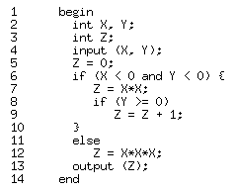
Example: Statement Coverage
Coverage domain: S_{e} = {4, 5, 6, 7, 8, 9, 12, 13} Let T₁ = {t₁:< x = −1,
y = −1 >, t₂:< x = 1, y = 1 >}
Statements covered:
  t₁: 4, 5, 6, 7, 8 and 13
  t₂: 4, 5, 6, 12, and 13
S_{c} = 7, S_{i} = 1, S_{e} = 8. The statement coverage for T₁ is 7 / (8 − 1) = 1. Hence we conclude that T₁ is adequate for (P, R) with respect to the statement coverage criterion. Note: 9 is unreachable.
Controlflow-based Coverage Criteria (© 2012 Professor W. Eric Wong, The University of Texas at Dallas)

Slide 9
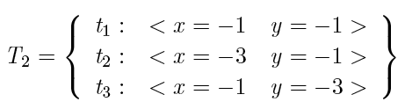
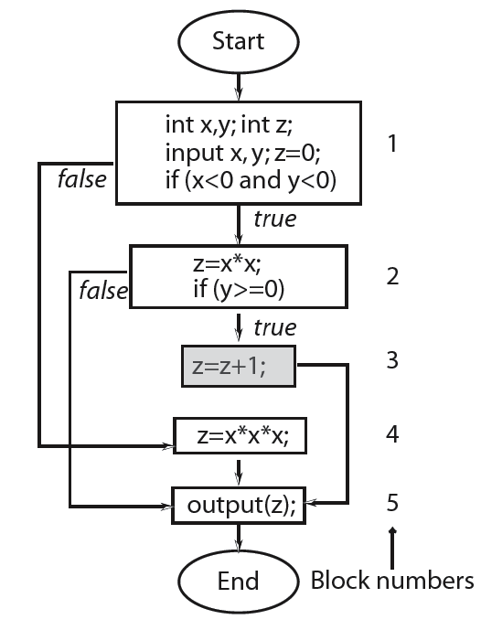
Example: Block Coverage (1)
Coverage domain: B_{e}={1, 2, 3, 4, 5}
Blocks covered:
  t₁: Blocks 1, 2, 5
  t₂, t₃: same coverage as of t₁.
B_{e} = 5 , B_{c} = 3, B_{i} = 1.
  Block coverage for T₂= 3 / (5 − 1) = 0.75.
  Hence T₂ is not adequate for (P, R) with
  respect to the block coverage criterion.
Controlflow-based Coverage Criteria (© 2012 Professor W. Eric Wong, The University of Texas at Dallas)

Slide 10
Example: Block Coverage (2)
T₁ is adequate w.r.t. block coverage criterion. Verify this statement!
Also, if test t₂ in T₁ is added to T₂, we obtain a test set adequate with respect to the block coverage criterion for the program under consideration.
Verify this statement!
Controlflow-based Coverage Criteria (© 2012 Professor W. Eric Wong, The University of Texas at Dallas)

Slide 11
Coverage Values
The formulae given for computing various types of code coverage yield
a coverage value between 0 and 1. However, while specifying a coverage value, one might instead use percentages. For example, a statement coverage of 0.65 is the same as 65% statement coverage.
Controlflow-based Coverage Criteria (© 2012 Professor W. Eric Wong, The University of Texas at Dallas)

Slide 12
Condition and Decision Coverage

Slide 13
Conditions
Any expression that evaluates to true or false constitutes a condition. Such an expression is also known as a predicate.
Given that A, B, and D are Boolean variables, and x and y are integers, A, x > y, A OR B, A AND (x < y), (A AND B) are sample conditions.
Note that in programming language C, x and x + y are valid conditions, and the constants 1 and 0 correspond to, respectively, true and false.
Controlflow-based Coverage Criteria (© 2012 Professor W. Eric Wong, The University of Texas at Dallas)

Slide 14
Simple and Compound Conditions
A simple condition does not use any Boolean operators except for the not operator. It is made up of variables and at most one relational operator from the set {<, ≤, >, ≥, ==, ≠}.
Simple conditions are also referred to as atomic or elementary conditions because they cannot be parsed any further into
two or more conditions.
A compound condition is made up of two or more simple conditions joined by one or more Boolean operators.
Controlflow-based Coverage Criteria (© 2012 Professor W. Eric Wong, The University of Texas at Dallas)

Slide 15
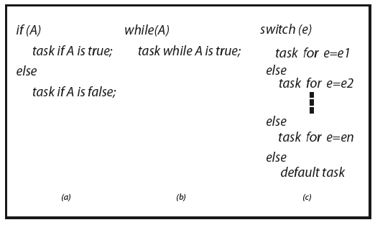
Conditions as Decisions
Any condition can serve as a decision in an appropriate context within a program. Most high level languages provide if, while, and switch statements to serve as contexts for decisions.
Controlflow-based Coverage Criteria (© 2012 Professor W. Eric Wong, The University of Texas at Dallas)

Slide 16
Outcomes of a Decision
A decision can have three possible outcomes: true, false, and undefined.
In some cases the evaluation of a condition might fail in which case the corresponding decision's outcome is undefined.
Controlflow-based Coverage Criteria (© 2012 Professor W. Eric Wong, The University of Texas at Dallas)

Slide 17
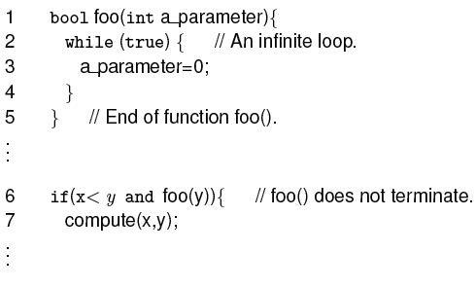
Undefined Condition
The condition inside the if statement on line 6 will remain undefined because the loop at lines 2-4 will never end. Thus the decision on line 6 evaluates to undefined.
Controlflow-based Coverage Criteria (© 2012 Professor W. Eric Wong, The University of Texas at Dallas)

Slide 18
Coupled Conditions
How many simple conditions are there in the compound condition:
D = (A AND B) OR (C AND A)? The first occurrence of A is said to be coupled to its second occurrence.
Does D contain three or four simple conditions? Both answers are correct depending on one's point of view. Indeed, there are three distinct conditions A , B, and C. The answer is four when one is interested in the number of occurrences of simple conditions in a compound condition.
Controlflow-based Coverage Criteria (© 2012 Professor W. Eric Wong, The University of Texas at Dallas)

Slide 19
Conditions within Assignments
Strictly speaking, a condition becomes a decision only when it is used in the appropriate context such as within an if statement.
At line 4, x < y does not constitute a decision and neither does A × B.
1. A = x < y; // A simple condition assigned to a Boolean variable A.
2. X = P or Q; // A compound condition assigned to a Boolean variable x
3. x = y + z × s; if(x)…// The condition will be true if x = 1 and false otherwise
4. A = x < y; x = A × B; // A is used in a subsequent expression for x but not as a decision
Controlflow-based Coverage Criteria (© 2012 Professor W. Eric Wong, The University of Texas at Dallas)

Slide 20
Decision Coverage
A decision is considered covered if the flow of control has been diverted to all possible destinations that correspond to this decision, i.e.,
all outcomes of the decision have been taken.
This implies that, for example, the expression in the if or a while statement has evaluated to true in some execution of the program under test and to false in the same or another execution.
Controlflow-based Coverage Criteria (© 2012 Professor W. Eric Wong, The University of Texas at Dallas)

Slide 21
Decision Coverage: Switch Statement
Decision implied by the switch statement is considered covered if during one or more executions of the program under test the flow of control has been diverted to all possible destinations.
Controlflow-based Coverage Criteria (© 2012 Professor W. Eric Wong, The University of Texas at Dallas)

Slide 22
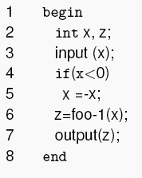
Decision Coverage: Example (1)
Requirement:
  The following code inputs an integer x, and if x < 0, transforms it into a positive value before invoking foo-1 to compute the output z.
  It is supposed to compute z using foo-2 when x ≥ 0.
  It has a bug.
Controlflow-based Coverage Criteria (© 2012 Professor W. Eric Wong, The University of Texas at Dallas)

Slide 23
Decision Coverage: Example (2)
Consider the test set T = {t₁:< x = –5 >}.
  It is adequate with respect to statement and block coverage criteria, but does not reveal the bug.
Another test set T’ = {t₁:< x = –5 > t₂:< x = 3 >} does reveal the bug. It covers the decision whereas T does not. Check!
This example illustrates how and why decision coverage might help in revealing a bug that is not revealed by a test set adequate with respect to statement and block coverage.
Controlflow-based Coverage Criteria (© 2012 Professor W. Eric Wong, The University of Texas at Dallas)

Slide 24
Decision Coverage: Computation
The decision coverage of T with respect to (P, R) is computed as
D_{c} / (D_{e} − D_{i}), where D_{c} is the number of decisions covered.
D_{i} is the number of infeasible decisions, and D_{e} is the total number of decisions in the program, i.e., the size of the decision coverage domain.
T is considered adequate with respect to the decision coverage criterion
if the decision coverage of T with respect to (P, R) is 1.
Controlflow-based Coverage Criteria (© 2012 Professor W. Eric Wong, The University of Texas at Dallas)

Slide 25
Decision Coverage: Domain
The domain of decision coverage consists of all decisions in the program under test.
Controlflow-based Coverage Criteria (© 2012 Professor W. Eric Wong, The University of Texas at Dallas)

Slide 26
Condition Coverage
A decision can be composed of a simple condition such as x < 0, or of
a more complex condition, such as ((x < 0 AND y < 0) OR (p ≥ q)).
AND, OR, XOR are the logical operators that connect two or more simple conditions to form a compound condition.
A simple condition is considered covered if it evaluates to true and false in one or more executions of the program in which it occurs.
A compound condition is considered covered if each simple condition it is comprised of is also covered.
Controlflow-based Coverage Criteria (© 2012 Professor W. Eric Wong, The University of Texas at Dallas)

Slide 27
Decision and Condition Coverage (1)
Decision coverage is concerned with the coverage of decisions regardless of whether or not a decision corresponds to a simple or a compound condition. Thus in the statement
  1. if (x < 0 and y < 0) {
  2. z = foo(x, y)
There is only one decision that leads control to line 2 if the compound condition inside the if evaluates to true.
However, a compound condition might evaluate to true or false in one of several ways.
Question
if (x < 0)
if (y < 0)
z=foo(x, y);
How many decision?
Controlflow-based Coverage Criteria (© 2012 Professor W. Eric Wong, The University of Texas at Dallas)

Slide 28
Decision and Condition Coverage (2)
Referring to the following code
1. if (x < 0 and y < 0) {
2. z = foo(x, y)
The condition at line 1 evaluates to false when x ≥ 0 regardless of the value of y.
Another condition, such as (x < 0 OR y < 0), evaluates to true regardless of the value of y, when x < 0.
With this evaluation characteristic in view, compilers often generate code that uses short circuit evaluation of compound conditions.
Controlflow-based Coverage Criteria (© 2012 Professor W. Eric Wong, The University of Texas at Dallas)

Slide 29

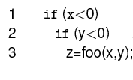
Decision and Condition Coverage (3)
Here is a possible translation:
We now see two decisions, one corresponding to each simple condition in the if statement.
Controlflow-based Coverage Criteria (© 2012 Professor W. Eric Wong, The University of Texas at Dallas)

Slide 30

Condition Coverage
The condition coverage of T with respect to (P, R) is computed as
C_{c} / (C_{e} − C_{i}) , where
  C_{c} is the number of simple conditions covered,
  C_{i} is the number of infeasible simple conditions, and
  C_{e} is the total number of simple conditions in the program.
T is considered adequate with respect to the condition coverage criterion if the condition coverage of T with respect to (P, R) is 1.
An alternate formula where each simple condition contributes 2, 1, or 0
to C_{c} depending on whether it is covered, partially covered, or not covered, respectively, is:
Controlflow-based Coverage Criteria (© 2012 Professor W. Eric Wong, The University of Texas at Dallas)

Slide 31
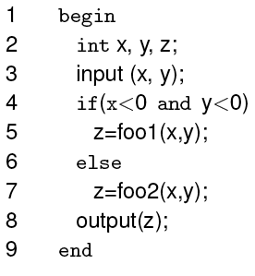
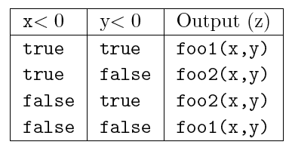
Condition Coverage: Example (1)
Partial specifications for computing z
This program has a bug based on the specification.
Controlflow-based Coverage Criteria (© 2012 Professor W. Eric Wong, The University of Texas at Dallas)

Slide 32
Condition Coverage: Example (2)
Consider the test set
Check that T is adequate with respect to the statement, block, and decision coverage criteria and the program behaves correctly against t₁ and t₂.
C_{c} = 1, C_{e} = 2, C_{i} = 0. Hence, condition coverage for T = 0.5.
Controlflow-based Coverage Criteria (© 2012 Professor W. Eric Wong, The University of Texas at Dallas)

Slide 33
Condition Coverage: Example (3)
Add the following test case to T: t₃: < x = 3, y = 4 >
Check that the enhanced test set T is adequate with respect to the condition coverage criterion and possibly reveals a bug in the program.
  The programs shows z = foo2(x, y)
  But the specifications says z = foo1(x, y)
Under what conditions will the bug be revealed by t₃?
Controlflow-based Coverage Criteria (© 2012 Professor W. Eric Wong, The University of Texas at Dallas)

Slide 34
Condition/Decision Coverage
When a decision is composed of a compound condition, decision coverage does not imply that each simple condition within a compound condition has taken both values true and false.
Condition coverage ensures that each component simple condition within a condition has taken both values true and false.
Question: Does the condition coverage require each decision to take all its outcomes?
Controlflow-based Coverage Criteria (© 2012 Professor W. Eric Wong, The University of Texas at Dallas)

Slide 35
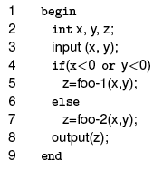


Condition/Decision Coverage: Example
Consider the following program and two test sets.
In-class exercise:
  Is T₁ is adequate with respect to decision coverage?
  Is T₁ is adequate with respect to condition coverage?
  How about T₂?
Controlflow-based Coverage Criteria (© 2012 Professor W. Eric Wong, The University of Texas at Dallas)

Slide 36
Condition/Decision Coverage: Definition
The condition/decision coverage of T with respect to (P, R) is computed as (C_{c} + D_{c}) / ((C_{e} − C_{i}) +(D_{e} − D_{i}), where
  C_{c} is the number of simple conditions covered
  D_{c} is the number of decisions covered,
  C_{e} and D_{e} are the number of simple conditions and decisions respectively
  C_{i} and D_{i} are the number of infeasible simple conditions and decisions, respectively.
Controlflow-based Coverage Criteria (© 2012 Professor W. Eric Wong, The University of Texas at Dallas)

Slide 37

Condition/Decision Coverage: Example
In-class exercise: Is T adequate with respect to the condition/decision coverage criterion?
Controlflow-based Coverage Criteria (© 2012 Professor W. Eric Wong, The University of Texas at Dallas)

Slide 38
Multiple Condition Coverage

Slide 39
Multiple Condition Coverage
Consider a compound condition with two or more simple conditions. Using condition coverage on some compound condition C implies that each simple condition within C needs to be evaluated to true and false.
However, does it imply that all combinations of the values of the individual simple conditions in C have been exercised?
Controlflow-based Coverage Criteria (© 2012 Professor W. Eric Wong, The University of Texas at Dallas)

Slide 40
Multiple Condition Coverage/Simple Condition Coverage
Multiple condition coverage versus simple condition coverage is similar to uni-dimensional equivalence class partitioning versus
multi-dimensional equivalence partitioning.
➔ considered separately versus considered simultaneously
Controlflow-based Coverage Criteria (© 2012 Professor W. Eric Wong, The University of Texas at Dallas)

Slide 41

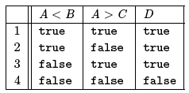
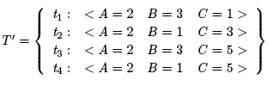
Multiple Condition Coverage: Example
Consider D = (A < B) OR (A > C) composed of two simple conditions A < B and A > C. The four possible combinations of the outcomes of these two simple conditions are enumerated in the table.
  Check: Is T 100% w.r.t. the decision coverage?
  Check: Is T 100% w.r.t. the condition coverage?
  Check: Does T cover all four combinations?
  Check: Does T ’ cover all four combinations?
Controlflow-based Coverage Criteria (© 2012 Professor W. Eric Wong, The University of Texas at Dallas)

Slide 42

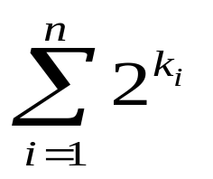
Multiple Condition Coverage: Definition (1)
Suppose that the program under test contains a total of n decisions. Assume also that each decision contains k₁, k₂, …, k_{n} simple conditions. Each decision has several combinations of values of its constituent simple conditions.
For example, decision i will have a total of combinations. Thus the total number of combinations to be covered is
Controlflow-based Coverage Criteria (© 2012 Professor W. Eric Wong, The University of Texas at Dallas)

Slide 43
Multiple Condition Coverage: Definition (2)
The multiple condition coverage of T with respect to (P, R) is computed as C_{c} / (C_{e} − C_{i}), where:
  C_{c} is the number of combinations covered,
  C_{i} is the number of infeasible simple combinations, and
  C_{e} is the total number of combinations in the program.
T is considered adequate with respect to the multiple condition coverage criterion if the condition coverage of T with respect to (P, R) is 1.
Controlflow-based Coverage Criteria (© 2012 Professor W. Eric Wong, The University of Texas at Dallas)

Slide 44

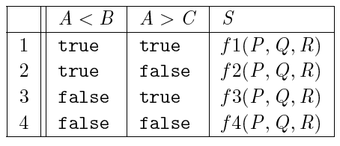

Multiple Condition Coverage: Example (1)
Consider the following program with specifications in the table.
There is an obvious bug in the program: computation of S for one of the four combinations, line 3 in the table, has been left out.
Controlflow-based Coverage Criteria (© 2012 Professor W. Eric Wong, The University of Texas at Dallas)

Slide 45

Multiple Condition Coverage: Example (2)
Is T adequate w.r.t. decision coverage?
Multiple condition coverage?
Does it reveal the bug?
Controlflow-based Coverage Criteria (© 2012 Professor W. Eric Wong, The University of Texas at Dallas)

Slide 46
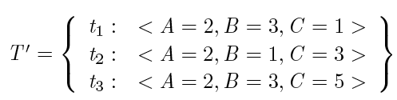
Multiple Condition Coverage: Example (3)
Is T ’100% with respect to the decision coverage?
Does T ’reveal the bug?
Controlflow-based Coverage Criteria (© 2012 Professor W. Eric Wong, The University of Texas at Dallas)

Slide 47
Multiple Condition Coverage: Example (4)
In-class exercise:
  Is T ’100% w.r.t. simple condition coverage?
  Is T ’100% w.r.t. multiple condition coverage?
Now add a test to T ’ to cover the uncovered combinations.
  Does your test reveal the bug?
  If yes, then under what conditions?
Controlflow-based Coverage Criteria (© 2012 Professor W. Eric Wong, The University of Texas at Dallas)

