Slide 1
STAR
Laboratory of Advanced Research on Software Technology
Dataflow-based Coverage Criteria
W. Eric Wong
Department of Computer Science
The University of Texas at Dallas
ewong@utdallas.edu
http://www.utdallas.edu/~ewong
Dataflow-based Coverage Criteria (© 2012 Professor W. Eric Wong, The University of Texas at Dallas)

Slide 2

Speaker Biographical Sketch
Professor & Director of International Outreach
Department of Computer Science
University of Texas at Dallas
Guest Researcher
Computer Security Division
National Institute of Standards and Technology (NIST)
Vice President, IEEE Reliability Society
Secretary, ACM SIGAPP (Special Interest Group on Applied Computing)
Principal Investigator, NSF TUES (Transforming Undergraduate Education in Science, Technology, Engineering and Mathematics) Project
  Incorporating Software Testing into Multiple Computer Science and Software Engineering Undergraduate Courses
Founder & Steering Committee co-Chair for the SERE conference
(IEEE International Conference on Software Security and Reliability)
(http://paris.utdallas.edu/sere13)
Dataflow-based Coverage Criteria (© 2012 Professor W. Eric Wong, The University of Texas at Dallas)

Slide 3
Basic Concepts
We will now examine some test adequacy criteria based on the flow of “data” in a program. This is in contrast to criteria based on the flow of “control” that we have examined so far.
Test adequacy criteria based on the flow of data are useful in improving tests that are adequate with respect to controlflow-based criteria.
Let us look at an example.
Dataflow-based Coverage Criteria (© 2012 Professor W. Eric Wong, The University of Texas at Dallas)

Slide 4
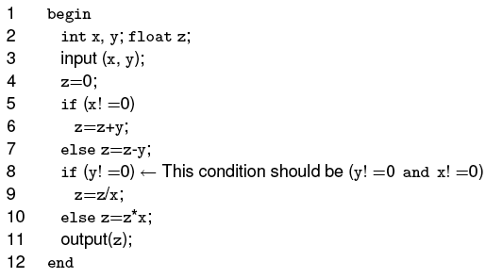

Example: Test Enhancement using Dataflow (1)
= = 0)
Question: Does the following test set reveal the bug?
Dataflow-based Coverage Criteria (© 2012 Professor W. Eric Wong, The University of Texas at Dallas)

Slide 5
Example: Test Enhancement using Dataflow (2)
Neither of the two test cases forces the use of z defined on line 6, at line 9. To do so one requires a test that causes conditions at lines 5 and 8 to be true (i.e., need to satisfy x = = 0 and y != 0)
The test which we have does not force the execution of this path and hence the divide by zero error is not revealed.
=
define z here
use z here
Dataflow-based Coverage Criteria (© 2012 Professor W. Eric Wong, The University of Texas at Dallas)

Slide 6
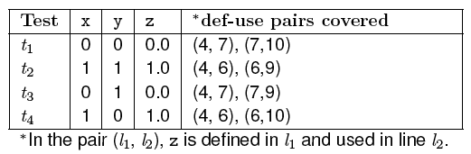
Example: Test Enhancement using Dataflow (3)
Verify that the following test set covers all def-use pairs of z and reveals the bug.
0.0
(4,6), (6,10), (10, 11)
4, 5, 6, 8, 10
−1.0
(4,7), (7,9), (9, 11)
4, 5, 7, 8, 9
---
(4,6), (6,9)
4, 5, 6, 8, 9
(reveal the bug)
0.0
(4,7), (7,10), (10, 11)
4, 5, 7, 8, 10
def-use pairs with respect to the variable z
Dataflow-based Coverage Criteria (© 2012 Professor W. Eric Wong, The University of Texas at Dallas)

Slide 7
Definitions and Uses (1)
A program written in a procedural language, such as C and Java, contains variables.
Variables are defined by assigning values to them and are used in expressions.
  Statement x = y + z defines variable x and uses variables y and z
  Statement scanf (“%d %d”, &x, &y) defines variables x and y
  Statement printf (“Output: %d \n”, x + y) uses variables x and y
Dataflow-based Coverage Criteria (© 2012 Professor W. Eric Wong, The University of Texas at Dallas)

Slide 8
Definitions and Uses (2)
A parameter x passed as call-by-value to a function, is considered as a use of (or a reference to) x
A parameter x passed as call-by-reference, can serve as a definition and use of x
Dataflow-based Coverage Criteria (© 2012 Professor W. Eric Wong, The University of Texas at Dallas)

Slide 9

Definitions and Uses: Pointers
Consider the following sequence of statements that use pointers.
  The first defines a pointer variable z
  the second defines y and uses z
  the third defines x through the pointer variable z, and
  the last defines y and uses x accessed through the pointer variable z
Variable z is a pointer pointing to variable x and
contains the memory address of variable x.
*z retrieves the value at the memory address pointed by
variable z. Consequently, *z = 25 is to assign 25 to the
memory address pointed by variable z. That is, to assign
25 to variable x.
y = *z + 1 is to define y as the sum of 1 and
the value at the memory address pointed
by variable z, i.e., the value of x
Dataflow-based Coverage Criteria (© 2012 Professor W. Eric Wong, The University of Texas at Dallas)

Slide 10

Definitions and Uses: Arrays
Arrays are also tricky. Consider the following declaration and two statements in C:
The first statement defines variable A.
The second statement defines A and uses i, x, and y.
Alternate: second statement defines A[i] and not the entire array A.
The choice of whether to consider the entire array A as defined or the specific element depends upon how stringent the requirement for coverage analysis is.
Dataflow-based Coverage Criteria (© 2012 Professor W. Eric Wong, The University of Texas at Dallas)

Slide 11
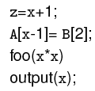
C-Use
Uses of a variable that occurs within an expression as part of an assignment statement, in an output statement, as a parameter within a function call, and in subscript expressions, are classified as c-use, where the “c” in c-use stands for computational.
How many c-uses of x can you find in the following statements?
Answer = ?
Dataflow-based Coverage Criteria (© 2012 Professor W. Eric Wong, The University of Texas at Dallas)

Slide 12

P-Use
The occurrence of a variable in an expression used as a condition in a branch statement such as an if and a while, is considered as a p-use. The “p” in p-use stands for predicate.
How many p-uses of z and x can you find in the following statements?
Answer = ?
Dataflow-based Coverage Criteria (© 2012 Professor W. Eric Wong, The University of Texas at Dallas)

Slide 13

P-Use: Possible Confusion
Consider the statement:
The use of A is clearly a p-use.
Is the use of x in the subscript a c-use or a p-use?
Dataflow-based Coverage Criteria (© 2012 Professor W. Eric Wong, The University of Texas at Dallas)

Slide 14

C-Uses Within a Basic Block
Consider the basic block
While there are two definitions of p in this block, only the second definition will propagate to the next block. The first definition of p is considered local to the block while the second definition is global.
We are only concerned with global definitions and uses.
Note that y and z are global uses; their definitions flow into this block from some other block.
local definition
within the block
global definition
Dataflow-based Coverage Criteria (© 2012 Professor W. Eric Wong, The University of Texas at Dallas)

Slide 15
Dataflow Graph
A dataflow graph of a program, also known as def-use graph, captures the flow of definitions (also known as defs) and uses
across basic blocks in a program.
It is similar to a control flow graph of a program in that the nodes, edges, and all paths in the control flow graph are preserved in the data flow graph. An example follows.
Dataflow-based Coverage Criteria (© 2012 Professor W. Eric Wong, The University of Texas at Dallas)

Slide 16
Dataflow Graph: Example (1)
Given a program, find its basic blocks, compute defs, c-uses and
p-uses in each block. Each block becomes a node in the def-use graph (this is similar to the control flow graph).
Attach defs, c-use and p-use to each node in the graph.
Label each edge with the condition which when true causes the edge to be taken.
We use d_{i}(x) to refer to the definition of variable x at node i. Similarly, u_{i}(x) refers to the use of variable x at node i.
Dataflow-based Coverage Criteria (© 2012 Professor W. Eric Wong, The University of Texas at Dallas)

Slide 17
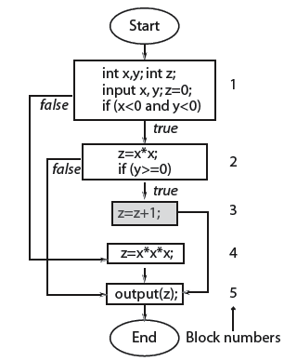
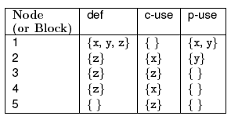
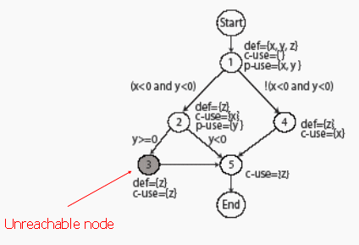
Dataflow Graph: Example (2)
Dataflow-based Coverage Criteria (© 2012 Professor W. Eric Wong, The University of Texas at Dallas)

Slide 18
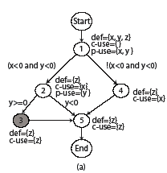
Def-Clear Path
Any path starting from a node at which variable x is defined and ending at a node at which x is used, without redefining x anywhere else along the path, is a def-clear path for x
Path 2-5 is def-clear for variable z defined at node 2 and used at node 5.
Path 1-2-5 is NOT def-clear for variable z defined at node 1 and used at node 5.
Thus definition of z at node 2
is live at node 5 while that
at node 1 is not live at node 5.
Dataflow-based Coverage Criteria (© 2012 Professor W. Eric Wong, The University of Texas at Dallas)

Slide 19
Def-Use Pairs
Definition of a variable at line l₁ and its use at line l₂ constitute a def-use pair. l₁ and l₂ can be the same.
  dcu(d_{i}(x)) denotes the set of all nodes where d_{i}(x) is live and c-used.
  dpu(d_{i}(x)) denotes the set of all edges (k, l) such that there is
  a def-clear path from node i to edge (k, l) and x is p-used at node k.
We say that a def-use pair (d_{i}(x), u_{j}(x)) is covered when
a def-clear path that includes nodes i to node j is executed.
If u_{j}(x) is a p-use then all edges of the kind (j, k) must also be taken during some executions.
Dataflow-based Coverage Criteria (© 2012 Professor W. Eric Wong, The University of Texas at Dallas)

Slide 20
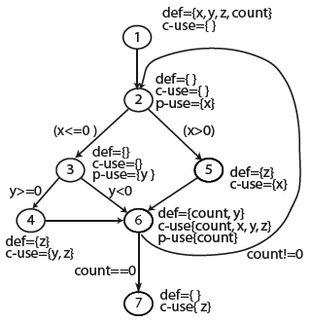
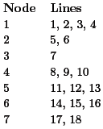
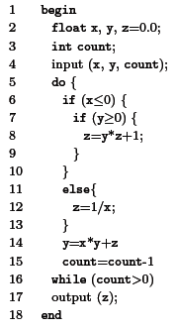
Def-Clear Path (Another Example) (1)
>
<
Find def-clear paths for defs and uses of x and z.
Which definitions are live at node 4?
Dataflow-based Coverage Criteria (© 2012 Professor W. Eric Wong, The University of Texas at Dallas)

Slide 21
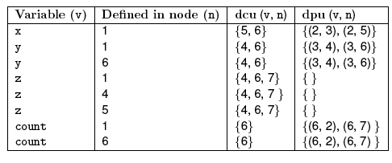
Def-Clear Path (Another Example) (2)
Infeasible! Why?
Dataflow-based Coverage Criteria (© 2012 Professor W. Eric Wong, The University of Texas at Dallas)

Slide 22
Def-Use Pairs: Minimal Set (1)
Def-use pairs are items to be covered during testing. However, in some cases, coverage of a def-use pair implies coverage of another def-use pair. Analysis of the data flow graph can reveal a minimal set of def-use pairs whose coverage implies coverage of all def-use pairs.
Exercise: Analyze the def-use graph shown on slide 20 to determine
  Which def-uses are infeasible?
  A minimal set of def-uses to be covered
    corresponding to “set covering”
    in theory, this is NP-complete
    χSuds/ATAC provides a good “approximate” solution
    (will be further explained when we discuss “Regression Testing”)
Dataflow-based Coverage Criteria (© 2012 Professor W. Eric Wong, The University of Texas at Dallas)

Slide 23
Def-Use Pairs: Minimal Set (2)
What will be also covered if we have a test case which covers (d₁(z), u₄(z))?
How about (d₄(z), u₄(z))?
Dataflow-based Coverage Criteria (© 2012 Professor W. Eric Wong, The University of Texas at Dallas)

Slide 24

C-Use Coverage
The c-use coverage of a test set T with respect to (P, R) is computed as
where CU is the total number of c-uses, CU_{C} is the number of c-uses covered by test cases in T, and CU_{f} is the number of infeasible c-uses.
T is considered adequate with respect to the c-use coverage criterion if its c-use coverage is 1.
Dataflow-based Coverage Criteria (© 2012 Professor W. Eric Wong, The University of Texas at Dallas)

Slide 25
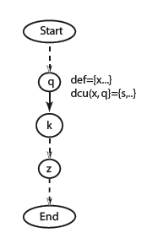
C-Use Coverage: Path Traversed
Path (Start, .. q, k, .., z, .. End) covers the c-use at node z of x defined at node q given that (k …, z) is def-clear with respect to x
In-class Exercise: Find the c-use coverage when the code on slide 20 is executed against the test case < x = 5, y = −1, count = 1 >
Definition of x
C-use of x
c-use of x
Dataflow-based Coverage Criteria (© 2012 Professor W. Eric Wong, The University of Texas at Dallas)

Slide 26

P-Use Coverage
The p-use coverage of a test set T with respect to (P, R) is computed as
where PU is the total number of p-uses, PU_{C} is the number of p-uses covered by test cases in T, and PU_{f} is the number of infeasible p-uses.
T is considered adequate with respect to the p-use coverage criterion if its p-use coverage is 1.
Dataflow-based Coverage Criteria (© 2012 Professor W. Eric Wong, The University of Texas at Dallas)

Slide 27
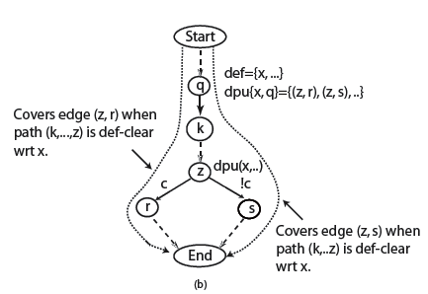
P-Use Coverage: Paths Traversed
Definition of x
Coverage edge (z, r) when
path (k, …, z) is def-clear
with respect to x
P-use of x
Coverage edge (z, s) when
path (k, …, z) is def-clear
with respect to x
In-class Exercise: Find the p-use coverage when the code on slide 20 is executed against the test case < x = −2, y = −1, count = 3 >
Dataflow-based Coverage Criteria (© 2012 Professor W. Eric Wong, The University of Texas at Dallas)

Slide 28

All-Uses Coverage
The all-uses coverage of a test set T with respect to (P, R) is computed as
where CU, CU_{C} and CU_{f} are defined on slide 24, and PU, PU_{C} and PU_{f} are defined on slide 26.
T is considered adequate with respect to the all-uses coverage criterion if its all-uses coverage is 1.
Dataflow-based Coverage Criteria (© 2012 Professor W. Eric Wong, The University of Texas at Dallas)

Slide 29
All-Uses Coverage: Example
In-class Exercise: Referring to the code on slide 20, is a test set
T={< x = 5, y = −1, count = 1 >, < x = −2, y = −1, count = 3 >}
adequate with respect to the all-uses coverage?
Dataflow-based Coverage Criteria (© 2012 Professor W. Eric Wong, The University of Texas at Dallas)

Slide 30
Infeasible P- and C-Uses
Coverage of a c-use or a p-use requires a path to be traversed through the program. However, if this path is infeasible, then some c-uses and p-uses that require this path to be traversed might also be infeasible.
Infeasible c-uses and p-uses are often difficult to determine.
Dataflow-based Coverage Criteria (© 2012 Professor W. Eric Wong, The University of Texas at Dallas)

Slide 31
Infeasible C-Use: Example
Consider the c-use at node 4 of z defined at node 5.
Explain why this c-use is infeasible.
Dataflow-based Coverage Criteria (© 2012 Professor W. Eric Wong, The University of Texas at Dallas)

Slide 32
Subsumes Relation
Given a test set T that is adequate with respect to a criterion C₁, what can we conclude about the adequacy of T with respect to another criterion C₂
Dataflow-based Coverage Criteria (© 2012 Professor W. Eric Wong, The University of Texas at Dallas)

Slide 33
Effectiveness of an Adequate Test Set
Given a test set T that is adequate with respect to a criterion C, what can we expect regarding its effectiveness in revealing bugs?
Dataflow-based Coverage Criteria (© 2012 Professor W. Eric Wong, The University of Texas at Dallas)

Slide 34
Effectiveness Relation
Given a test set T₁ that is adequate with respect to a criterion C₁ and
a test set T₂ that is adequate with respect to another criterion C₂. Assume criterion C₁ subsumes criterion C₂, what can we conclude about the fault detection effectiveness of T₁ with respect to the fault detection effectiveness of T₂?
Dataflow-based Coverage Criteria (© 2012 Professor W. Eric Wong, The University of Texas at Dallas)

