Slide 1
STAR
Laboratory of Advanced Research on Software Technology
Test Adequacy Measurement & Enhancement
W. Eric Wong
Department of Computer Science
The University of Texas at Dallas
ewong@utdallas.edu
http://www.utdallas.edu/~ewong
Test Adequacy Measurement & Enhancement (© 2012 Professor W. Eric Wong, The University of Texas at Dallas)

Slide 2

Speaker Biographical Sketch
Professor & Director of International Outreach
Department of Computer Science
University of Texas at Dallas
Guest Researcher
Computer Security Division
National Institute of Standards and Technology (NIST)
Vice President, IEEE Reliability Society
Secretary, ACM SIGAPP (Special Interest Group on Applied Computing)
Principal Investigator, NSF TUES (Transforming Undergraduate Education in Science, Technology, Engineering and Mathematics) Project
  Incorporating Software Testing into Multiple Computer Science and Software Engineering Undergraduate Courses
Founder & Steering Committee co-Chair for the SERE conference
(IEEE International Conference on Software Security and Reliability)
(http://paris.utdallas.edu/sere13)
Test Adequacy Measurement & Enhancement (© 2012 Professor W. Eric Wong, The University of Texas at Dallas)

Slide 3
Outline
Test Adequacy Measurement
Test Set Enhancement
Test Adequacy Measurement & Enhancement (© 2012 Professor W. Eric Wong, The University of Texas at Dallas)

Slide 4

What Is Test Adequacy ?

Slide 5
What Is Adequacy ?
Consider a program P written to meet a set of functional requirements R. We notate such a P and R as (P, R)
Let R contain n requirements labeled R₁, R₂, …, R_{n}
Suppose now that a set T containing k test cases has been constructed to test P to determine whether or not it meets all the requirements in R
  Assume also P has been executed against each test case in T and has produced correct behavior
We now ask: Is T good enough?
  This question can be stated differently as:
  Has P been tested thoroughly?
  or as: Is T adequate?
Test Adequacy Measurement & Enhancement (© 2012 Professor W. Eric Wong, The University of Texas at Dallas)

Slide 6
Measurement of Adequacy
In the context of software testing, the terms “thorough,” “good enough,” and “adequate,” used in the questions above, have the same meaning.
Adequacy is measured for a given test set designed to test P to determine whether or not P meets its requirements.
This measurement is done against a given criterion C.
  A test set is considered adequate with respect to a criterion C
  when it satisfies C.
  The determination of whether or not a test set T for program P satisfies a criterion C depends on the criterion itself and is explained later.
Test Adequacy Measurement & Enhancement (© 2012 Professor W. Eric Wong, The University of Texas at Dallas)

Slide 7
Black-box and White-box Criteria
For each adequacy criterion C, we derive a finite set known as the
coverage domain and denoted as C_{e}.
A criterion C is a white-box test adequacy criterion if the corresponding coverage domain C_{e} depends solely on program P under test.
A criterion C is a black-box test adequacy criterion if the corresponding coverage domain C_{e} depends solely on requirements R for the program
P under test.
Test Adequacy Measurement & Enhancement (© 2012 Professor W. Eric Wong, The University of Texas at Dallas)

Slide 8
Coverage
We want to measure the adequacy of T. Given that C_{e} has n≥ 0 elements,
we say that T covers C_{e} if for each element e’ in C_{e} there is at least one test case in T that tests e’.
  T is considered adequate with respect to C if it covers all elements in the coverage domain
  T is considered inadequate with respect to C if it covers k elements of C_{e} where k < n
The fraction k/n is a measure of the extent to which T is adequate with respect to C. This fraction is also known as the coverage of T with respect to C, P, and R .
Test Adequacy Measurement & Enhancement (© 2012 Professor W. Eric Wong, The University of Texas at Dallas)

Slide 9
Example I (1)
Program sumProduct must meet the following requirements
  R₁ Input two integers, say x and y, from the standard input device
  R_{2.1} Find and print to the standard output device the sum of x and y if x < y
  R_{2.2} Find and print to the standard output device the product of x and y if x ≥ y
Test Adequacy Measurement & Enhancement (© 2012 Professor W. Eric Wong, The University of Texas at Dallas)

Slide 10
Example I (2)
Suppose now that the test adequacy criterion C is specified as
A test T for program (P, R) is considered adequate if for each requirement r in R there is at least one test case in T that tests the correctness of P with respect to r .
In this case the coverage domain C_{e}={R₁, R_{2.1}, R_{2.2}}
T = {t: < x = 2, y = 3 >} (which has x < y) covers R₁ and R_{2.1} but not R_{2.2}
  T is not adequate with respect to C
  The coverage of T with respect to C, P, and R is 0.66
Test Adequacy Measurement & Enhancement (© 2012 Professor W. Eric Wong, The University of Texas at Dallas)

Slide 11
Example II (1)
Consider the following criterion
A test T for program (P, R) is considered adequate if each path in P is traversed at least once.
Assume that P has exactly two paths, one corresponding to condition
x < y and the other to x ≥ y.
  We refer to these as p₁ and p₂, respectively.
  For the given adequacy criterion C we have the coverage domain
  C_{e}={p₁, p₂}.
We assume that P has exactly two paths. This assumption is based on the knowledge of the requirements. However, when the coverage domain contains elements from the code, such elements should be derived from the program directly and not by an examination of its requirements.
Test Adequacy Measurement & Enhancement (© 2012 Professor W. Eric Wong, The University of Texas at Dallas)

Slide 12
Example II (2)
To measure the adequacy of T of sumProduct against C, we execute P against each test case in T .
As T={< x = 2, y = 3 >} contains only one test for which x < y , only the path p₁ is executed.
  The coverage of T with respect to C, P, and R is 0.5.
  T is not adequate with respect to C.
  We can also say that p₁ is tested and p₂ is not tested.
Test Adequacy Measurement & Enhancement (© 2012 Professor W. Eric Wong, The University of Texas at Dallas)

Slide 13
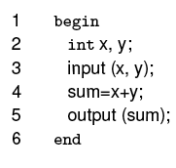
Example III
The following program is incorrect as per the requirements of sumProduct
  Using the path-based coverage criterion C, we have the coverage domain
  C_{e}={p₁}
  This path traverses all the statements
  T={< x = 2, y = 3 >} is adequate with respect to C but does not reveal the bug
sumProduct-1
Test Adequacy Measurement & Enhancement (© 2012 Professor W. Eric Wong, The University of Texas at Dallas)

Slide 14
Lessons Learned
An adequate test set might not reveal even the most obvious bug in a program.
However, this does not diminish in any way the need for the measurement of test adequacy as increasing coverage might reveal a bug!
Test Adequacy Measurement & Enhancement (© 2012 Professor W. Eric Wong, The University of Texas at Dallas)

Slide 15
Test Enhancement

Slide 16
Test Enhancement
While a test set adequate with respect to some criterion does not guarantee a bug-free program, an inadequate test set is a cause
for worry.
  Inadequacy with respect to any criterion often implies deficiency.
Identification of this deficiency helps in the enhancement of the inadequate test set.
  Enhancement is likely to test the program in ways it has not been tested
  before such as testing an untested portion, or testing the features in a
  sequence different from the one used previously.
Testing the program differently than before raises the possibility of discovering any hidden bugs.
Test Adequacy Measurement & Enhancement (© 2012 Professor W. Eric Wong, The University of Texas at Dallas)

Slide 17
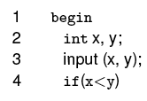
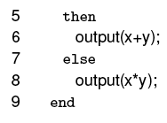
Example IV (1)
The following program is correct as per the requirements of sumProduct
  It has two paths denoted by p₁ and p₂
  T = {< x = 2, y = 3 >} is inadequate with respect to the path-based
  coverage criterion C
sumProduct-2
Test Adequacy Measurement & Enhancement (© 2012 Professor W. Eric Wong, The University of Texas at Dallas)

Slide 18
Example IV (2)
For sumProduct-2, to make T adequate with respect to the path coverage criterion we need to add a test case that covers p₂
  One test case that does so is {< x = 3, y = 1 >}
  Adding this test case to T and denoting the expanded test set by T’ we have T’ ={< x = 3, y = 4 >, <x = 3, y = 1 >}
Executing sumProduct-2 against the two test cases in T’ will have both p₁ and p₂ traversed
  T’ is adequate with respect to the path coverage criterion
Test Adequacy Measurement & Enhancement (© 2012 Professor W. Eric Wong, The University of Texas at Dallas)

Slide 19
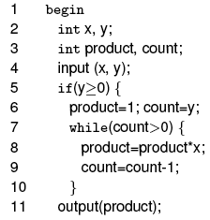

Example V (1)
Consider a program intended to compute x^{y} given integers x and y.
For y < 0 the program skips the computation and outputs a suitable
error message.
Test Adequacy Measurement & Enhancement (© 2012 Professor W. Eric Wong, The University of Texas at Dallas)

Slide 20
Example V (2)
Suppose that a test set T is considered adequate if it tests the program on the previous slide for at least one zero and one non-zero value of each of the two inputs x and y.
The coverage domain for C can be determined without any inspection of the program.
  C_{e} = {x = 0, y = 0, x ≠ 0, y ≠ 0}
  We can derive an adequate test set for the program by an examination of C_{e}
  T = {t₁: < x = 0, y = 1 >, t₂: < x = 1, y = 0 >} is adequate with respect to C
Test Adequacy Measurement & Enhancement (© 2012 Professor W. Eric Wong, The University of Texas at Dallas)

Slide 21
Example VI (Path Coverage) (1)
Criterion C of the previous example is a black-box coverage criterion as it does not require an examination of the program under test for the measurement of adequacy.
Let us now consider the path coverage criterion.
An examination of the exponentiation program reveals that it has an indeterminate number of paths due to the while loop.
  The number of paths depends on the value of y and hence that of count.
Test Adequacy Measurement & Enhancement (© 2012 Professor W. Eric Wong, The University of Texas at Dallas)

Slide 22
Example VI (Path Coverage) (2)
Given that y is any non-negative integer, the number of paths can be arbitrarily large. This simple analysis of paths in the exponentiation program reveals that for the path coverage criterion we cannot determine the coverage domain.
The usual approach in such cases is to simplify C and reformulate it as follows:
A test T is considered adequate if it tests all paths. In case the program contains a loop, then it is adequate to traverse the loop body zero times and once. (boundary-interior)
Test Adequacy Measurement & Enhancement (© 2012 Professor W. Eric Wong, The University of Texas at Dallas)

Slide 23
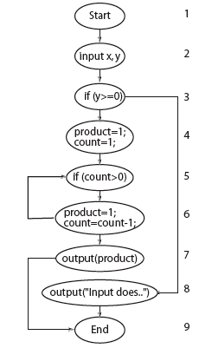
Example VI (Path Coverage) (3)
The coverage domain of the modified path coverage
criterion is {p₁, p₂, p₃}
  p₁: 1 → 2 → 3 → 4 → 5 → 7 → 9 (red path)
  p₂: 1 → 2 → 3 → 4 → 5 → 6 → 5 → 7 → 9 (blue path)
  p₃: 1 → 2 → 3 → 8 → 9 (green path)
Let T={t₁: < x = 0, y = 1 >,
t₂: < x = 1, y = 0 >,
t₃: < x = 5, y = –1 >}
  As T does not contain any test with y < 0,
  p₃ (the green path) remains uncovered.
  The coverage is 2/3 = 0.66
<
y
Test Adequacy Measurement & Enhancement (© 2012 Professor W. Eric Wong, The University of Texas at Dallas)

Slide 24
Example VI (Path Coverage) (4)
Any test case with y < 0 will cause p₃ to be traversed.
Let t₃ be < x = 5, y = –1 >
  Test case t₃ covers path p₃ and P behaves correctly.
  After adding t₃ to T, we have covered all feasible elements of the coverage domain.
  The enhanced test set is T = {t₁: < x = 0, y = 1 >, t₂: < x = 1, y = 0 >, t₃: < x = 5, y = –1 >}
Test Adequacy Measurement & Enhancement (© 2012 Professor W. Eric Wong, The University of Texas at Dallas)

Slide 25
Infeasibility and Test Adequacy
An element of the coverage domain is infeasible if it cannot be covered by any test in the input domain of the program under test.
There does not exist an algorithm that would analyze a given program and determine if a given element in the coverage domain is infeasible or not. Thus it is usually the tester who determines whether or not an element of the coverage domain is infeasible.
Test Adequacy Measurement & Enhancement (© 2012 Professor W. Eric Wong, The University of Texas at Dallas)

Slide 26
Demonstrating Feasibility
Feasibility can be demonstrated by executing the program under test against a test case and showing that indeed the element under consideration is covered.
Infeasibility cannot be demonstrated by program execution against a finite number of test cases.
  In some cases simple arguments can be constructed to show that a given element is infeasible.
  For more complex programs the problem of determining infeasibility
  could be difficult. Thus, an attempt to enhance a test set by executing
  a test t aimed at covering element e of program P, might fail.
Test Adequacy Measurement & Enhancement (© 2012 Professor W. Eric Wong, The University of Texas at Dallas)

Slide 27
Adequacy and Infeasibility
In the presence of one or more infeasible elements in the coverage domain, a test is considered adequate when all feasible elements in the domain have been covered.
While programmers might not be concerned with infeasible elements, testers attempting to obtain code coverage are.
Prior to test enhancement, a tester usually does not know which elements of a coverage domain are infeasible.
  Unfortunately, it is only during an attempt to construct a test case to cover an element that one might realize the infeasibility of an element
Test Adequacy Measurement & Enhancement (© 2012 Professor W. Eric Wong, The University of Texas at Dallas)

Slide 28
Fault Detection and Test Enhancement
The purpose of test enhancement is to determine test cases that test the untested parts of a program.
  Even the most carefully designed tests based exclusively on requirements can be enhanced.
The more complex the set of requirements, the more likely it is that a test set designed using requirements is inadequate with respect to even the simplest of various test adequacy criteria.
Test Adequacy Measurement & Enhancement (© 2012 Professor W. Eric Wong, The University of Texas at Dallas)

Slide 29
Example VII (1)
A program to meet the following requirements is to be developed.
R₁: Upon start the program offers the following three options to the user:
  Compute x^{y} for integers x and y ≥ 0.
  Compute the factorial of integer x ≥ 0.
  Exit.
R_{1.1}: If the “Compute x^{y}” option is selected then the user is asked to supply the values of x and y, x^{y} is computed and displayed. The user may now select any of the three options once again.
R_{1.2}: If the “Compute factorial x” option is selected then the user is asked to supply the value of x and factorial of x is computed and displayed. The user may now select any of the three options once again.
R_{1.3}: If the “Exit” option is selected the program displays a goodbye message and exits.
Test Adequacy Measurement & Enhancement (© 2012 Professor W. Eric Wong, The University of Texas at Dallas)

Slide 30
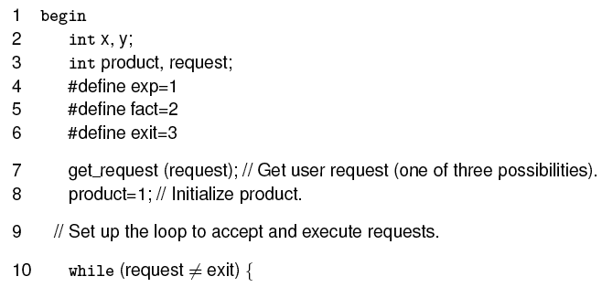
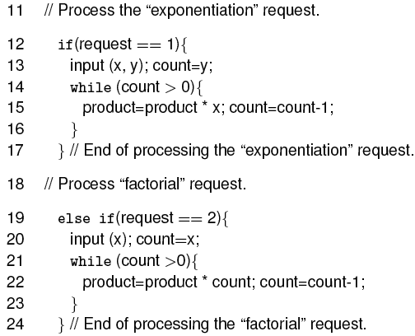
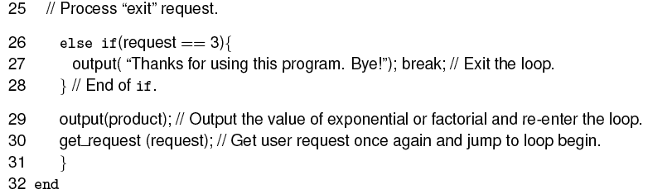
Example VII (2)
Consider this program written to meet the above requirements.
product =1;
25
input (request);
26
27
28
Test Adequacy Measurement & Enhancement (© 2012 Professor W. Eric Wong, The University of Texas at Dallas)

Slide 31
Example VII (3)
Suppose now that the following test set has been developed to test whether or not our program meets its requirements.
T = {< request = 1, x = 2, y = 3 >, < request = 2, x = 4 >, < request = 3 >}
For the first two requests (exponential followed by factorial), the program correctly outputs 8 and 24. The program exits when executed against the third request. This program’s behavior is correct and hence one might conclude that the program is correct.
Is this conclusion correct?
Test Adequacy Measurement & Enhancement (© 2012 Professor W. Eric Wong, The University of Texas at Dallas)

Slide 32
Example VII (4)
Let us now evaluate T against the path coverage criterion.
Construct the control flow graph of the example program and identify the paths not covered by T.
The coverage domain consists of all paths that traverse each of the three loops zero and once in the same or different executions of the program.
Test Adequacy Measurement & Enhancement (© 2012 Professor W. Eric Wong, The University of Texas at Dallas)

Slide 33
Example VII (5)
Consider the path p that begins execution at line 1, reaches the outermost while at line 10, then the first if at line 12, followed by the statements that compute the factorial starting at line 20, and then the code to compute the exponential starting at line 13.
p is traversed when the program is launched and the first input request is to compute the factorial of a number, followed by a request to compute the exponential. It is easy to verify that the sequence of requests in T (on slide 34) does not exercise p. Therefore, T is inadequate with respect to the path coverage criterion.
Test Adequacy Measurement & Enhancement (© 2012 Professor W. Eric Wong, The University of Texas at Dallas)

Slide 34
Example VII (6)
To cover p we construct the following test:
T’ = {< request = 2, x = 4 >, < request = 1, x = 2, y = 3 >, < request = 3 >}
When the values in T’ are input to our example program in the sequence given, the program correctly outputs 24 as the factorial of 4 but incorrectly outputs 192 (24 * 2 * 2 * 2) as the value of 2³ .
This happens because T’ traverses our “tricky” path which makes the computation of the exponentiation begin without initializing product.
In fact the code at line 14 begins with the value of product set to 24.
Test Adequacy Measurement & Enhancement (© 2012 Professor W. Eric Wong, The University of Texas at Dallas)

Slide 35
Example VII (7)
In our effort to increase the path coverage we constructed T’. Execution of the test program on T’ did cover a path that was not covered earlier and revealed a bug in the program.
This example has illustrated a benefit of test enhancement based on code coverage.
Test Adequacy Measurement & Enhancement (© 2012 Professor W. Eric Wong, The University of Texas at Dallas)

Slide 36
Multiple Executions (1)
In the previous example we constructed two test sets T and T’. Notice that both T and T’ contain three tests one for each value of the variable request. Should T (or T’) be considered a single test or a sequence of three tests?
T’={< request = 2, x = 4 >, < request = 1, x = 2, y = 3 >, < request = 3 >}
Test Adequacy Measurement & Enhancement (© 2012 Professor W. Eric Wong, The University of Texas at Dallas)

Slide 37
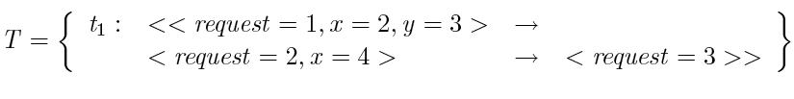
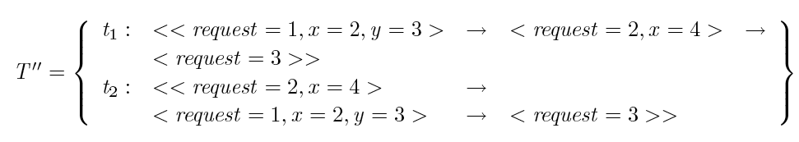
Multiple Executions (2)
We assumed that all three tests, one for each value of request, are input in a sequence during a single execution of the test program. Hence we consider T as a test set containing one test case and write it as follows:
T” = T ∪ T’
Test Adequacy Measurement & Enhancement (© 2012 Professor W. Eric Wong, The University of Texas at Dallas)

