Slide 1
STAR
Laboratory of Advanced Research on Software Technology
Reduce Cost of Regression Testing
W. Eric Wong
Department of Computer Science
The University of Texas at Dallas
ewong@utdallas.edu
http://www.utdallas.edu/~ewong
Reducing Cost of Regression Testing (© 2012 Professor W. Eric Wong, The University of Texas at Dallas)

Slide 2
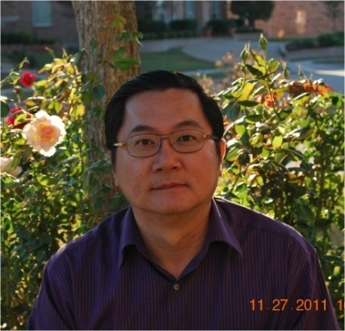
Speaker Biographical Sketch
Professor & Director of International Outreach
Department of Computer Science
University of Texas at Dallas
Guest Researcher
Computer Security Division
National Institute of Standards and Technology (NIST)
Vice President, IEEE Reliability Society
Secretary, ACM SIGAPP (Special Interest Group on Applied Computing)
Principal Investigator, NSF TUES (Transforming Undergraduate Education in Science, Technology, Engineering and Mathematics) Project
  Incorporating Software Testing into Multiple Computer Science and Software Engineering Undergraduate Courses
Founder & Steering Committee co-Chair for the SERE conference
(IEEE International Conference on Software Security and Reliability)
(http://paris.utdallas.edu/sere13)
Reducing Cost of Regression Testing (© 2012 Professor W. Eric Wong, The University of Texas at Dallas)

Slide 3
Outline
What is regression testing?
How to select a subset of tests for regression testing?
  Modification-based test selection
  Coverage-based test selection
    Test set minimization
    Test case prioritization
  Risk analysis-based test selection
Reducing Cost of Regression Testing (© 2012 Professor W. Eric Wong, The University of Texas at Dallas)

Slide 4
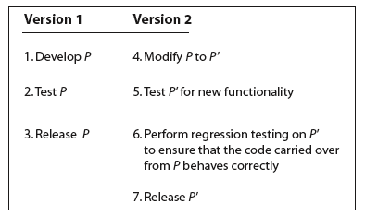
Regression Testing (1)
or bug fixing
May need to generate
additional new test cases
to test the enhancement
Reducing Cost of Regression Testing (© 2012 Professor W. Eric Wong, The University of Texas at Dallas)

Slide 5
Regression Testing (2)
Small changes in one part of a program may have subtle undesired effects in other seemingly unrelated parts of the program.
  Does fixing introduce new bugs?
  Revalidate the functionalities inherited from the previous release
Consequences of poor regression testing
  Thousands of 800 numbers disabled by a poorly tested software upgrade
  (December 1991)
  Fault in an SS7 software patch causes extensive phone outages
  (June 1991)
  Fault in a 4ESS upgrade causes massive breakdown in the AT&T network
  (January 1990)
Reducing Cost of Regression Testing (© 2012 Professor W. Eric Wong, The University of Texas at Dallas)

Slide 6
AT&T Network Outage, January 1990 (1)
At 2:20PM on January 15, 1990, the 75 screens displaying a giant map of the United States at the AT&T operation center in New Jersey began to suddenly display red lines stretching from one switch to another, cascading across the wall. The entire country was soon covered in a series of red lines, representing switches that were now offline.
Only 50% of calls placed through AT&T were connected, the other half heard a prerecorded message saying, “Sorry, all circuits are busy now.”
The network remained down until a team of 100 telephone technicians discovered and corrected the problem at 11:30 that night.
AT&T carried 70% of the nation’s telephone traffic routing over 115 million telephone calls on an average day
Reducing Cost of Regression Testing (© 2012 Professor W. Eric Wong, The University of Texas at Dallas)

Slide 7
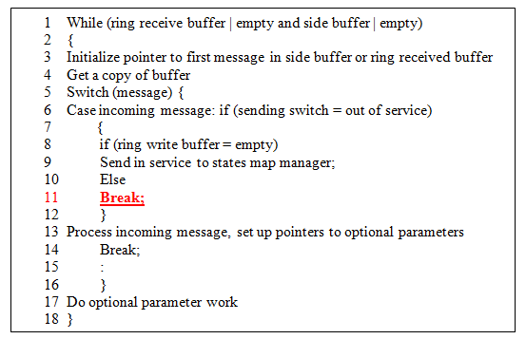
AT&T Network Outage, January 1990 (2)
Bug!
Reducing Cost of Regression Testing (© 2012 Professor W. Eric Wong, The University of Texas at Dallas)

Slide 8
Outline
What is regression testing?
How to select a subset of tests for regression testing?
  Modification-based test selection
  Coverage-based test selection
    Test set minimization
    Test case prioritization
  Risk analysis-based test selection
Reducing Cost of Regression Testing (© 2012 Professor W. Eric Wong, The University of Texas at Dallas)

Slide 9

Static & Dynamic Slice
A static slice for a given variable at a given statement contains all the executable statements that could possibly affect the value of this variable at the statement.
  Example: a static slice treats an entire array as a single variable
  Advantage: easy to implement
  Disadvantage: can be unnecessarily large with too much code
A dynamic slice can be considered as a refinement of the corresponding static slice by excluding those statements in the program that do not have an impact on the variables of interest.
  Different types of dynamic slices
  Example: a dynamic slice treats every array element as a separate variable
  Advantage: size is much smaller
  Disadvantage: construction is in general time-consuming
1: if ( a ≤ 0 )
2: x = y + 1;
3: else
4: x = y - 1;
Static Slice: 1, 2, 4
Dynamic Slice with respect to
variable x at line 4 for input (a = 1,y = 3): 1, 4
Reducing Cost of Regression Testing (© 2012 Professor W. Eric Wong, The University of Texas at Dallas)

Slide 10
Execution Slice (1)
An execution slice with respect to a given test case contains the set of code executed by this test.
We can also represent an execution slice as a set of blocks, decisions, c-uses, or p-uses, respectively, with respect to the corresponding block, decision, c-use, or p-use coverage criterion
Reducing Cost of Regression Testing (© 2012 Professor W. Eric Wong, The University of Texas at Dallas)

Slide 11

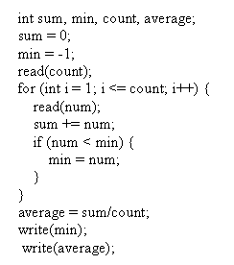
Execution Slice (2)
The dynamic slice with respect to the output variables includes only those statements that are not only executed but also have an impact on the program output under that test.
Since not all the statements executed might have an impact on the output variables, an execution slice can be a super set of the corresponding dynamic slice.
No inclusion relationship between static and execution slices
  The first statement, sum = 0, will be included in the execution slice with respect to min but not in the corresponding static slice (nor the dynamic slice) because this statement does not affect the value of min.
  An execution slice can be constructed very easily if we know the coverage of the test because the execution slice with respect to a test case can be obtained simply by converting the coverage data collected during the testing into another format, i.e., instead of reporting the coverage percentage, it reports which parts of the program (in terms of basic blocks, decisions, c-uses, and p-uses) are covered.
Reducing Cost of Regression Testing (© 2012 Professor W. Eric Wong, The University of Texas at Dallas)

Slide 12
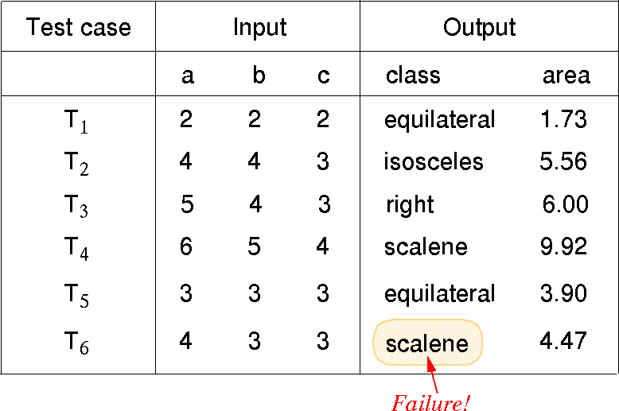
An Example (1)
Which tests should be re-executed?
Quiz: Should T₆ be selected?
Reducing Cost of Regression Testing (© 2012 Professor W. Eric Wong, The University of Texas at Dallas)

Slide 13
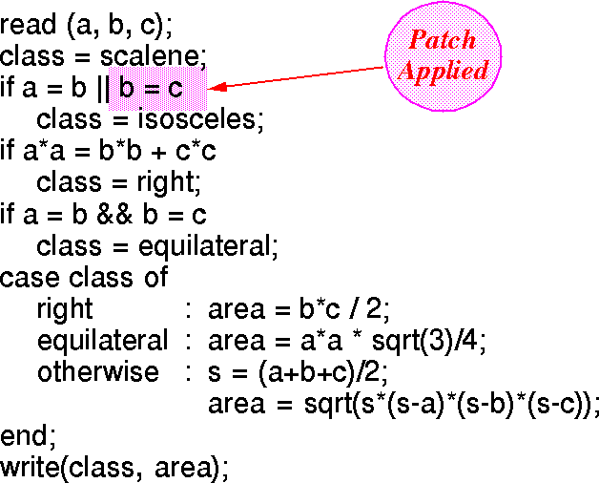
An Example (2)
A patch is installed
Reducing Cost of Regression Testing (© 2012 Professor W. Eric Wong, The University of Texas at Dallas)

Slide 14
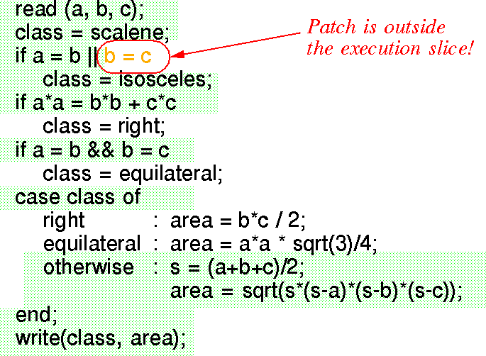
An Example (3)
Execution Slice w.r.t. the Successful Test T₂ = (4 4 3)
Quiz: Should T₂ be selected?
Reducing Cost of Regression Testing (© 2012 Professor W. Eric Wong, The University of Texas at Dallas)

Slide 15
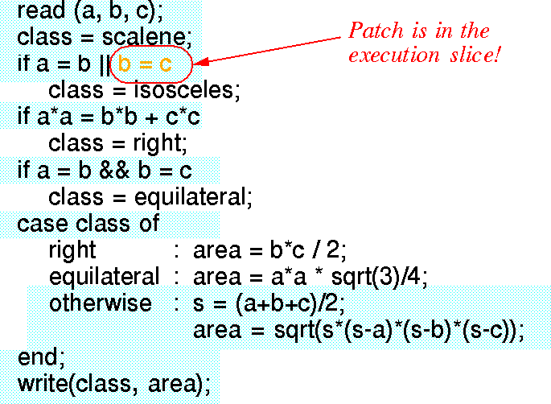
An Example (4)
Execution Slice w.r.t. the Successful Test T₄ = (6 5 4)
Quiz: Should T₄ be selected?
Reducing Cost of Regression Testing (© 2012 Professor W. Eric Wong, The University of Texas at Dallas)

Slide 16
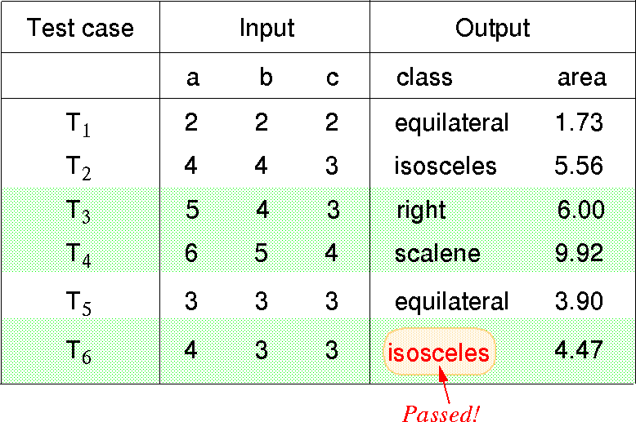
An Example (5)
Which tests should be re-executed? (cont’d)
Quiz: What if still too many tests?
Reducing Cost of Regression Testing (© 2012 Professor W. Eric Wong, The University of Texas at Dallas)

Slide 17
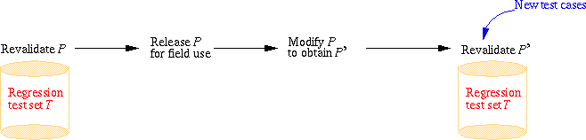
How to Select Regression Tests (1)
(Too Expensive)
Traditional approach: select all
  The test-all approach is good when you want to be certain that the new version works on all tests developed for the previous version.
  What if you only have limited resources to run tests and have to meet a deadline?
Those on which the new and the old programs produce different outputs (Undecidable)
Reducing Cost of Regression Testing (© 2012 Professor W. Eric Wong, The University of Texas at Dallas)

Slide 18
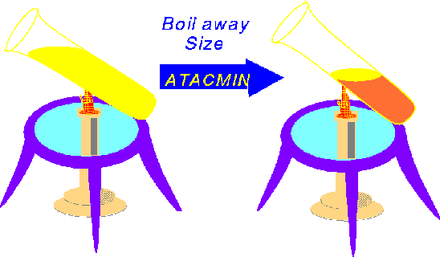
How to Select Regression Tests (2)
Select a subset (T_{sub}) of the original test set such that successful execution
of the modified code (P’) against T_{sub} implies that all the functionality
carried over from the original code to P’ is still intact.
Modification-based test selection
  Those which execute some modified code
    Still too many
    Need to further reduce the number of regression tests
Coverage-based test selection
  Those selected based on Test Set Minimization and Test Case Prioritization
Coverage Same
Size Reduced Significantly
Reducing Cost of Regression Testing (© 2012 Professor W. Eric Wong, The University of Texas at Dallas)

Slide 19
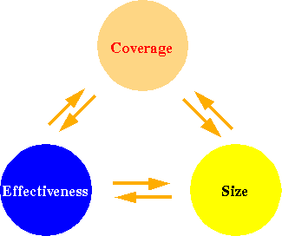
Three Attributes of a Test Set
Is a larger test set likely to be more effective in revealing program faults than a smaller of equal coverage ?
Is a higher coverage test set likely to be more effective than one of lower coverage but the same size ?
Need a better understanding of the relationship among a test set's size, its code coverage, and its fault detection effectiveness
Reducing Cost of Regression Testing (© 2012 Professor W. Eric Wong, The University of Texas at Dallas)

Slide 20

Coverage, Size, & Effectiveness
Coverage and effectiveness are more correlated
than size and effectiveness
Reducing Cost of Regression Testing (© 2012 Professor W. Eric Wong, The University of Texas at Dallas)

Slide 21
Is Test Set Minimization Affordable in Practice ?
The minimization algorithm can be exponential in time
  Does not occur in our experience
    Some examples
      an object-oriented language compiler (100 KLOC)
      a provisioning application (353 KLOC) with 32K regression tests
      a database application with 50 files (35 KLOC)
      a space application (10 KLOC)
  Stop after a pre-defined number of iterations
  Obtain an approximate solution by using a greedy heuristic
Reducing Cost of Regression Testing (© 2012 Professor W. Eric Wong, The University of Texas at Dallas)

Slide 22
Greedy Algorithm for Test Set Minimization
Select each test case whose cost is zero
  The complexity is order of n where n is the number of test cases
For the remaining test cases
  If the minimized subset has the same coverage as the original test set, STOP
  Select the one that gives the maximal coverage increment per unit cost
  Add this test case to the minimized subset
  Go back to the beginning of this step
  The complexity for the worst case scenario is order of n²
Reducing Cost of Regression Testing (© 2012 Professor W. Eric Wong, The University of Texas at Dallas)

Slide 23
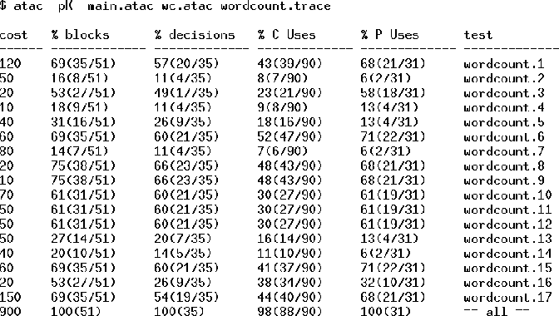
Test Set Minimization (1)
Coverage & Cost per Test Case
coverage increment per cost = 38 blocks/10
Reducing Cost of Regression Testing (© 2012 Professor W. Eric Wong, The University of Texas at Dallas)

Slide 24
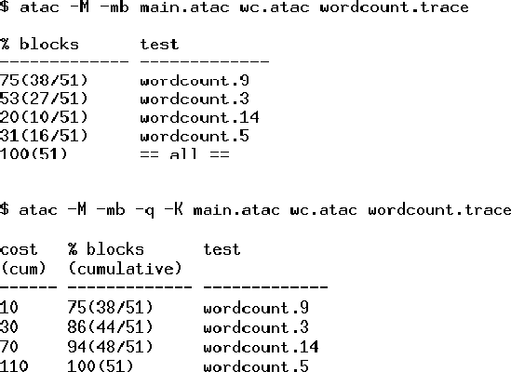
Test Set Minimization (2)
Minimization w.r.t. Block Coverage
Reducing Cost of Regression Testing (© 2012 Professor W. Eric Wong, The University of Texas at Dallas)

Slide 25
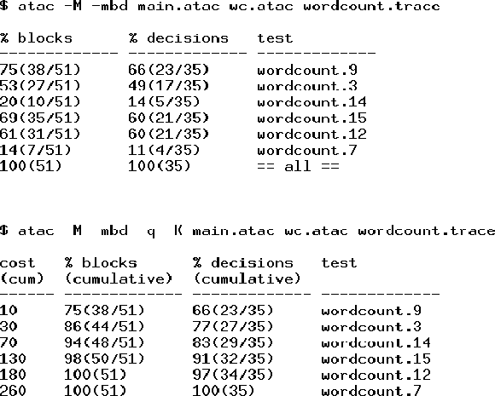
Test Set Minimization (3)
Minimization w.r.t. Block and Decision Coverage
Reducing Cost of Regression Testing (© 2012 Professor W. Eric Wong, The University of Texas at Dallas)

Slide 26
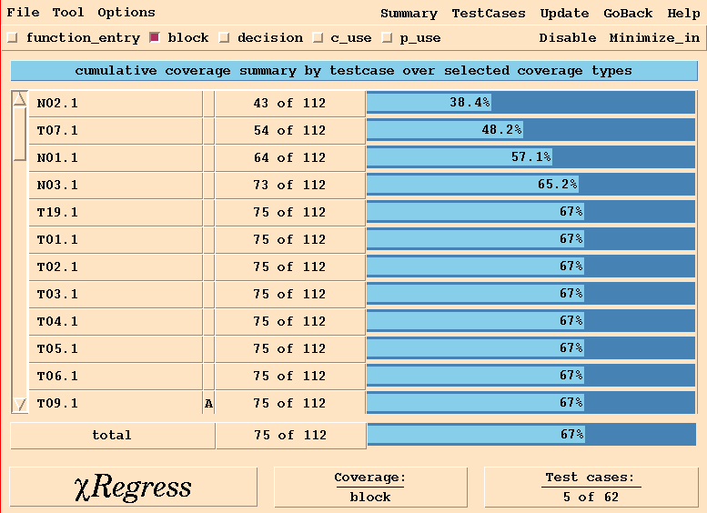
Test Set Minimization (4)
Sort test cases in order of increasing cost per additional coverage
Only 5 of the 62 test cases
are included in the minimized
subset which has the same block
coverage as the original test set.
Reducing Cost of Regression Testing (© 2012 Professor W. Eric Wong, The University of Texas at Dallas)

Slide 27
Test Set Minimization (5)
How to guarantee the inclusion of a certain test?
  Assign a very low cost to that test
How to guarantee the exclusion of a certain test?
  Assign a very high cost to that test
  Some tests might become obsolete when P is modified to P’.
  Such tests should not be included in the regression subset.
Reducing Cost of Regression Testing (© 2012 Professor W. Eric Wong, The University of Texas at Dallas)

Slide 28
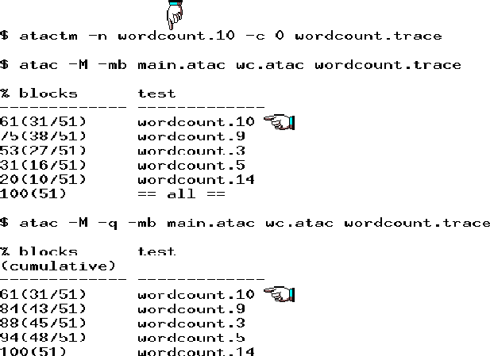
Test Set Minimization (6)
Include wordcount.10 in the Minimized Set
Reducing Cost of Regression Testing (© 2012 Professor W. Eric Wong, The University of Texas at Dallas)

Slide 29
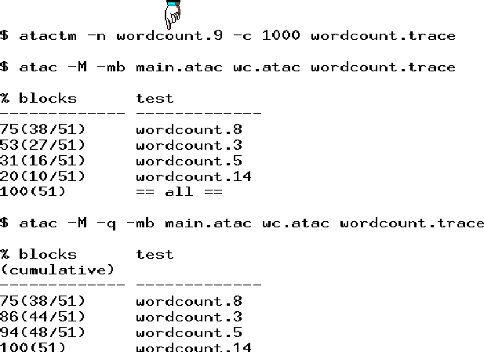
Test Set Minimization (7)
Exclude wordcount.9 in the Minimized Set
Reducing Cost of Regression Testing (© 2012 Professor W. Eric Wong, The University of Texas at Dallas)

Slide 30
Test Set Minimization (8)
Is it reasonable to apply coverage-based criteria as a filter to reduce the size of a test set ?
  Recall that coverage and effectiveness are more correlated than size and effectiveness
Yes, it is
  Test cases that do not add coverage are likely to be ineffective in revealing more program faults
  Test set minimization can be used to reduce the cost of regression testing
Reducing Cost of Regression Testing (© 2012 Professor W. Eric Wong, The University of Texas at Dallas)

Slide 31
Test Case Prioritization (1)
Sort test cases in order of increasing cost per additional coverage
Select the first test case
Repeat the above two steps until n test cases are selected
Reducing Cost of Regression Testing (© 2012 Professor W. Eric Wong, The University of Texas at Dallas)

Slide 32
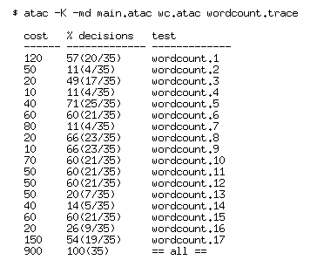
Test Case Prioritization (2)
Individual decision coverage and cost per test case
Reducing Cost of Regression Testing (© 2012 Professor W. Eric Wong, The University of Texas at Dallas)

Slide 33
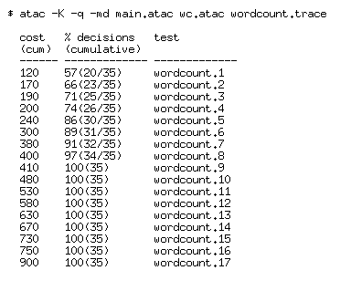
Test Case Prioritization (3)
Cumulative decision coverage and cost per test case
Reducing Cost of Regression Testing (© 2012 Professor W. Eric Wong, The University of Texas at Dallas)

Slide 34
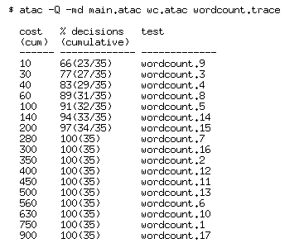
Test Case Prioritization (4)
Prioritized cumulative decision coverage and cost per test case
increasing order
cost per additional coverage
10/23 = 0.43
(30-10)/(27-23) = 20/4 = 5.00
(40-30)/(29-27) = 10/2 = 5.00
(60-40)/(31-29) = 20/2 = 10.00
(100-60)/(32-31) = 40/1 = 40.00
Reducing Cost of Regression Testing (© 2012 Professor W. Eric Wong, The University of Texas at Dallas)

Slide 35
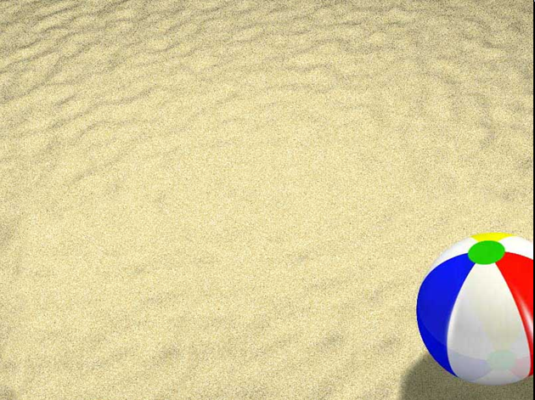
Modification-based Selection
followed by
Test Set Minimization
and/or
Test Case Prioritization

Slide 36
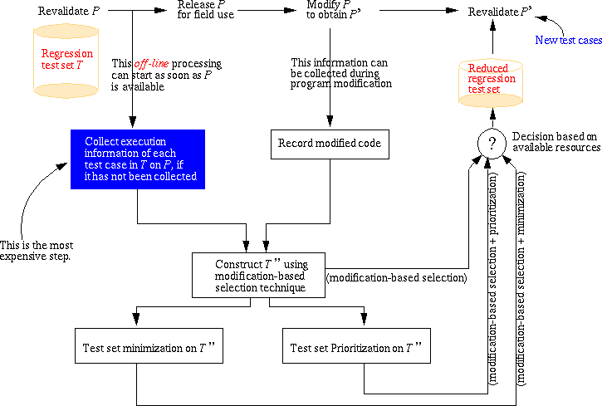
How to Select Regression Tests (3)
Reducing Cost of Regression Testing (© 2012 Professor W. Eric Wong, The University of Texas at Dallas)

Slide 37
How to Select Regression Tests (4)
Reducing Cost of Regression Testing (© 2012 Professor W. Eric Wong, The University of Texas at Dallas)

Slide 38
How to Select Regression Tests (5)
Reducing Cost of Regression Testing (© 2012 Professor W. Eric Wong, The University of Texas at Dallas)

Slide 39
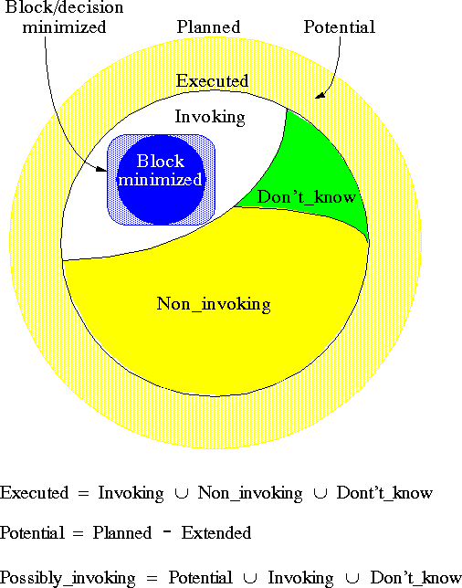
How to Select Regression Tests (6)
Executed
Reducing Cost of Regression Testing (© 2012 Professor W. Eric Wong, The University of Texas at Dallas)

Slide 40
How to Select Regression Tests (7)
A complete approach selects all tests in the Planned category
A conservative approach excludes tests in the Non-invoking category
An aggressive approach selects all tests in the Invoking category
A very aggressive approach selects the block/decision minimized subset of the Invoking category
An extremely aggressive approach selects the block minimized subset of the Invoking category
Reducing Cost of Regression Testing (© 2012 Professor W. Eric Wong, The University of Texas at Dallas)

Slide 41
How to Select Regression Tests (8)
We can also conduct regression test selection using dynamic slicing (instead of execution slicing).
What are the advantages?
What price do we have to pay for such advantages?
It is a trade-off decision!
Reducing Cost of Regression Testing (© 2012 Professor W. Eric Wong, The University of Texas at Dallas)

Slide 42
Risk Analysis-based Test Selection

Slide 43

Our Method
Combining dynamic testing effort such as code coverage and execution counts with static complexity computed by using the internal and external metrics
  Fault-proneness of a module with high static complexity should be appropriately calibrated based on how much effort has been spent on testing it.
Fault-proneness of a module =
f (inflows, outflows, fan-in, fan-out, ………
#of decisions, # of def-uses, # of interface mutants, ……
block coverage, decision coverage, execution counts, …...)
internal/external complexity metrics
controlflow-/dataflow-/mutation-based testing metrics
dynamic testing effort
Reducing Cost of Regression Testing (© 2012 Professor W. Eric Wong, The University of Texas at Dallas)

Slide 44
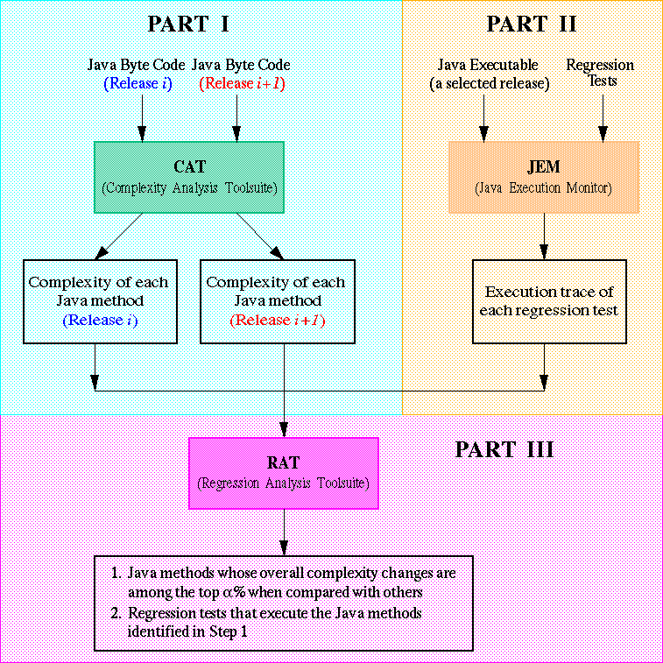
Risk Analysis & Regression Test Selection
Parts I and III need to be
performed between every two
subsequent releases, but Part II
only on some selected release
to create an appropriate
baseline.
Parts I and III need to be
performed between every two
subsequent releases, but Part II
only on some selected release
to create an appropriate
baseline.
Parts I and III need to be
performed between every two
subsequent releases, but Part II
only on some selected release
to create an appropriate
baseline.
Reducing Cost of Regression Testing (© 2012 Professor W. Eric Wong, The University of Texas at Dallas)

Slide 45
Rules of Thumb for Regression Test Selection
Effectiveness
Efficiency
Tool-Support
State-of-Art Research versus State-of-Practice Techniques
Remember:
In testing, variation is good.
Reducing Cost of Regression Testing (© 2012 Professor W. Eric Wong, The University of Texas at Dallas)

Slide 46
Summary
Regression testing is an essential phase of software product development.
In a situation where test resources are limited and deadlines are to be met, execution of all tests might not be feasible.
One can make use of different techniques for selecting a subset of all tests to reduce the time and cost for regression testing.
Reducing Cost of Regression Testing (© 2012 Professor W. Eric Wong, The University of Texas at Dallas)

Slide 47
Tool Demo

Slide 48
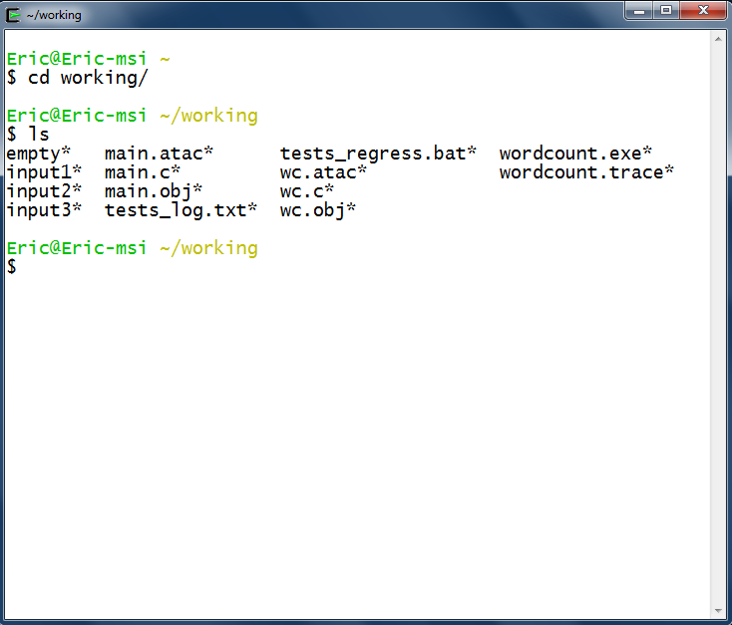
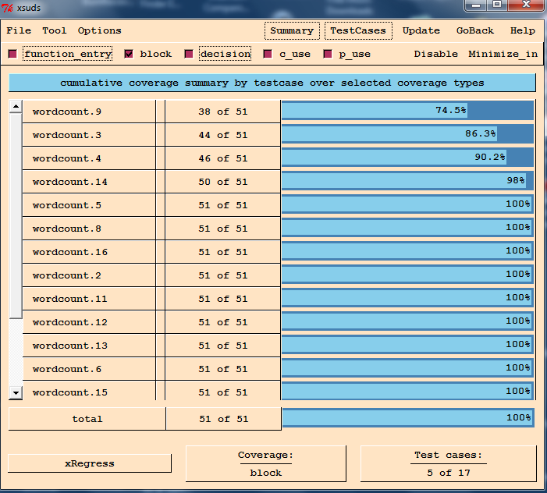
Tools for Regression Testing
χSuds from Telcordia Technologies (formerly Bellcore) can be used for C/C++ programs to minimize and prioritize tests
Many commercial tools for regression testing simply run the tests automatically; they do not use any of the algorithms described here for test selection. Instead they rely on the tester for test selection. Such tools can be useful when all tests are to be rerun.
Unit 3
Reducing Cost of Regression Testing (© 2012 Professor W. Eric Wong, The University of Texas at Dallas)

Slide 49
Hands-On In-Class Exercises

Slide 50
χRegress Tutorial
Following the instructions in Chapter 11 of the χSuds User's manual
  Complete the tutorial
  Make sure your final result matches Figure 11-13
Reducing Cost of Regression Testing (© 2012 Professor W. Eric Wong, The University of Texas at Dallas)

Slide 51
Review Questions

Slide 52
Which Test Cases Should be Selected for Regression Testing ?
A sample program
1. main ( ) {
2. int p, q, r, z
3. z=0
4. input (p, q, r)
5. if (p < q)
6. z = 1 ⬅ This statement is modified
7. if (r < 6)
8. z = 2
9. output (z)
10. end
11. }
test case t₁: <p = 1; q = 3; r = 8>
test case t₂: <p = 3; q = 1; r = 0>
test case t₃: <p = 1; q = 3; r = 0>
Should t₁ be selected? How about t₂ and t₃ ?
Reducing Cost of Regression Testing (© 2012 Professor W. Eric Wong, The University of Texas at Dallas)

Slide 53
More Questions
Explain the difference between execution, static and dynamic slicing
  Is there a subsumption relationship between these slices?
  If yes, explain why?
  If not, give an example to support your answer.
What are the advantages and disadvantages of using execution slices over dynamic and static slices to select regression tests?
Explain why it is reasonable to use code coverage as a filter to reduce the number of test cases for regression testing
  How to guarantee the inclusion of a preferred test case?
  How to guarantee the exclusion of an undesired test case?
Reducing Cost of Regression Testing (© 2012 Professor W. Eric Wong, The University of Texas at Dallas)

Slide 54
References

Slide 55
References (1)
Hiralal Agrawal, Joseph R. Horgan, Edward Krauser, and Saul London, “Incremental Regression Testing,” in Proceedings of the 9th International Conference on Software Maintenance, pp, 348-357, Quebec, Canada,
September 1993
Paolo Benedusi, Aniello Cimitile, Ugo de Carlini, “Post-Maintenance Testing Based on Path Change Analysis,” in Proceedings of the 4th International Conference on Software Maintenance, pp, 352-361, Scottsdale, Arizona,
USA, October 1988
David. Binkley, “Reducing the cost of Regression Testing by Semantics Guided Test Case Selection,” in Proceedings of the 11th International Conference on Software Maintenance, pp. 251-260, Nice, France, October 1995
Swarnendu Biswas, Rajib Mall, Manoranjan Satpathy and Srihari Sukumaran, “Regression Test Selection Techniques: A Survey,” Informatica, 35(3):289–321, October 2011
Y. F. Chen, D. S. Rosenblum, and K. P. Vo, “TestTube: A System for Selective Regression Testing,” in Proceedings of the 16th International Conference on Software Engineering, pp. 211-222, Sorrento, Italy, May 1994
Reducing Cost of Regression Testing (© 2012 Professor W. Eric Wong, The University of Texas at Dallas)

Slide 56
References (2)
Gregg Rothermel and Mary Jean Harrold, “Empirical Studies of a Safe Regression Test Selection Technique,” IEEE Transactions on Software Engineering, 24(6):401-419, June 1998
Todd L. Graves, Mary Jean Harrold, Jung-Min Kim, Adam Porter, Gregg Rothermel, “An Empirical Study of Regression Test Selection Techniques,”
ACM Transactions on Software Engineering and Methodology, 10(2):184-208, April 2001
Mary Jean Harrold, Rajiv Gupta, and Mary Lou Soffa, “A Methodology for Controlling the Size of a Test Suite,” ACM Transactions on Software Engineering and Methodology, 2(3):270-285, July 1993
Rajiv Gupta, Mary Jean Harrold, and Mary Lou Soffa, “Program Slicing-Based Regression Testing Techniques,” Journal of Software Testing, Verification and Reliability, 6(2):83-112, June 1996
Reducing Cost of Regression Testing (© 2012 Professor W. Eric Wong, The University of Texas at Dallas)

Slide 57
References (3)
W. Eric Wong, Joseph R. Horgan, Saul London and Aditya P. Mathur, “Effect of Test Set Minimization on Fault Detection Effectiveness,” Software-Practice and Experience, 28(4):347-369, April 1998
W. Eric Wong, Joseph R. Horgan, Saul London and Hira Agrawal,
“A Study of Effective Regression Testing in Practice,” in Proceedings
of the 8th IEEE International Symposium on Software Reliability Engineering, pp. 264-274, Albuquerque, New Mexico, USA,
November 1997
W. Eric Wong, Joseph R. Horgan, Saul London and Aditya P. Mathur, “Effect of Test Set Size and Block Coverage on Fault Detection Effectiveness,” in Proceedings of the 5th IEEE International Symposium on Software Reliability Engineering (ISSRE), pp. 230-238, Monterey, California, USA, November 1994
Reducing Cost of Regression Testing (© 2012 Professor W. Eric Wong, The University of Texas at Dallas)

Slide 58
The End

Slide 59
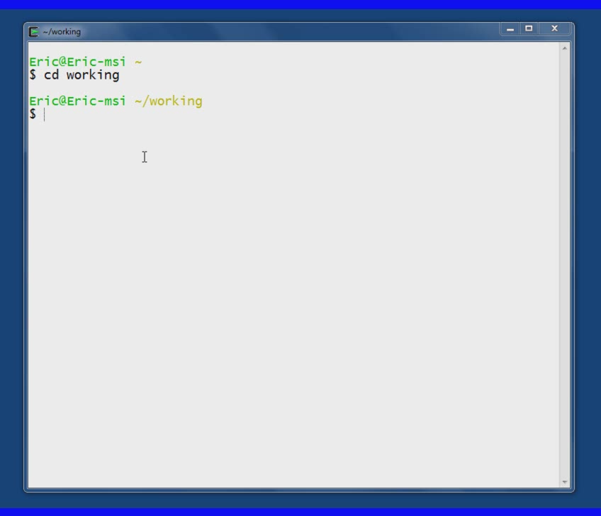


Slide 60
