Slide 1
STAR
Laboratory of Advanced Research on Software Technology
Mutation Testing
W. Eric Wong
Department of Computer Science
The University of Texas at Dallas
ewong@utdallas.edu
http://www.utdallas.edu/~ewong
Mutation Testing (© 2013 Professor W. Eric Wong, The University of Texas at Dallas)

Slide 2
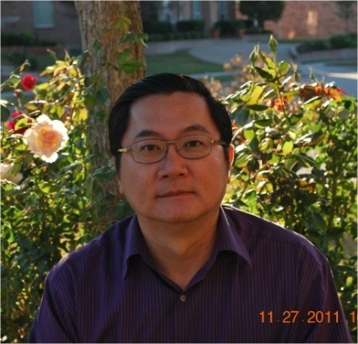
Speaker Biographical Sketch
Professor & Director of International Outreach
Department of Computer Science
University of Texas at Dallas
Guest Researcher
Computer Security Division
National Institute of Standards and Technology (NIST)
Vice President, IEEE Reliability Society
Secretary, ACM SIGAPP (Special Interest Group on Applied Computing)
Principal Investigator, NSF TUES (Transforming Undergraduate Education in Science, Technology, Engineering and Mathematics) Project
  Incorporating Software Testing into Multiple Computer Science and Software Engineering Undergraduate Courses
Founder & Steering Committee co-Chair for the SERE conference
(IEEE International Conference on Software Security and Reliability)
(http://paris.utdallas.edu/sere13)
Mutation Testing (© 2013 Professor W. Eric Wong, The University of Texas at Dallas)

Slide 3
Mutation Testing (1)
The process of program development is considered as iterative whereby an initial version of the program is refined by making simple, or a combination of simple changes, towards the final version.
Mutation testing is a code-based test assessment and improvement technique.
  Can be extended to architecture (e.g., Statecharts) and design (e.g., SDL)
Mutation Testing (© 2013 Professor W. Eric Wong, The University of Texas at Dallas)

Slide 4
Mutation Testing (2)
It relies on the competent programmer hypothesis which is the following assumption:
  Given a specification a programmer develops a program that is either correct or differs from the correct program by a combination of simple errors
It also relies on “coupling effect” which suggests that
  Test cases that detect simple types of faults are sensitive enough to detect more complex types of faults.
Mutation Testing (© 2013 Professor W. Eric Wong, The University of Texas at Dallas)

Slide 5
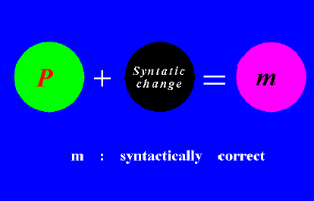
Mutant (1)
Given a program P, a mutant of P is obtained by making a simple change in P
Mutation Testing (© 2013 Professor W. Eric Wong, The University of Texas at Dallas)

Slide 6
Example (1)
a := b + c
a := c + c
a := b − c
Mutation Testing (© 2013 Professor W. Eric Wong, The University of Texas at Dallas)

Slide 7
Example (2)
Program
Mutant
1. int x, y;
2. if (x != 0)
3. y = 5;
4. else z = z − x;
5. if (z > 1)
6. z = z/x;
7. else
8. z = y;
1. int x, y;
2. if (x! = 0)
3. y = 5;
4. else z = z − x;
5. if (z > 1)
6. z = z/&x;
7. else
8. z = y;
Mutation Testing (© 2013 Professor W. Eric Wong, The University of Texas at Dallas)

Slide 8
Example (3)
Program
Mutant
1. int x, y;
2. if (x! = 0)
3. y = 5;
4. else z = z − x;
5. if (z > 1)
6. z = z/x;
7. else
8. z = y;
1. int x, y;
2. if (x! = 0)
3. y = 5;
4. else z = z − x;
5. if (z < 1)
6. z = z/x;
7. else
8. z = y;
Mutation Testing (© 2013 Professor W. Eric Wong, The University of Texas at Dallas)

Slide 9
Order of Mutants
First order mutants
  One syntactic change
Higher order mutants
  Multiple syntactic changes
Coupling effect
Mutation Testing (© 2013 Professor W. Eric Wong, The University of Texas at Dallas)

Slide 10
Type of Mutants (1)
Distinguished mutants
Live mutants
Equivalent mutants
Non-equivalent mutants
Mutation Testing (© 2013 Professor W. Eric Wong, The University of Texas at Dallas)

Slide 11
Type of Mutants (2)
A mutant m is considered distinguished (or killed) by a test case t ∈T if
  P(t) ≠ m(t)
where P(t) and m(t) denote, respectively, the observed behavior of P and m when executed on test input t
A mutant m is considered equivalent to P if
  P(t) = m(t)
for any test case in the input domain
Mutation Testing (© 2013 Professor W. Eric Wong, The University of Texas at Dallas)

Slide 12
Distinguish a Mutant (1)
Reachability
  Execute the mutated statement
Necessity
  Make a state change
Sufficiency
  Propagate the change to output
Mutation Testing (© 2013 Professor W. Eric Wong, The University of Texas at Dallas)

Slide 13
Distinguish a Mutant (2)
Program P
read a
if (a > 3)
then
x = 5
else
x = 2
endif
print x
Program m
read a
if (a ≥ 3)
then
x = 5
else
x = 2
endif
print x
Mutant m is distinguished by a = 3
Mutation Testing (© 2013 Professor W. Eric Wong, The University of Texas at Dallas)

Slide 14
Equivalent Mutant (1)
Program P
read a, b
a = b
x = a + b
print x
Program m
read a, b
a = b
x = a + a
print x
P is equivalent to m
Mutation Testing (© 2013 Professor W. Eric Wong, The University of Texas at Dallas)

Slide 15
Equivalent Mutant (2)
Consider the following program P
int x, y, z;
scanf (&x, &y);
if (x>0)
x = x + 1; z = x × (y − 1);
else
x = x − 1; z = x × (y − 1);
Here z is considered the output of P
Mutation Testing (© 2013 Professor W. Eric Wong, The University of Texas at Dallas)

Slide 16
Equivalent Mutant (3)
Now suppose that a mutant of P is obtained by changing x = x + 1 to
x = abs(x) + 1
This mutant is equivalent to P as no test case can distinguish it from P
Mutation Testing (© 2013 Professor W. Eric Wong, The University of Texas at Dallas)

Slide 17
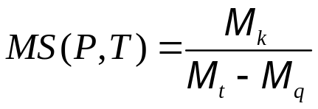
Mutation Score (1)
During testing a mutant is considered live if it has not been distinguished or proven equivalent.
Suppose that a total of M_{t} mutants are generated for program P
The mutation score of a test set T, designed to test P, is computed as:
  M_{k} – number of mutants killed
  M_{q} – number of equivalent mutants
  M_{t} – total number of mutants
Mutation Testing (© 2013 Professor W. Eric Wong, The University of Texas at Dallas)

Slide 18
Mutation Score (2)
Mutation score:
  Number of mutants distinguished
  Total number of non-equivalent mutants
Data flow score:
  Number of blocks (decisions, p-uses, c-uses, all-uses) covered
  Total number of feasible blocks (decisions, p-uses, c-uses, all-uses)
Mutation Testing (© 2013 Professor W. Eric Wong, The University of Texas at Dallas)

Slide 19
Test Adequacy Criterion
A test T is considered adequate with respect to the mutation criterion if its mutation score is 1
  Equivalent mutants?
  Which mutant operators are used?
The number of mutants generated depends on P and the
mutant operators applied on P
A mutant operator is a rule that when applied to the program under test generates zero or more mutants
Mutation Testing (© 2013 Professor W. Eric Wong, The University of Texas at Dallas)

Slide 20
Mutant Operator (1)
Consider the following program:
    int abs (x);
    int x;
    {
      if (x ≥ 0) x = 0 − x;
      return x;
    }
Mutation Testing (© 2013 Professor W. Eric Wong, The University of Texas at Dallas)

Slide 21
Mutant Operator (2)
Consider the following rule:
  Replace each relational operator in P by all possible relational operators excluding the one that is being replaced.
Assuming the set of relational operators to be: {<, >, ≤, ≥, = =, !=},
the above mutant operator will generate a total of 5 mutants of P
Mutation Testing (© 2013 Professor W. Eric Wong, The University of Texas at Dallas)

Slide 22
Mutant Operator (3)
Mutation operators are language dependent
For Fortran a total of 22 operators were proposed
For C a total of 77 operators were proposed
Mutation Testing (© 2013 Professor W. Eric Wong, The University of Texas at Dallas)

Slide 23
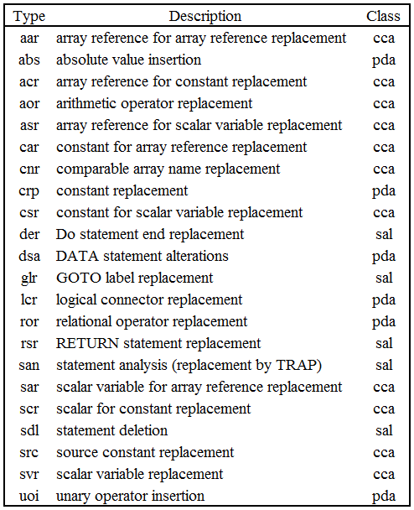
Mutant Operators for Fortran (1)
Mutation Testing (© 2013 Professor W. Eric Wong, The University of Texas at Dallas)

Slide 24
Mutant Operators for Fortran (2)
san: replace each statement by TRAP
(an instruction that causes the program to halt, killing the mutant)
  Which code coverage-based criterion will also be satisfied by killing all the san mutants?
rsr: replace each statement in a subprogram by RETURN
Mutation Testing (© 2013 Professor W. Eric Wong, The University of Texas at Dallas)

Slide 25
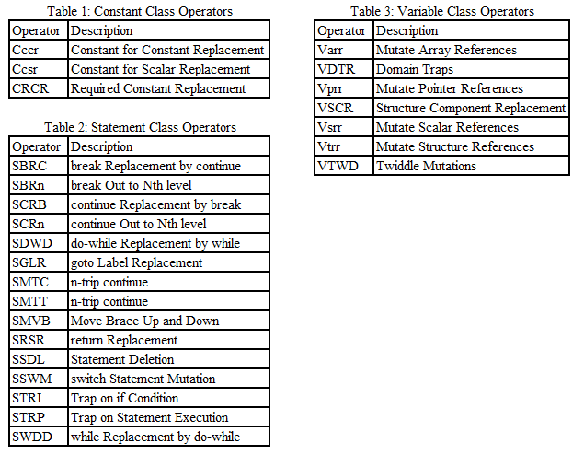
Mutant Operators for C (1)
Mutation Testing (© 2013 Professor W. Eric Wong, The University of Texas at Dallas)

Slide 26
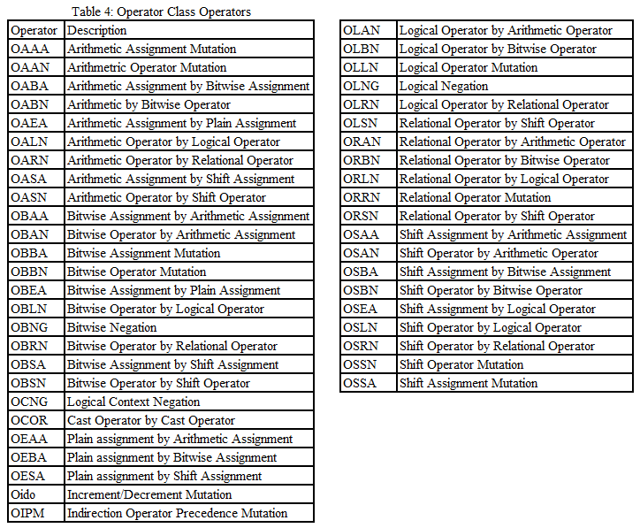
Mutant Operators for C (2)
Mutation Testing (© 2013 Professor W. Eric Wong, The University of Texas at Dallas)

Slide 27
Mutation Testing Procedure (1)
Given P and a test set T
  Generate mutants
  Compile P and the mutants
  Execute P and the mutants on each test case
  Determine equivalent mutants
  Determine mutation score
  If mutation score is not 1 then improve the test case and repeat from Step 3
Mutation Testing (© 2013 Professor W. Eric Wong, The University of Texas at Dallas)

Slide 28
Mutation Testing Procedure (2)
In practice the above procedure is implemented incrementally
One applies a few selected mutant operators to P and computes the mutation score with respect to the mutants generated
Once these mutants have been distinguished or proven equivalent, another set of mutant operators is applied
Mutation Testing (© 2013 Professor W. Eric Wong, The University of Texas at Dallas)

Slide 29
Mutation Testing Procedure (3)
This procedure is repeated until either all the mutants have been exhausted or some external condition forces testing to stop
Mutation Testing (© 2013 Professor W. Eric Wong, The University of Texas at Dallas)

Slide 30
Tools for Mutation Testing
Mothra: for Fortran, developed at Purdue, 1990
Proteum: for C, developed at the University of São Paulo at São Paulo in Brazil.
Mutation Testing (© 2013 Professor W. Eric Wong, The University of Texas at Dallas)

Slide 31
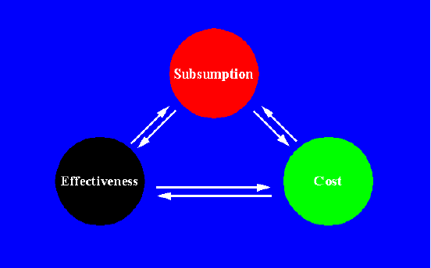
Comparison Criterion
Mutation Testing (© 2013 Professor W. Eric Wong, The University of Texas at Dallas)

Slide 32
Mutation Hypothesis
More difficulty to satisfy
More expensive
More effective in fault detection
Mutation Testing (© 2013 Professor W. Eric Wong, The University of Texas at Dallas)

Slide 33
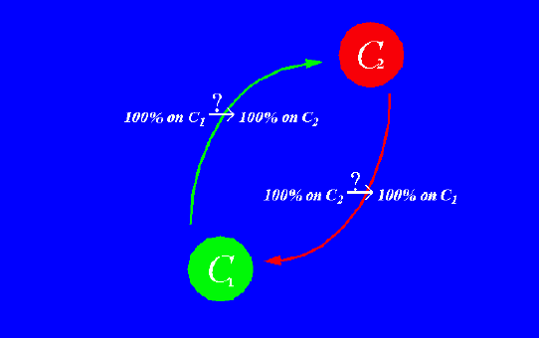
Subsumption
Mutation Testing (© 2013 Professor W. Eric Wong, The University of Texas at Dallas)

Slide 34
Program Classification
SDSU (single definition, single use)
SDMU (single definition, multiple uses)
MDSU (multiple definitions, single use)
MDMU (multiple definitions, multiple uses)
Mutation Testing (© 2013 Professor W. Eric Wong, The University of Texas at Dallas)

Slide 35
Program Classification
SDSU
  M (Mothra) subsumes AU, CU, and PU
SDMU
  M (Mothra) subsumes AU, CU, and PU
MDSU (multiple definitions, single use)
  M (Mothra) subsumes CU, but not PU, and AU
MDMU
  M (Mothra) does not subsume CU, PU, and AU
Mutation Testing (© 2013 Professor W. Eric Wong, The University of Texas at Dallas)

Slide 36
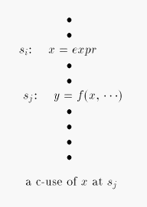
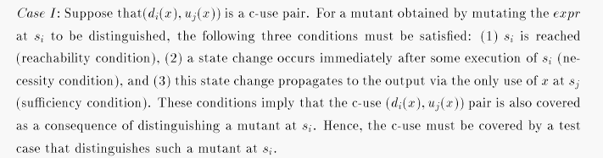
SDSU (1)
Mutation Testing (© 2013 Professor W. Eric Wong, The University of Texas at Dallas)

Slide 37
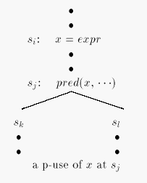
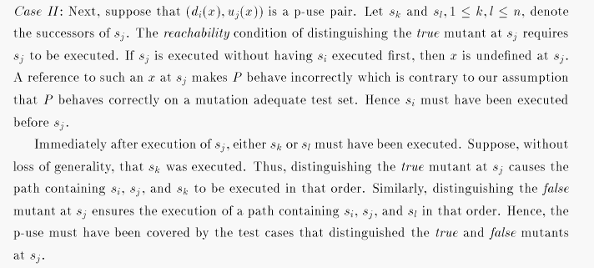
SDSU (2)
Mutation Testing (© 2013 Professor W. Eric Wong, The University of Texas at Dallas)

Slide 38
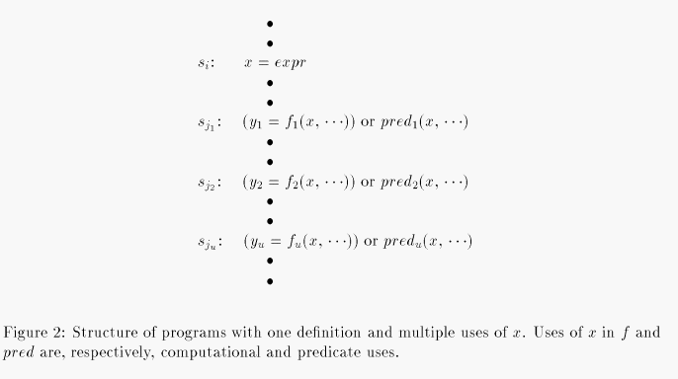

SDMU (1)
Mutation Testing (© 2013 Professor W. Eric Wong, The University of Texas at Dallas)

Slide 39
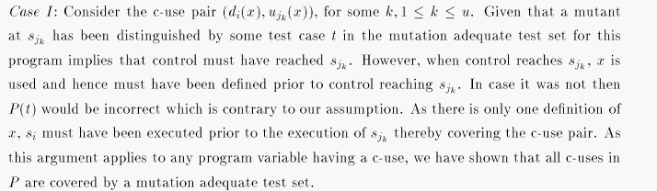
SDMU (2)
Mutation Testing (© 2013 Professor W. Eric Wong, The University of Texas at Dallas)

Slide 40
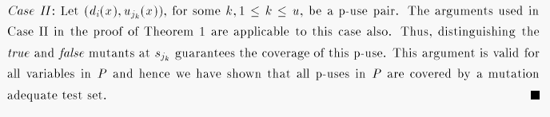
SDMU (3)
Mutation Testing (© 2013 Professor W. Eric Wong, The University of Texas at Dallas)

Slide 41
MDSU (1)
Lemma 1 For Category III, M_{R} subsumes CU
Proof: The proof follows from the arguments used in Case I of the proof of Theorem 1 applied to all c-use pairs
Mutation Testing (© 2013 Professor W. Eric Wong, The University of Texas at Dallas)

Slide 42
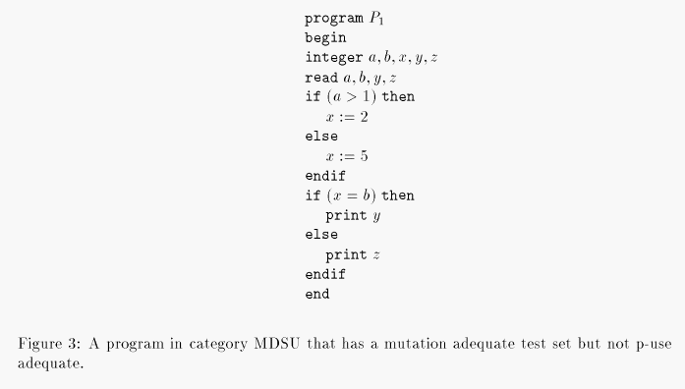
MDSU (2)
Definition of x
Definition of x
P-use of x
Mutation Testing (© 2013 Professor W. Eric Wong, The University of Texas at Dallas)

Slide 43
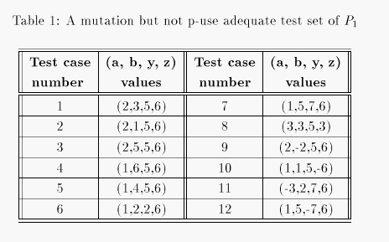
MDSU (3)
Proof: Figure 3 shows a program that has two p-use pairs for variable x. Table 1 lists a mutation adequate test set which does not cover the p-use pair consisting of the definition x:=2 and its use in the predicate x=b because the successor print y is not executed.
Mutation Testing (© 2013 Professor W. Eric Wong, The University of Texas at Dallas)

Slide 44
Empirical Study : Subsumption
All-uses scores using mutation adequate test sets are, in general, higher than the mutation scores using all-uses adequate test sets.
Mutation Testing (© 2013 Professor W. Eric Wong, The University of Texas at Dallas)

Slide 45
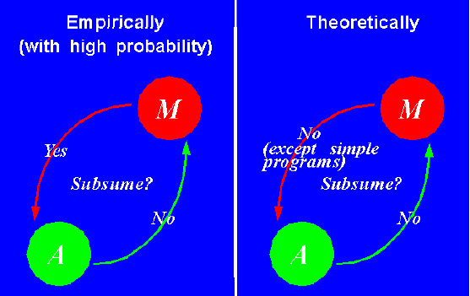
Conclusion on Subsumption
Mutation Testing (© 2013 Professor W. Eric Wong, The University of Texas at Dallas)

Slide 46
Cost Metrics
Number of executions
Number of test cases
Test case generation
Learning testing tools
Identifying equivalent mutants & infeasible all-uses
Mutation Testing (© 2013 Professor W. Eric Wong, The University of Texas at Dallas)

Slide 47
Reducing Mutation Cost
The cost of mutation testing can be reduced if the number of mutants to be examined is reduced
Mutation Testing (© 2013 Professor W. Eric Wong, The University of Texas at Dallas)

Slide 48
Selection Mutation
Select proper mutant operators
  ror: relational operator replacement
  lcr: logical connector replacement
  abs: absolute value insertion
  sdl: statement deletion
Mutation Testing (© 2013 Professor W. Eric Wong, The University of Texas at Dallas)

Slide 49
abs Mutant Operator
a := b + c
a := |b| + c
a := −|b| + c
a := 0 + c
Mutation Testing (© 2013 Professor W. Eric Wong, The University of Texas at Dallas)

Slide 50
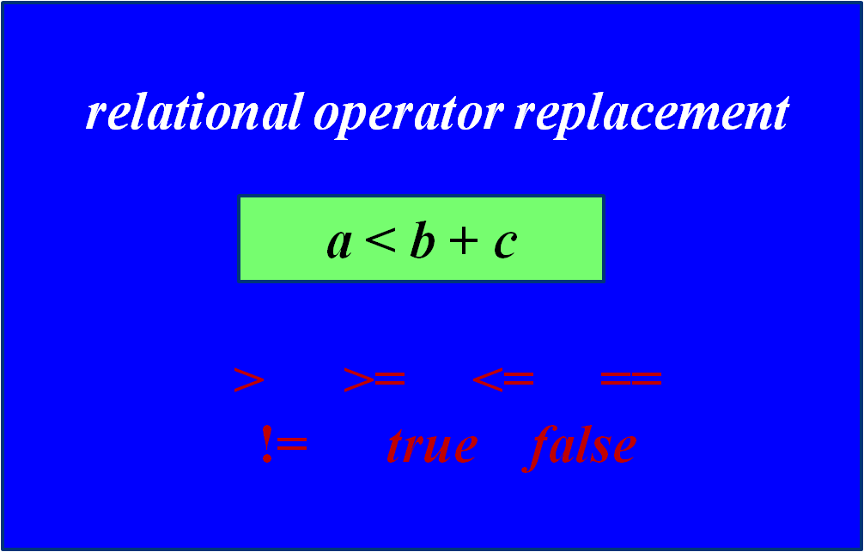
ror Mutant Operator
Mutation Testing (© 2013 Professor W. Eric Wong, The University of Texas at Dallas)

Slide 51
Random x% Mutation
Randomly select a small percentage of mutants from each mutant type
Mutation Testing (© 2013 Professor W. Eric Wong, The University of Texas at Dallas)

Slide 52
Weak Mutation (1)
Reachability
  Execute the mutated statement
Necessity
  Make a state change
Sufficiency
  Propagate the change to output
Mutation Testing (© 2013 Professor W. Eric Wong, The University of Texas at Dallas)

Slide 53
Weak Mutation - Advantage
Weak mutation reduces the amount of execution for distinguishing each mutant
Mutation Testing (© 2013 Professor W. Eric Wong, The University of Texas at Dallas)

Slide 54
Weak Mutation - Disadvantage
The disadvantage of weak mutation testing is that there is no guarantee that the different immediate effect will cause a different final result.
Mutation Testing (© 2013 Professor W. Eric Wong, The University of Texas at Dallas)

Slide 55
Weak Mutation (2)
Weak mutation is as effective as strong mutation if the weak mutation hypothesis is true:
  (reachability and necessity) → sufficiency
Experiments have shown that this is true for 61% of all the cases studied
Mutation Testing (© 2013 Professor W. Eric Wong, The University of Texas at Dallas)

Slide 56
Weak Mutation (3)
Suppose that the weak mutation hypothesis does not hold for a particular fault (say F). That is, there exists a non–empty input set that satisfies the reachability and necessity conditions while not producing a detectable failure.
But in the code under test, there will be many locations with potential faults, each with its own reachability and necessity conditions. It may be that satisfying those other conditions will force the execution of this fault (i.e., F) in a way that must produce a detectable failure (namely to satisfy the sufficiency condition).
Thus, the weak mutation hypothesis may not hold when a single fault is considered alone, but may hold when the fault is considered as part of a larger program (which has many faults).
Mutation Testing (© 2013 Professor W. Eric Wong, The University of Texas at Dallas)

Slide 57
Reduction Measurement (1)
Size reduction:
Expense reduction:
Mutation Testing (© 2013 Professor W. Eric Wong, The University of Texas at Dallas)

Slide 58
Reduction Measurement (2)
Mutation score reduction
All-uses scores reduction
Mutation Testing (© 2013 Professor W. Eric Wong, The University of Texas at Dallas)

Slide 59
Observation
Compared to mutation, randomly selected x% mutation and abs/ror mutation provide:
  Significant size reduction
  Significant expense reduction
  Small reduction on mutation scores
  Small reduction on all-uses scores
Mutation Testing (© 2013 Professor W. Eric Wong, The University of Texas at Dallas)

Slide 60
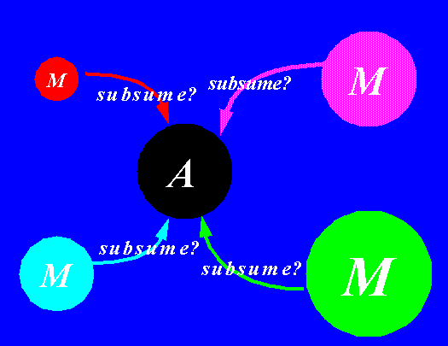
Alternate Mutation
Mutation Testing (© 2013 Professor W. Eric Wong, The University of Texas at Dallas)

Slide 61
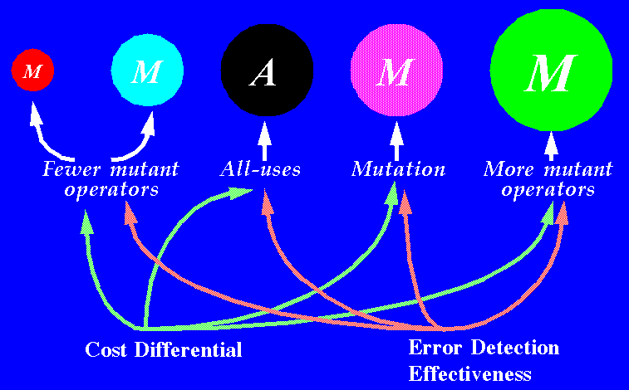
Incremental Testing Strategy
Mutation Testing (© 2013 Professor W. Eric Wong, The University of Texas at Dallas)

Slide 62
Questions?
Mutation Testing (© 2013 Professor W. Eric Wong, The University of Texas at Dallas)

Slide 63
Review Question (1)
A mutation system creates mutants for a program using various operators (i.e., rules to generate mutants). A test set for mutation testing is one that includes test cases which collectively “kill” all the (non-equivalent) mutants. The ABC mutation system has the following operators:
Operator A: Statement deletion – delete a statement in the program.
Operator B: Logical Constant Insertion – replace a condition with
Boolean constants (True, False).
Operator C: Variable replacement – replace an occurrence of a variable
x with some other variable that appears in the program.
(a) What are the “subsumes” relations between ABC-mutation testing
and “statement/block,” “decision,” and “all-uses”?
(b) How many mutants will ABC-mutation generate in the worst cases
for a program with n statements and k variables?
Mutation Testing (© 2013 Professor W. Eric Wong, The University of Texas at Dallas)

Slide 64
Review Question (1) (cont’d)
For mutant operator A which deletes a statement in the program,
statement/block coverage is satisfied.
For mutant operator B which replaces a condition with Boolean
constants (True, False), decision coverage is satisfied.
For mutant operator C which replaces an occurrence of a variable x with some other variable that appears in the program, which may satisfy some def-use pairs but not all.
However, the “all-uses” criterion is not satisfied by the ABC-mutation.
Mutation Testing (© 2013 Professor W. Eric Wong, The University of Texas at Dallas)

Slide 65
Review Question (1) (cont’d)
How many mutants will ABC-mutation generate in the worst cases for
a program with n statements and k variables?
For mutant operator A which deletes a statement in the program,
n mutants can be generated for the program.
In the worst case, there are (n-1) conditions in a program with
n statements.
  2 mutants for each condition
  all together, there are 2 * (n-1) = mutants
For operator C which replaces an occurrence of a variable x with some other variable that appears in the program
  (k-1) mutants for each variable
  all together there are (k-1) * k mutants
Mutation Testing (© 2013 Professor W. Eric Wong, The University of Texas at Dallas)

Slide 66
Review Question (2)
Mutation has proven to be a very effective though extremely costly technique for test set assessment. Design a mutation scheme that keeps most of the effectiveness of the technique while considerably reducing its cost. Clearly explain your answer.
Mutation Testing (© 2013 Professor W. Eric Wong, The University of Texas at Dallas)

