Slide 1


Slide 2
Introduction
Testing is about choosing elements from input domain.
The input domain of a program consists of all possible inputs that could be taken by the program.
  Easy to get started, based on description of the inputs

Slide 3
Test Selection Problem
Ideally, the test selection problem is to select a subset T of the input domain such that the execution of T will reveal all errors.
In practice, the test selection problem is to select a subset of T within budget of the input domain such that the execution of T will reveal as many error as possible.

Slide 4
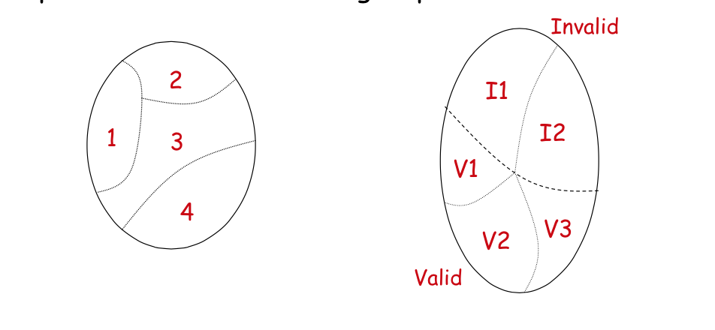
Partitioning
The input domain partitioned into region that are contained equally useful values for testing, and values are selected from each region.
    The partition must cover the entire domain (completeness)
    The blocks must not overlap (disjoint)

Slide 5
Input Domain Modeling (IDM)
Step 1: Identify the input domain
Read the requirements carefully and identify all input and output variables, any conditions associated with their use.
Step 2: Identify equivalence classes
Partition the set of values of each variable into disjoint subsets, based on the expected behavior.
Step 3: Combine equivalence classes.
Use some well-defined strategies to avoid potential explosion
Step 4: Remove infeasible combinations of equivalence classes

Slide 6
Different Approaches to IDM
Interface-Based IDM
Strength:
Easy to identify characteristics
Easy to translate abstract test cases to concrete test case
Weakness
IDM may be incomplete
Each parameter analyzed in isolation so that important sub combination may be missed

Slide 7
Different Approaches to IDM
functionality-Based IDM
Strength:
Use semantics and domain knowledge
Requirements are available so test cases generation can start early
Weakness
Hard to identify characteristics
Hard to translate abstract test cases to concrete test cases

Slide 8
Example
public boolean findElement (List list, Element element)
//If list or element is null throw NullPointerException else returns true if element is in the list , false otherwise

Slide 9
List Characteristics
Interface-based
Characteristics | Blocks and Values
List is null | b1 = true
 | b2 = false
List is empty | b1 = true
 | b2 = false
Functionality-based
Characteristics | Blocks and Values
Number of occurrences of element in list | b1 = 0
 | b2 = 1
 | b3 = more than 1
Element occurs first in list | b1 = true
 | b2 = false

Slide 10
Identify Characteristics
The interface-based approach develops characteristics directly from input parameters
The functionality-based approach develops characteristics from functional or behavioral view

Slide 11
Choosing Block and Values
Valid values
Boundaries
Normal use
Invalid values
Special values
Missing partitions
Overlapping partitions

Slide 12
Functionality-Based
Geometric partitioning of TriTyp’s inputs
Partition | b1 | b2 | b3 | b4
Geometric Classification | Scalene | Isosceles | Equilateral | invalid
Geometric partitioning of TriTyp’s inputs
Partition | b1 | b2 | b3 | b4
Geometric Classification | Scalene | Isosceles, not equilateral | Equilateral | invalid
Geometric partitioning of TriTyp’s inputs
Partition | b1 | b2 | b3 | b4
triangle | (4,5,6) | (3,3,4) | (3,3,3) | (3,4,8)

Slide 13
Recommended Approach
Scalene | Isosceles | Equilateral | Valid
true | true | true | true
false | false | false | false
The fact that choosing Equilateral = true also means choosing Isosceles = true is then simply a constraint.
This approach satisfies the disjointness and completeness properties.

Slide 14
Combination Strategies Criteria
The behavior of a software application may be affected by many factors, e.g., input parameters, environment configurations, and state variables.
Techniques like equivalence partitioning and boundary-value analysis can be used to identify the possible values of individual factors.
It is impractical to test all possible combinations of values of all those factors. (Why?)

Slide 15
Combinatorial Explosion
Assume that an application has 10 parameters, each of which can take 5 values. How many possible combinations?

Slide 16
Combinatorial Design
Instead of testing all possible combinations, a subset of combinations is generated to satisfy some well-defined combination strategies.
A key observation is that not every factor contributes to every fault, and it is often the case that a fault is caused by interactions among a few factors.
Combinatorial design can dramatically reduce the number of combinations to be covered but remains very effective in terms of fault detection.

Slide 17
Fault Model
A t-way interaction fault is a fault that is triggered by a certain combination of t input values
A simple fault is a t-way fault where t = 1; a pairwise fault is a t-way fault where t = 2.
In practice, a majority of software faults consist of simple and pairwise faults.

Slide 18
Example – Pairwise Fault
begin
int x, y, z;
input (x, y, z);
if (x == x1 and y == y2)
output (f(x, y, z));
else if (x == x2 and y == y1)
output (g(x, y));
else
output (f(x, y, z) + g(x, y))
End
Expected: x = x1 and y = y1 => f(x, y, z) – g(x, y); x = x2, y = y2 => f(x, y, z) + g(x, y)

Slide 19
Example – 3-way Fault
// assume x, y ! {-1, 1}, and z ! {0, 1}
begin
int x, y, z, p;
input (x, y, z);
p = (x + y) * z // should be p = (x – y) * z
if (p >= 0)
output (f(x, y, z));
else
output (g(x, y));
end

Slide 20
All Combinations Coverage
Every possible combination of values of the parameters must be covered
For example, if we have three parameters P1 = (A, B), P2 = (1, 2, 3), and P3 = (x, y), then all combinations coverage requires 12 tests: {(A, 1, x), (A, 1, y), (A, 2, x), (A, 2, y), (A, 3, x), (A, 3, y), (B, 1, x), (B, 1, y), (B, 2, x), (B, 2, y), (B, 3, x), (B, 3, y)}

Slide 21
Each Choice Coverage
Each parameter value must be covered in at least one test case.
Consider the previous example, a test set that satisfies each choice coverage is the following: {(A, 1, x), (B, 2, y), (A, 3, x)}

Slide 22
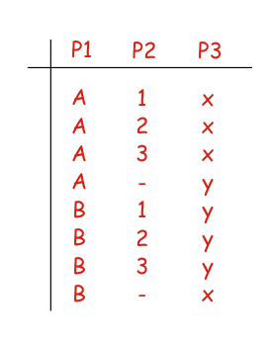
Pairwise Coverage
Given any two parameters, every combination of values of these two parameters are covered in at least one test case.
A pairwise test set of the previous example is:

Slide 23
T-Wise Coverage
Given any t parameters, every combination of values of these t parameters must be covered in at least one test case.
For example, a 3-wise coverage requires every triple be covered in at least one test case.
Note that all combinations, each choice, and pairwise coverage can be considered to be a special case of t-wise coverage.

Slide 24
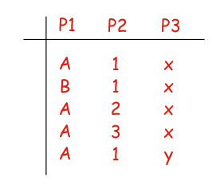
Base Choice Coverage
For each parameter, one of the possible values is designated as a base choice of the parameter
A base test is formed by using the base choice for each parameter
Subsequent tests are chosen by holding all base choices constant, except for one, which is replaced using a non-base choice of the corresponding parameter:

Slide 25
Multiple Base Choices Coverage
At least one, and possibly more, base choices are designated for each parameter.
The notions of a base test and subsequent tests are defined in the same as Base Choice.

Slide 26
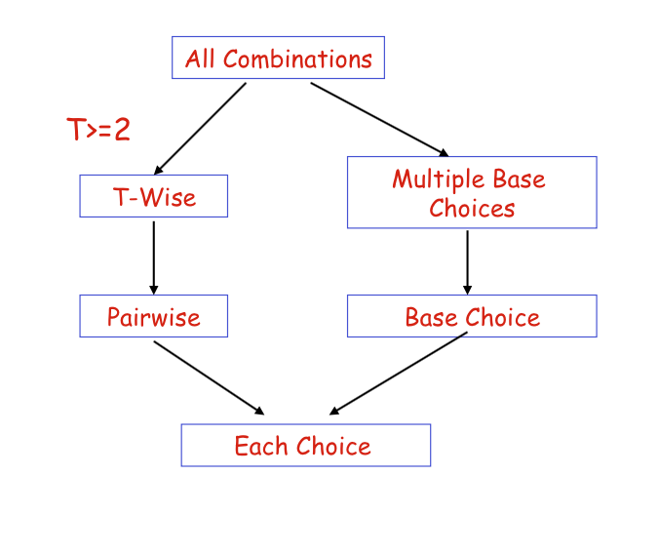
Subsumption Relation

Slide 27
Pairwise Test Generation
Why Pairwise?
Many faults are caused by the interactions between two parameters
  92% statement coverage, 85% branch coverage
Not practical to cover all the parameter interactions
  Consider a system with n parameter, each with m values. How many interactions to be covered?
A trade-off must be made between test effort and fault detection
  For a system with 20 parameters each with 15 values, pairwise testing only requires less than 412 tests, whereas exhaustive testing requires 1520 tests.

Slide 28
Example
Consider a system with the following parameters and values:
parameter A has values A1 and A2
parameter B has values B1 and B2, and
parameter C has values C1, C2, and C3

Slide 29
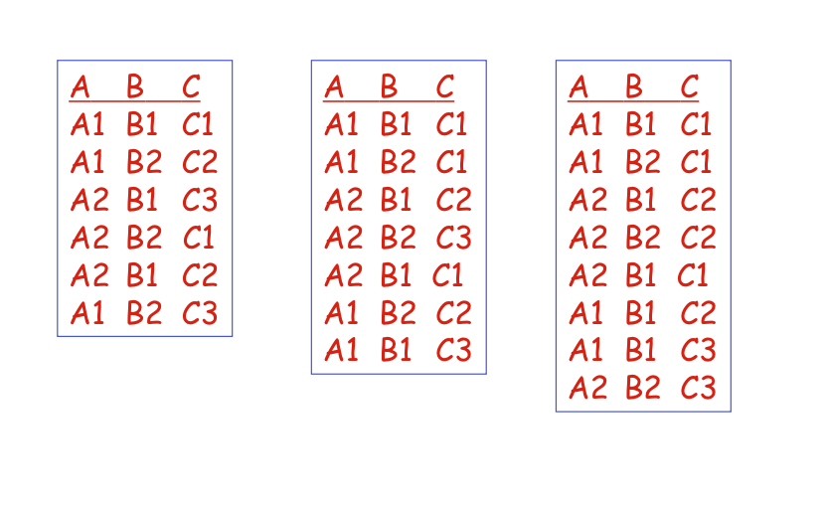
Example cont.,

Slide 30
The IPO Strategy
First generate a pairwise test set for the first two parameters, then for the first three parameters, and so on
A pairwise test set for the first n parameters is built by extending the test set for the first n – 1 parameters
  Horizontal growth: Extend each existing test case by adding one value of the new parameter
  Vertical growth: Adds new tests, if necessary

Slide 31
Summary
Combinatorial testing makes an excellent trade- off between test effort and test effectiveness.
Pairwise testing can often reduce the number of dramatically, but it can still detect faults effectively.
The IPO strategy constructs a pairwise test set incrementally, one parameter at a time.
In practice, some combinations may be invalid from the domain semantics, and must be excluded, e.g., by means of constraint processing.

