Slide 1
STAR
Laboratory of Advanced Research on Software Technology
Understanding Your Code
in a More Cost-Effective Way
W. Eric Wong
Department of Computer Science
The University of Texas at Dallas
ewong@utdallas.edu
http://www.utdallas.edu/~ewong
Understanding Your Code in a More Cost-Effective Way (© 2012 Professor W. Eric Wong, The University of Texas at Dallas)

Slide 2

Speaker Biographical Sketch
Professor & Director of International Outreach
Department of Computer Science
University of Texas at Dallas
Guest Researcher
Computer Security Division
National Institute of Standards and Technology (NIST)
Vice President, IEEE Reliability Society
Secretary, ACM SIGAPP (Special Interest Group on Applied Computing)
Principal Investigator, NSF TUES (Transforming Undergraduate Education in Science, Technology, Engineering and Mathematics) Project
  Incorporating Software Testing into Multiple Computer Science and Software Engineering Undergraduate Courses
Founder & Steering Committee co-Chair for the SERE conference
(IEEE International Conference on Software Security and Reliability)
(http://paris.utdallas.edu/sere13)
Understanding Your Code in a More Cost-Effective Way (© 2012 Professor W. Eric Wong, The University of Texas at Dallas)

Slide 3
Outline
Locating Program Features using Execution Slices
Quantifying the Disparity, Concentration, and Dedication between Program Components and Features
Measuring Distance between Program Features
Understanding Your Code in a More Cost-Effective Way (© 2012 Professor W. Eric Wong, The University of Texas at Dallas)

Slide 4


PART I
Locating Program Features using
Execution Slices
W. E. Wong, S. S. Gokhale, J. R. Horgan, and K. S. Trivedi, “Locating Program Features using Execution Slices,” in Proceedings of the Second IEEE Symposium on Application-Specific Systems and Software Engineering Technology, pp. 194-203, Richardson, Texas, March, 1999.
Click on the following pdf icon to download the paper

Slide 5
What is a Feature
A feature is an abstract description of a functionality given in the specification
  Example: the ATM software has three features
    Withdraw
    Deposit
    Balance
  Example: the UNIX wordcount program has three features
    Number of lines, words, characters
Understanding Your Code in a More Cost-Effective Way (© 2012 Professor W. Eric Wong, The University of Texas at Dallas)

Slide 6
Do You Understand Customer Feedback
Requirement changes and enhancement requests are usually specified in terms of features affected, not in terms of software components that must be modified
Example: A telephone switch
  Call Setup
  Call Waiting
  Speed Dialing
Understanding Your Code in a More Cost-Effective Way (© 2012 Professor W. Eric Wong, The University of Texas at Dallas)

Slide 7
Here is How
Software developers must locate and understand the code associated with the affected features before they can translate change requests into code change
Features
Software components
mapping
Understanding Your Code in a More Cost-Effective Way (© 2012 Professor W. Eric Wong, The University of Texas at Dallas)

Slide 8
Software Structure from the Program Feature Point of View
Well-designed Software Systems
  A high degree of cohesion
    A cohesive module should ideally do just one thing
  A low degree of coupling
  Each module addresses a specific subfunction of the requirements and has a simple interface when viewed from other parts of the program structure
  A clear mapping between each feature and its corresponding code segments
Software systems in the real world
  Low cohesion & high coupling
  Program features are mixed together in the code – across modules which are seemingly unrelated
Understanding Your Code in a More Cost-Effective Way (© 2012 Professor W. Eric Wong, The University of Texas at Dallas)

Slide 9
A Challenge
In a complex software system it is not unusual to find that modifications made to one feature, which can be viewed as a functionality of the system, have adverse impacts on other seemingly unrelated features
Such impacts can subsequently change the behavior of those features and cause a system failure
Need a good understanding of the system
Understanding Your Code in a More Cost-Effective Way (© 2012 Professor W. Eric Wong, The University of Texas at Dallas)

Slide 10
Objective
Locate program code relevant to a particular feature in order to provide software programmers and maintainers with a good starting point for quick program understanding
  Develop novel heuristics and experiment with them to identify
    Code unique to the given feature
    Code common to the given feature and others
  Examine factors which affect the code so identified
Understanding Your Code in a More Cost-Effective Way (© 2012 Professor W. Eric Wong, The University of Texas at Dallas)

Slide 11
Three Different Approaches
Systematic
  Provides a good understanding
  Impractical for large complicated systems
As-needed
  Less expensive and less time-consuming
  Miss some non-local interactions between features
Execution Slice-based
  An execution slice is the set of program components (blocks, decisions, c-uses, or p-uses) executed by a test input
Qualitative description versus quantitative measurement
Understanding Your Code in a More Cost-Effective Way (© 2012 Professor W. Eric Wong, The University of Texas at Dallas)

Slide 12
Reading Documentation Does Not Work
Does not exist
Incomplete and difficult to understand
Not updated
Implementation spread across several non-adjacent modules
Do not want to read it
Understanding Your Code in a More Cost-Effective Way (© 2012 Professor W. Eric Wong, The University of Texas at Dallas)

Slide 13
A Factor to Consider
Most software development projects have a set of regression tests to help find bugs in the next release. But these tests can be used for more than just finding errors.
Understanding Your Code in a More Cost-Effective Way (© 2012 Professor W. Eric Wong, The University of Texas at Dallas)

Slide 14
A Better Strategy
Instead of spending time trying to understand the system,
let the system tell you how it works.
Understanding Your Code in a More Cost-Effective Way (© 2012 Professor W. Eric Wong, The University of Texas at Dallas)

Slide 15
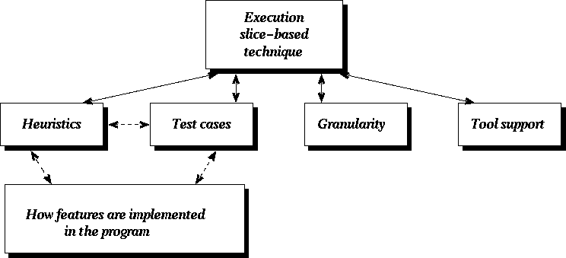
Execution Slice-Based Technique
Code identified depends on which heuristic is applied, which by itself is affected not only by how invoking and excluding tests are selected but also how the features are implemented in the program.
Understanding Your Code in a More Cost-Effective Way (© 2012 Professor W. Eric Wong, The University of Texas at Dallas)

Slide 16
Definitions: Invoking & Excluding Tests
For a given program P and a feature F
  An invoking test is a test that when executed on P shows the functionality of F
  Example
    P: The wordcount program (wc)
    F: The functionality to count the number of characters
      ‘‘wc -c data’’ (say t₁) is an invoking test
  An excluding test is one that does not
      ‘‘wc -w data’’ is an excluding test
  An invoking test is focused on F if it exhibits only F and no other features
      t₁ is a focused invoking test
      ‘‘wc data’’ is NOT because in addition to the number of characters, it also returns the number of words and lines
Understanding Your Code in a More Cost-Effective Way (© 2012 Professor W. Eric Wong, The University of Texas at Dallas)

Slide 17
Number of Tests Required
Do not need to use all the invoking and excluding tests for a given P and F
T = {a few carefully selected test cases}
  A few invoking tests (preferred to be the focused ones)
  A few excluding tests
Three notations
  ∪_{invoking} = {code executed by at least one invoking test in T}
  ∪_{excluding} = {code executed by any tests in T that do not exhibit F}
  ∩_{invoking} = {code executed by every invoking test in T}
Understanding Your Code in a More Cost-Effective Way (© 2012 Professor W. Eric Wong, The University of Texas at Dallas)

Slide 18
Heuristics for Finding Code Unique to a Feature (1)
Only one invoking test and one excluding test
  Invoking test : the one with the smallest execution slice
  Excluding test : the one with the largest execution slice
∩_{invoking} − ∪_{excluding} = {code that is commonly executed by all invoking tests but not any excluding test}
  Example
    F_{α} can only be exhibited if either F_{β} or F_{γ} is also exhibited
      All the invoking tests for F_{α} must also exhibit at least F_{β} or F_{γ} and perhaps many other features.
      F_{α} has no focused invoking tests.
    Use ∩_{invoking} − ∪_{excluding} to find the code that is uniquely related to F_{α}
Understanding Your Code in a More Cost-Effective Way (© 2012 Professor W. Eric Wong, The University of Texas at Dallas)

Slide 19
Heuristics for Finding Code Unique to a Feature (2)
∪_{invoking} − ∪_{excluding} = {code that is executed by any invoking test but not by any excluding test}
  Example
    F_{α} is not bundled with F_{β} or F_{γ} in the way just described.
    F_{α} can be exhibited by itself without other features being exhibited simultaneously
Understanding Your Code in a More Cost-Effective Way (© 2012 Professor W. Eric Wong, The University of Texas at Dallas)

Slide 20
Heuristics for Finding Code Common to Features
Code common to F₁ and F₂ is what is executed by at least a test that exhibits only F₁ and not F₂, and at least a test that exhibits only F₂ and not F₁
  ∪_{invoking} for F₁ = {code executed by tests which exhibit only F₁ and no other features (or at least not F₂)}
  ∪_{invoking} for F₂ = {code executed by tests which exhibit only F₂ and no other features (or at least not F₁)}
  Code common to F₁ and F₂ = (∪_{invoking} for F₁) ∩ (∪_{invoking} for F₂)
Code common to F₁ and F₂ is what is executed by at least a test that exhibits only F₁ and not F₂, and at least a test that exhibits only F₂ and not F₁
  ∪_{invoking} for F₁ = {code executed by tests which exhibit only F₁ and no other features (or at least not F₂)}
  ∪_{invoking} for F₂ = {code executed by tests which exhibit only F₂ and no other features (or at least not F₁)}
  Code common to F₁ and F₂ = (∪_{invoking} for F₁) ∩ (∪_{invoking} for F₂)
Understanding Your Code in a More Cost-Effective Way (© 2012 Professor W. Eric Wong, The University of Texas at Dallas)

Slide 21
Selecting Invoking and Excluding Tests (1)
Different sets of code may be identified by different sets of invoking and excluding tests
Poorly selected tests will lead to inaccurate identification
  Example
    Including code that is not unique to a given feature
    Excluding code that should not be excluded
Find code unique to a given feature
  Invoking tests should be focused on the feature being located, if possible
  Excluding tests should be as similar (in terms of execution slice) as possible to the invoking tests in order to filter out as much common code as possible
Understanding Your Code in a More Cost-Effective Way (© 2012 Professor W. Eric Wong, The University of Texas at Dallas)

Slide 22
Selecting Invoking and Excluding Tests (2)
Find code common to a group of features
  For each feature, its invoking tests should be focused with respect to this feature, if possible
  The invoking tests for a feature should be as dissimilar (in terms of execution slice) as possible to the invoking tests for other features
  in the group in order to exclude as much uncommon code as possible
Understanding Your Code in a More Cost-Effective Way (© 2012 Professor W. Eric Wong, The University of Texas at Dallas)

Slide 23
Components
Program components can be files, functions, blocks, decisions, c-uses, and p-uses
Understanding Your Code in a More Cost-Effective Way (© 2012 Professor W. Eric Wong, The University of Texas at Dallas)

Slide 24
Requirements for Using χVue
χVue is part of χSuds (a Software Understanding and Diagnosis System) developed at Telcordia (formerly Bellcore)
Effective use of χVue requires only that the programmer has a basic understanding of the program’s features and can identify some invoking
as well as excluding tests
By default, every test is in the dont_know category
Understanding Your Code in a More Cost-Effective Way (© 2012 Professor W. Eric Wong, The University of Texas at Dallas)

Slide 25
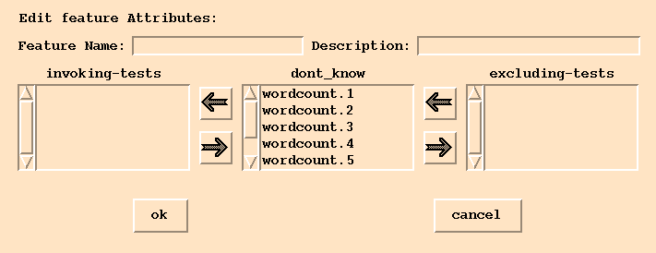
Visualizing Features in Code Using χVue (1)
Slice 15 (counting characters of the wordcount program)
Chapter 12 of the χSuds User’s Manual
Understanding Your Code in a More Cost-Effective Way (© 2012 Professor W. Eric Wong, The University of Texas at Dallas)

Slide 26
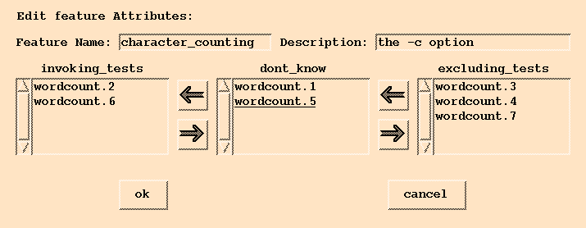
Visualizing Features in Code Using χVue (2)
Understanding Your Code in a More Cost-Effective Way (© 2012 Professor W. Eric Wong, The University of Texas at Dallas)

Slide 27
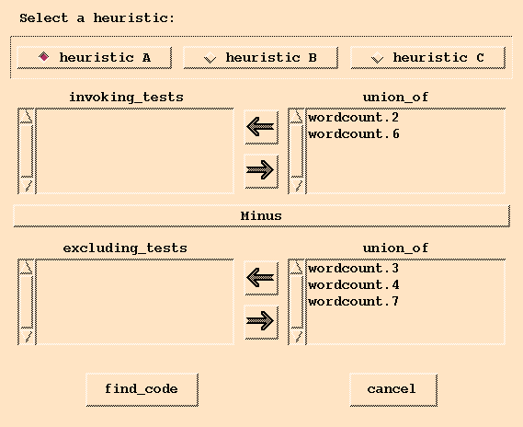
Visualizing Features in Code Using χVue (3)
Understanding Your Code in a More Cost-Effective Way (© 2012 Professor W. Eric Wong, The University of Texas at Dallas)

Slide 28
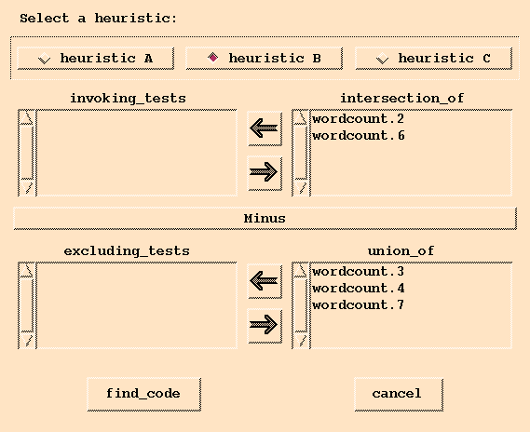
Visualizing Features in Code Using χVue (4)
Understanding Your Code in a More Cost-Effective Way (© 2012 Professor W. Eric Wong, The University of Texas at Dallas)

Slide 29
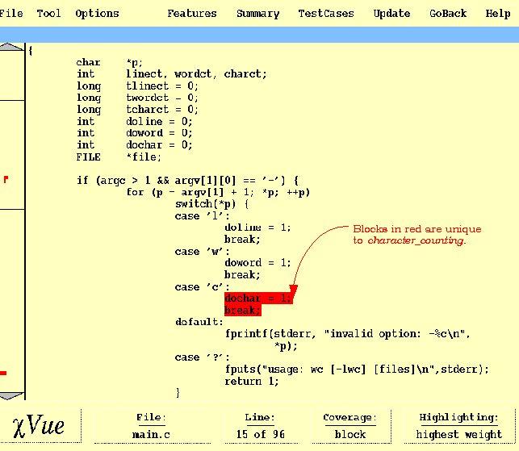
Visualizing Features in Code Using χVue (5)
Understanding Your Code in a More Cost-Effective Way (© 2012 Professor W. Eric Wong, The University of Texas at Dallas)

Slide 30
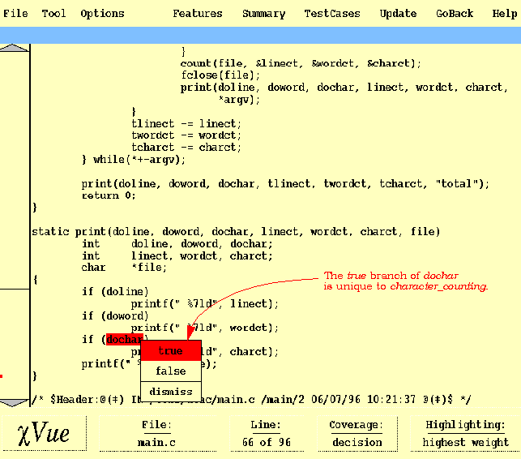
Visualizing Features in Code Using χVue (6)
Understanding Your Code in a More Cost-Effective Way (© 2012 Professor W. Eric Wong, The University of Texas at Dallas)

Slide 31
A Case Study on SHARPE
SHARPE
  A Symbolic Hierarchical Automated Reliability and
  Performance Evaluator
  35,412 lines of C code in 30 files
  373 functions
  Examined five features are studied
    MC (Markov Chain) (f₁)
    MRM (Markov Reward Models) (f₂)
    GSPN (Generalized Stochastic Petri-Nets) (f₃)
    PFQN (Product-Form Queuing Networks) (f₄)
    FT (Fault Trees) (f₅)
Understanding Your Code in a More Cost-Effective Way (© 2012 Professor W. Eric Wong, The University of Texas at Dallas)

Slide 32
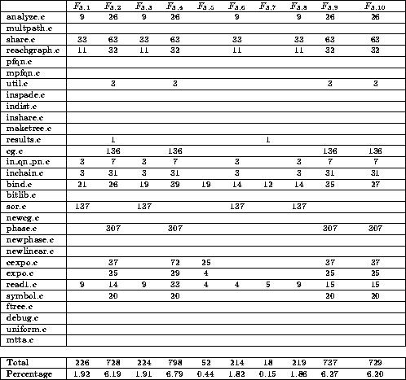
Number of Blocks Unique to F_{3,j} (1 ≤ j ≤ 10)
A blank entry means no block in the corresponding file is unique to the specified feature
Only a small percentage of blocks are selected
Understanding Your Code in a More Cost-Effective Way (© 2012 Professor W. Eric Wong, The University of Texas at Dallas)

Slide 33
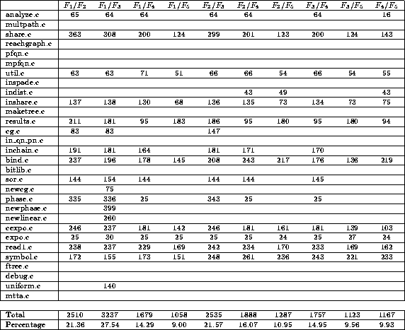
Number of Blocks Common to Each Pair of Features
The notation F₁/F₂ indicates code common to features F₁ and F₂
A blank entry means
no common block in
the corresponding file
Understanding Your Code in a More Cost-Effective Way (© 2012 Professor W. Eric Wong, The University of Texas at Dallas)

Slide 34
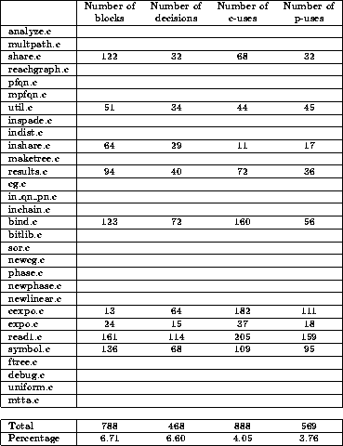
Code Common to All Five Features
A blank entry means no common code in the corresponding file
Understanding Your Code in a More Cost-Effective Way (© 2012 Professor W. Eric Wong, The University of Texas at Dallas)

Slide 35
Verification with SHARPE Experts
The identified files, functions, blocks, and decisions are either unique to a feature as they should be or shared by a pair of features or common to all five features.
No complete verification was done with respect to the identified c-uses and p-uses
  Very difficult for humans to have a complete understanding of a complicated system at such a fine granularity
  Some identified c-uses and p-uses are verified and agreed on by the experts
Need more objective verification
  Ask experts to highlight code segments they think are important to each feature
  Different segments might be highlighted by different people
  Need to summarize such divergent information
Understanding Your Code in a More Cost-Effective Way (© 2012 Professor W. Eric Wong, The University of Texas at Dallas)

Slide 36
Conclusion (PART I)
Code identified using the execution slice-based technique (either unique to a feature or common to a group of features) can be used as a good starting point for studying program features
  C-uses and p-uses provide an in-depth understanding
This technique may not find all relevant code that makes up a feature
Apply to the Y2K problems
  Identify ‘‘date-sensitive’’ code which may be only a few lines in a system consisting of millions of lines of code
Extend to Program Debugging
  ‘‘Invoking tests’’ correspond to the ‘‘failed tests’’
  ‘‘Excluding tests’’ correspond to the ‘‘successful tests’’
Understanding Your Code in a More Cost-Effective Way (© 2012 Professor W. Eric Wong, The University of Texas at Dallas)

Slide 37
PART II
Quantifying the Disparity, Concentration, and Dedication between Program Components and
Features
W. Eric Wong, Swapna S. Gokhale, and Joseph R. Horgan, “Quantifying the closeness between program components and features,” Journal of Systems and Software, Volume 54, Issue 2, pp. 87-98, October 2000
Click on the following pdf icon to download the paper

Slide 38
Objective
Measure, in a quantitative way, the closeness between a feature and a program component
  Example:
    How much of the code in a program component is used to implement a given feature?
    50%, 70%, or more than 90%?
Previous studies highlight code that is uniquely related to a given feature.
  Can be used as good starting points for locating program features
  Does not identify where the majority of the code related to a given feature resides
Metrics proposed
  Provide a much more complete picture of how a feature spreads over a software system
Understanding Your Code in a More Cost-Effective Way (© 2012 Professor W. Eric Wong, The University of Texas at Dallas)

Slide 39
Three Metrics
Disparity: measures how close a feature is to a program component
Concentration: shows how much a feature is concentrated in a program component
Dedication: indicates how much a program component is dedicated to a feature
Understanding Your Code in a More Cost-Effective Way (© 2012 Professor W. Eric Wong, The University of Texas at Dallas)

Slide 40
Represent a Feature Using a Set of Blocks
Represent an abstract feature in terms of some concrete program elements
Use the union of the execution slices of invoking inputs to find a set of code that is used to implement a given feature
  Theoretically, we may need to use all the invoking inputs for a given program and feature
  In practice, this is impossible and unnecessary
  An alternative is to use a good set of focused invoking inputs (which can be obtained from the regression test suite) to identify most of the code that is used to implement the feature
Understanding Your Code in a More Cost-Effective Way (© 2012 Professor W. Eric Wong, The University of Texas at Dallas)

Slide 41
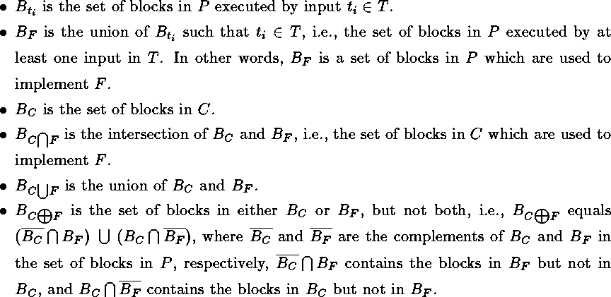
Notation
Let P be a program, F a feature of P, C a component of P, and T a small set of carefully selected invoking inputs with the focus on F
Understanding Your Code in a More Cost-Effective Way (© 2012 Professor W. Eric Wong, The University of Texas at Dallas)

Slide 42

Disparity Metric: DISP_{CF}
DISP_{CF}
0 ≤ DISP_{CF} ≤ 1
Inversely proportional to the number of blocks in B_{C∩F}
  When C and F share more common blocks, their disparity should be smaller
Proportional to the number of blocks in B
  The more blocks in either B_{C} or B_{F}, but not both, the larger the disparity between C and F
DISP_{CF} = 1 if and only if there is no common block between B_{C} and B_{F}
  B_{C∩F} = φ
DISP_{CF} = 0 if and only if feature F is totally implemented in component C and every block in C is used to implement F
  B_{C∩F} = B_{C∪F} (i.e., B_{C} = B_{F})
Understanding Your Code in a More Cost-Effective Way (© 2012 Professor W. Eric Wong, The University of Texas at Dallas)

Slide 43

Concentration Metric: CONC_{FC}
CONC_{FC} =
0 ≤ CONC_{FC} ≤ 1
Inversely proportional to the number of blocks in B_{F}
  When B_{F} has more blocks, it is less likely for all the blocks to reside in the same component
Proportional to the number of blocks in B_{C∩F}
  When C and F have more blocks in common, they have a bigger commitment to each other
CONC_{FC} = 1 if and only if all the blocks used to implement F are in C
CONC_{FC} = 0 if and only if none of these blocks is in C
Understanding Your Code in a More Cost-Effective Way (© 2012 Professor W. Eric Wong, The University of Texas at Dallas)

Slide 44

Dedication Metric: DEDI_{CF}
DEDI_{CF} =
0 ≤ DEDI_{CF} ≤ 1
Inversely proportional to the number of blocks in B_{C}
  When B_{C} has more blocks, it is more likely that some of these blocks have nothing to do with F
Proportional to the number of blocks in B_{C∩F}
  When C and F have more blocks in common, they have a bigger commitment to each other
DEDI_{CF} = 1 if and only if all the blocks in C are used to implement F
DEDI_{CF} = 0 if and only if none of these blocks has anything to do with F
Understanding Your Code in a More Cost-Effective Way (© 2012 Professor W. Eric Wong, The University of Texas at Dallas)

Slide 45
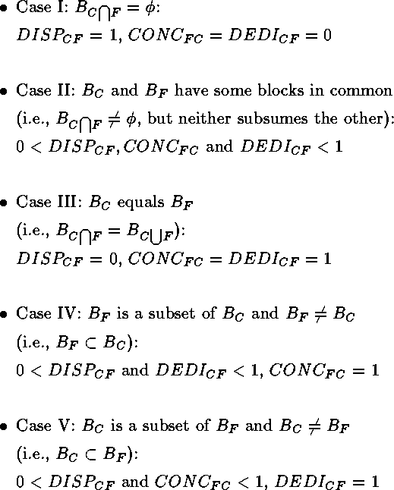
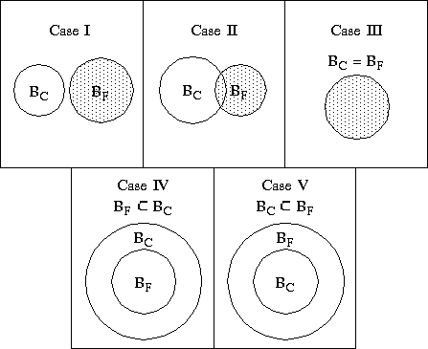
Possible Relationship between B_{F} and B_{C}
Understanding Your Code in a More Cost-Effective Way (© 2012 Professor W. Eric Wong, The University of Texas at Dallas)

Slide 46
DISP_{CF} , CONC_{FC} and DEDI_{CF}
A 100% concentration or a 100% dedication does not guarantee a zero disparity between F and C
Disparity is 0 if and only if both concentration and dedication are 100%,
(i.e., B_{F} = B_{C})
Disparity is 1 if and only if both concentration and dedication are 0,
(i.e., B_{C∩F} = φ)
If CONC_{FC} ≠ 0 (i.e., B_{C∩F} ≠ φ ) then DEDI_{CF} ≠ 0, and vice versa
If CONC_{FC} = 0 (i.e., B_{C∩F} = φ ) then DEDI_{CF} = 0, and vice versa
Understanding Your Code in a More Cost-Effective Way (© 2012 Professor W. Eric Wong, The University of Texas at Dallas)

Slide 47
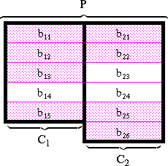
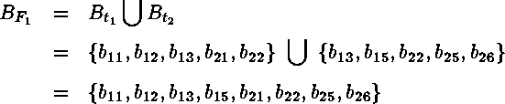
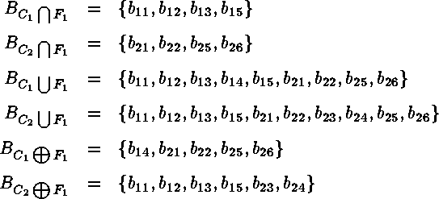
Example (1)
2 components C₁ and C₂
2 features F₁ and F₂
2 invoking inputs (t₁ and t₂) focused on F₁
Assume
We have
Each cell in the diagram is
a block. The pink ones are
related to the feature F₁
Understanding Your Code in a More Cost-Effective Way (© 2012 Professor W. Eric Wong, The University of Texas at Dallas)

Slide 48
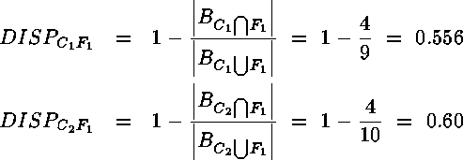
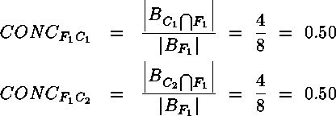
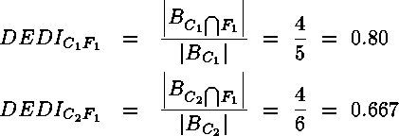
Example (2)
The disparity
The concentration
The dedication
Understanding Your Code in a More Cost-Effective Way (© 2012 Professor W. Eric Wong, The University of Texas at Dallas)

Slide 49
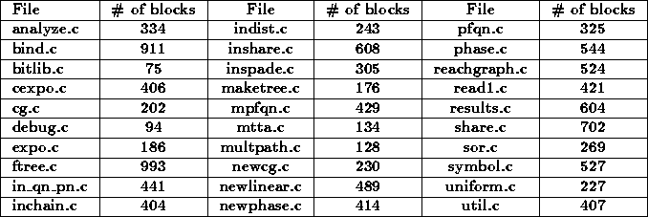
A Case Study on SHARPE
First developed in 1986
35,412 lines of C code in 30 files
373 functions and 11752 blocks
Six features
  MC (Markov Chain)
  FT (Fault Trees)
  GSPN (Generalized Stochastic Petri-Nets)
  PFQN (Product-Form Queuing Networks)
  RELG (Reliability Graphs)
  MRM (Markov Reward Models)
Understanding Your Code in a More Cost-Effective Way (© 2012 Professor W. Eric Wong, The University of Texas at Dallas)

Slide 50
Data Collection
Each c file as a separate program component
A set of invoking inputs focused on each feature was carefully selected from the regression test suite of SHARPE
  Advantages of using regression tests
    They were real inputs used during the integration and system testing
    There exist clear descriptions for many of these tests, which made it very easy to select invoking inputs focused on a given feature
Execution slice in terms of blocks of each of these inputs was computed
Computed also were B_{F} for each of the six features and B_{C} for each of the 30 files of SHARPE
Using B_{F}’s and B_{C}'s, compute DEDI_{CF} , CONC_{FC} and DISP_{CF} with respect to every possible pair of F and C
Understanding Your Code in a More Cost-Effective Way (© 2012 Professor W. Eric Wong, The University of Texas at Dallas)

Slide 51
Data Verification
Need an oracle
  Design documentation
    Well-designed system: a clear mapping between each feature and its corresponding code segments
  Experts who have a good knowledge of the system being analyzed
    May not exist
    Time consuming & not affordable
    How to summarize divergent information
Present each B_{F} to experts who are familiar with SHARPE
  The identified blocks are used to implement the designated feature as they should be
  No additional block that has to be added to each B_{F}
Understanding Your Code in a More Cost-Effective Way (© 2012 Professor W. Eric Wong, The University of Texas at Dallas)

Slide 52
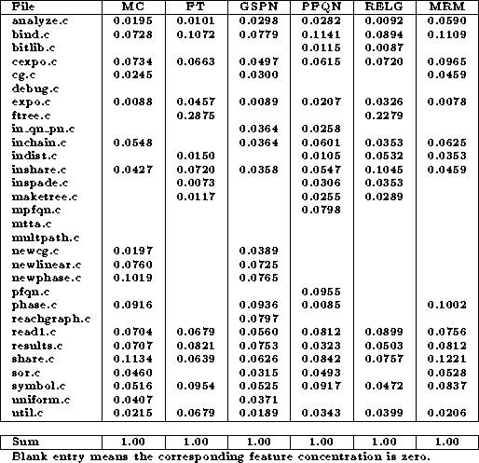
Feature Concentration in Components
Understanding Your Code in a More Cost-Effective Way (© 2012 Professor W. Eric Wong, The University of Texas at Dallas)

Slide 53
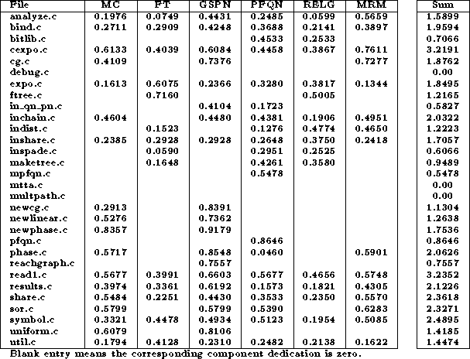
Component Dedication to Features
Understanding Your Code in a More Cost-Effective Way (© 2012 Professor W. Eric Wong, The University of Texas at Dallas)

Slide 54
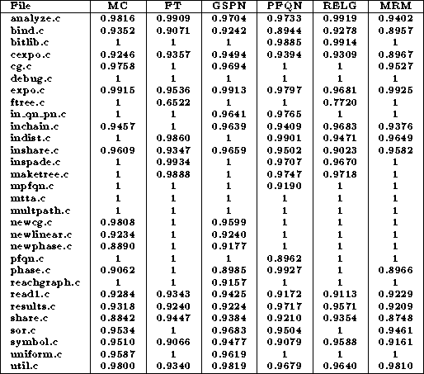
Disparity between Features and Components
Understanding Your Code in a More Cost-Effective Way (© 2012 Professor W. Eric Wong, The University of Texas at Dallas)

Slide 55
Conclusion (PART II) (1)
SHARPE has a very delocalized structure with features spread over many files
  For a given feature, in general, it has less than 8% concentration in a file
  For a given file, if it is used to implement a feature, it normally has at least 20% of its blocks dedicated to this feature
  Why?
    Features are incrementally incorporated into SHARPE, rather than planned in the original design
Understanding Your Code in a More Cost-Effective Way (© 2012 Professor W. Eric Wong, The University of Texas at Dallas)

Slide 56
Conclusion (PART II) (2)
Three metrics are proposed (disparity, concentration and dedication) to provide a good quantitative measure of the closeness between a feature and a program component
Help programmers capture more precisely where each feature resides in the system
  A quantitative measure computed based on carefully defined metrics versus a qualitative understanding obtained from intuitive feeling
Our metrics are complementary to other program comprehension techniques to help software programmers better understand the system at hand
Understanding Your Code in a More Cost-Effective Way (© 2012 Professor W. Eric Wong, The University of Texas at Dallas)

Slide 57
PART III
Measuring Distance between Program Features
W. E. Wong and S. Gokhale, “Static and Dynamic Distance Metrics for Feature-Based Code Analysis,” Journal of Systems and Software, Volume 74, Number 3, pp. 283-295, February 2005
Click on the following pdf icon to download the paper

Slide 58
Objective
Develop a metric to determine the distance between features
  How are features of a system close to each other in a quantitative way?
    Is the distance between features α and β larger than that between β and γ?
    If so, how much larger?
  Provide a good start to understanding how a modification made to one feature is likely to affect other features
Understanding Your Code in a More Cost-Effective Way (© 2012 Professor W. Eric Wong, The University of Texas at Dallas)

Slide 59
Our Approach
Represent an abstract feature in terms of some concrete program elements
  Use an execution slice-based technique to identify a set of code (basic blocks in our case) that is used to implement each feature
    A basic block (also known as a block) is a sequence of consecutive code containing no branch such that if part of the code is executed, other code will also be executed
  An input is an invoking input with respect to a feature if, when executed on the program, it shows the functionality of that feature.
Compute distance between two features
  Static distance
    in terms of code that is used to implement these features
  Dynamic distance
    in terms of code that is executed by inputs which exhibit these features
Understanding Your Code in a More Cost-Effective Way (© 2012 Professor W. Eric Wong, The University of Texas at Dallas)

Slide 60
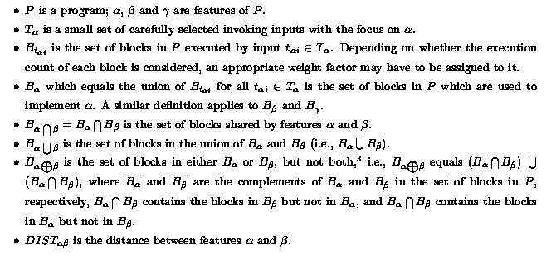
Notation
Understanding Your Code in a More Cost-Effective Way (© 2012 Professor W. Eric Wong, The University of Texas at Dallas)

Slide 61
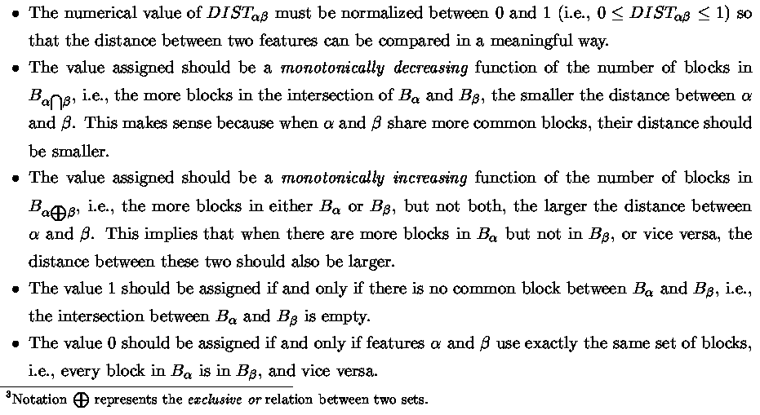
Properties
Understanding Your Code in a More Cost-Effective Way (© 2012 Professor W. Eric Wong, The University of Texas at Dallas)

Slide 62
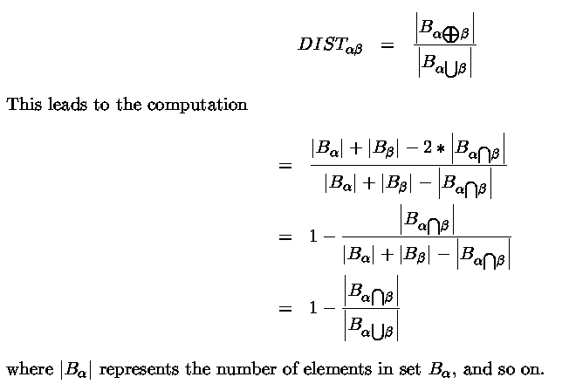
Distance Metric
Understanding Your Code in a More Cost-Effective Way (© 2012 Professor W. Eric Wong, The University of Texas at Dallas)

Slide 63
Three Axioms
DIST_{αα} = 0
DIST_{αβ} = DIST_{βα}
DIST_{αβ} + DIST_{βγ} >= DIST_{αγ}
Understanding Your Code in a More Cost-Effective Way (© 2012 Professor W. Eric Wong, The University of Texas at Dallas)

Slide 64
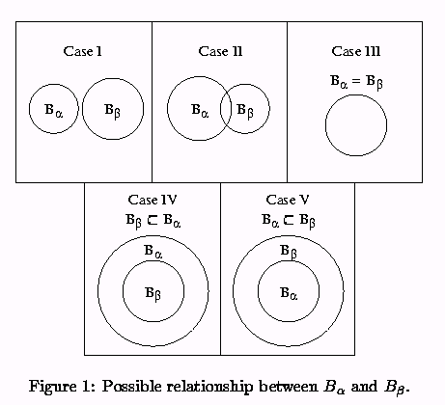
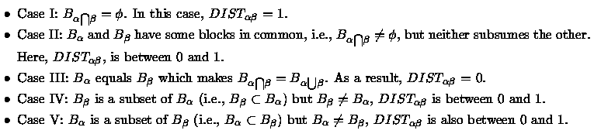
Observation
Understanding Your Code in a More Cost-Effective Way (© 2012 Professor W. Eric Wong, The University of Texas at Dallas)

Slide 65
Static Distance versus Dynamic Distance (1)
Depending on whether the execution frequency of each block is considered during the construction of the sets of code
  Static distance
    Only depends on how features are implemented in the system
    The execution frequency of each block is not used in computing the distance
  Dynamic distance
    Depends on how each feature is implemented
    Also takes into account how each feature is executed based on a user's operational profile
Static distance gives the closeness of two features from the system implementation point of view, whereas the dynamic distance presents such closeness from a user’s execution point of view
Understanding Your Code in a More Cost-Effective Way (© 2012 Professor W. Eric Wong, The University of Texas at Dallas)

Slide 66
Static Distance versus Dynamic Distance (2)
Static distance between two features is fixed once their implementation is completed, but the dynamic distance changes depending on how these features are executed
The dynamic distance computed using one user's operational profile can be different from that using another profile even though the corresponding static distance stays the same
Understanding Your Code in a More Cost-Effective Way (© 2012 Professor W. Eric Wong, The University of Texas at Dallas)

Slide 67
Static Distance versus Dynamic Distance (3)
If the static distance between two features is unity (i.e., no overlap in the implementation), the dynamic distance between these two features must also be unity
static distance = 1 ➔ dynamic distance = 1 (YES)
  Is the reverse true?
    Consider “error handling code” used for two features but not executed
      Dynamic distance equals one but not the static distance
      In general, do NOT expect this to happen
      dynamic distance = 1 ➔ static distance = 1 (not necessarily)
Understanding Your Code in a More Cost-Effective Way (© 2012 Professor W. Eric Wong, The University of Texas at Dallas)

Slide 68
Static Distance versus Dynamic Distance (4)
A zero static distance between two features (i.e., the same set of code is used to implement both features), does not necessarily give a zero dynamic distance
  Different blocks may have different execution counts
  static distance = 0 ➔ dynamic distance = 0 (not necessarily)
A zero dynamic distance between two features does not imply a zero static distance
  Different error handling routines are implemented for these two features.
  The dynamic distance can be zero if none of their invoking inputs trigger the errors.
  Nevertheless, after the error routines are taken into account, the static distance is greater than zero.
dynamic distance = 0 ➔ static distance = 0 (not necessarily)
Understanding Your Code in a More Cost-Effective Way (© 2012 Professor W. Eric Wong, The University of Texas at Dallas)

Slide 69
Static Distance versus Dynamic Distance (5)
For two given features, if their static distance is between zero and one, their dynamic distance, in general, is also between zero and one, and vice versa
A smaller static distance does not imply a smaller dynamic distance, and vice versa
A larger static distance does not imply a larger dynamic distance, and vice versa
Understanding Your Code in a More Cost-Effective Way (© 2012 Professor W. Eric Wong, The University of Texas at Dallas)

Slide 70
A Case Study on SHARPE (1)
A Symbolic Hierarchical Automated Reliability and Performance Evaluator
  35,412 lines of C code in 30 files
  373 functions
  Examined 5 features
    Fault Trees (FT) (f₁)
    Markov Chains (MC) (f₂)
    Generalized Stochastic Petri-Nets (GSPN) (f₃)
    Product-Form Queuing Networks (PFQN) (f₄)
    Reliability Graph (RELG) (f₅)
Understanding Your Code in a More Cost-Effective Way (© 2012 Professor W. Eric Wong, The University of Texas at Dallas)

Slide 71
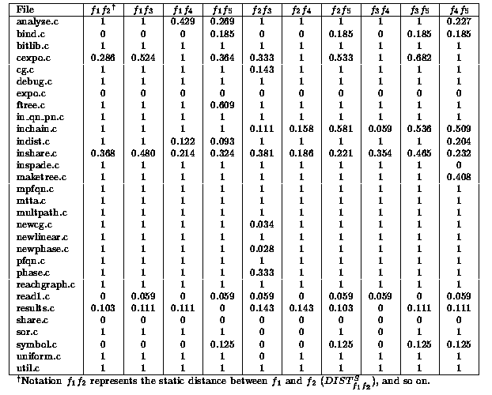
Static Distance between Each Pair of Features in SHARPE
Understanding Your Code in a More Cost-Effective Way (© 2012 Professor W. Eric Wong, The University of Texas at Dallas)

Slide 72
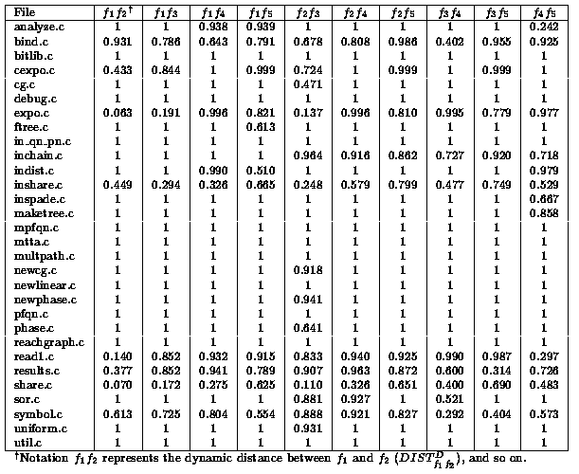
Static Distance between Each Pair of Features in SHARPE
Understanding Your Code in a More Cost-Effective Way (© 2012 Professor W. Eric Wong, The University of Texas at Dallas)

Slide 73
A Case Study on SHARPE (2)
SHARPE has a very delocalized structure with features spread over many files
  Confirmed by those who are very familiar with SHARPE
    Features are incrementally incorporated into SHARPE, rather than planned in the original design
Provide quantitative measurements (both static and dynamic) to help programmers accurately capture how far two features are from each other rather than rely on some intuitive feel for the system which provides only a qualitative description of whether two features are close to each other.
Understanding Your Code in a More Cost-Effective Way (© 2012 Professor W. Eric Wong, The University of Texas at Dallas)

Slide 74
Conclusion (PART III)
Our metrics can be used to measure the distance between two features
The distance measurement can serve as a good starting point to understanding how a modification made to one feature is likely to affect other features
  DIST_{αβ} << DIST_{αγ} ➔ modifications to α can very possibly have a higher impact on β than on γ
Allow programmers to understand the possibility for interactions between features from a different perspective
Our next step is to investigate how our metrics complement other methodologies for better detecting of interactions between program features
Understanding Your Code in a More Cost-Effective Way (© 2012 Professor W. Eric Wong, The University of Texas at Dallas)

Slide 75
Overall Conclusion
A set of techniques are developed to help programmers understand their code in a more cost effective way
Understanding Your Code in a More Cost-Effective Way (© 2012 Professor W. Eric Wong, The University of Texas at Dallas)

