Slide 1
STAR
Laboratory of Advanced Research on Software Technology
Source Code-based Risk Analysis
W. Eric Wong
Department of Computer Science
The University of Texas at Dallas
ewong@utdallas.edu
http://www.utdallas.edu/~ewong
Source Code-based Risk Analysis (© 2012 Professor W. Eric Wong, The University of Texas at Dallas)

Slide 2

Speaker Biographical Sketch
Professor & Director of International Outreach
Department of Computer Science
University of Texas at Dallas
Guest Researcher
Computer Security Division
National Institute of Standards and Technology (NIST)
Vice President, IEEE Reliability Society
Secretary, ACM SIGAPP (Special Interest Group on Applied Computing)
Principal Investigator, NSF TUES (Transforming Undergraduate Education in Science, Technology, Engineering and Mathematics) Project
  Incorporating Software Testing into Multiple Computer Science and Software Engineering Undergraduate Courses
Founder & Steering Committee co-Chair for the SERE conference
(IEEE International Conference on Software Security and Reliability)
(http://paris.utdallas.edu/sere13)
Source Code-based Risk Analysis (© 2012 Professor W. Eric Wong, The University of Texas at Dallas)

Slide 3
Outline
Motivation
Our Ongoing Effort
Case Study I
Case Study II
Related Studies
Case Study III
Future Directions
Source Code-based Risk Analysis (© 2012 Professor W. Eric Wong, The University of Texas at Dallas)

Slide 4

Motivation
Source Code-based Risk Analysis (© 2012 Professor W. Eric Wong, The University of Texas at Dallas)

Slide 5
Motivation
Not all modules can be extensively reviewed and tested
Approximately 20% of a software system is responsible for
80% of the faults
  Pareto’s principle: 80% of wealth is held by 20% of population
  The same principle is applicable to other areas
Need measurements to identify only a small percentage of the modules
in a software system as fault-prone
V. Pareto, “On the Distribution of Wealth and Income, in Roots of the Italian School of Economics
and Finance: From Ferrara (1857) to Einaudi (1944),” M. Baldassarri and P. Ciocca, eds., vol. 2, Houndmills: Palgrav, 2001.
Source Code-based Risk Analysis (© 2012 Professor W. Eric Wong, The University of Texas at Dallas)

Slide 6
When to Apply the Measurements (1)
Can be applied to both new and existing projects at different stages
  Design Documentation, SDL, Java, C, C++
Possible Benefits
  Determine better design when alternative choices exist
  Assign fault-prone modules to experienced programmers
  Allow more testing effort for these modules
    Unit testing
    Regression testing
Source Code-based Risk Analysis (© 2012 Professor W. Eric Wong, The University of Texas at Dallas)

Slide 7
When to Apply the Measurements (2)
If the system being considered was already developed,
we should extract the metrics values directly from
the source code rather than from the corresponding
design documentation which may not exist, or if it
does exist, it may be incomplete, difficult to understand,
or not updated.
➔ Reverse-engineering the existing code to extract the
proper metric values
This process can be automated through the use of a
metric analysis tool.
Requirements/
Design
UML
EFSM
SDL
Representation
Automatic Code Generation
Code
(Java, C, C++)
Manual Implementation
Source Code-based Risk Analysis (© 2012 Professor W. Eric Wong, The University of Texas at Dallas)

Slide 8
Our Ongoing Effort

Slide 9

Risk Analysis Model (1)
A risk analysis-based model supported by tools to identify fault-prone software modules
  Model Construction
    Static metrics: can be collected at compile time (e.g., lines of code, McCabe complexity)
    Dynamic metrics: cannot be collected until run-time (e.g., test coverage)
    Internal metrics: focus on the internal structure of a software module (e.g., number of lines of code)
    External metrics: emphasize the interactions between a software module and the rest of the system
    Special metrics: unique to multi-threaded embedded software (e.g., number of threads through each module)
    Process-based metrics: how a software system is built and operated
Source Code-based Risk Analysis (© 2012 Professor W. Eric Wong, The University of Texas at Dallas)

Slide 10
Risk Analysis Model (2)
  Model Validation and Refinement
    Evaluate the model against real defect data
    Refine it, if necessary, to improve its accuracy on fault-proneness prediction
    Use open-source applications and software developed at our member companies, as available
  Model Application
    Repeat the risk analysis at different stages of the software development lifecycle
    Our model is flexible as it uses various data depending on its availability
Source Code-based Risk Analysis (© 2012 Professor W. Eric Wong, The University of Texas at Dallas)

Slide 11
Problems of Current Approaches
Only static and/or process-based metrics are used
No dynamic information such as how each module has been tested is considered
Results of many studies are inconsistent or contradictory
Source Code-based Risk Analysis (© 2012 Professor W. Eric Wong, The University of Texas at Dallas)

Slide 12
Our Solution
Our solution overcomes existing drawbacks by calibrating the static metrics-based complexity using dynamic metrics, and also incorporating special metrics unique to software being analyzed.
Source Code-based Risk Analysis (© 2012 Professor W. Eric Wong, The University of Texas at Dallas)

Slide 13
Case Study I

Slide 14
Case Study I
A Target Software System from Telcordia (formerly Bellcore)
  A distributed software system with a client-server architecture
  Three major components: server, clients, and database
  Server written in C with embedded SQL statements
    35,000 non-blank/non-comment lines of C code
    20% of them converted from the embedded SQL statements
    97 files/530 functions
W. E. Wong, J. R. Horgan, M. Syring, W. M. Zage, and D. M. Zage, “Applying Design Metrics
to Predict Fault-Proneness: A Case Study on a Large-Scale Software System,” Software-Practice
and Experience, 30(14):1587-1608, November 2000
Source Code-based Risk Analysis (© 2012 Professor W. Eric Wong, The University of Texas at Dallas)

Slide 15
Case Study I: Metrics M_{i}, M_{e}, and M_{c}
Five metrics were used
  M_{i}: an internal complexity metric which incorporates factors related to
  a function’s internal structure
  M_{e}: an external complexity metric which focuses on a function’s
  external relationships to the rest of the software system
  M_{c},: a composite complexity metric which is a linear combination of M_{i} and M_{e}
    Other combinations should also be considered
  The union of M_{i}, M_{e}, and M_{c}
    Do not care how a function gets selected (whether by M_{i}, M_{e}, or M_{c}), just that it is
  The intersection of M_{i}, M_{e}, and M_{c}
  W. Zage and D. Zage, “Evaluating Design Metrics on Large-Scale Software,” IEEE Software,
  10(4):75-81, July 1993.
Source Code-based Risk Analysis (© 2012 Professor W. Eric Wong, The University of Texas at Dallas)

Slide 16
Case Study I: Metrics M_{i}, M_{e}, and M_{c} (cont’d)
M_{i}: = i₁ (functions calls) + i₂ (Data Structure Manipulations) + i₃ (I/O)
  Possible locations for the majority of faults
    the point of a function call
    statement with complex data structure manipulations
    input/output statements
  A function has a high M_{i} if it has complex code
  Examples of functions with high M_{i}
    A function which has many pointer and array accesses
    A print function which does a great deal of I/O
    A function which calls a few functions (low fan-out) but calls them many times
  Question: Is a function with a high M_{i} also fault-prone?
M_{e} = e₁ (inflows * outflows) + e₂ (fan-in * fan-out)
  inflows and outflows: amount of data flow
  fan-in: number of functions that call the target functions
  fan-out: number of functions that the target function calls
  A function has a high M_{e} if it has many interactions with other parts of the program
  Examples of functions with high M_{e}
    a high level control function responsible for calling many other functions
    A utility function called by many other functions
  Question: Is a function with a high M_{e} also fault-prone?
Source Code-based Risk Analysis (© 2012 Professor W. Eric Wong, The University of Texas at Dallas)

Slide 17
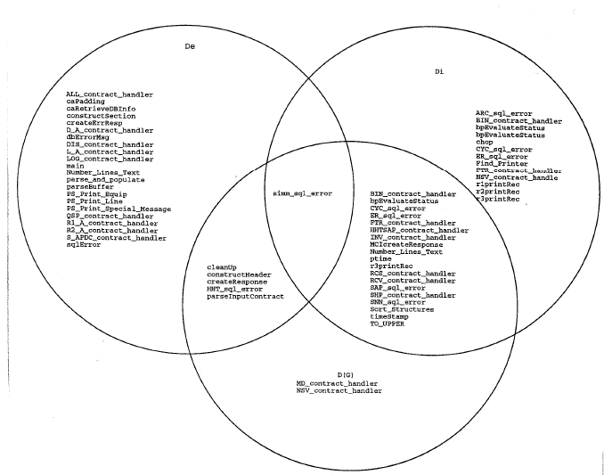
Case Study I: Tool & Results
Automatically collects and analyzes metrics values
  A metric analysis tool (χMetrics) was implemented
  Built on top of ATAC (an Automatic Testing and Analysis tool for C by Bellcore)
  Code to be analyzed must be syntactically correct
Identify functions with high metrics values
  Functions identified by top 5% of M_{i}, M_{e}, and M_{c}
    57 functions identified
    1 by all three
    20 by M_{i} and M_{c}
    6 by M_{e} and M_{c}
    10 by M_{i} only
    20 by M_{e} only
    2 by M_{c} only
M_{e}
M_{i}
M_{c}
Source Code-based Risk Analysis (© 2012 Professor W. Eric Wong, The University of Texas at Dallas)

Slide 18
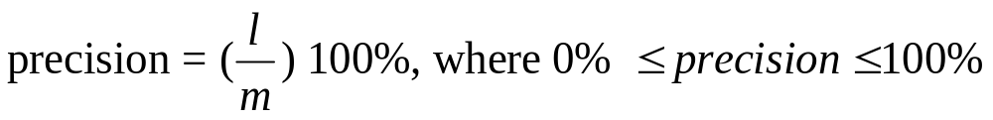

Case Study I: Results
Validate fault-prone functions by real defect data between two major releases for their fault-proneness
Assume there are m functions identified as fault-prone; of these l are fault-laden. Assume n functions contain at least one fault based on the real defect data
Our experiment results suggest that
  Metrics M_{e} and M_{i} can be good indicators of fault prone functions
  No particular metric has a clear advantage over the others in determining which function is fault-laden
Source Code-based Risk Analysis (© 2012 Professor W. Eric Wong, The University of Texas at Dallas)

Slide 19
Impact of Function Size
Function size may be related to the metrics values
Do we need to do the normalization?
  Dividing metrics values by function size determined by non-comment and non-blank lines of code
Normalized metrics identify very different functions than non-normalized metrics.
Validation using real defect data to determine which one is better?
  Non-normalized metrics are better than the normalized metrics
Function size is a factor that should be considered
  Ostrand, Weyuker and Bell (IEEE Transactions on Software Engineering, 31(4):340-355, April 2005)
  Our data indicate that in no case does the size-based selection catch all the functions selected by M_{i}, M_{e},or M_{c}.
  This suggests that function size cannot replace any of the metrics.
Source Code-based Risk Analysis (© 2012 Professor W. Eric Wong, The University of Texas at Dallas)

Slide 20
Case Study II

Slide 21
Possible Improvement
Questions
  Why do we need a different set of complexity metrics?
    If not, what kind of metrics can be used?
  Is it easy to collect these metrics values?
    “Data Structure Manipulations” is not only ill-defined but also difficult to collect
W. E. Wong, J. R. Horgan, J. C. Maldonado, and J. V. LaGrange, “Integrating Testing and Design Metrics to Predict Fault-Prone Software Modules,” in Proceedings of the 11th International
Conference on Software Engineering & its Applications, Paris, France, December, 1998.
Source Code-based Risk Analysis (© 2012 Professor W. Eric Wong, The University of Texas at Dallas)

Slide 22
Case Study II: Motivation
Many studies explore the fault detection capability of test sets adequate with respect to
  controlflow-based criteria (statement, block, decision)
  dataflow-based criteria (all-uses, potential all-uses)
  mutation-based criteria (interface mutation)
No study has used testing metrics such as
  number of all-uses
  number of interface mutants to identify fault-prone software modules even before any testing is conducted.
Source Code-based Risk Analysis (© 2012 Professor W. Eric Wong, The University of Texas at Dallas)

Slide 23
Case Study II: Objective
Develop a hybrid metric as an integration of controlflow-, dataflow- and mutation-based testing metrics and some components of the internal and/or external complexity metrics to better predict the fault-prone software modules.
Source Code-based Risk Analysis (© 2012 Professor W. Eric Wong, The University of Texas at Dallas)

Slide 24
Case Study II: Our Method
Replace the difficult-to-collect and mistake-prone metrics used in computing the internal complexity M_{i} and the external complexity M_{e} by other better defined and more easily collected ones.
  Replace “Data Structure Manipulations” (number of references to complex data types) by DEC (the number of decisions), AU (the number of all-uses), or PAU (the number of potential all-uses)
    None of the decisions, all-uses, and potential all-uses need to be covered
  Use IM (number of interface mutants) as an index for the probability of faults introduced because of the communications between two software modules
    None of the mutants have to be compiled
    None will be executed on any test case
Source Code-based Risk Analysis (© 2012 Professor W. Eric Wong, The University of Texas at Dallas)

Slide 25
Case Study II: Metrics
M_{i0} = the original internal complexity metric
M_{i1}= DEC + AU
M_{i2}= DEC + AU + Function Calls + I/O
M_{i3}= DEC + PAU
M_{i4}= DEC + PAU + Function Calls + I/O
M_{i5}= DEC
M_{i6}= DEC + Function Calls + I/O
M_{i7}= AU
M_{i8}= AU + Function Calls + I/O
M_{i9}= PAU
M_{i10}= PAU + Function Calls + I/O
M_{e0} = the original external complexity metric
M_{e1}= IM
M_{c0}= M_{i0} + M_{e0}
M_{ck}= M_{ik} + M_{e1} where 1 ≤ k ≤ 10
Source Code-based Risk Analysis (© 2012 Professor W. Eric Wong, The University of Texas at Dallas)

Slide 26
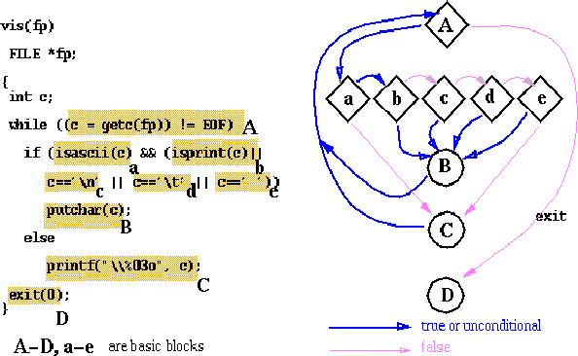
DEC - Number of Decisions
A decision is a boolean predicate with two possible values, true and false
McCabe’s Cyclomatic complexity = number of decision nodes + 1
Simple versus compound decisions
Source Code-based Risk Analysis (© 2012 Professor W. Eric Wong, The University of Texas at Dallas)

Slide 27
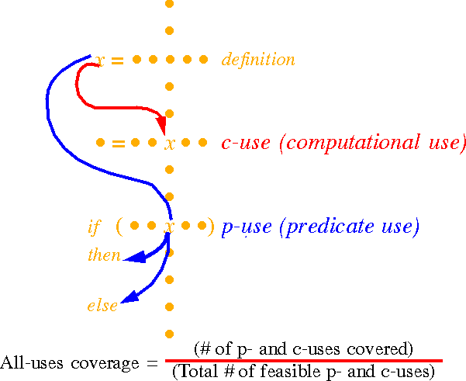
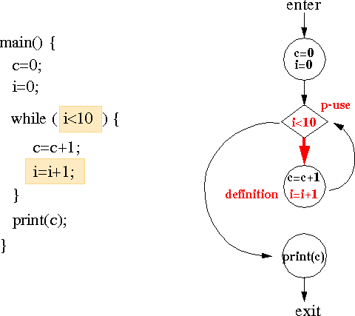
AU – Number of All-Uses
Source Code-based Risk Analysis (© 2012 Professor W. Eric Wong, The University of Texas at Dallas)

Slide 28
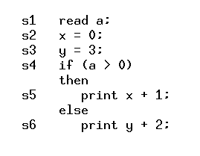
PAU – Number of Potential All-Uses
With respect to variable x
  one c-use (s₂, s₅)
  no p-use
  two potential c-uses (s₂, s₅) and (s₂, s₆)
  two potential p-uses (s₂, s₄, s₅) and
  (s₂, s₄, s₆)
  x=0 and y=3 are in the same block
    No substitution
All-uses: an explicit use of x
Potential all-uses: a potential use of x
Source Code-based Risk Analysis (© 2012 Professor W. Eric Wong, The University of Texas at Dallas)

Slide 29
IM – Number of Interface Mutants
Function parameters replacement
  replacing a parameter by another appropriate one
Function parameters switch
  permuting the order of parameters in a call statement
Function parameters elimination
  deleting one parameter at a time
Function parameters increment/decrement
  inserting a pre-increment operator (++) or pre-decrement operator (--) before a parameter
Unary operator insertion
  inserting an arithmetic negation, a logical negation, or a bit negation before a parameter
Function call deletion
  deleting the call to a function. If the function call is part of an expression, it is replaced by a value from a pre-defined set.
Source Code-based Risk Analysis (© 2012 Professor W. Eric Wong, The University of Texas at Dallas)

Slide 30
Target Program & Tools Used
The SPACE program which provides a language-oriented user interface for configuration of antenna arrays.
  about 10K lines of C code in 134 files
  Defect data were obtained from the error-log maintained during its testing and integration phases
Tools
  ATAC (χSuds): A data-flow coverage measurement tool to compute
  DEC and AU
  POKE: another data-flow coverage measurement tool to compute PAU
  Proteum/IM: a mutation analysis tool to compute IM
  χMetrics: a metrics analysis tool to compute M_{i0}, M_{e0}, and M_{c0}
Source Code-based Risk Analysis (© 2012 Professor W. Eric Wong, The University of Texas at Dallas)

Slide 31
Case Study II: Results
DEC (number of decisions) by itself is not a good metric for predicting fault-proneness
M_{i0} does not provide as good identification as other M_{i}’s which use either AU (number of all-uses) or PAU (number of potential all-uses)
  The internal complexity of a module can be better represented by AU or PAU than DSM (number of references to complex data types).
The number of interface mutants serves as a better metric for identifying modules with faults due to the external communication of a module and the rest of the system.
Our hybrid metrics can better predict fault-prone software modules than the internal and external complexity metrics used in Case Study I.
Source Code-based Risk Analysis (© 2012 Professor W. Eric Wong, The University of Texas at Dallas)

Slide 32
Case Study II: Results (cont’d)
The purpose of using metrics is to get insight, not to compare their absolute values across different projects.
  Relative comparison of metrics values within the same project (or similar projects) is useful
This is supported by the study conducted by Nagappan, Ball, and Zeller (Mining Metrics to Predict Component Failures, in Proceeding of the 28th International Conference on Software Engineering, pp. 452-461, Shanghai, China, May 2006. )
  Predictors are accurate only when obtained from the same or similar projects
Source Code-based Risk Analysis (© 2012 Professor W. Eric Wong, The University of Texas at Dallas)

Slide 33
Related Studies

Slide 34
Related Studies (1)
There are many related studies. Here are a few.
  Norman E. Fenton and Niclas Ohlsson “Quantitative Analysis of Faults and Failures in a Complex Software System,” IEEE Transactions on Software Engineering, 26(8):797-814, August 2000.
  A. G. Koru and Jeff Tian, “An Empirical Comparison and Characterization of High Defect and High Complexity Modules,” The Journal of Systems and Software, 67(3):153-163, September 2003
  A.G. Koru and J. Tian, “Comparing High-Change Modules and Modules with the Highest Measurement Values in Two Large-Scale Open-Source Products,” IEEE Transactions on Software Engineering, 31(8):625-642, August 2005
  N. Nagappan, T. Ball, and A. Zeller, “Mining Metrics to Predict Component Failures,” in Proceeding of the 28th International Conference on Software Engineering, pp. 452-461, Shanghai, China, May 2006.
  T. Ostrand, E. Weyuker, and R. Bell, “Predicting the Location and Number of Faults in Large Software Systems,” IEEE Transactions on Software Engineering, 31(4):340-355, April 2005
  V. R. Basili and B.T. Perricone, “Software Errors and Complexity: An Empirical Investigation,” Communications of the ACM, 27(1)42-52, January 1984
  T. Khoshgoftaar, E. B. Allen, K. S. Kalaichelvan, and N. Goel, “Early Quality Prediction: A Case Study in Telecommunications," IEEE Software, 13(1):65-71, January 1996
  S. R. Chidamber and C. F. Kemerer, “A Metrics Suite for Object Oriented Design,” IEEE Transactions on Software Engineering, 20(6):476-493, June 1994.
  M. Lorenz and J. Kidd, Object-Oriented Metrics: Measures of Complexity. Pearson Education, December 1995.
  L. C. Briand, J. W. Daly, and J. K. Wust, “A Unified Framework for Cohesion Measurement in Object-Oriented Systems,” Journal of Empirical Software Engineering, 3(1)65-117, 1998.
  L. C. Briand, J. W. Daly, and J.K. Wust, “A Unified Framework for Coupling Measurement in Object-Oriented Systems,” IEEE Transactions on Software Engineering, 25(1):91-121, January/February 1999
Source Code-based Risk Analysis (© 2012 Professor W. Eric Wong, The University of Texas at Dallas)

Slide 35
Related Studies (2)
Norman E. Fenton and Niclas Ohlsson “Quantitative Analysis of Faults and Failures in a Complex Software System,” IEEE Transactions on Software Engineering, 26(8):797-814, August 2000.
  A small number of modules contain most of the faults discovered in prerelease testing, and a very small number of modules contain most of the faults discovered in operation.
  Neither of these phenomena can be explained by the size or the complexity of the modules.
  No evidence to support the relationship between module size and fault density
  No evidence that popular complexity metrics are good predictors of either fault-prone or failure-prone modules
Source Code-based Risk Analysis (© 2012 Professor W. Eric Wong, The University of Texas at Dallas)

Slide 36
Related Studies (2) (cont’d)
  The number of faults discovered in prerelease testing is an order of magnitude greater than the number discovered in 12 months of operational use
  Those modules which are the most fault-prone prerelease are among the least fault-prone post-release.
  Fail to take into account testing effort and operational usage.
Source Code-based Risk Analysis (© 2012 Professor W. Eric Wong, The University of Texas at Dallas)

Slide 37
Related Studies (3)
A. G. Koru and Jeff Tian, “An Empirical Comparison and Characterization of High Defect and High Complexity Modules,” The Journal of Systems and Software, 67(3):153-163, September 2003
  Six software products: two from IBM and four from Nortel Networks
  Examine the relationship between high defect modules and high complexity modules
    positively correlated but not monotonic relationship
  The most complex modules often have an acceptable quality
    Many complex modules are intrinsically complex because of the problem they are dealing with, and are recognized as such. Consequently, highly skilled personnel and adequate effort were allocated to such modules, resulting in their relative high quality
  The high defect modules are not typically the most complex ones, but slightly below the most complex ones
    Those ‘‘not too big (complex) not too small (simple)’’ modules may contain the highest number of defects.
Source Code-based Risk Analysis (© 2012 Professor W. Eric Wong, The University of Texas at Dallas)

Slide 38
Related Studies (4)
A.G. Koru and J. Tian, “Comparing High-Change Modules and Modules with the Highest Measurement Values in Two Large-Scale Open-Source Products,” IEEE Transactions on Software Engineering, 31(8):625-642, August 2005
  Two large-scale open-source products, Mozilla and OpenOffice
  Identifying change-prone modules can help programmers take preventive actions to reduce maintenance cost and improve software quality.
  Top modules in change count rankings and the modules with the highest values of static metrics are different
    High-change modules have high metrics values but not the highest
    In Mozilla, the top 2%, 5%, and 20% modules in the change rankings include 34.78%, 51.45%, and 82.43% of the total change count
      Similar to the 80/20 principle
Source Code-based Risk Analysis (© 2012 Professor W. Eric Wong, The University of Texas at Dallas)

Slide 39
Related Studies (5)
N. Nagappan, T. Ball, and A. Zeller, “Mining Metrics to Predict Component Failures,” in Proceeding of the 28th International Conference on Software Engineering, pp. 452-461, Shanghai, China, May 2006.
  A study uses five projects from Microsoft
  For each project, we can find a set of complexity metrics that correlates with post-release defects and the corresponding failures
  There is no single set of metrics that fits all projects
  Predictors obtained from principal component analysis are useful in building regression models to estimate post-release defects
  Predictors are accurate only when obtained from the same or similar projects
  DO NOT use complexity metrics without validating them for your project
  DO use metrics that are validated from history to identify low-quality components
Source Code-based Risk Analysis (© 2012 Professor W. Eric Wong, The University of Texas at Dallas)

Slide 40
Related Studies (6)
T. Ostrand, E. Weyuker, and R. Bell, “Predicting the Location and Number of Faults in Large Software Systems,” IEEE Transactions on Software Engineering, 31(4):340-355, April 2005
  Develop a model to predict the expected number of faults in each file of the next release of a system based on the code in the current release, and fault and modification history of the file from previous releases
  Two projects from AT&T
    one with 17 consecutive quarterly releases over 4 years
    one with 9 releases over 2 years
  The 20% of the files with the highest predicted number of faults contain between 71% and 92% of the faults that were actually detected, with the overall average being 83%
    another support for the 80/20 principle
Source Code-based Risk Analysis (© 2012 Professor W. Eric Wong, The University of Texas at Dallas)

Slide 41
Related Studies (6) (cont’d)
  A simplified version of the predictor (sorting files by their size) selects 20% of the files that are the largest containing on average, 73% and 74% of the faults for the two systems.
    Module size is the most significant factor influencing the number of faults
El Emam et al. also noted that there is a continuous relationship between size and defects.
Source Code-based Risk Analysis (© 2012 Professor W. Eric Wong, The University of Texas at Dallas)

Slide 42
Related Studies (7)
V. R. Basili and B.T. Perricone, “Software Errors and Complexity: An Empirical Investigation,” Communications of the ACM, 27(1)42-52, January 1984
  Larger modules tended to have a lower fault density than smaller ones, where fault density is the number of faults discovered divided by a measure of module size (e.g., thousands lines of code)
T. Khoshgoftaar, E. B. Allen, K. S. Kalaichelvan, and N. Goel, “Early Quality Prediction: A Case Study in Telecommunications," IEEE Software, 13(1):65-71, January 1996
  Measures of early products of development can predict the final product’s quality.
    We should apply metrics to SDL specifications
Source Code-based Risk Analysis (© 2012 Professor W. Eric Wong, The University of Texas at Dallas)

Slide 43
Related Studies (8)
Metrics for Object-Oriented Code
  S. R. Chidamber and C. F. Kemerer, “A Metrics Suite for Object
  Oriented Design,” IEEE Transactions on Software Engineering, 20(6):476-493, June 1994.
    Depth of Inheritance Tree (DIT)
    Coupling between object classes (CBO)
    Number of Children (NOC) = number of immediate subclasses
    subordinated to a class in the class hierarchy
    Lack of Cohesion in Methods (LCOM)
  M. Lorenz and J. Kidd, Object-Oriented Metrics: Measures of
  Complexity. Pearson Education, December 1995.
Source Code-based Risk Analysis (© 2012 Professor W. Eric Wong, The University of Texas at Dallas)

Slide 44
Related Studies (8) (cont’d)
  L. C. Briand, J. W. Daly, and J. K. Wust, “A Unified Framework for Cohesion Measurement in Object-Oriented Systems,” Journal of Empirical Software Engineering, 3(1)65-117, 1998
  L. C. Briand, J. W. Daly, and J.K. Wust, “A Unified Framework for Coupling Measurement in Object-Oriented Systems,” IEEE Transactions on Software Engineering, 25(1):91-121, January/February 1999
    Coupling and inheritance measures are strongly related to the probability of having defects in a class
Source Code-based Risk Analysis (© 2012 Professor W. Eric Wong, The University of Texas at Dallas)

Slide 45
Case Study III

Slide 46
What is next ?
  ?
Source Code-based Risk Analysis (© 2012 Professor W. Eric Wong, The University of Texas at Dallas)

Slide 47
Quiz
Given two modules C₁ and C₂
C₁ has higher metrics values but also is significantly more tested than C₂
Is the probability of C₁ containing any faults still higher than that of C₂?
Source Code-based Risk Analysis (© 2012 Professor W. Eric Wong, The University of Texas at Dallas)

Slide 48
Case Study III: Our Method
Combining dynamic testing effort such as code coverage and execution counts with static complexity computed by using the internal and external metrics
  Fault-proneness of a module with high static complexity should be appropriately calibrated based on how much effort has been spent on testing it.
Fault-proneness of a module =
f (inflows, outflows, fan-in, fan-out, ………
#of decisions, # of def-uses, # of interface mutants, ……
block coverage, decision coverage, execution counts, …...)
internal/external complexity metrics
controlflow-/dataflow-/mutation-based testing metrics
dynamic testing effort
Source Code-based Risk Analysis (© 2012 Professor W. Eric Wong, The University of Texas at Dallas)

Slide 49
Case Study III: Our Advantage
We have coverage measurement tools for C, C++, Java bytecode, and SDL
  Code coverage
  Execution counts
These tools can also be easily modified to collect other metrics values
  χSuds (C and C++)
  eXVantage (C, C++, and Java bytecode)
  χSuds/SDL
Source Code-based Risk Analysis (© 2012 Professor W. Eric Wong, The University of Texas at Dallas)

Slide 50
Case Study III: Source Code-Based Risk Assessment
A risk in a software system can be viewed as a potential problem, and a problem is a risk that has manifested.
  In order to reduce the risk of software operations, code which has the potential to cause problems has to be identified so that necessary actions can be taken to prevent any such problems from occurring.
W. E. Wong, Y. Qi, and K. Cooper, “Source Code-Based Software Risk Assessing,” in Proceedings
of The 20th ACM Symposium on Applied Computing (ACM SAC), pp. 1485-1490, Santa Fe,
New Mexico, March 13-17, 2005
Source Code-based Risk Analysis (© 2012 Professor W. Eric Wong, The University of Texas at Dallas)

Slide 51
Case Study III: Two Important Principles
The more complex the static structure of the code, the higher the risk it has.
The more thoroughly the code is tested, the lower the risk it has.
Source Code-based Risk Analysis (© 2012 Professor W. Eric Wong, The University of Texas at Dallas)

Slide 52
Case Study III: Our Approach (1)
We propose two types of risk models: static models and dynamic models
using metrics collected based on the source code
The computation of the risks of code is automated at different granularity levels ranging from basic blocks to functions, files, subsystems, etc.
  A basic block, also known as a block, is a sequence of consecutive statements or expressions containing no transfers of control except at the end, so that if one element of it is executed, all are.
    This of course assumes that the underlying hardware does not fail during the execution of a block.
Source Code-based Risk Analysis (© 2012 Professor W. Eric Wong, The University of Texas at Dallas)

Slide 53
Case Study III: Our Approach (2)
The risks of functions or files or subsystems are built on top of the risks
of their member blocks.
  Their risks are the highest risk of their member blocks.
  For example, suppose a function f contains three blocks b₁, b₂ and b₃.
  The risk of these blocks for containing some bug(s) are α, β, and γ, respectively, where α > β > γ.
  Then, the risk of f containing some bug(s) is the highest risk of its member blocks, that is, the highest of α, β, and γ which is α.
Source Code-based Risk Analysis (© 2012 Professor W. Eric Wong, The University of Texas at Dallas)

Slide 54
Case Study III: Risk Models (1)
The static model is constructed by using metrics related to the static structure of the code such as the number of c-uses, p-uses, definitions, decisions and function calls.
The dynamic model uses whatever is selected by the static model and additional dynamic test coverage of the code such as decision, c-use and p-use coverage to calibrate the metric values used in the model.
Source Code-based Risk Analysis (© 2012 Professor W. Eric Wong, The University of Texas at Dallas)

Slide 55
Case Study III: Risk Models (2)
Users can choose all or some of the following metric components with appropriate weighting factors for model construction.
  number of variable definitions (V),
  number of function calls (F),
  number of decisions (D),
  number of c-uses (C), and
  number of p-uses (P) are selected.
They can also select from one of the two modeling schemes:
  a summation scheme which constructs a risk model by using the sum of the selected metrics, or
  a product scheme which uses the product of the selected metrics.
  Suppose also the summation scheme is selected.
  The corresponding static risk model can be expressed as
V * α + F * β + D * γ + C * ε + P * ω
where α, β, γ, ε, and ω are the weighting factors.
Source Code-based Risk Analysis (© 2012 Professor W. Eric Wong, The University of Texas at Dallas)

Slide 56
Case Study III: Static Model versus Dynamic Model
The major difference between a static and a dynamic model is that the latter uses test coverage to calibrate the actual value of each metric component.
  Suppose we want to use the model listed in Equation (1) to compute the risk of a block B.
  Suppose also block B has 20 c-uses.
  For a static model, the metric component C (number of c-uses) has the value 20.
  For a dynamic model, the actual value of C is the number of c-uses in B which are not covered (i.e., not executed) by all the successful tests before an execution failure is observed.
  Assuming eight (8) of them are covered.
  This makes the metric component C have a value 12 (obtained by subtracting 8 from 20) when a dynamic model (assuming the metric component C is selected) is used to compute the risk of block B.
    A different approach is to make C equal 20 – 8 * ε where 0 < ε ≤ 1
    Disadvantages versus advantages
Source Code-based Risk Analysis (© 2012 Professor W. Eric Wong, The University of Texas at Dallas)

Slide 57
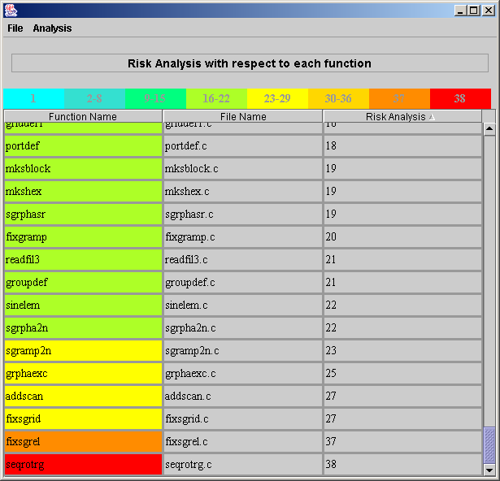
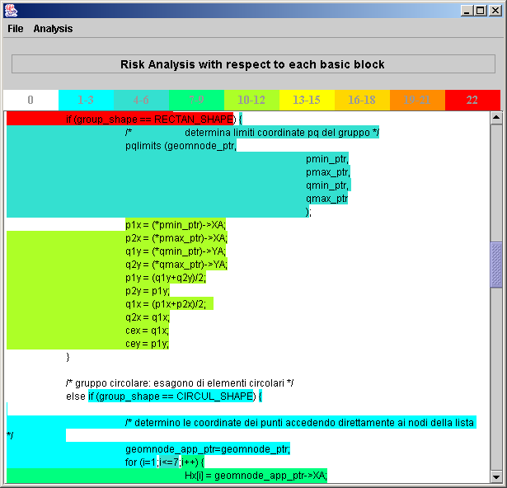
Case Study III: Visualize Risk in Code
We compute the risk of each block and function, prioritize them in terms of the risk, and highlight them in different colors
A display at the function level A display at the block level
Source Code-based Risk Analysis (© 2012 Professor W. Eric Wong, The University of Texas at Dallas)

Slide 58
Case Study III: Results
Our static risk models perform well by identifying a small percentage of functions and blocks as fault-prone.
In many cases, the dynamic models perform better than the corresponding static models.
How much? This depends on a few factors
  the test coverage of the successful tests
  the nature of the fault
Source Code-based Risk Analysis (© 2012 Professor W. Eric Wong, The University of Texas at Dallas)

Slide 59
Case Study III: Three Important Aspects
Our models use metrics based on the source code, whereas other risk assessments rely on the data collected from the process of how a software system is built, operated, deployed or maintained, and which organization is responsible for such activities.
  Data collected for the latter would be affected by different interpretations of the process
  Data collected with respect to the metrics used for constructing our risk models do not have such a potential inconsistency problem
Our method allows the risk of code to be computed at a very fine granularity level such as a basic block.
  This is very different from many other studies which only identify the fault proneness at the module (or function) level.
Source Code-based Risk Analysis (© 2012 Professor W. Eric Wong, The University of Texas at Dallas)

Slide 60
Case Study III: Three Important Aspects (cont’d)
Our models use either the static, or the static and the dynamic, data collected from the source code.
  The risk of code can be computed by using only the static data.
  However, if the dynamic test coverage is available, it can be used to calibrate the metric values used for computing the risk.
  This makes our risk model flexible, depending on the available data.
Source Code-based Risk Analysis (© 2012 Professor W. Eric Wong, The University of Texas at Dallas)

Slide 61
Future Directions

Slide 62
Future Directions
What kind of testing effort should be considered?
  Test coverage
  Execution frequency
How to introduce the dynamic testing effort to calibrate static complexity?
  Use the same static metrics with modified values
  Add additional dynamic metrics to the model
Source Code-based Risk Analysis (© 2012 Professor W. Eric Wong, The University of Texas at Dallas)

Slide 63
Backup Slides

Slide 64

Risk Analysis Model Construction
Code-
based
Process-
based
Principal component analysis
Statistical modeling
Appropriate weight factors
+
Most Studies
Generic
Special
Static
Dynamic
Internal
External
Internal
External
Source Code-based Risk Analysis (© 2012 Professor W. Eric Wong, The University of Texas at Dallas)

