Slide 1
Automation In Practice –
It’s Not What You Think It Is
CS/SE 6367: Software Testing, Validation & Verification
April 24, 2015

Slide 2

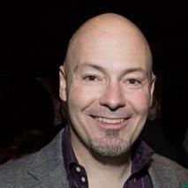


Who Is This Guy?
Paul Grizzaffi
Automation Program Architect & Manager
MedAssets – a healthcare performance improvement company
“Quality Accelerator” / “Software Pediatrician”
Career focused on automation
Community Advisory Board for Software Test Professionals (STP)
paul_grizzaffi@yahoo.com
http://www.linkedin.com/in/paulgrizzaffi
@pgrizzaffi

Slide 3
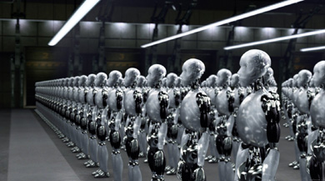
What Comes To Mind?

Slide 4
What Comes To Mind?
Saves Time
Scripts
Test Cases
A Lot Of Work
Inconsistent
Regression
Tools
I’m Getting Laid Off
Brittle

Slide 5
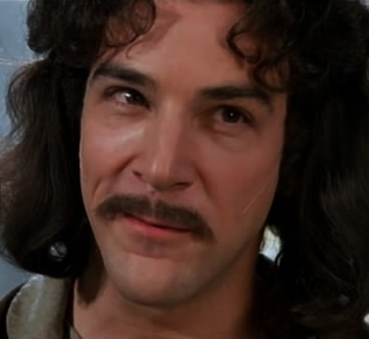



Slide 6
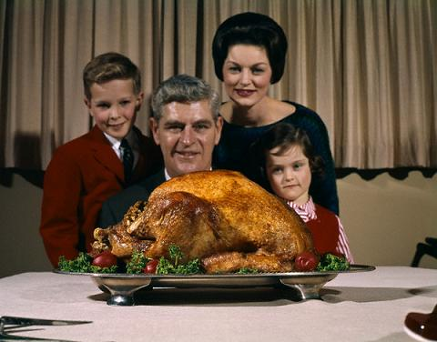
Traditions Can Be Important

Slide 7
Traditions Can Be Important
Traditional automation
  Detect behavior changes
  Reduce effort on smoke and regression
  Earlier execution, earlier alerts
  Scheduled execution
This is what most companies call automation
MedAssets has this and it’s valuable
Is there something else?

Slide 8
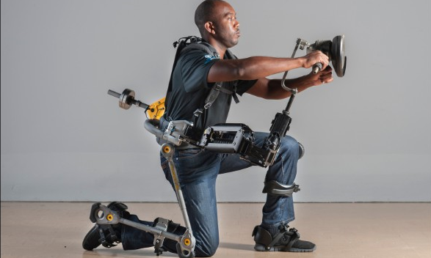
What If We Think Differently?

Slide 9

What If We Think Differently?
“Let’s help the humans”
What makes us more efficient or more effective?
What’s valuable?
What hurts?
Instead of automation, do we need assistance?

Slide 10
Automation Assist
Umbrella term for non-traditional automation
  “Words mean things” – Patrick Amaku
  Changing meanings is difficult
  New vocabulary for new concepts
Things that increase the value of manual effort
  “Off label” tool usage
  New tools, applications, scripts
  Tools not traditionally thought of as automation
Lets Look At Some Examples

Slide 11
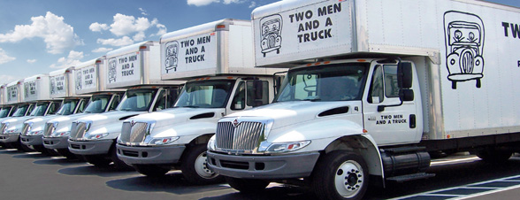
Movin’ On Up

Slide 12

MIRV

Slide 13
MIRV
The premise
  Data center migration for a large, complex product
  Aggressive dates, limited testing time, limited staff
  Experience: system will work or “be egregiously broken”
The solution
  Scripts based on existing tool to find egregious issues
  Execute against multiple facilities simultaneously
  Running on repurposed laptops
  TestComplete scripts: several weeks of effort
Why that solution?
  Quick, shallow checks can maximize humans’ value
  Existing tool reuse reduces effort
  7 – 12 business critical incidents prevented

Slide 14
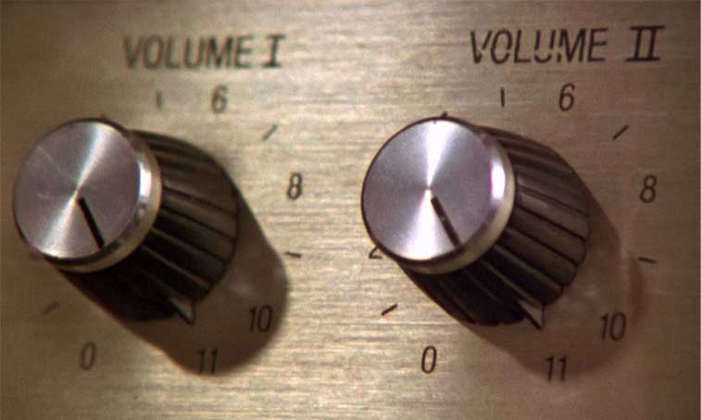
High Volume Automated Testing

Slide 15
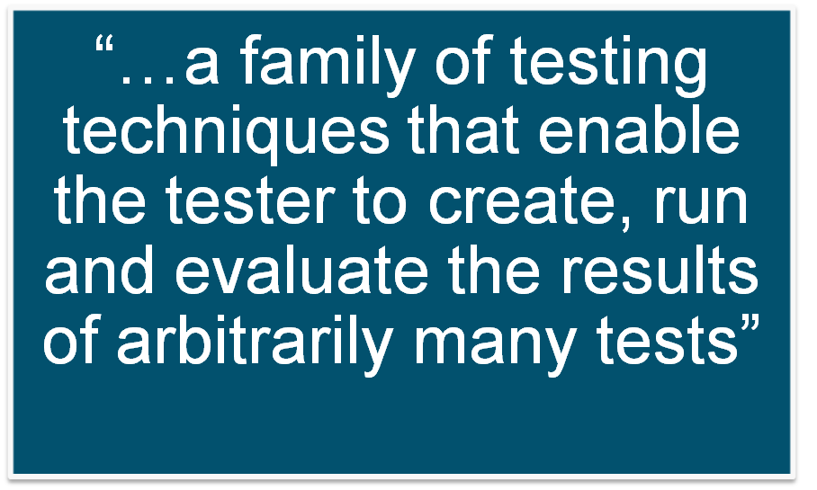
High Volume Automated Testing
Workshop on Teaching Software Testing (WTST) 2013

Slide 16
High Volume Automated Testing
Aka HiVAT
Research from Florida Institute of Technology (FIT)
Dr. Cem Kaner, J.D., Ph.D.
Andy Tinkham
http://context-driven-testing.com/?p=69
Interesting facets for MedAssets
  Many executions
  Random execution
  Results vetted by humans

Slide 17
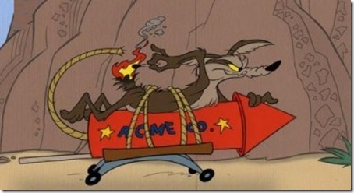
Scud

Slide 18
Scud
The premise
  Product is large, complex, aging
  Not feasible to enumerate and follow all paths
The solution
  Random menu clicker – “Scud”
  Looking for things that “don’t seem right”
  Selenium-based Python script: 32 hours of effort
  Found four issues in the first week of use

Slide 19
Scud (cont.)
Why that solution?
  Value shown at GameStop
  TestComplete not appropriate for this activity
  Open source so broad license usage
  Not competing for traditional automation licenses
  Why a scripting language?
    Learning curve is relatively shallow
    Development is “faster”
    Python expertise is available in our area

Slide 20
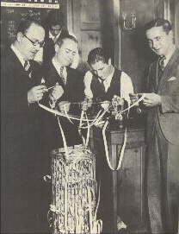
Data Regressor

Slide 21
Data Regressor
The premise
  “Regression” testing between software versions
  Volatile stock market data
  Takes about 8 hours of effort
The solution
  Comparison tool
  Connect to both servers and compare
  Time to test reduced 1 minute
  C++ program: “ROI”: 6 weeks
Why that solution?
  Traditional test scripts not appropriate
  Existing API into the product
  C++ primary development language
  Product bug found during first execution

Slide 22
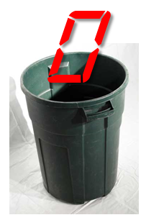
Zero Remover

Slide 23
Zero Remover
The premise
  Thousands of “golden files”
  In some cases DB now returns NULL instead of 0.00
  Manual effort estimate: 4 – 6 weeks
The solution
  A program to do the file transformation
  C# program: 5 hours
Why that solution?
  Disposable
  Windows/.Net shop
  Easy to distribute executable

Slide 24
Some Words About Effort
Effort is a funny thing
ROI can be difficult to calculate
“Opportunity cost” can be easier and as useful
Think about value

Slide 25
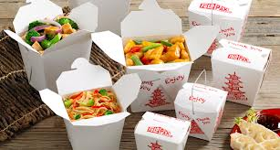
Takeaways
This is different
Nothing wrong with scripting test cases, but that’s an implementation
This is software development
Situational – the “knowns” help guide
Coverage: direct or indirect
Ecosystem: running, distributing
Life span: disposable or long term

Slide 26
Questions?
paul_grizzaffi@yahoo.com
http://www.linkedin.com/in/paulgrizzaffi
@pgrizzaffi

