Slide 1
STAR
Laboratory of Advanced Research on Software Technology
Test Generation based on Finite State Models
W. Eric Wong
Department of Computer Science
The University of Texas at Dallas
ewong@utdallas.edu
http://www.utdallas.edu/~ewong
Test Generation based on Finite State Models (© 2014 Professor W. Eric Wong, The University of Texas at Dallas)

Slide 2

Speaker Biographical Sketch
Professor & Director of International Outreach
Department of Computer Science
University of Texas at Dallas
Guest Researcher
Computer Security Division
National Institute of Standards and Technology (NIST)
Vice President, IEEE Reliability Society
Secretary, ACM SIGAPP (Special Interest Group on Applied Computing)
Principal Investigator, NSF TUES (Transforming Undergraduate Education in Science, Technology, Engineering and Mathematics) Project
  Incorporating Software Testing into Multiple Computer Science and Software Engineering Undergraduate Courses
Founder & Steering Committee co-Chair for the SERE conference
(IEEE International Conference on Software Security and Reliability)
(http://paris.utdallas.edu/sere13)
Test Generation based on Finite State Models (© 2014 Professor W. Eric Wong, The University of Texas at Dallas)

Slide 3
Learning Objectives
What are Finite State Machines (FSM)?
The W method for test generation
The Wp method for test generation
Automata theoretic versus control-flow based test generation
What are Extended Finite State Machines (EFSM)?
What are Communicating Extended State Machines (CEFSM)?
  Architectural design in SDL
EFSM-based test generation
CEFSM-based test generation
Test Generation based on Finite State Models (© 2014 Professor W. Eric Wong, The University of Texas at Dallas)

Slide 4
Where Are These Methods Used?
Conformance testing of communications protocols
  Finite state machines are widely used in modeling of different kinds of systems.
  Testing of any system/subsystem modeled as a finite state machine, e.g. elevator designs, automobile components (locks, transmission, stepper motors, etc.), steam boiler control, etc.
  Generation of tests from FSM assists in testing the
  conformance of implementations to the corresponding FSM model
White box-based coverage testing for SDL design specifications, EFSMs, CFEMSs, reachability graphs, etc.
Test Generation based on Finite State Models (© 2014 Professor W. Eric Wong, The University of Texas at Dallas)

Slide 5
What is an Finite State Machine?
A finite state machine, abbreviated as FSM, is an abstract representation of behavior exhibited by some systems.
An FSM is derived from application requirements. For example, a network protocol could be modeled using an FSM.
Not all aspects of an application’s requirements are specified by an FSM. For example, real time requirements and performance requirements cannot be specified by an FSM.
Test Generation based on Finite State Models (© 2014 Professor W. Eric Wong, The University of Texas at Dallas)

Slide 6
Requirements Specification or Design Specification?
An FSM could serve as a specification of the required behavior or as a design artifact according to which an application is to be implemented.
  The role assigned to an FSM depends on whether it is a part of the requirements specification or of the design specification.
  FSMs are part of UML 2.0 design notation.
Test Generation based on Finite State Models (© 2014 Professor W. Eric Wong, The University of Texas at Dallas)

Slide 7
Finite State Machines with Output
Mealy Machine (due to G. H. Mealy -1955 publication)
  Outputs corresponds transitions between states.
Moore Machine (due to E. F. Moore -1956 publication)
  Outputs are determined only by the states
Test Generation based on Finite State Models (© 2014 Professor W. Eric Wong, The University of Texas at Dallas)

Slide 8
Mealy Machine (1)
A Mealy machine M = {S, I, O, f, g, s_{o}}
  S: a finite set of states
  S_{o}: the start state ( a.k.a. initial state) contained in S
  I: a finite input alphabet
  O: a finite output alphabet
  f: a transition function that maps a state/input pair to the next state (S x I → S)
  g: an output function that maps a state/input pair to an output (S x I → O)
Test Generation based on Finite State Models (© 2014 Professor W. Eric Wong, The University of Texas at Dallas)

Slide 9
State Diagram Representation of a Mealy FSM
A state diagram is a directed graph where each node is a state and each edge is a transition between states
Each transition from a state can be triggered by an input and produce an output
  Input x Current State ➔ Output x Next State
Test Generation based on Finite State Models (© 2014 Professor W. Eric Wong, The University of Texas at Dallas)

Slide 10
Tabular Representation of a Mealy FSM
A table is often used as an alternative to the state diagram
The table consists of two sub-tables that consist of one or more columns each.
  The left sub-table is the input sub-table.
  The rows are labeled by the states of the FSM.
  The right sub-table is the output sub-table.
Test Generation based on Finite State Models (© 2014 Professor W. Eric Wong, The University of Texas at Dallas)

Slide 11
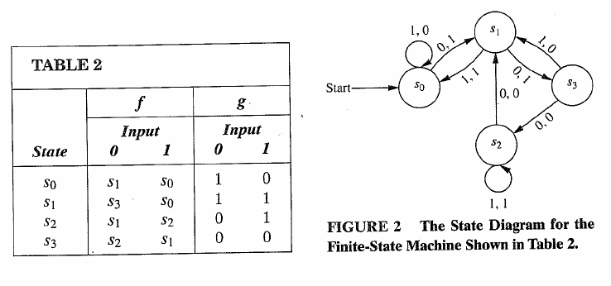
Mealy Machine (2)
An example of a Mealy machine
input
output
Input
The state diagram for the FSM shown in the table
Test Generation based on Finite State Models (© 2014 Professor W. Eric Wong, The University of Texas at Dallas)

Slide 12
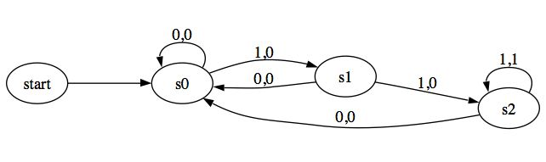
Mealy Machine (3)
A Mealy machine that outputs 1 if and only if the input string read so far ends with 111. This machine is a language recognizer.
Test Generation based on Finite State Models (© 2014 Professor W. Eric Wong, The University of Texas at Dallas)

Slide 13
Moore Machine (1)
A Moore machine M = {S, I, O, f, g, s_{o}}
  S: a finite set of states
  S_{o}: the start state ( a.k.a. initial state) contained in S
  I: a finite input alphabet
  O: a finite output alphabet
  f: a transition function that maps a (current) state/input pair to the next state
  (S x I → S)
  g: an output function that maps a state to an output (S → O)
Test Generation based on Finite State Models (© 2014 Professor W. Eric Wong, The University of Texas at Dallas)

Slide 14
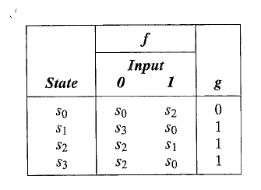
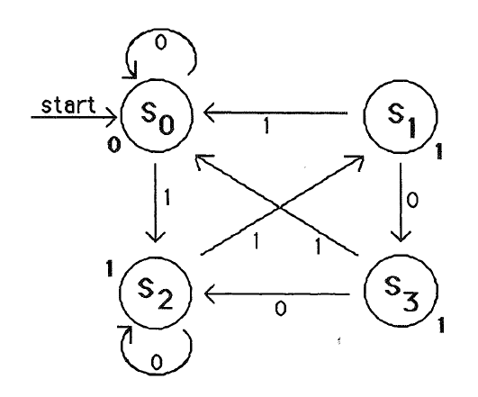
Moore Machine (2)
In a Moore machine, the output at each transition is only dependent on the state, rather than a state/input pair
In other words, the output after transition is determined solely by the final state of the transition.
input
output
Test Generation based on Finite State Models (© 2014 Professor W. Eric Wong, The University of Texas at Dallas)

Slide 15
Deterministic versus Nondeterministic
A deterministic finite automaton: For each pair of state and input value, there is a unique next state given by the transition function.
A nondeterministic finite automaton: There may be several possible next states for each pair of state and input value.
  If the language L is recognized by a nondeterministic finite state automaton M₁, then L is also recognized by a deterministic finite state automaton M₂.
Test Generation based on Finite State Models (© 2014 Professor W. Eric Wong, The University of Texas at Dallas)

Slide 16
Properties of FSM
Completely specified: An FSM M is said to be completely specified if from each state in M there exists a transition for each input symbol.
Strongly connected: An FSM M is considered strongly connected if for each pair of states (s_{i} s_{j}) there exists an input sequence that takes M from state s_{i} to s_{j}.
Test Generation based on Finite State Models (© 2014 Professor W. Eric Wong, The University of Texas at Dallas)

Slide 17
V-Equivalence of Two States
V-equivalence: Let M₁=(I, O, S₁, s¹₀, f₁, g₁) and M₂=(I, O, S₂, s²₀, f₂, g₂) be two FSMs (Mealy Machines). Let V denote a set of non-empty strings over the input alphabet I, that is, V⊆ I⁺.
Let s_{i} and s_{j}, i ≠ j, be two states of machines M₁ and M₂, respectively. s_{i} and s_{j} are considered V-equivalent if g₁(s_{i}, v)=g₂(s_{j}, v) for all v in V.
Stated differently, states s_{i} and s_{j} are considered V-equivalent if M₁ and M₂, when excited in states s_{i} and s_{j}, respectively, yield identical output sequences.
Test Generation based on Finite State Models (© 2014 Professor W. Eric Wong, The University of Texas at Dallas)

Slide 18
Equivalence of Two States
States s_{i} and s_{j} are said to be equivalent if g₁(s_{i}, v)=g₂(s_{j}, v) for any set V
  If s_{i} and s_{j} are not equivalent then they are said to be distinguishable
We write s_{i}=s_{j} if states s_{i} and s_{j} are equivalent, and s_{i}≠s_{j} when they are distinguishable
Test Generation based on Finite State Models (© 2014 Professor W. Eric Wong, The University of Texas at Dallas)

Slide 19
Equivalence of Two FSMs
Machines M₁ and M₂ are said to be equivalent if
  For each state α in M₁ there exists a state α’ in M₂ such that α and α’ are equivalent
  For each state β in M₂ there exists a state β’ in M₁ such that β and β’ are equivalent
Machines that are not equivalent are considered distinguishable.
If M₁ and M₂ are strongly connected, then they are equivalent if their respective initial states, s¹₀ and s²₀, are equivalent
We write M₁=M₂ if machines M₁ and M₂ are equivalent, and M₁≠M₂ when they are distinguishable
Test Generation based on Finite State Models (© 2014 Professor W. Eric Wong, The University of Texas at Dallas)

Slide 20
K-Equivalence
States s_{i} ∈S₁ and s_{j} ∈ S₂ are considered k-equivalent if
when excited by any input of length k, yield identical output sequences
  States that are not k-equivalent are considered k-distinguishable
It is also easy to see that if two states are k-distinguishable for any k>0 then they are also distinguishable for any n≥ k
Test Generation based on Finite State Models (© 2014 Professor W. Eric Wong, The University of Texas at Dallas)

Slide 21
Minimal Machine
An FSM M is considered minimal if the number of states in M is less than or equal to any other FSM equivalent to M.
Test Generation based on Finite State Models (© 2014 Professor W. Eric Wong, The University of Texas at Dallas)

Slide 22
Faults in Implementation
An FSM serves to specify the correct requirement or design of an application. Hence tests generated from an FSM target faults related to the FSM itself.
What faults are targeted by the tests generated using an FSM?
Test Generation based on Finite State Models (© 2014 Professor W. Eric Wong, The University of Texas at Dallas)

Slide 23
Fault Model (1)
a/1
a/0
q0
q0
q0
a/1
a/1
a/1
b/1
a/1
b/1
b/1
q1
q1
q1
b/0
b/0
b/0
Correct design
Operation error
Transfer error
Test Generation based on Finite State Models (© 2014 Professor W. Eric Wong, The University of Texas at Dallas)

Slide 24
Fault Model (2)
a/1
b/0
a/1
b/1
q0
q0
q2
a/1
a/1
q1
b/0
Extra state error
Missing state error
Test Generation based on Finite State Models (© 2014 Professor W. Eric Wong, The University of Texas at Dallas)

Slide 25
Test Generation using the W Method

Slide 26
Assumption
M is completely specified, minimal, connected, and deterministic
M starts in a fixed initial state
M can be reset accurately to the initial state. A null output is generated during the reset operation
M and the implementation under test have the same input alphabet
Test Generation based on Finite State Models (© 2014 Professor W. Eric Wong, The University of Texas at Dallas)

Slide 27
Steps of the W Method
Step 1: Estimate the maximum number of states (m) in the correct implementation of the given FSM M
Step 2: Construct the characterization set W for M
Step 3: (1) Construct the testing tree for M and
(2) Generate the transition cover set P from the testing tree
Step 4: Construct set Z from W and m
Step 5: Test generation and execution
Test Generation based on Finite State Models (© 2014 Professor W. Eric Wong, The University of Texas at Dallas)

Slide 28
Step 1: Estimation of m

Slide 29
Estimation of m
This is based on a knowledge of the implementation. In the absence of any such knowledge, let m = |S| (number of states in the given FSM)
Test Generation based on Finite State Models (© 2014 Professor W. Eric Wong, The University of Texas at Dallas)

Slide 30
Step 2: Construction of W
Step 2.1: Construction of the K-Equivalence Partitions
Step 2.2: Derivation of the Characterization Set

Slide 31
What is a Characterization Set ?
Let M=(I, O, S, s₀, f, g) be a minimal and complete FSM
W is a finite set of input sequences that distinguish the behavior of any pair of states in M.
  Each input sequence in W is of finite length
Given states s_{i} and s_{j} ∈ S,
W contains a string α such that g(s_{i}, α) ≠ g(s_{j}, α)
Test Generation based on Finite State Models (© 2014 Professor W. Eric Wong, The University of Texas at Dallas)

Slide 32
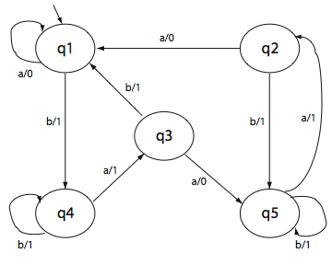
An Example of W
For the following M, we have W={baaa,aa,aaa}
For example, baaa distinguishes state s₁ from s₂ as g(s₁, baaa) ≠ g(s₂, baaa) More precisely, g(s₁, baaa) =1101 and g(s₂, baaa) =1100
s
s
s
s
s
Test Generation based on Finite State Models (© 2014 Professor W. Eric Wong, The University of Texas at Dallas)

Slide 33
Step 2.1: Construction of the K-Equivalence Partitions

Slide 34
What is a k-equivalence partition of S?
Given an FSM M=(I, O, S, s₀, f, g) k-equivalence partition of S, denoted as P_{k}, is a collection of n finite sets Σ_{k1}, Σ_{k2} … Σ_{kn} such that
  ∪^{n}_{i=1} Σ_{ki} = S
  states in Σ_{ki} for 1 ≤ i ≤ n are k-equivalent
  If state u is in Σ_{ki} and v in Σ_{kj} for i ≠ j, then u and v are k-distinguishable
Test Generation based on Finite State Models (© 2014 Professor W. Eric Wong, The University of Texas at Dallas)

Slide 35
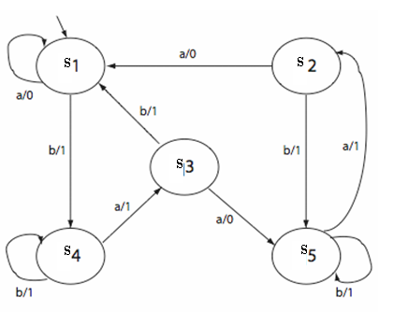
Construction of One-Equivalence Partition (1)
Computing the one-equivalence partition, P₁, for the following FSM
Start with a tabular representation of M
Current state | Output |  | Next state
 | a | b | a | b
s1 | 0 | 1 | s1 | s4
s2 | 0 | 1 | s1 | s5
s3 | 0 | 1 | s5 | s1
s4 | 1 | 1 | s3 | s4
s5 | 1 | 1 | s2 | s5
Test Generation based on Finite State Models (© 2014 Professor W. Eric Wong, The University of Texas at Dallas)

Slide 36
Construction of One-Equivalence Partition (2)
Group states identical in their output entries. This gives us 1-partition P₁ consisting of Σ₁={s₁, s₂, s₃} and Σ₂ ={s₄, s₅}
We have the one-equivalence partition as follows
  P₁ = {1, 2}
  Group 1 = Σ₁₁ = {s₁, s₂, s₃}
  Group 2 = Σ₁₂ = {s₄, s₅}
P₁ Table
Σ | Current state | Output |  | Next state
 |  | a | b | a | b
1 | s1 | 0 | 1 | s1 | s4
 | s2 | 0 | 1 | s1 | s5
 | s3 | 0 | 1 | s5 | s1
2 | s4 | 1 | 1 | s3 | s4
 | s5 | 1 | 1 | s2 | s5
Test Generation based on Finite State Models (© 2014 Professor W. Eric Wong, The University of Texas at Dallas)

Slide 37
Construction of Two-Equivalence Partition (1)
Rewrite P₁ Table. Remove the output columns. Replace a state entry s_{i} by s_{ij} where j is the group number in which lies state s_{i}
Σ | Current state | Next state
 |  | a | b
1 | s1 | s11 | s42
 | s2 | s11 | s52
 | s3 | s52 | s11
2 | s4 | s31 | s42
 | s5 | s21 | s52
group number
state s₅ is in group 2
state s₁ is in group 1
Test Generation based on Finite State Models (© 2014 Professor W. Eric Wong, The University of Texas at Dallas)

Slide 38
Construction of Two-Equivalence Partition (2)
Construct P₂ Table. Group all entries with identical second subscripts under the next state column. This gives us the P₂ table.
  Note the change in second subscripts
  We have three groups in the P₂ table
P₂ Table
Σ | Current state | Next state
 |  | a | b
1 | s1 | s11 | s43
 | s2 | s11 | s53
2 | s3 | s53 | s11
3 | s4 | s32 | s43
 | s5 | s21 | s53
state s₅ is in group 3
Test Generation based on Finite State Models (© 2014 Professor W. Eric Wong, The University of Texas at Dallas)

Slide 39
Construction of Three-Equivalence Partition
Construct P₃ Table. Group all entries with identical second subscripts under the next state column. This gives us the P₃ table.
  Note the change in second subscripts
  We have four groups in the P₃ table
P₃ Table
Σ | Current state | Next state
 |  | a | b
1 | s1 | s11 | s43
 | s2 | s11 | s54
2 | s3 | s54 | s11
3 | s4 | s32 | s43
4 | s5 | s21 | s54
state s₅ is in group 4
Test Generation based on Finite State Models (© 2014 Professor W. Eric Wong, The University of Texas at Dallas)

Slide 40
Construction of Four-Equivalence Partition
Construct P₄ Table. Continuing with regrouping and re-labeling
  Note the change in second subscripts
  We have five groups in the P₄ table
P₄ Table
Σ | Current state | Next state
 |  | a | b
1 | s1 | s11 | s44
2 | s2 | s11 | s55
3 | s3 | s55 | s11
4 | s4 | s33 | s44
5 | s5 | s22 | s55
state s₅ is in group 5
Test Generation based on Finite State Models (© 2014 Professor W. Eric Wong, The University of Texas at Dallas)

Slide 41
k-equivalence partition: Convergence
The process is guaranteed to converge
When the process converges, and the machine is minimal, each state will be in a separate group
The next step is to obtain the distinguishing strings for each state
Test Generation based on Finite State Models (© 2014 Professor W. Eric Wong, The University of Texas at Dallas)

Slide 42
Step 2.2: Using the W-Procedure to derive the Characterization Set W
A procedure to derive W from a set of partition tables constructed at Step 2.1

Slide 43
The W-Procedure (1)
Let M={S, I, O, f, g, s_{o}} be the FSM for which P = {P₁, P₂, …P_{n}} is the
set of k-equivalence partition tables for k = 1, 2, …, n
Initialize W = ∅
Traverse the k-equivalence partitions in reverse order to obtain distinguishing sequence for each pair of states
Test Generation based on Finite State Models (© 2014 Professor W. Eric Wong, The University of Texas at Dallas)

Slide 44
Finding the distinguishing sequences (1)
Let us find a distinguishing sequence for states s₁ and s₂
Find Tables P_{i} and P_{i+1} such that (s₁, s₂) are in the same group in P_{i} and different groups in P_{i+1}. We get P₃ and P₄
Initialize z=ε. Find the input symbol that distinguishes s₁ and s₂ in P₃. This symbol is b. We update z to z.b. Hence z now becomes b.
Test Generation based on Finite State Models (© 2014 Professor W. Eric Wong, The University of Texas at Dallas)

Slide 45
Finding the distinguishing sequences (2)
The next states for s₁ and s₂ on b are, respectively, s₄ and s₅.
We find that s₄ and s₅ are in the same group in P₂ and different groups in P₃.
We move to the P₂ table and find the input symbol that distinguishes s₄ and s₅. Let us select a as the distinguishing symbol. Update z which now becomes ba.
Refer to Table P₂, the next states for states s₄ and s₅ on symbol a are, respectively, s₃ and s₂. These two states are distinguished in P₁ by a and b (i.e., s₂ and s₃ are in the same group in P₁ and different groups in P₂). Let us select a. We update z to baa.
Test Generation based on Finite State Models (© 2014 Professor W. Eric Wong, The University of Texas at Dallas)

Slide 46
Finding the distinguishing sequences (3)
Refer to Table P₁. The next states for s₂ and s₃ on a are, respectively, s₁ and s₅.
We find that s₁ and s₅ are in the same group in the original table and different groups in P₁.
Moving to the original state transition table we obtain a as the distinguishing symbol for s₁ and s₅
We update z to baaa. This is the farthest we can go backwards through the various tables. baaa is the desired distinguishing sequence for states s₁ and s₂. Check that g(s₁, baaa) =1101 and g(s₂, baaa) =1100. We have
g(s₁, baaa) ≠ g(s₂, baaa)
Test Generation based on Finite State Models (© 2014 Professor W. Eric Wong, The University of Texas at Dallas)

Slide 47
Finding the distinguishing sequences (4)
Using the procedure analogous to the one used for s₁ and s₂, we can find the distinguishing sequence for each pair of states. This leads us to the following characterization set for our FSM
We have the distinguishing sequences as follows
  s₁, s₂ ➔ baaa s₂, s₄ ➔ a
  s₁, s₃ ➔ aa s₂, s₅ ➔ a
  s₁, s₄ ➔ a s₃, s₄ ➔ a
  s₁, s₅ ➔ a s₃, s₅ ➔ a
  s₂, s₃ ➔ aa s₄, s₅ ➔ aaa
  This gives W={a, aa, aaa, baaa}
Test Generation based on Finite State Models (© 2014 Professor W. Eric Wong, The University of Texas at Dallas)

Slide 48
Where Are We?
Step 1: Estimate the maximum number of states (m) in the correct implementation of the given FSM M
Step 2: Construct the characterization set W for M
Step 3: (a) Construct the testing tree for M and (b) generate the transition cover set P from the testing tree
Step 4: Construct set Z from W and m
Step 5: Desired test se is P.Z
Test Generation based on Finite State Models (© 2014 Professor W. Eric Wong, The University of Texas at Dallas)

Slide 49
Step 3.1: Construction of the Testing Tree for M

Slide 50
Tree Construction (1)
A testing tree of an FSM, M={S, I, O, f, g, s_{o}}, is a tree rooted at the initial state. It contains at least one path from the initial state to the remaining states in M.
Construction procedure
  State s₀, the initial state, is the root of the testing tree.
  Suppose that the testing tree has been constructed until level k
  The (k+1)^{th} level is built as follows
  Select a node n at level k.
  If n appears at any level from 1 through k , then n is a leaf node
  and is not expanded any further.
  If n is not a leaf node then we expand it by adding a branch
  from node n to a new node m if f(n, α)=m for α ∈ I.
  This branch is labeled as α.
  This step is repeated for all nodes at level k.
Test Generation based on Finite State Models (© 2014 Professor W. Eric Wong, The University of Texas at Dallas)

Slide 51
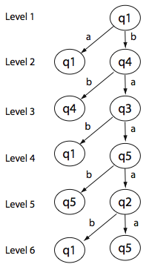
Tree Construction (2)
s
Start here, initial state is the root
s
s
s₁ becomes leaf, s₄ can be expanded
s
s
s
s
s
s
s
s
No further expansion possible
Test Generation based on Finite State Models (© 2014 Professor W. Eric Wong, The University of Texas at Dallas)

Slide 52
Tree Construction (3)
The testing tree is initialized with the initial state s₁ as the root node.
This is level 1 of the tree.
We note that g(s₁, a) = s₁ and g(s₁, b) = s_{4.} Hence, we create two nodes at the next level and label them as s₁ and s₄.
The branches from s₁ to s₁ and s₄ are labeled, respectively, a and b.
As s₁ is the only node at level 1, we now proceed to expand the tree to form level 2.
At level 2, we first consider the node labeled s₁. However, another mode labeled s₁ already appears at level 1; hence, this node becomes a leaf node and is not expanded any further.
Next, we examine the node labeled s₄. We note that g(s₄, a) = s₃ and g(s₄, b) = s_{4.} We, therefore, create two new nodes at level 3 and label these as s₃ and s₄ and label the corresponding branches as a and b, respectively.
Test Generation based on Finite State Models (© 2014 Professor W. Eric Wong, The University of Texas at Dallas)

Slide 53
Step 3.2: Generation of the transition cover set P from the testing tree

Slide 54
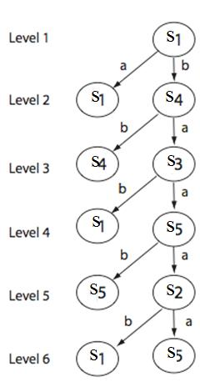
Find The Transition Cover Set from a Testing Tree
A transition cover set P is a set of all strings representing sub-paths, starting at the root, in the testing tree.
  A sub-path is a path starting from the root of the testing tree and terminating in any node of the tree.
  Concatenation of the labels along the edges of a sub-path is a string that belongs to P.
  The empty string (ε) also belongs to P.
P={ε, a, b, bb, ba, bab, baa, baab, baaa, baaab, baaaa}
Test Generation based on Finite State Models (© 2014 Professor W. Eric Wong, The University of Texas at Dallas)

Slide 55
Why is it called a Transition Cover Set?
Exciting an FSM in s₀, the initial set, with an element of P, forces the FSM into some state.
After the FSM has been excited with all elements of P, each time starting in the initial state, the FSM has reached every state.
Thus, exciting an FSM with elements of P ensures that all states are reached and all transitions have been traversed at least once.
  The empty input sequence does not traverse any branch but is useful in constructing some desired test sequence.
Test Generation based on Finite State Models (© 2014 Professor W. Eric Wong, The University of Texas at Dallas)

Slide 56
Step 4: Construction of Z from W and m

Slide 57
Construction of Z from W and m
Given that I is the input alphabet and W the characterization set. Suppose that the number of states estimated to be in the implementation under test is m, and the number of states in the design specification is n, m > n.
We compute Z as
Z = (I⁰.W) ∪ (I¹.W) ∪ ….. (I^{m-1-n}.W) ∪ (I^{m-n}.W)
  Recall that I⁰ = {ε}, I¹ = I, I² = I . I, and so on, where (.) denotes string concatenation.
For m = n, we get Z = I⁰.W=W
For m < n, we use Z = IW
Test Generation based on Finite State Models (© 2014 Professor W. Eric Wong, The University of Texas at Dallas)

Slide 58
Step 5.1: Test Generation

Slide 59
Generation of a Test Set from P and Z
The test inputs based on the given FSM M can now be derived as T=P.Z
Let’s use the same example. Suppose m = n = 5. We also have I={a, b} and W (the characterization set) ={a, aa, aaa, baaa} (see slide 46)
  Concatenating P with Z, we obtain the desired test set as follows
    Z = I⁰.W ={a, aa, aaa, baaa} (Note: I⁰ = {ε} see slide 56)
    T = P . Z ={ε, a, b, bb, ba, bab, baa, baab, baaa, baaab, baaaa} . {a, aa, aaa, baaa}
If we assume that the implementation has one extra state, that is, m = 6, then we have
    Z = I⁰.W ∪ (I¹.W) ={a, aa, aaa, baaa, aa, aaa, aaaa, abaaa, ba, baa, baaa, bbaaa}
    T = P . Z ={ε, a, b, bb, ba, bab, baa, baab, baaa, baaab, baaaa} .
    {a, aa, aaa, baaa, aa, aaa, aaaa, abaaa, ba, baa, baaa, bbaaa}
Test Generation based on Finite State Models (© 2014 Professor W. Eric Wong, The University of Texas at Dallas)

Slide 60
Step 5.2: Test Execution

Slide 61
Execution of the Generated Test Set
To test the given implementation against its specification M, we do the following for each test input
  Find the expected response to each element of T
  Generate test cases for the application. Note that even though the application is modeled by M, there might be variables to be set before it can be exercised with elements of T.
  Execute the application and check if the response matches.
  Reset the application to the initial state after each test.
    A mismatch between the expected and the actual response does not necessarily imply an error in the implementation.
      Is the specification error free?
      Are the expected and actual responses determined without any error?
      Is the comparison between them correct?
      If the answer is YES to all these questions, then a mismatch implies an error in the implementation.
Test Generation based on Finite State Models (© 2014 Professor W. Eric Wong, The University of Texas at Dallas)

Slide 62
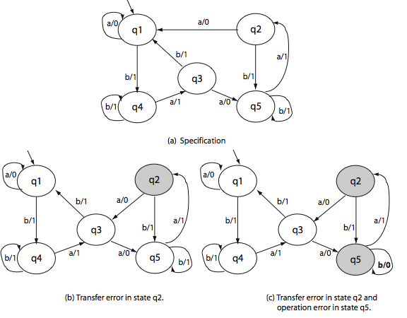
Example One (1): n = m = 5
s
s
M
s
s
s
Correct design
M₁
M₂
s
s
s
s
s
s
s
s
s
s
(b) Transfer error in state s₂
(b) Transfer error in state s₂ and
operation error in state s₅
Test Generation based on Finite State Models (© 2014 Professor W. Eric Wong, The University of Texas at Dallas)

Slide 63
Example One (2): n = m = 5
To test M₁ against M, we apply each test t from the set P.Z and compare M(t) with M₁(t).
  We find that when t = baaaaaa, M(t) = 1101000 and M₁(t) = 1101001.
  Hence, the input sequence baaaaaa reveals the transfer error in M₁.
Similarly, to test M₂ against M, we apply each test t from the set P.Z and compare M(t) with M₂(t).
  We find that when t = baaba, M(t) = 11011 and M₂(t) = 11001.
  Hence, the input sequence baaba reveals the transfer error in M₂.
Test Generation based on Finite State Models (© 2014 Professor W. Eric Wong, The University of Texas at Dallas)

Slide 64
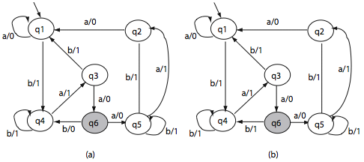
Example Two (1): n = 5 & m = 6
s
s
M
s
s
s
Correct design
s
s
s
s
s
s
s
s
M₃
s
s
s
s
M₄
s
s
s
s
s
s
s
s
s
s
(d) an extra state
(e) an extra state
Test Generation based on Finite State Models (© 2014 Professor W. Eric Wong, The University of Texas at Dallas)

Slide 65
Example Two (2): n = 5 & m = 6
To test M₃ against M, we apply each test t from the set P.Z and compare M(t) with M₃(t).
  We find that when t = baaba, M(t) = 11011 and M₃(t) = 11001.
  Hence, the input sequence baaba reveals the transfer error in M₃.
Similarly, to test M₄ against M, we apply each test t from the set P.Z and compare M(t) with M₄(t).
  We find that when t = baaa, M(t) = 1101 and M₄(t) = 1100.
  Hence, the input sequence baaa reveals the transfer error in M₄.
Test Generation based on Finite State Models (© 2014 Professor W. Eric Wong, The University of Texas at Dallas)

Slide 66
Test Sets Generated Using the W-Method
The W-method is used for constructing a test set from a given FSM M.
The test set so constructed is a finite set of sequences that can be input to a program whose control structure is modeled by M.
The tests can also be input to a design to test its correctness with respect to some specification.
Most software systems cannot be modeled 100% accurately using an FSM. However, the global control structure of a software system cam be modeled by an FSM.
Tests generated using the W-method, or any other method based exclusively on a finite-state model of an implementation is likely to
reveal only certain types of faults. (see slide 4)
Test Generation based on Finite State Models (© 2014 Professor W. Eric Wong, The University of Texas at Dallas)

Slide 67
Automata Theoretical
versus
Control-Flow-Based Techniques
Test Generation based on Finite State Models (© 2014 Professor W. Eric Wong, The University of Texas at Dallas)

Slide 68
Question
The W method is an automata theoretic method for test generation.
In contrast, many books on software testing mention control flow-based techniques for test generation.
What is the difference between the two types of techniques and their fault detection abilities?
Test Generation based on Finite State Models (© 2014 Professor W. Eric Wong, The University of Texas at Dallas)

Slide 69
Control-Flow-Based Techniques (1)
State cover: A test set T is considered adequate with respect to the state cover criterion for an FSM M if the execution of M against each element of T causes each state in M to be visited at least once
Transition cover: A test set T is considered adequate with respect to the branch/transition cover criterion for an FSM M if the execution of M against each element of T causes each transition in M to be taken at least once
Switch cover: A test set T is considered adequate with respect to the
1-switch cover criterion for an FSM M if the execution of M against each element of T causes each pair of transitions (tr₁, tr₂) in M to be taken at least once, where for some input substring ab tr₁: f(s_{j}, a)=s_{i} and
tr₂: f(s_{i}, b) = s_{k}
Test Generation based on Finite State Models (© 2014 Professor W. Eric Wong, The University of Texas at Dallas)

Slide 70
Control-Flow-Based Techniques (2)
Boundary interior cover: A test set T is considered adequate with respect to the boundary-interior cover criterion for an FSM M if the execution of M against each element of T causes each loop (a self-transition) across states to be traversed zero times and at least once.
  Exiting the loop upon arrival covers the “boundary” condition
  Entering it and traversing the loop at least once covers the “interior” condition
Test Generation based on Finite State Models (© 2014 Professor W. Eric Wong, The University of Texas at Dallas)

Slide 71
The following examples illustrate weaknesses of the state cover, branch/transition cover, switch cover and the boundary-interior cover test-adequacy criteria.
Test Generation based on Finite State Models (© 2014 Professor W. Eric Wong, The University of Texas at Dallas)

Slide 72
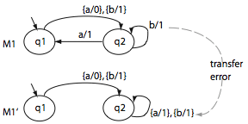
Control-Flow-Based Techniques (3)
Consider the following machines, a correct one (M₁) and one with a transfer error (M₁’)
t=abba covers all states but does not reveal the error. Both machines generate the same output which is 0111.
Will the tests generated by the W method reveal this error?
  Check it out!
M₁
s
s
Refer to Example 3.38, Page 263
M₁’
s
s
Test Generation based on Finite State Models (© 2014 Professor W. Eric Wong, The University of Texas at Dallas)

Slide 73
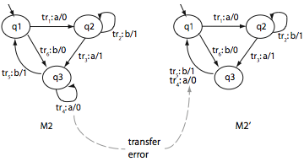
Control-Flow-Based Techniques (4)
Consider the following machines, a correct one (M₂) and one with a transfer error (M₂’)
There are 12 branch pairs, such as (tr₁, tr₂), (tr₁, tr₃), tr₆, tr₅)
Consider the test set: {bb, baab, aabb, aaba, abbaab}
  Does it cover all branches?
  Yes
  T also satisfies the 1-switch cover criterion
  Does it reveal the error?
  No
  Are the states in M₂ 1-distinguishable?
  YES
  For each pair of states (s_{i}, s_{j}), i ≠j, there
  exists a string of length 1 that
  distinguishes s_{i} from s_{j}
s
s
s
s
s
s
M₂’
M₂
Refer to Example 3.38
Test Generation based on Finite State Models (© 2014 Professor W. Eric Wong, The University of Texas at Dallas)

Slide 74
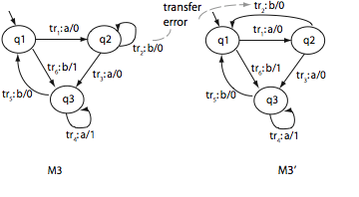
Control-Flow-Based Techniques (5)
Consider the following machines, a correct one (M₃) and one with a transfer error (M₃’)
  There are two loops in M₃ one in state s₂ and the other in s₃
Consider T={t₁: aab, t₂: abaab}
  T is adequate with respect to the
  boundary-interior cover criterion
  t₁ causes both loops to exit without
  looping in either s₂ or s₃
  t₂ causes each loop to be
  traversed once
Is the error revealed by T?
  g_{M3}(s₁, t₁) = g_{M’3}(s₁, t₁) = 000
  g_{M3}(s₁, t₂) = g_{M’3}(s₁, t₂) = 00010
  T cannot distinguish M₃ from M’₃ and
  hence does not reveal the error
s
s
s
s
s
s
M₃
M₃’
Test Generation based on Finite State Models (© 2014 Professor W. Eric Wong, The University of Texas at Dallas)

Slide 75
Summary
Behavior of a large variety of applications can be modeled using finite state machines (FSM)
The W method is an automata theoretic method to generate tests from a given FSM model
Tests generated by using the W method are guaranteed to detect all operation errors, transfer errors, and missing/extra state errors in the implementation given that the FSM representing the implementation is complete, connected, and minimal.
  What happens if it is not?
Automata theoretic techniques generate tests superior in their fault detection ability than their control-theoretic counterparts
Test Generation based on Finite State Models (© 2014 Professor W. Eric Wong, The University of Texas at Dallas)

