Slide 1
Regression Testing
Daniel Barnes
Tracy Han
November 20, 2015

Slide 2

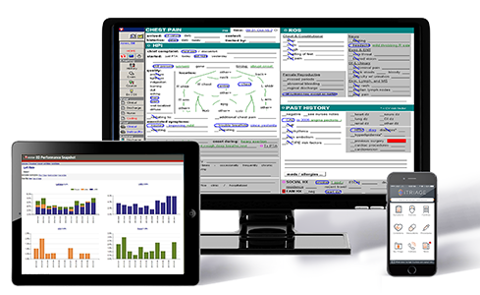
Overview
Background
Tools
Methods
Discussion

Slide 3
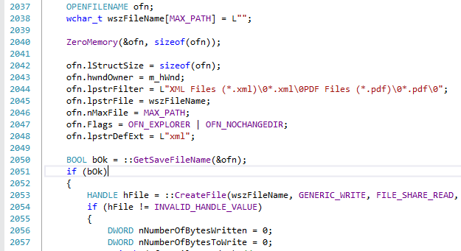
Background
Emergency Department Information System (EDIS)
  C#/C++
  Developed over 15 years
50,000 files in 500 projects
37,000 test cases
Major release: 3000
Minor release: 100-1000
Testing Challenge

Slide 4


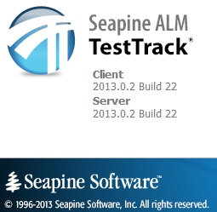

Tools
Scrum Management Axosoft OnTime
Issue Tracking TestTrack
Source Control Subversion
Build System Team City

Slide 5
Methods
TestTrack/OnTime entries drive regression tests
  User stories
  New features
  Defects
  Escalations
Local QA
  Create and assign test cases
Offshore testing team
  No automation, manual execution

Slide 6
Discussion
Missing regression test
  Single line commented out
Insufficient testing
  Single value error
Cloud
Questions

Slide 7
Contact
Daniel Barnes
dbarnes@tsystem.com
Tracy Han
than@tsystem.com

