Slide 1
MC/DC
MC/DC is defined in DO-178B/ED-12B, -“Software Considerations in Airborne Systems and Equipment Certification”, dated December 1, 1992.
Definition of MC/DC:
(1) Every point of entry and exit in the program has been invoked at least once
(2) Every condition in a decision in the program has taken all possible outcomes at least once
(3) Every decision in the program has taken all possible outcomes at least once
(4) Each condition in a decision has been shown to independently affect that decision's outcome. A condition is shown to independently affect a decision's outcome by varying just that condition while holding fixed all
other possible conditions
Notes:
Security testing:
http://en.wikipedia.org/wiki/Security_testing
Six basic security testing concepts
http://www.softwaretestingmentor.com/types-of-testing/security-testing.php
http://en.wikipedia.org/wiki/Security_testing

Slide 2
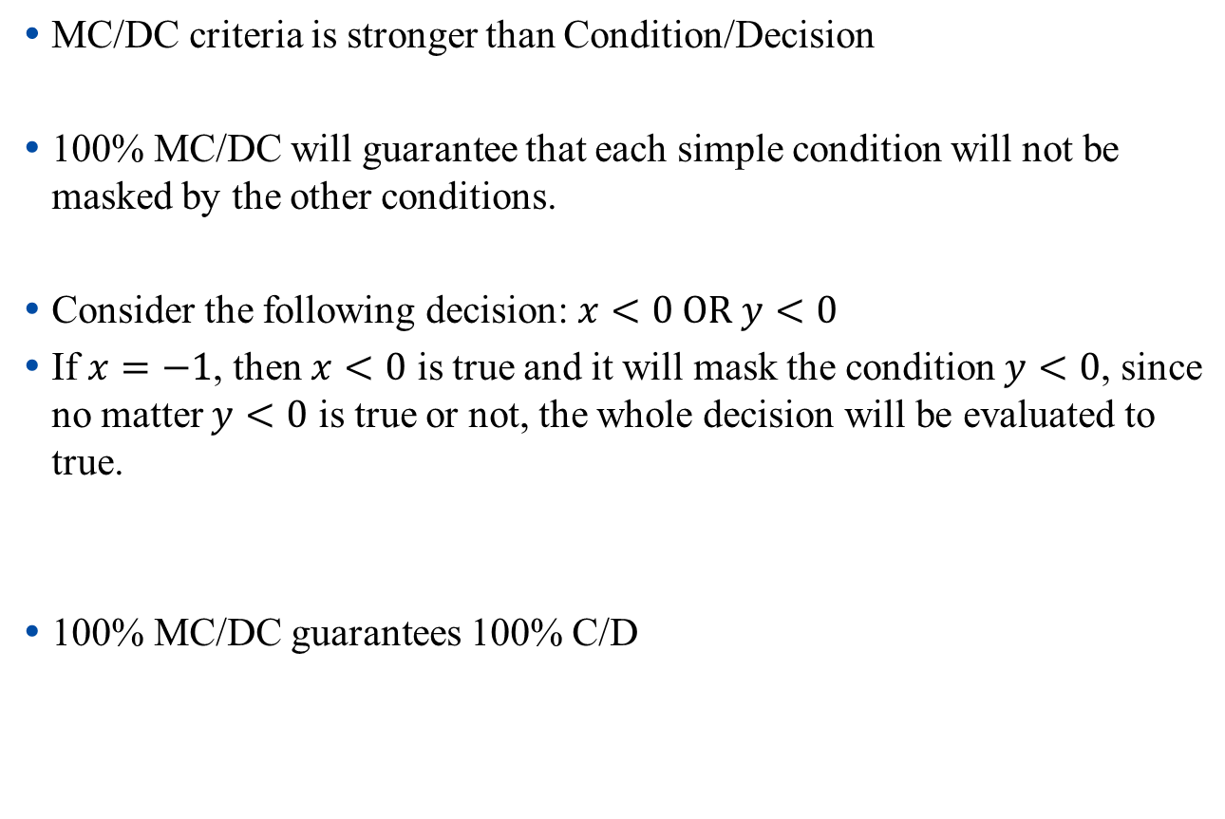
MC/DC
Notes:
Security testing:
http://en.wikipedia.org/wiki/Security_testing
Six basic security testing concepts
http://www.softwaretestingmentor.com/types-of-testing/security-testing.php
http://en.wikipedia.org/wiki/Security_testing

Slide 3
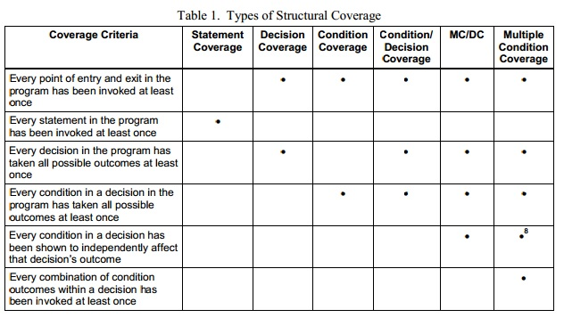
Difference Between Coverage Criterias
Hayhurst, Kelly; Veerhusen, Dan; Chilenski, John; Rierson, Leanna (May 2001). "A Practical Tutorial on Modified Condition/ Decision Coverage". NASA.
Notes:
Security testing:
http://en.wikipedia.org/wiki/Security_testing
Six basic security testing concepts
http://www.softwaretestingmentor.com/types-of-testing/security-testing.php
http://en.wikipedia.org/wiki/Security_testing

Slide 4
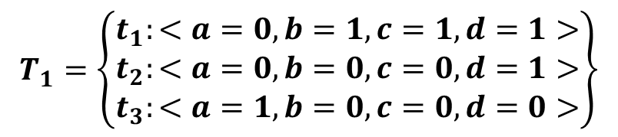

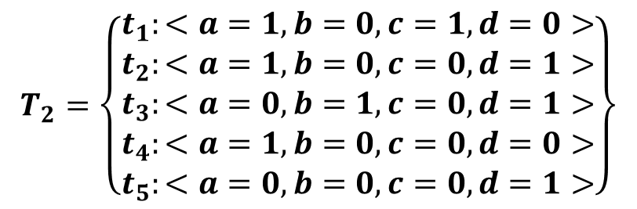

MC/DC Example
Considering the following code:
int isReadyToTakeOff(int a, int b, int c, int d)
{
if(((a == 1) ||(b == 1)) && ((c == 1) || (d == 1)))
return 1; else return 0;
}
Notes:
Security testing:
http://en.wikipedia.org/wiki/Security_testing
Six basic security testing concepts
http://www.softwaretestingmentor.com/types-of-testing/security-testing.php
http://en.wikipedia.org/wiki/Security_testing

Slide 5
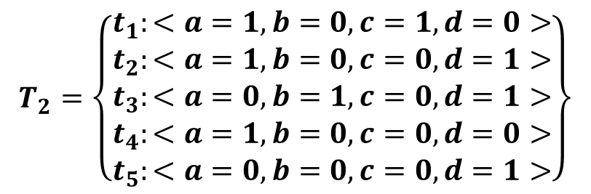

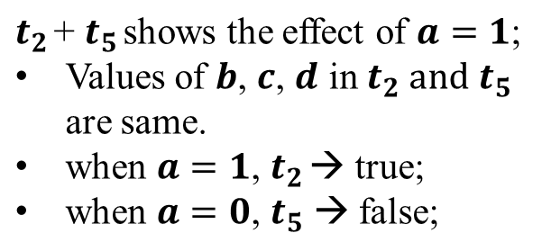
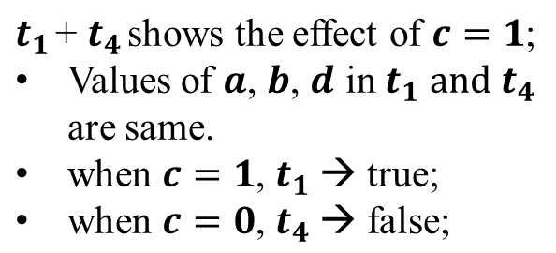
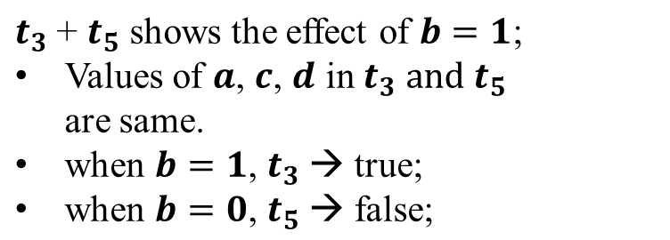
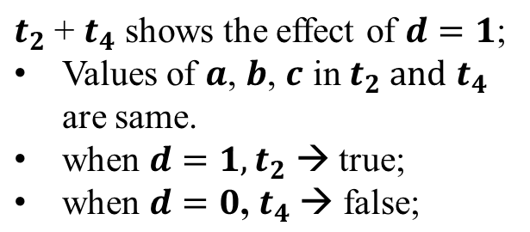
MC/DC Example
Notes:
Security testing:
http://en.wikipedia.org/wiki/Security_testing
Six basic security testing concepts
http://www.softwaretestingmentor.com/types-of-testing/security-testing.php
http://en.wikipedia.org/wiki/Security_testing

Slide 6
STAR
Laboratory of Advanced Research on Software Technology
MCDC Demo
Using Logiscope TestChecker

Slide 7
How Does Logiscope TestChecker Work?
Visual Studio
Generate Make File
[project].mak
Import make file
Create
Logiscope Project
Logiscope
Build Instrumented
Binary Code
Instrumented Binary
Run
Logiscope
TestChecker
Notes:
Security testing:
http://en.wikipedia.org/wiki/Security_testing
Six basic security testing concepts
http://www.softwaretestingmentor.com/types-of-testing/security-testing.php
http://en.wikipedia.org/wiki/Security_testing

Slide 8
Requirement
The self-check module will check the status of 4 engines of a airplane, then return if the airplane can take off.
The airplane shall be able to take off with at least one of the engine1 and engine2 on, and at least one of the engine 3 and engine 4 on.
E2
E3
E1
E4
Notes:
Security testing:
http://en.wikipedia.org/wiki/Security_testing
Six basic security testing concepts
http://www.softwaretestingmentor.com/types-of-testing/security-testing.php
http://en.wikipedia.org/wiki/Security_testing

Slide 9
Source Code
int isReadyToTakeOff(int engine1, int engine2, int engine3, int engine4)
{
if(((engine1 == 1) ||(engine2 == 1))
&& ((engine3 == 1) || (engine4 == 1)))
{
return 1;
}
else
{
return 0;
}
}
Notes:
Security testing:
http://en.wikipedia.org/wiki/Security_testing
Six basic security testing concepts
http://www.softwaretestingmentor.com/types-of-testing/security-testing.php
http://en.wikipedia.org/wiki/Security_testing

Slide 10
Source Code
100% C/D coverage
Test cases | engine1 | engine2 | engine3 | engine4 | Result | Oracle
1 | 0 | 1 | 1 | 0 | 1 | 1
2 | 0 | 0 | 0 | 1 | 0 | 0
3 | 1 | 0 | 0 | 0 | 0 | 0
Notes:
Security testing:
http://en.wikipedia.org/wiki/Security_testing
Six basic security testing concepts
http://www.softwaretestingmentor.com/types-of-testing/security-testing.php
http://en.wikipedia.org/wiki/Security_testing

Slide 11
Requirement
The self-check module will check the status of 4 engines of a airplane, then return if airplane can take off.
The airplane shall be able to take off with at least one of the engine1 and engine2 on, and at least one of the engine3 and engine4 on.
New requirement:
The airplane shall not be able to take off with engine3 off.
Notes:
Security testing:
http://en.wikipedia.org/wiki/Security_testing
Six basic security testing concepts
http://www.softwaretestingmentor.com/types-of-testing/security-testing.php
http://en.wikipedia.org/wiki/Security_testing

Slide 12

Source Code
Although these test cases achieved 100% C/D coverage, bug is not revealed, since with respect to all test cases, engine3 == 0 can not directly effect the decision’s outcomes.
In another word, with respect to all test cases, engine3 == 0 is masked by other conditions.
Test cases | engine1 | engine2 | engine3 | engine4 | Result | Oracle
1 | 0 | 1 | 1 | 0 | 1 | 1
2 | 0 | 0 | 0 | 1 | 0 | 0
3 | 1 | 0 | 0 | 0 | 0 | 0
Notes:
Security testing:
http://en.wikipedia.org/wiki/Security_testing
Six basic security testing concepts
http://www.softwaretestingmentor.com/types-of-testing/security-testing.php
http://en.wikipedia.org/wiki/Security_testing

Slide 13
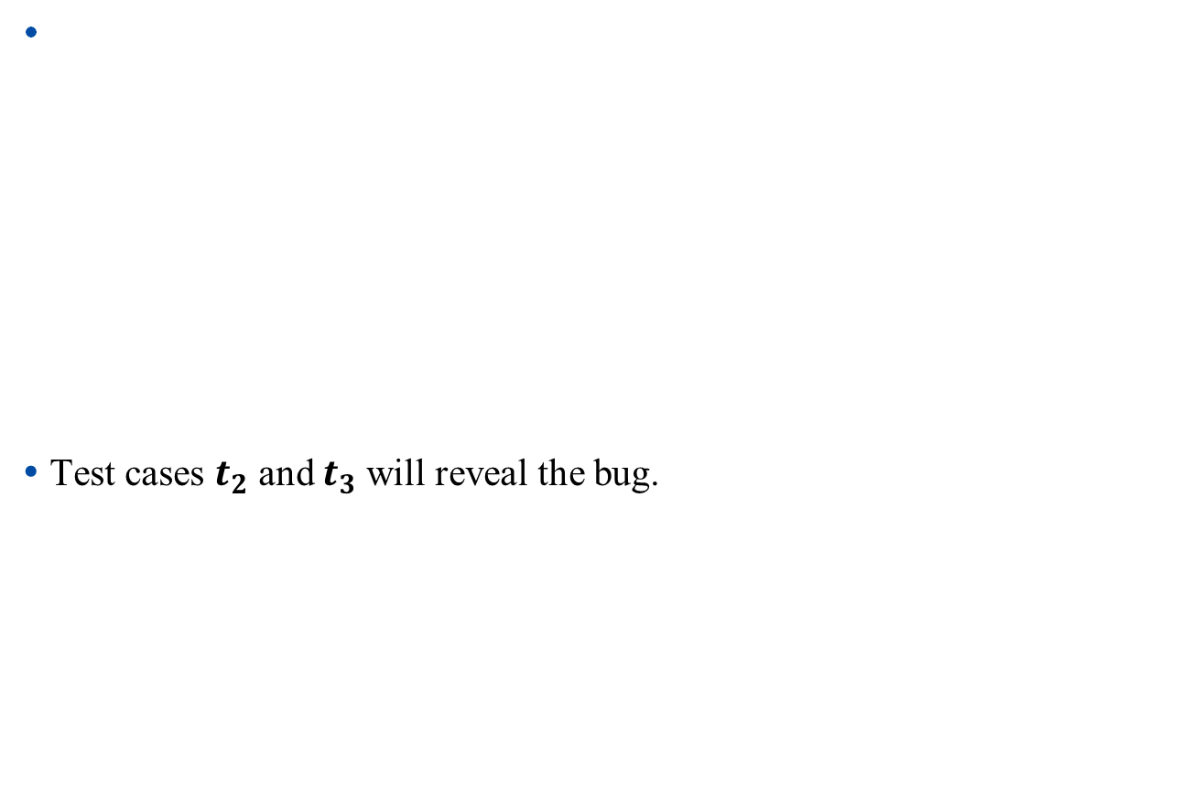

Source Code
Test cases | engine1 | engine2 | engine3 | engine4 | Result | Oracle
1 | 1 | 0 | 1 | 0 | 1 | 1
2 | 1 | 0 | 0 | 1 | 1 | 0
3 | 0 | 1 | 0 | 1 | 1 | 0
4 | 1 | 0 | 0 | 0 | 0 | 0
5 | 0 | 0 | 0 | 1 | 0 | 0
Notes:
Security testing:
http://en.wikipedia.org/wiki/Security_testing
Six basic security testing concepts
http://www.softwaretestingmentor.com/types-of-testing/security-testing.php
http://en.wikipedia.org/wiki/Security_testing

