Slide 1
Systematic Software
Testing Techniques: Combinatorial Testing
Dr. Renée Bryce
Associate Professor
University of North Texas
Renee.Bryce@unt.edu

Slide 2
Presentation outline
Introductions
Motivation
Background on combinatorial testing
    Exercise – Create a combinatorial test suite on paper
Algorithms for combinatorial testing
  Exercise – Download and use the ACTS tool
Prioritized Combinatorial Testing

Slide 3
Introductions
Briefly share your experiences with Software Testing

Slide 4
Motivation
Costs of software defects
  Software defects cost ~$59 billion per year [1]
One contributor to software defects
    Many system components are tested individually, but often unexpected interactions between components cause failures.
[1] National Institute of Standards and Technology, The Economic Impacts of Inadequate Infrastructure for Software Testing, U.S. Department of Commerce, May 2002.

Slide 5
Combinatorial Test Example
Hardware | Operating System | Network Connection | Memory
PC | Windows XP | Dial-up | 64MB
Laptop | Linux | DSL | 128MB
PDA | FreeBSD | Cable | 256MB
Four factors (components) have three levels (options) each
Sample test
Test
No.
Hardware
Operating
System
Network
Connection
Memory
1
PC
Windows XP
Dial-up
64MB
Pairs covered
1. (PC, Windows XP) | 4. (Windows XP, Dial-up)
2. (PC, Dial-up) | 5. (Windows XP, 64MB)
3. (PC, 64MB) | 6. (Dial-up, 64MB)

Slide 6
Combinatorial Test Example
Hardware | Operating System | Network Connection | Memory
PC | Windows XP | Dial-up | 64MB
Laptop | Linux | DSL | 128MB
PDA | FreeBSD | Cable | 256MB
Four factors (components) have three levels (options) each
Test No.
Hardware
Operating
System
Network
Connection
Memory
1
PC
Windows XP
Dial-up
64MB
2
Laptop
FreeBSD
DSL
64MB
3
PDA
Linux
Cable
64MB
4
Laptop
Windows XP
Cable
128MB
5
Laptop
Linux
Dial-up
256MB
6
PC
Linux
DSL
128MB
7
PDA
Windows XP
DSL
256MB
8
PC
FreeBSD
Cable
256MB
9
PDA
FreeBSD
Dial-up
128MB

Slide 7
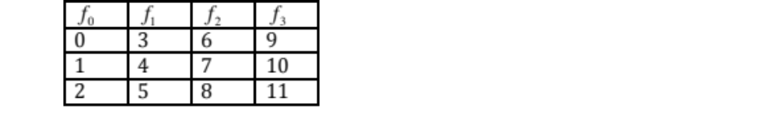
Exercise 1
1. List all of the 2way combinations (pairs) for this input:
Hint: Example pairs are (0,3) (0,4) (0,5)…. (8,11)
2. Create a combinatorial test suite for the input above. No credit will be given for an exhaustive test suite.

Slide 8
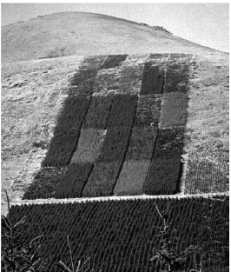
Brief background
Combinatorial testing has been used
in several fields:
  Agriculture
  Combinatorial chemistry
  Genomics
  Software/hardware testing
Study of Mozilla web browser found 70% of defects with 2-way coverage; ~90% with 3-way; and 95% with 4-way. [Kuhn et. al., 2002]
Combinatorial testing of 109 software-controlled medical devices recalled by US FDA uncovered 97% of flaws with 2-way coverage; and only 3 required higher than 2. [Kuhn et. al., 2004]

Slide 9


Covering arrays
A covering array, , is an N x k array. In every N x t subarray, each t-tuple occurs at least λ times. In our application, t is the strength of the coverage of interactions, k is the number of components (factors), and v is the number of options for each component (levels). In all of our discussions, we treat only the case when λ = 1, (i.e. that every t-tuple must be covered at least once).
Behind the scenes this combinatorial object is constructed to represent interaction test suites
No efficient exact method is known
Mathematicians and Computer Scientists have offered solutions from different view points. Their solutions have been measured by time to generate test suites and sizes of test suites.

Slide 10
Perceived benefits of greedy algorithms
 | Mathematical | Greedy | Search
Size of test suites | Accurate on special cases; but not as general as needed | Reasonably accurate | Most accurate (if given enough time)
Time to generate tests | Yes | Yes | Often time consuming (for good results)
Seeding/ Constraints | Difficult to accommodate seeds/constraints | Yes | Yes

Slide 11
History of One-test-at-a-time Greedy Algorithms
AETG
  Pros
    First tool to generate test suites (based on covering arrays)
  Cons
    Produces different test suites to the same inputs
    Slow
  Pros
    Deterministic
    Particularly good for mixed-level inputs
    Faster
  Cons
    Overly large test suites for fixed-level inputs
  Pros
    Deterministic
    Competitive results
    Logarithmic guarantee on the size of test suites
TCG
DDA

Slide 12
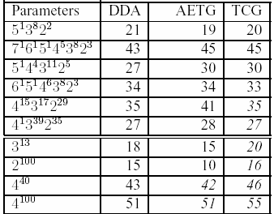
Sample sizes of test suites
[1] R. Bryce, C.J. Colbourn. A Density-Based Greedy Algorithm for Higher Strength Covering Arrays, Journal of Software Testing, Verification, and Reliability, (March 2009), 19(1):37-53.
[2] R. Bryce, C.J. Colbourn. The Density Algorithm for Pairwise Interaction Testing, Journal of Software Testing, Verification and Reliability, (August 2007), 17(3): 159-182.
*(Citeseer impact ranking of STVR: .36)

Slide 13
Framework of One-row-at-a-time Greedy Methods
Defines commonalities that all “one-row-at-a-time” greedy algorithms have in common
A process provides statistical feedback on the impact of different decisions that can be made in the framework
Experiments explore several thousand instantiations of the framework and provide a requisite of knowledge

Slide 14
Framework for greedy methods
Framework
Layer one: test suite repetitions
Layer two: multiple candidates
Layer three: factor ordering*
Layer four: level selection*
Pairs left to cover:
Test No.
Hardware
Operating
System
Network
Connection
Memory
48
1
PC
Windows XP
Dial-up
64MB
42
2
PC
Linux
DSL
128MB
36
3
PC
FreeBSD
Cable
256MB
4
?
?
?
?

Slide 15
Framework for greedy methods
Framework
Layer one: test suite repetitions
Layer two: multiple candidates
Layer three: factor ordering*
Layer four: level selection*
Factor 1 | ? | ? | ?
PC
Laptop
PDA
Involved in 9 uncovered pairs
Involved in 9 uncovered pairs
Involved in no uncovered pairs

Slide 16
Framework for greedy methods
Framework
Layer one: test suite repetitions
Layer two: multiple candidates
Layer three: factor ordering*
Layer four: level selection*
Laptop | ? | ? | ?
PC
Laptop
PDA
Involved in 9 uncovered pairs
Involved in 9 uncovered pairs
Involved in no uncovered pairs

Slide 17
Framework for greedy methods
Framework
Layer one: test suite repetitions
Layer two: multiple candidates
Layer three: factor ordering*
Layer four: level selection*
Laptop | ? | Factor 3 | ?
Dial-up
DSL
Cable
Will cover 1 new pair
Will cover 1 new pair
Will cover 1 new pair

Slide 18
Framework for greedy methods
Framework
Layer one: test suite repetitions
Layer two: multiple candidates
Layer three: factor ordering*
Layer four: level selection*
Laptop | ? | DSL | ?
Dial-up
DSL
Cable
Will cover 1 new pair
Will cover 1 new pair
Will cover 1 new pair

Slide 19
Framework for greedy methods
Framework
Layer one: test suite repetitions
Layer two: multiple candidates
Layer three: factor ordering*
Layer four: level selection*
Laptop | Factor 2 | DSL | ?
WinXP
Linux
FreeBSD
Will cover 2 new pair
Will cover 1 new pair
Will cover 2 new pairs

Slide 20
Framework for greedy methods
Framework
Layer one: test suite repetitions
Layer two: multiple candidates
Layer three: factor ordering*
Layer four: level selection*
Laptop | WinXP | DSL | ?
WinXP
Linux
FreeBSD
Will cover 2 new pair
Will cover 1 new pair
Will cover 2 new pairs

Slide 21
Framework for greedy methods
Framework
Layer one: test suite repetitions
Layer two: multiple candidates
Layer three: factor ordering*
Layer four: level selection*
Laptop | WinXP | DSL | Factor 4
64MB
128MB
256MB
Will cover 2 new pair
Will cover 2 new pair
Will cover 3 new pairs

Slide 22
Framework for greedy methods
Framework
Layer one: test suite repetitions
Layer two: multiple candidates
Layer three: factor ordering*
Layer four: level selection*
Laptop | WinXP | DSL | 64MB
64MB
128MB
256MB
Will cover 2 new pair
Will cover 2 new pair
Will cover 3 new pairs

Slide 23
Framework for greedy methods
Framework
Layer one: test suite repetitions
Layer two: multiple candidates*
Layer three: factor ordering
Layer four: level selection
Number of newly covered pairs
3 candidate rows
PDA
Linux
Cable
128MB
6
PDA
Win XP
Cable
64MB
5
PDA
Linux
Cable
128MB
5

Slide 24
Framework for greedy methods
Framework
Layer one: test suite repetitions*
Layer two: multiple candidates
Layer three: factor ordering
Layer four: level selection
Test suite A
Test suite B
Test suite C
Select the smallest test suite generated.

Slide 25
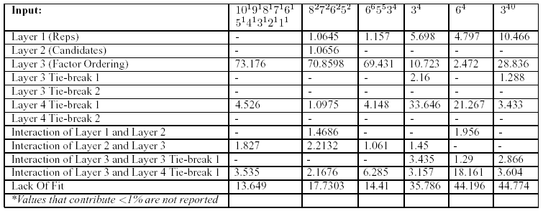
Framework experiment - ANOVA results for several inputs
[1] R.Bryce, C.J. Colbourn, M.B. Cohen. A Framework of Greedy Methods for Constructing Interaction Tests. The 27th International Conference on Software Engineering (ICSE), St. Louis, Missouri. (May 2005), pp. 146-155. (13% acceptance rate)
*Citeseer impact ranking of ICSE: 2.05

Slide 26
ACTS – Free Download
ACTS is a free tool to generate combinatorial test suites
Download at: http://csrc.nist.gov/groups/SNS/acts/download/
login ID is 'fireeye',
password 'acts71362'
Create a test suite for this input with 2way coverage and then generate a 2nd test suite with 3way coverage:

Slide 27
Prioritized combinatorial testing
What if parts of a system are more important to test earlier?
What if a tester learns during testing and wants to regenerate a test suite with new priorities?
What if a tester has time to run pair-wise coverage and time to run some three-way tests?

Slide 28

A variation of the covering array
An ℓ-biased covering array is a covering array CA(N; 2, k, v) in which the first rows form tests whose total benefit is as large as possible. That is, no CA(N; 2, k, v) has rows that provide larger total benefit.
Input
3 factors with varying numbers of associated levels (options) and weights assigned to each level

Slide 29
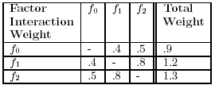
Algorithm Walkthrough
Input
3 factors with varying numbers of associated levels (options) and weights assigned to each level
Larger weight means higher priority should be given to testing earlier!
Step 1 – Calculate Factor Interaction Weights.
Factors will be assigned values in order of “highest priority”

Slide 30


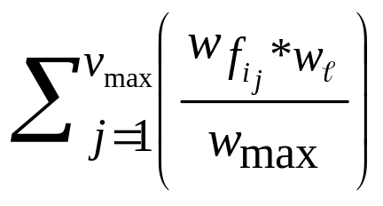
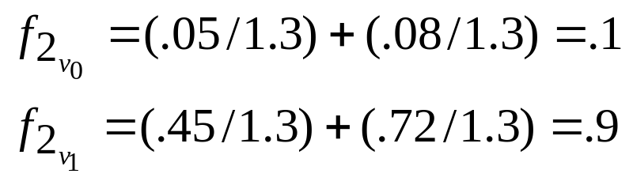

Algorithm Walkthrough
Input
Input has been processed
Factor interaction weights have been calculated (to determine order to assign level values to factors).
Step 2 – Calculate Factor-Level Interaction Weights to select the level that covers the most uncovered weighted density.
For a factor, i, and a level, ℓ, that number of levels for a factor is called , and the factor interaction weight is called
Factor-Level Interaction Weight =
Remember, the factor interaction weight was 1.3 for factor 2.

Slide 31
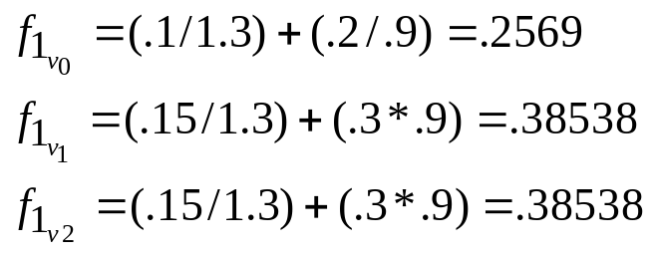
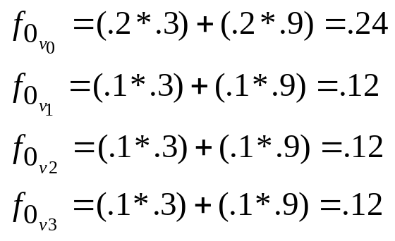
Algorithm Walkthrough
For a factor, i, and a level, ℓ, that number of levels for a factor is called , and the factor interaction weight is called
Factor-Level Interaction Weight =
Step 2 (continued) - Calculate Factor-Level Interaction Weights to select the level that covers the most uncovered weighted density.
Weight between two levels divided by max factor-interaction weight
Weight between two levels divided by max factor-interaction weight + Weight of level multiplied by weight of level (of fixed factor)
Weights of levels between each multiplied

Slide 32
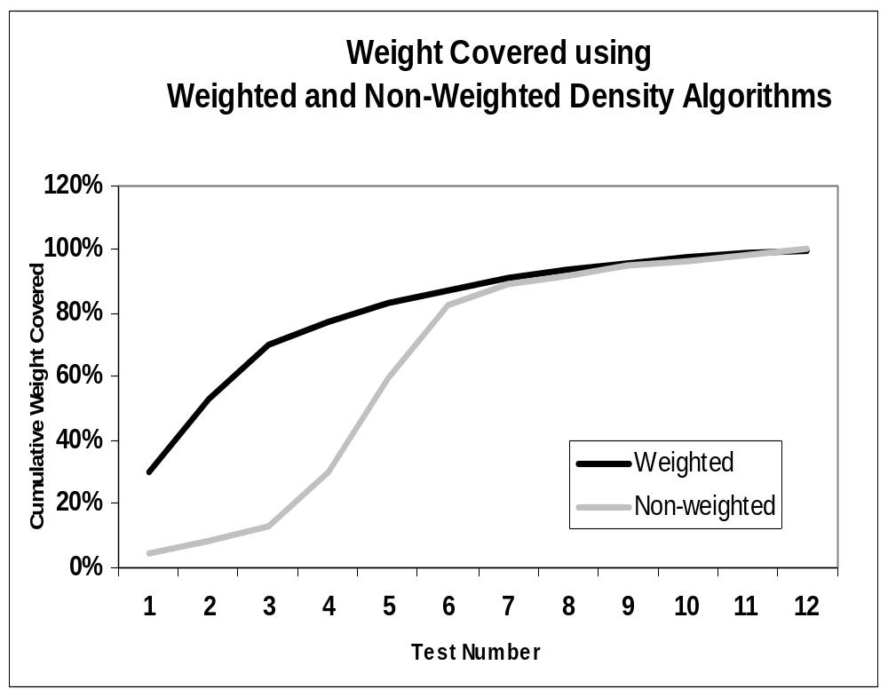
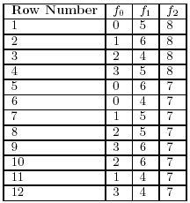
Sample Results
Input
Output
[1] R. Bryce, C.J. Colbourn. Prioritized Interaction Testing for Pairwise Coverage with Seeding and Avoids, Information and Software Technology Journal (IST, Elsevier), (October 2006), 48(10):960-970.
* Citeseer impact ranking of ICST: .19

Slide 33
Ongoing and future work
Ultimate goal: to develop systematic testing methodologies that are widely used to improve software quality
Reaching this goal:
  Testing methodology driven by practical concerns of testers
  Algorithms (for testing tools)
  Empirical studies

