Slide 1
Test Suite Prioritization and Reduction by Combinational-based Criteria
Dr. Renée Bryce
Associate Professor
University of North Texas
Renee.Bryce@unt.edu

Slide 2
Presentation outline
Test Suite Prioritization
  Exercise: Prioritize a test suite
Test Suite Reduction
  Exercise: Reduce a test suite using HGS
Discussion

Slide 3


Test Suite Prioritization
Test Suite Prioritization
  Problem: Given T, a test suite, Π, the set of all test suites obtained by permuting the tests of T, and f, a function from Π to the set of real numbers, the problem is to find π∈Π such that ∀π′ ∈Π,f(π)≥f(π′). In this definition, Π refers to the possible prioritizations of T and f is a function applied to evaluate the orderings.
Convert the web logs to a user-session-based test suite.
POST/GET requests
The test suite is large!

Slide 4
Case Study: Prioritizing User-session-based Test Suites
Methodology: Convert web logs to user-session-based test suites, prioritize, and write to an XML format.
Algorithm: Efficiently prioritize by combinatorial-based coverage for large test suites
Empirical Studies: Families of empirical studies to analyze the effectiveness in relation to characteristics of the applications and test suites.

Slide 5
Research Questions
Can we improve the rate of fault detection for user-session-based testing with new prioritization criteria?
Which techniques are valuable in different scenarios?
  i.e.: tests have a high/low Fault Detection Density
  i.e.: predicted distribution of faults (deemed from prior versions of the software)
Can we fine tune the criteria?
  i.e.: cost-based prioritization

Slide 6
Prioritization Metrics
Test length based on number of base requests:
  order by the number of HTTP requests in a test case
Frequency-based prioritization:
  order such that test cases that cover most frequently accessed pages/sequence of pages are selected for execution before test cases that exercise the less frequently accessed pages/sequences of pages.
Unique coverage of parameter-values:
  order tests to cover all unique parameter-values as soon as possible
2-way parameter-value interaction coverage:
  order tests to cover all pair-wise combinations of parameter-values between pages as soon as possible
Test length based on number of parameter-value:
  order by number of parameter-values used in a test case
Random:
  randomly permute the order of tests

Slide 7
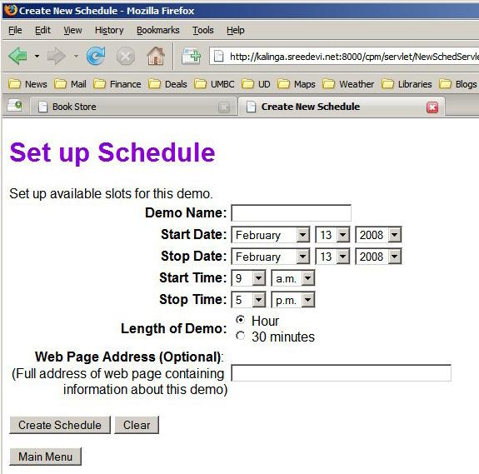

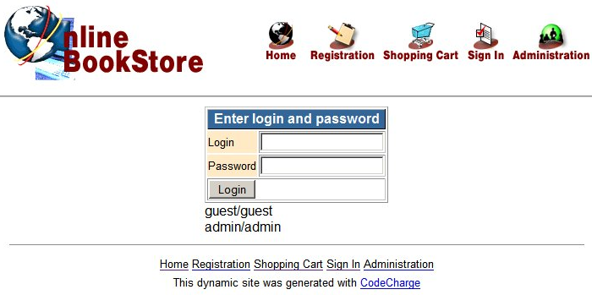
Empirical Studies
TerpCalc, TerpPaint, Terp Spreadsheet, and TerpWord
Online Bookstore
Online Course Project Manager (CPM)
Online Conference Management System
SchoolMate
Online Music Store
Metavist (sponsored by USDA)

Slide 8
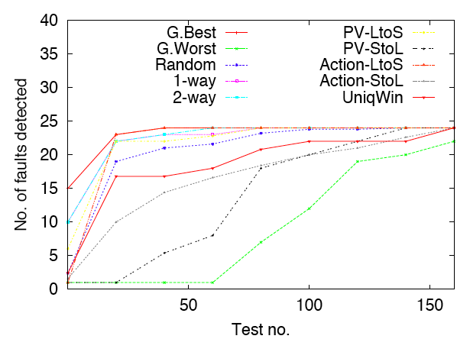
Results for an on-line system for a Course Project Manager and 890 Test Cases
[1] R. Bryce, S. Sampath, A. Memon. Developing a Single Model and Test Prioritization Strategies for Event-Driven Software, Transactions on Software Engineering, (January 2011), 37(1):48-64.

Slide 9
Sample results
% of test suite run | Most frequent requests | No. of Requests Long to short | No. of Requests Short to long | PVs Long to short | PVs Short to Long | 1-way | 2-way | Random
10 | 85.28 | 78.17 | 75.14 | 83.53 | 16.38 | 83.79 | 83.72 | 48.63
20 | 88.52 | 80.34 | 77.76 | 88.77 | 25.6 | 87.78 | 90.8 | 57.55
30 | 89.4 | 81.77 | 80.27 | 88.77 | 26.44 | 91.54 | 91.72 | 64.51
40 | 89.86 | 84.58 | 81.39 | 92.71 | 28.76 | 94.79 | 95.64 | 69.19
50 | 91.04 | 85.58 | 82.95 | 92.71 | 30.33 | 94.79 | 95.64 | 73.03
60 | 91.58 | 87.14 | 84.44 | 94.26 | 34.64 | 94.79 | 95.64 | 75.37
70 | 92.1 | 87.74 | 85.15 | 94.26 | 39.15 | 94.79 | 95.64 | 77.37
80 | 92.35 | 88.27 | 86.21 | 94.26 | 39.58 | 94.79 | 95.64 | 78.24
90 | 92.37 | 88.3 | 86.31 | 94.26 | 42.18 | 94.99 | 95.64 | 78.45
100 | 92.45 | 88.36 | 86.35 | 94.26 | 43.09 | 94.99 | 95.64 | 78.49

Slide 10
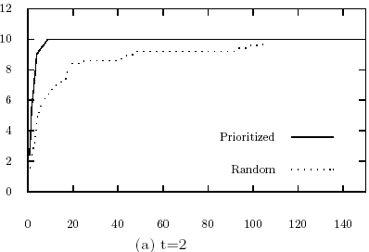
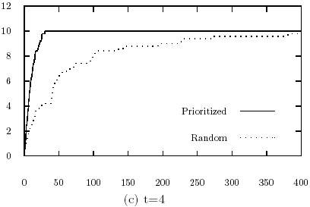
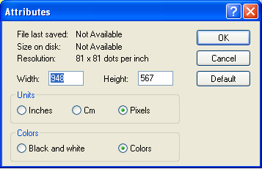
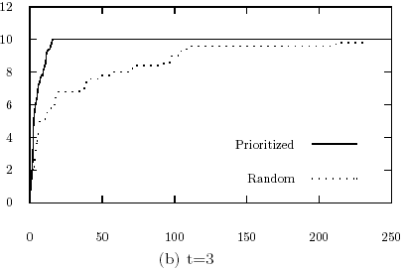
Test prioritization by interaction coverage
Test suite prioritization
  GUI-based testing

Slide 11

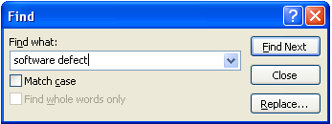
Empirical Studies
Traffic Collision Avoidance System
GUI-based Testing
  Word processor
  Spreadsheet
  Paint
  Calculator
Web application Testing
  Bookstore
  Course Project Manager
  Conference Management Software

Slide 12
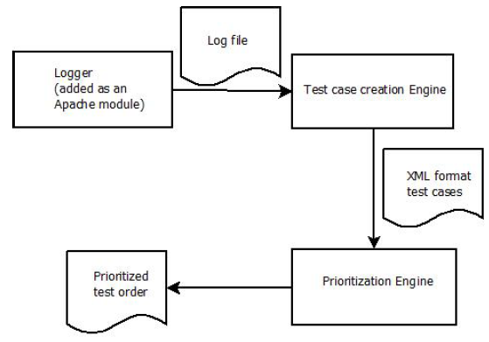

Transfer of Work
Potential users that have contacted NIST to use our tool:
AT&T
BBC (for Winter Olympics website)
Booz Allen Hamilton
Angel.com
U.S. Army Test and Evaluation Research Laboratory, Aberdeen Proving Ground
A2Z Research and Development
NASA IV&V

Slide 13
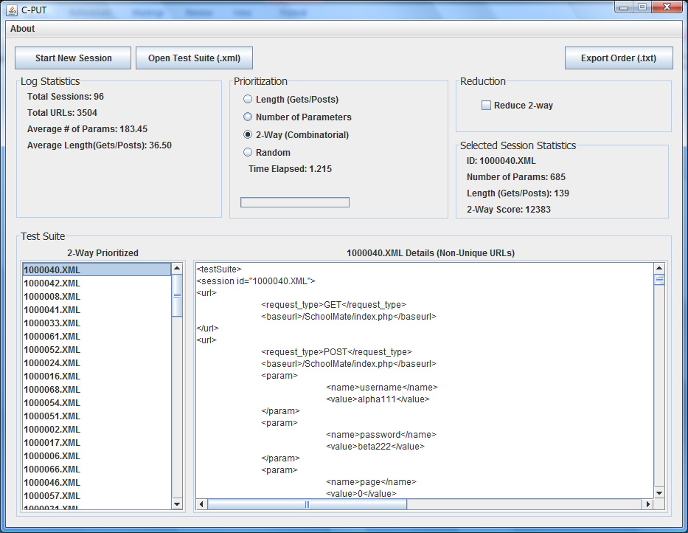
Transfer of Work (Demo)
[1] S. Sampath, R. Bryce, S. Jain, S. Manchester. A Tool for Combinatorial-based Prioritization and Reduction of User-Session-Based Test Suites, International Conference on Software Maintenance (ICSM) - Tool Demonstration Track, Williamsburg, VA, September 2011

Slide 14
Next steps
Methodologies
  Examining issues with RIAs
Algorithms
  Hybrid techniques
Empirical Studies
  “Real” studies
  RIA studies

Slide 15
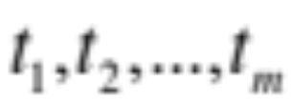




Test Suite Reduction
Problem: Given T, a test suite with test cases { }, a set of testing requirements,{ }, that must be satisfied to provide the desired test coverage of the program, and subsets { } of T, one associated with each of the s such that any one of the tests belonging to Ti satisfies . Find the minimal cardinality subset of T that exercises all of the requirements exercised by the original test suite T.
Original Test Suite
(Too large for our budget)
Reduced Test Suite
(Fits into budget)

Slide 16
Reduction Example
Original Test Suite
  {t1,t2,t3,t4}
Requirements covered by the test suite
  {r1,r2,r3,r4}
Problem: Reduce the test suite such that it maintains coverage of these requirements

Slide 17
Test Suite Reduction Example
T | Requirement | Ti
1 | 1 | {t3,t4}
2 | 2 | {t4}
3 | 3 | {t1, t2, t3, t5}
4 | 4 | {t1, t2, t3}
In this example, there are three possible solutions. We highlighted 1: {t1, t4}

Slide 18
Test Suite Reduction Example
HGS Algorithm
Select t5 since it is of cardinality 1
T | Requirement | Ti
1 | 1 | {t1, t5}
2 | 2 | {t5}
3 | 3 | {t1, t2, t3}
4 | 4 | {t3, t6}
5 | 5 | {t1, t4}
6 | 6 | {t1, t6}
7 | 7 | {t3, t4, t7}
8 | 8 | {t2, t3, t4, t7}
2. Consider unmarked Tis of cardinality 2, that is T4, T5, T6.
Select the test that appears in the most Tis. That is a tie between t1 and t6.
Break the tie by examining sets of cardinality (m+1), That is sets T3 and T7.
  Break tie between t1 and t6, by selecting t1 as it is in T3.
3. T4 is of cardinality 2, there is a tie between t3 and t6, so we look at sets of size cardinality (m+1). We choose t3.
Reduced Test Suite:
{t5,
t1,
t3}

Slide 19
Exercise
Reduce this test suite using the HGS algorithm:
T | Requirement | Ti
1 | 1 | {t1, t5}
2 | 2 | {t5}
3 | 3 | {t1, t2, t3}
4 | 4 | {t3, t6}
5 | 5 | {t1, t4}
6 | 6 | {t1, t6}
7 | 7 | {t3, t4, t7}
8 | 8 | {t2, t3, t4, t7}

Slide 20
Test Suite Reduction Example
HGS Algorithm
Select t5 since it is of cardinality 1
T | Requirement | Ti
1 | 1 | {t1, t5}
2 | 2 | {t5}
3 | 3 | {t1, t2, t3}
4 | 4 | {t3, t6}
5 | 5 | {t1, t4}
6 | 6 | {t1, t6}
7 | 7 | {t3, t4, t7}
8 | 8 | {t2, t3, t4, t7}
2. Consider unmarked Tis of cardinality 2, that is T4, T5, T6.
Select the test that appears in the most Tis. That is a tie between t1 and t6.
Break the tie by examining sets of cardinality (m+1), That is sets T3 and T7.
  Break tie between t1 and t6, by selecting t1 as it is in T3.
3. T4 is of cardinality 2, there is a tie between t3 and t6, so we look at sets of size cardinality (m+1). We choose t3.
Reduced Test Suite:
{t5,
t1,
t3}

