Slide 1
Automation In Practice – What It Is & What It Should Be
Software Testing, Validation & Verification - UTD
Fall, 2015

Slide 2




Who Is This Guy?
Paul Grizzaffi
Automation Program Architect & Manager
MedAssets – a healthcare performance improvement company
“Software Pediatrician”
Career focused on automation
Advisor to Software Test Professionals (STP)
http://www.softwaretestpro.com/default.aspx
http://www.stpcon.com
paul_grizzaffi@yahoo.com
http://www.linkedin.com/in/paulgrizzaffi
@pgrizzaffi

Slide 3

What Comes To Mind?

Slide 4
What Comes To Mind?
Saves Time
Scripts
Test Cases
A Lot Of Work
Inconsistent
Regression
Tools
I’m Getting Laid Off
Brittle

Slide 5

What’s It Like Out There?

Slide 6
What’s It Like Out There?
How many test scripts do you have?
How much of regression is automated?
Why aren’t you using QTP? (or Selenium? or TestComplete? or…)
Why do we need testers?

Slide 7
What’s It Like Out There?
Primarily based on test cases
Big focus on smoke and regression
Big focus on UI (but that’s changing)
Tool-centric
Selenium (open source)
QTP/UFT (HP)
Testing is dead (no I’m not)
SDETs – we don’t need testers

Slide 8

AUTOMATION
I DO NOT THINK IT MEANS WHAT YOU THINK IT MEANS

Slide 9
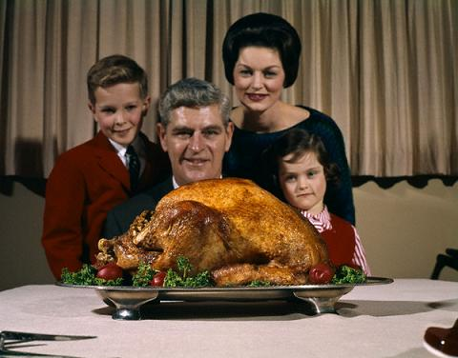
Traditions Can Be Important

Slide 10
Traditions Can Be Important
Traditional automation
Detect behavior changes
Reduce effort on smoke and regression
Earlier execution, earlier alerts
Scheduled execution
This is what most companies call automation
MedAssets has this and it’s valuable
Is there something else?

Slide 11

What If We Think Differently?

Slide 12

What If We Think Differently?
“Let’s help the humans”
What makes us more efficient or more effective?
What’s valuable?
What hurts?
Instead of automation, do we need assistance?

Slide 13
Automation Assist
Umbrella term for non-traditional automation
“Words mean things” – Patrick Amaku
Changing meanings is difficult
New vocabulary for new concepts
Things that increase the value of manual effort
“Off label” tool usage
New tools, applications, scripts
Tools not traditionally thought of as automation
Lets Look At Some Examples

Slide 14
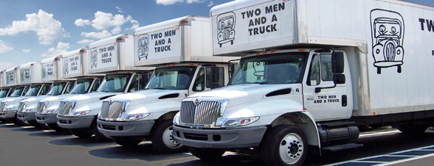
Movin’ On Up

Slide 15

MIRV

Slide 16
MIRV
The premise
Data center migration for a large, complex product
Aggressive dates, limited testing time, limited staff
Experience: system will work or “be egregiously broken”
The solution
Scripts based on existing tool to find egregious issues
Execute against multiple facilities simultaneously
Running on repurposed laptops
TestComplete scripts: several weeks of effort
Why that solution?
Quick, shallow checks can maximize humans’ value
Existing tool reuse reduces effort
7 – 12 business critical incidents prevented

Slide 17
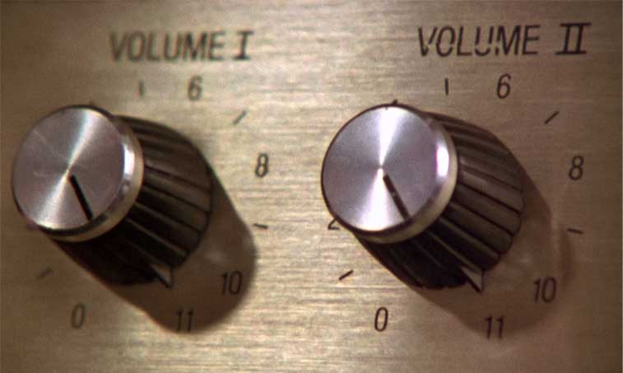
High Volume Automated Testing

Slide 18
High Volume Automated Testing
“…a family of testing techniques that enable the tester to create, run and evaluate the results of arbitrarily many tests”
Workshop on Teaching Software Testing (WTST) 2013

Slide 19
High Volume Automated Testing
Aka HiVAT
Research from Florida Institute of Technology (FIT)
Dr. Cem Kaner, J.D., Ph.D.
Andy Tinkham
http://kaner.com/?p=278
Interesting facets for MedAssets
Many executions
Random execution
Results vetted by humans

Slide 20

Scud

Slide 21
Scud
The premise
Product is large, complex, aging
Not feasible to enumerate and follow all paths
The solution
Random menu clicker – “Scud”
Looking for things that “don’t seem right”
Selenium-based Python script: 32 hours of effort
Found four issues in the first week of use

Slide 22
Scud (cont.)
Why that solution?
Value shown at GameStop
TestComplete not appropriate for this activity
Open source so broad license usage
Not competing for traditional automation licenses
Why a scripting language?
Learning curve is relatively shallow
Development is “faster”
Python expertise is available in our area

Slide 23
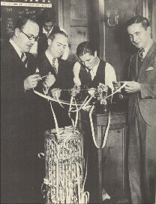
Data Regressor

Slide 24
Data Regressor
The premise
“Regression” testing between software versions
Volatile stock market data
Takes about 8 hours of effort
The solution
Comparison tool
Connect to both servers and compare
Time to test reduced 1 minute
C++ program: “Break Even point”: 6 weeks
Why that solution?
Traditional test scripts not appropriate
Existing API into the product
C++ primary development language
Product bug found during first execution

Slide 25

Results Dashboard

Slide 26
Results Dashboard
The premise
Current tool exercises backend, batch processes
Generates data and compares to “golden files”
Thousands of results files – hard to establish trends
The solution
Program to collate data and give “day minus one” trends
C# program: 16 hours
Why that solution?
Minimum behavior delivered quickly
Windows/.Net shop
Easy to distribute executable

Slide 27
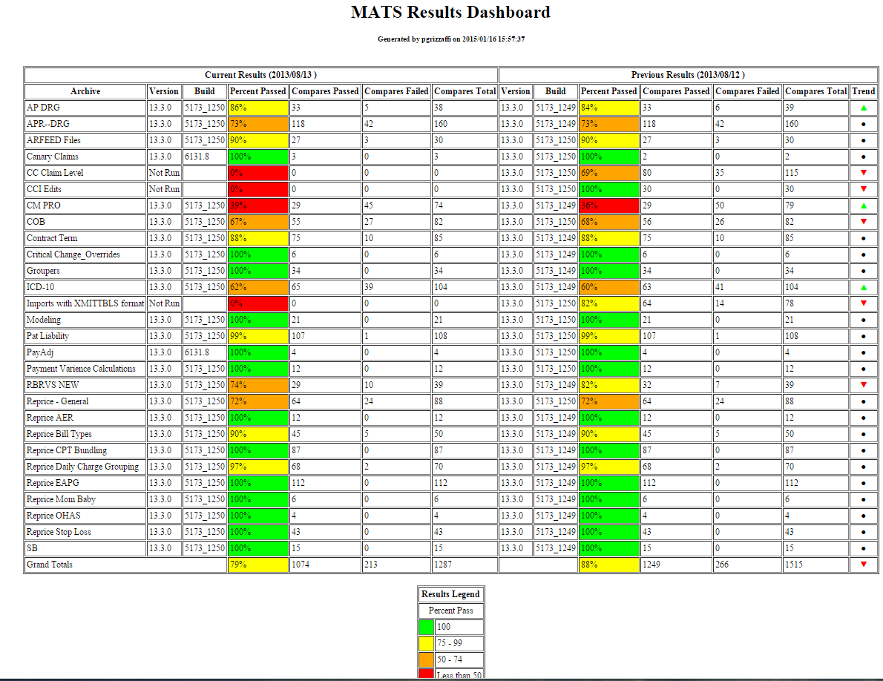

Slide 28
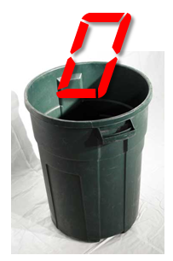
Zero Remover

Slide 29
Zero Remover
The premise
Thousands of “golden files”
In some cases DB now returns NULL instead of 0.00
Manual effort estimate: 4 – 6 weeks
The solution
A program to do the file transformation
C# program: 5 hours
Why that solution?
Disposable
Windows/.Net shop
Easy to distribute executable
Don’t forget about “record and playback”

Slide 30
Some Words About Effort
Effort is a funny thing
“There Ain’t No ROI In Testing”
http://blog.smartbear.com/testing/there-aint-no-roi-in-software-testing/
Instead, think about…
Value
Opportunity cost
Cost Benefit Analysis

Slide 31
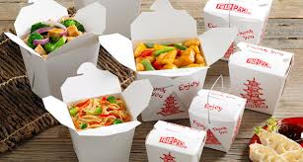
Takeaways
This is different
Nothing wrong with scripting test cases, but that’s an implementation
This is software development
Situational – the “knowns” help guide
Coverage: direct or indirect
Usage profile: running, distributing
Life span: disposable or long term

Slide 32
Questions?
paul_grizzaffi@yahoo.com
http://www.linkedin.com/in/paulgrizzaffi
@pgrizzaffi

Slide 33
Appendix

Slide 34
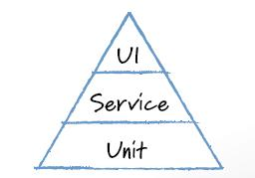
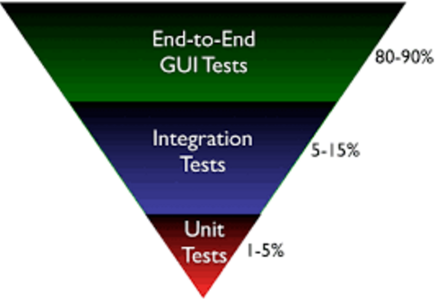
What’s It Like Out There? (Mike Cohn’s Automation Pyramid)
X

