Slide 1
My experiences with Testing
(Theory through to Practice)
VIDROHA DEBROY,
NOVEMBER 6TH 2015

Slide 2
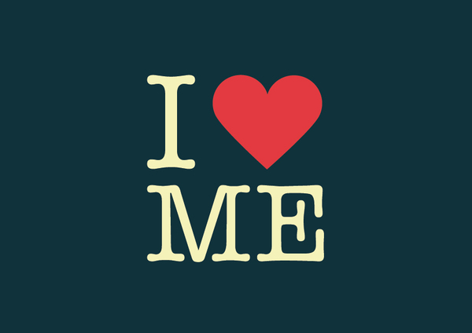
A little bit about me
Graduated with a PhD in Software Engineering under the supervision of Dr. Wong (I think you know him) in 2011.
Joined the Windows Team at Microsoft as an SDET and stayed there for close to 2 years
Returned to DFW and joined Hudson Alley Software as a Senior Software Engineer. Stayed there close to 2 years. Briefly joined another startup.
Currently a Senior Software Architect at Verizon, and an Adjunct Professor at Southern Methodist University.

Slide 3

Why test?
Well Dr. Wong told us we should…Congratulations! You will probably get an A ☺
Testing is an investment with proven returns
Testing is as fundamental a software development activity as any, and often can drive other activities
Testing lets you realize things about your product that you wouldn’t otherwise
On a personal note, testing can help avoid embarrassment

Slide 4

Effective Testing
Testing is not really a question of doing or not doing – it is about understanding; this is as much an art as it is a science
We need to be familiar with the software we are testing
We need to plan, scope and prioritize and measure
We need to treat our tests as first class citizens
We need to leverage automation as appropriate
We need to be creative!

Slide 5
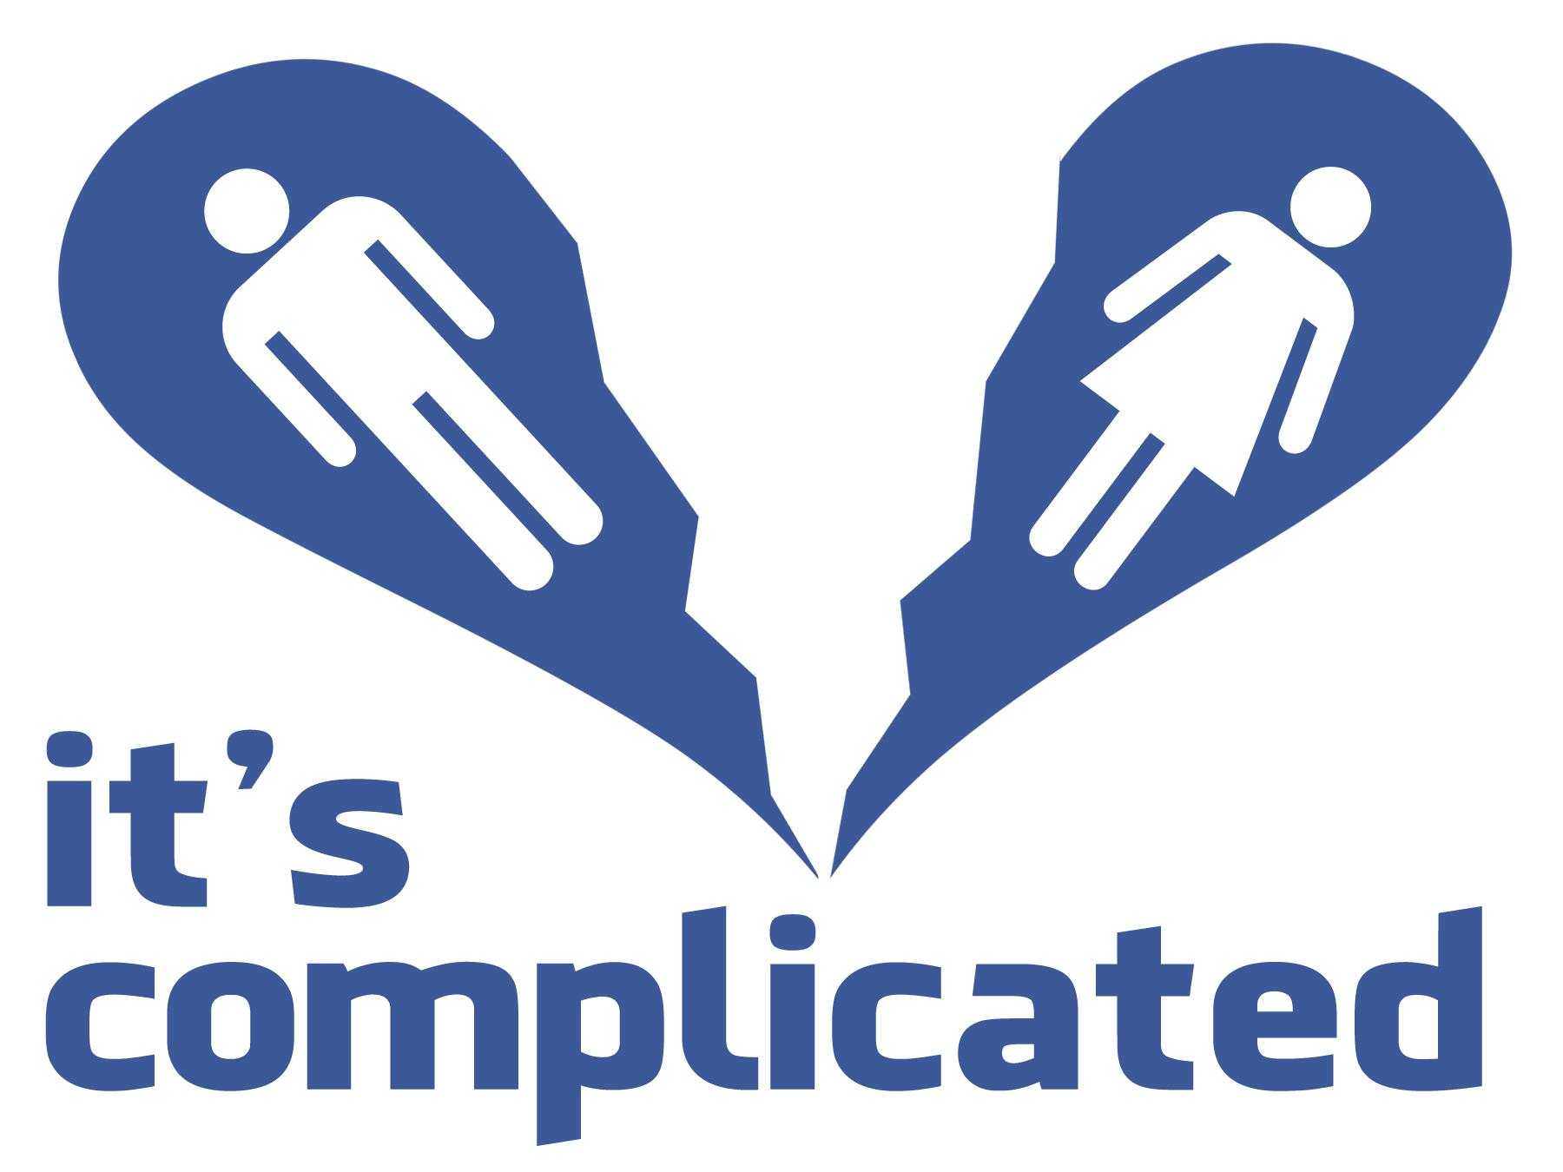
The relationship(s) between dev code and test code
What comes first – implementation or tests?
Dev code usually has to be modified to facilitate test code, i.e., dev code needs to be made testable
More test code is typically written than dev code
Does test code need to be of an inferior quality than dev code?
Ultimately, test code is meant to cover dev code (or is it ^_^)…
Dev code and test code alike need to be under SCM, they are equally important – that is an important takeaway

Slide 6

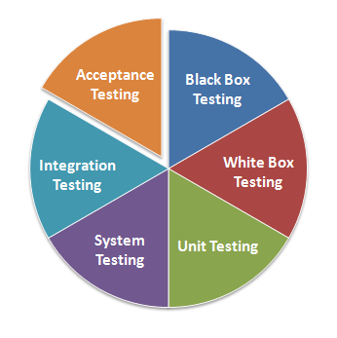
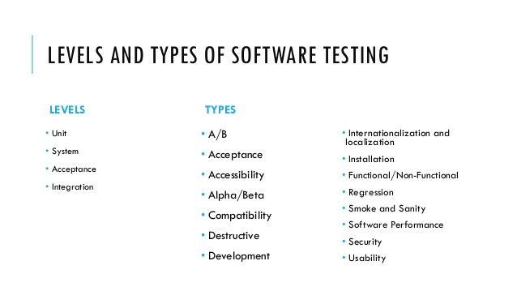
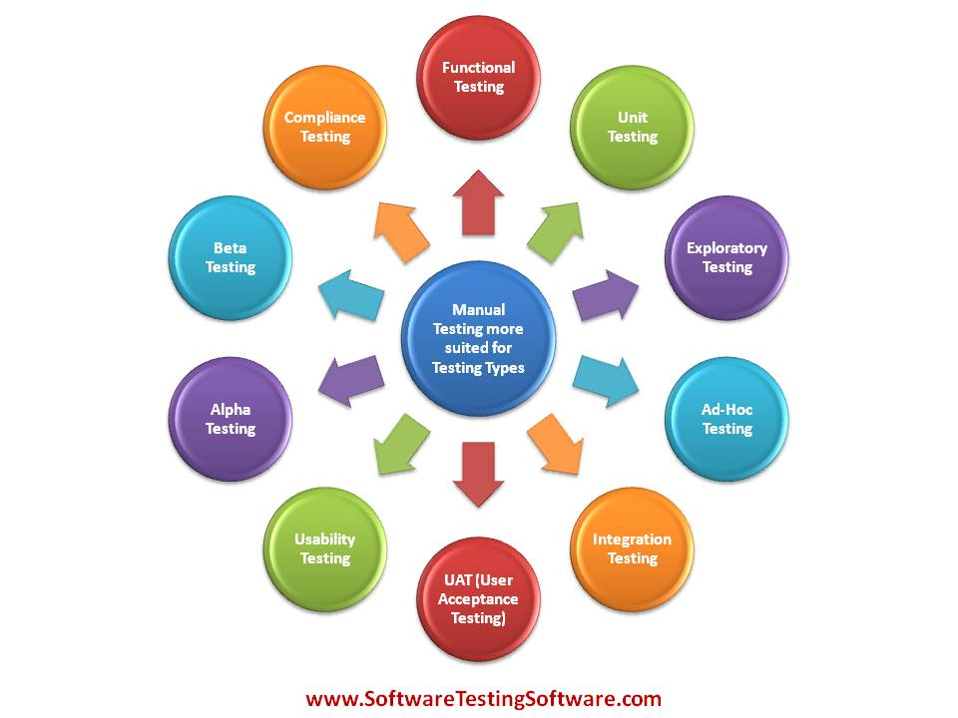
Categorizing tests helps
Not all tests are created alike…they have:
    Different goals
    Different needs (intentionally staying away from the word ‘requirements’)
    Different results and interpretations of the results

Slide 7

Tools and Automation
What can we do to automate and what can automation do for us?
How do we pick a good testing framework?
Test execution cannot be an all or nothing effort
Test results are more meaningful when they are consumable
When done right, automatic test execution and reporting is either:
      Triggered
      Performed on a timely basis
      Scheduled on-demand by anyone in the team

Slide 8

Code coverage
It is ‘a metric’ to evaluate tests
It is best taken literally – without inferring too much else
When used correctly, it is great at identifying untested code (and potentially untestable code)
When used incorrectly, it is great at instilling false confidence
The way I think it is best viewed – “when your tests have covered some code, you know something about the code; when you haven’t covered the code, you know nothing of it”

Slide 9
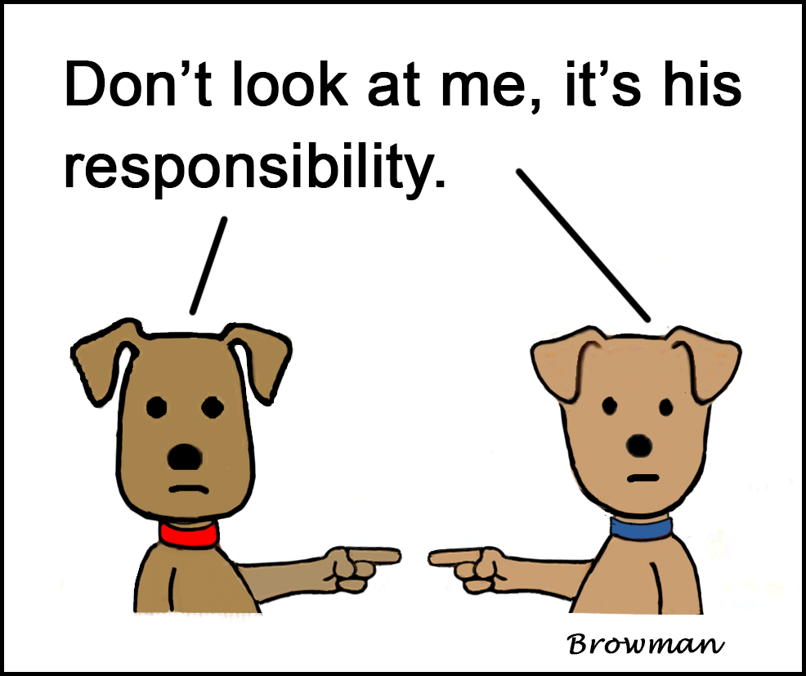
When tests fail…
Believe it or not, its quite normal…
Reproducibility is key
Sometimes its just not about the dev code or the test code, its just about the environment
Ultimately, test failures are a good thing
But the fix cannot be just about getting the test to pass – there is much more to it than that

Slide 10

Final thoughts on testing
We know its important and all that…but its also a great job
You get to play detective
You get the final say on whether the product is ready or not
It is true you have a lot of responsibility…
  Sometimes more than people give you credit for
  Sometimes it’s a thankless job (or so it seems)
In the end – have your pick of an example – would you get on a plane if you knew things hadn’t been tested?

Slide 11
Thank You
Vidroha Debroy
Southern Methodist University
vdebroy@smu.edu
Verizon Inc.
vidroha.debroy@verizon.com

