Slide 1
Practically...Testing (or a less boring title of your choice)
Vidroha debroy,
Oct 1st 2016

Slide 2
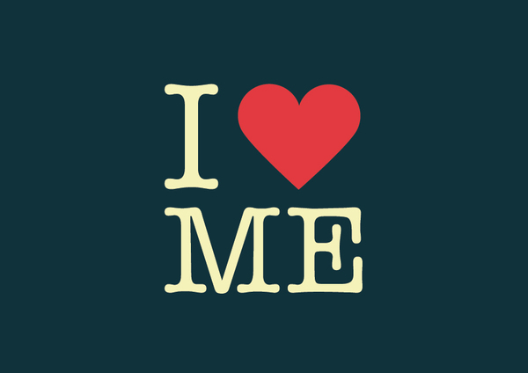
A little bit about me
Graduated with a PhD in Software Engineering under the supervision of Dr. Wong (I think you met him) in 2011
Joined the Windows Team at Microsoft as an SDET and stayed there for close to 2 years
Returned to DFW and joined Hudson Alley Software as a Senior Software Engineer. Stayed there close to 2 years
Became a Senior Software Architect at Verizon. But now I am with Varidesk and am loving being a developer again.
Also an Adjunct Professor of Computer Science at SMU
and clearly, I have nothing better to do on a Saturday…

Slide 3
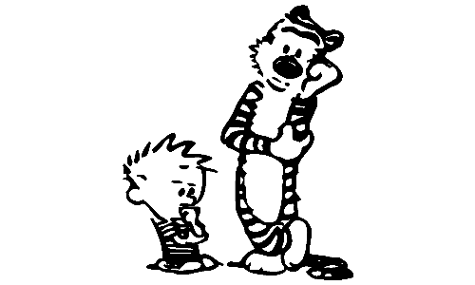
Why test?
Well Dr. Wong told us we should…Congratulations! You will probably get an A ☺.
Well… if we agree…this lecture could end sooner.
Well… I didn’t hear the question…but nod head along with others…
Seriously though…
Testing is an investment with proven returns
Testing is as fundamental a software development activity as any, and often can drive other activities
Testing lets you realize things about your product that you wouldn’t otherwise
On a personal note, testing can help avoid embarrassment

Slide 4

Effective Testing
Testing is not really a question of doing or not doing – it is about understanding; this is as much an art as it is a science
We need to be familiar with the software we are testing
We need to plan, scope and prioritize and measure
We need to treat our tests as first class citizens
We need to leverage automation as appropriate
We need to be creative!

Slide 5
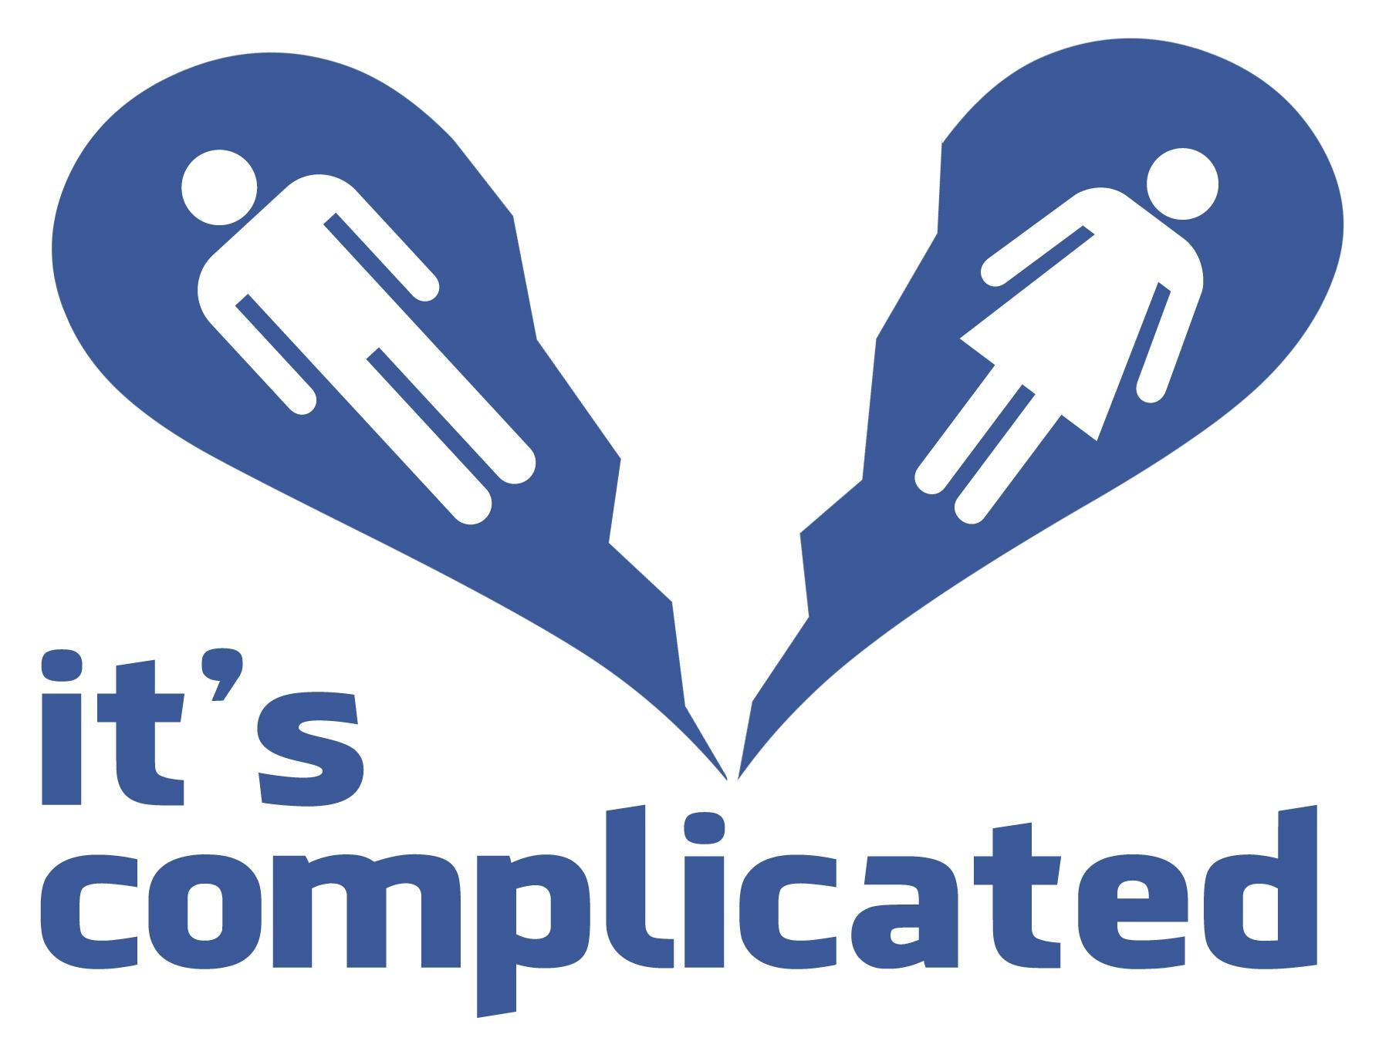
The relationship(s) between dev code and test code
What comes first – implementation or tests?
Dev code usually has to be modified to facilitate test code, i.e., dev code needs to be made testable
More test code is typically written than dev code
Does test code need to be of an inferior quality than dev code?
Ultimately, test code is meant to cover dev code (or is it ^_^)…
Dev code and test code alike need to be under SCM, they are equally important – that is an important takeaway

Slide 6

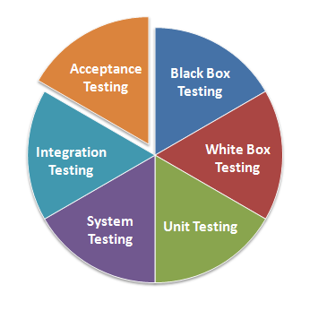
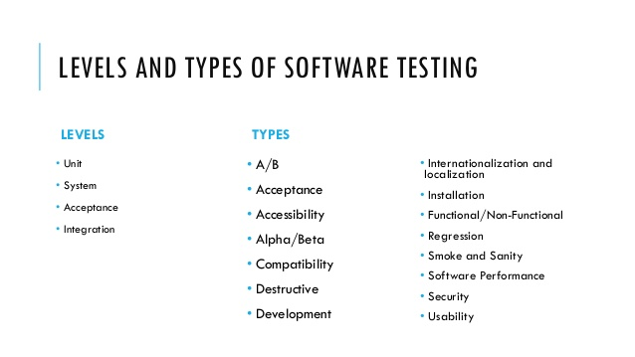
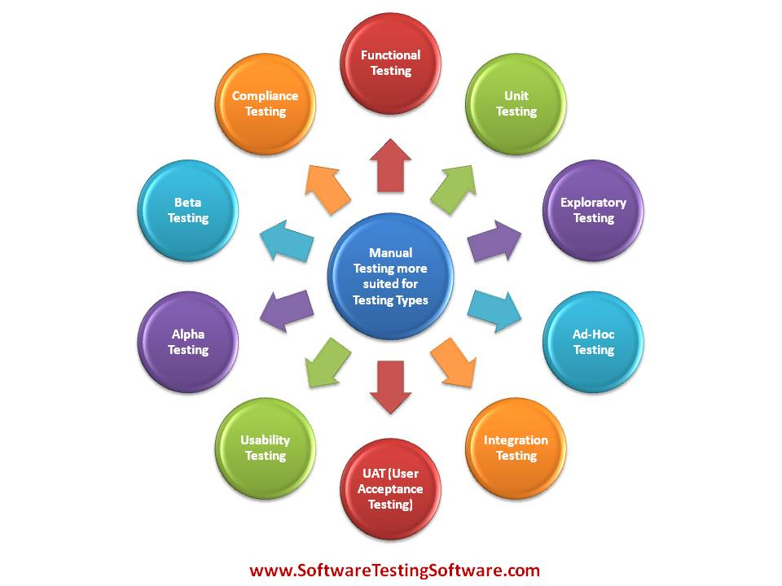
Categorizing tests helps
OK – enough with the stock pictures…we get it you know how to use Google Images…
Not all tests are created alike…they have:
Different goals
Different needs (intentionally staying away from the word ‘requirements’)
Different results and interpretations of the results

Slide 7

Tools and Automation
What can we do to automate and what can automation do for us?
Believe in this! Let’s look at a popular library: https://github.com/moment/moment
How do we pick a good testing framework?
Test execution cannot be an all or nothing effort
Test results are more meaningful when they are consumable
When done right, automatic test execution and reporting is either:
Triggered
Performed on a timely basis
Scheduled on-demand by anyone in the team

Slide 8
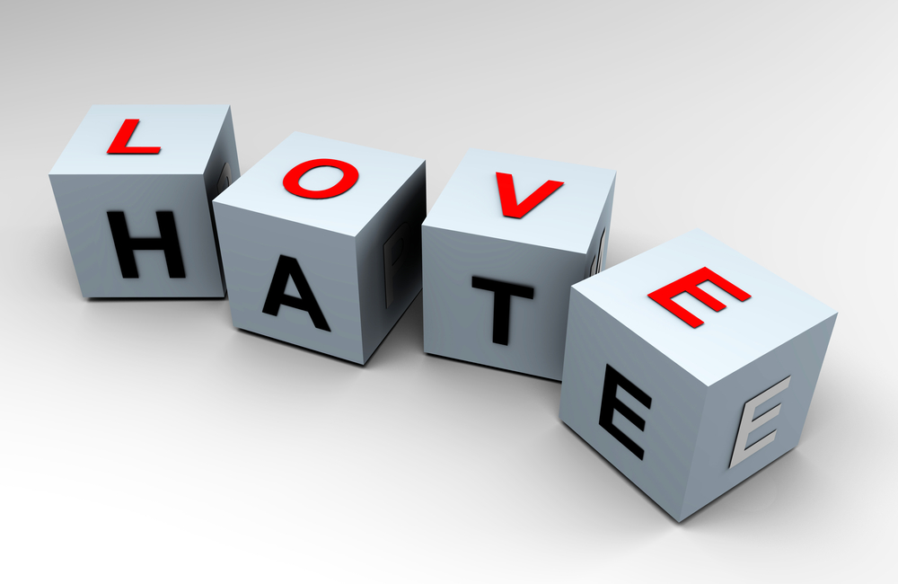
Code coverage
It is ‘a metric’ to evaluate tests
It is best taken literally – without inferring too much else
When used correctly, it is great at identifying untested code (and potentially untestable code)
When used incorrectly, it is great at instilling false confidence
The way I think it is best viewed – “when your tests have covered some code, you know something about the code; when you haven’t covered the code, you know nothing of it”

Slide 9
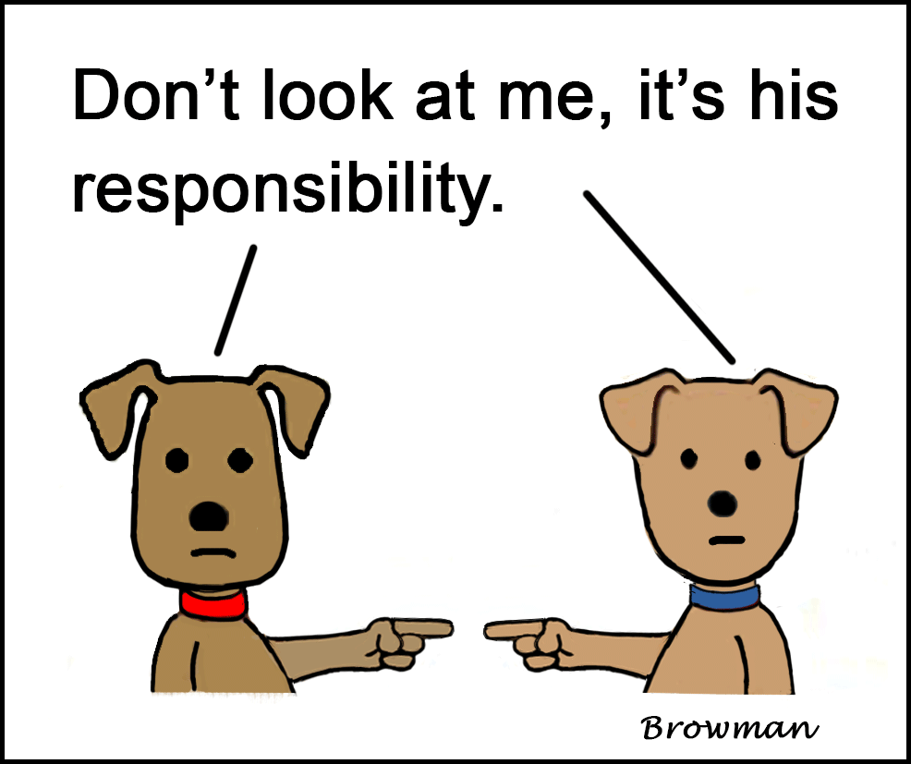
When tests fail…
Believe it or not, its quite normal…
Reproducibility is key
Sometimes its just not about the dev code or the test code, its just about the environment
Ultimately, test failures are a good thing
But the fix cannot be just about getting the test to pass – there is much more to it than that

Slide 10

Fitting into testing and fitting testing in
If I had an answer for you, I wouldn’t be here today…I’d pretty much be on my private jet to Hawaii…assuming I wasn’t already in Hawaii.
But I can tell you that the slide title is important to figure out
In fact…very important to figure out for yourself and those above and below you in the hierarchy of things (I couldn’t find a better term).
In a sense its not that different from other decisions…what’s the ROI?
What would a final bullet point be without a but? – Understand immediate returns versus a dividend style model.

Slide 11
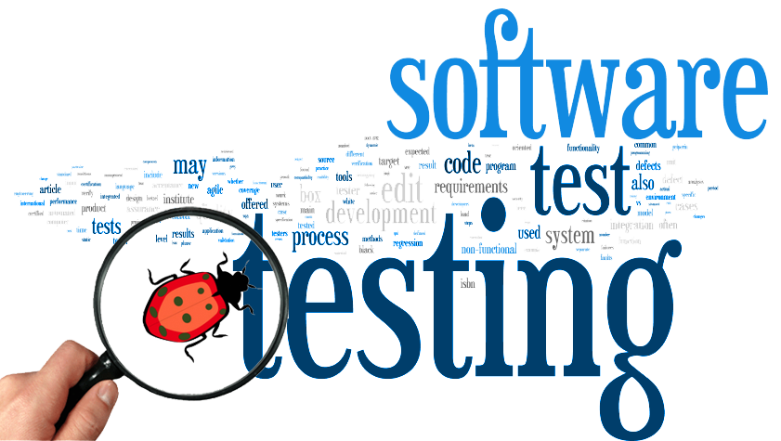
Final thoughts on testing
We know its important and all that…but its also a great job
You get to play detective
You get the final say on whether the product is ready or not
It is true you have a lot of responsibility…
Sometimes more than people give you credit for
Sometimes it’s a thankless job (or so it seems)
In the end – have your pick of an example – would you get on a plane if you knew things hadn’t been tested?

Slide 12
Thank You Questions?

