Slide 1
STAR
Laboratory of Advanced Research on Software Technology
Requirements-based Test Generation
for
Predicate Testing
W. Eric Wong
Department of Computer Science
The University of Texas at Dallas
ewong@utdallas.edu
http://www.utdallas.edu/~ewong
Requirements-based Test Generation for Predicate Testing (© 2012 Professor W. Eric Wong, The University of Texas at Dallas)

Slide 2

Speaker Biographical Sketch
Professor & Director of International Outreach
Department of Computer Science
University of Texas at Dallas
Guest Researcher
Computer Security Division
National Institute of Standards and Technology (NIST)
Vice President, IEEE Reliability Society
Secretary, ACM SIGAPP (Special Interest Group on Applied Computing)
Principal Investigator, NSF TUES (Transforming Undergraduate Education in Science, Technology, Engineering and Mathematics) Project
  Incorporating Software Testing into Multiple Computer Science and Software Engineering Undergraduate Courses
Founder & Steering Committee co-Chair for the SERE conference
(IEEE International Conference on Software Security and Reliability)
(http://paris.utdallas.edu/sere13)
Requirements-based Test Generation for Predicate Testing (© 2012 Professor W. Eric Wong, The University of Texas at Dallas)

Slide 3
Learning Objectives
Essential black-box techniques
for generating tests for
functional testing
Equivalence Class partitioning
Boundary value analysis
Test generation from predicates
Requirements-based Test Generation for Predicate Testing (© 2012 Professor W. Eric Wong, The University of Texas at Dallas)

Slide 4
Three Techniques
BOR
BRO
BRE
Requirements-based Test Generation for Predicate Testing (© 2012 Professor W. Eric Wong, The University of Texas at Dallas)

Slide 5
Test Generation from Predicates (1)
We will now examine three techniques
  BOR (Boolean Operator)
  BRO (Boolean and Relational Operator), and
  BRE (Boolean Relational Expression)
for generating test cases that are guaranteed to detect certain faults in the coding of conditions
The conditions from which test cases are generated might arise from requirements or might be embedded in the program to be tested.
Conditions guard actions
  For example,
if condition then action
is a typical format of many functional requirements
Requirements-based Test Generation for Predicate Testing (© 2012 Professor W. Eric Wong, The University of Texas at Dallas)

Slide 6
Test Generation from Predicates (2)
A condition is represented formally as a predicate, also known as a Boolean expression. For example, consider the requirement
“if the printer is ON and has paper then send document to printer”
This statement consists of a condition part and an action part.
The following predicate represents the condition part of the statement
p_{r}: (printerstatus = ON) ∧ (printertray != empty)
Requirements-based Test Generation for Predicate Testing (© 2012 Professor W. Eric Wong, The University of Texas at Dallas)

Slide 7
Predicates
Relational operators (relop): {<, ≤, >, ≥, =, ≠}
= and = = are equivalent
Boolean operators (bop): {!, ∧, ∨, xor} also known as
{not, AND, OR, XOR}
Relational expression: e₁ relop e₂ (e.g., a + b < c)
e₁ and e₂ are expressions whose values
can be compared using relop
Simple predicate: A boolean variable or a relational expression
(e.g., x < 0)
Compound predicate: Join one or more simple predicates using bop
(e.g., gender = = “female” ∧ age > 65)
Requirements-based Test Generation for Predicate Testing (© 2012 Professor W. Eric Wong, The University of Texas at Dallas)

Slide 8
Boolean Expressions (1)
Boolean expression: one or more Boolean variables joined by bop.
  Example: (a ∧ b ∨ !c) where a, b, and c are also known as literals.
Negation is also denoted by placing a bar over a Boolean expression.
such as in (a ∧ b)
We also write ab for a ∧ b and a + b for a ∨ b when there is no confusion.
Singular Boolean expression: When each literal appears only once.
  Example: (a ∧ b ∨ !c)
Requirements-based Test Generation for Predicate Testing (© 2012 Professor W. Eric Wong, The University of Texas at Dallas)

Slide 9
Boolean Expressions (2)
Disjunctive normal form (DNF): Sum of product terms:
  e.g., (pq) + (rs) + (ac).
Conjunctive normal form (CNF): Product of sums:
  e.g., (p + q)(r + s)(a + c).
Any Boolean expression in DNF can be converted to an equivalent
CNF and vice versa.
  e.g., CNF: (p + !r)(p + s)(q + !r)(q + s) is equivalent to
  DNF: (pq + !rs)
Requirements-based Test Generation for Predicate Testing (© 2012 Professor W. Eric Wong, The University of Texas at Dallas)

Slide 10
Boolean Expressions (3)
Mutually singular: Boolean expressions e₁ and e₂ are mutually singular when they do not share any literal
Requirements-based Test Generation for Predicate Testing (© 2012 Professor W. Eric Wong, The University of Texas at Dallas)

Slide 11
Boolean Expressions: Syntax Tree Representation
Abstract syntax tree (AST) for (a + b) < c ∧ !p
Internal nodes are labeled by boolean and relational operators
Root node (AND-node)
∧
<
!
(a + b)
c
p
Leaf nodes
Requirements-based Test Generation for Predicate Testing (© 2012 Professor W. Eric Wong, The University of Texas at Dallas)

Slide 12
Fault Model for Predicate Testing
What kind of faults are we targeting when testing for the correct implementation of predicates?
Suppose that the specification of a software module requires that an action be performed when the condition (a < b) ∨ (c > d) ∧ e is true.
Here a, b, c, and d are integer variables and e is a Boolean variable.
Requirements-based Test Generation for Predicate Testing (© 2012 Professor W. Eric Wong, The University of Texas at Dallas)

Slide 13
Boolean Operator Faults
Correct predicate: (a < b) ∨ (c > d) ∧ e
(a < b) ∧ (c > d) ∧ e Incorrect Boolean operator
(a < b) ∨ !(c > d) ∧ e Incorrect negation operator
(a < b) ∧ (c > d) ∨ e Incorrect Boolean operators
(a < b) ∨ (c > d) ∧ x Incorrect Boolean variable
Requirements-based Test Generation for Predicate Testing (© 2012 Professor W. Eric Wong, The University of Texas at Dallas)

Slide 14
Relational Operator Faults
Correct predicate: (a < b) ∨ (c > d) ∧ e
(a = = b) ∨ (c > d) ∧ e Incorrect relational operator
(a = = b) ∨ (c ≤ d) ∧ e Two relational operator faults
(a = = b) ∨ (c > d) ∨ e Incorrect relational and Boolean operators
Requirements-based Test Generation for Predicate Testing (© 2012 Professor W. Eric Wong, The University of Texas at Dallas)

Slide 15
Missing or Extra Boolean Variable Faults
Correct predicate: a ∨ b
Missing Boolean variable fault: a
Extra Boolean variable fault: a ∨ b ∧ c
Requirements-based Test Generation for Predicate Testing (© 2012 Professor W. Eric Wong, The University of Texas at Dallas)

Slide 16
Goal of Predicate Testing (1)
Given a correct predicate p_{c}, the goal of predicate testing is to generate a test set T such that there is at least one test case t ∈ T for which p_{c} and its faulty version p_{i} evaluate to different truth values (i.e., p_{c} = true and
p_{i} = false or vice versa)
Requirements-based Test Generation for Predicate Testing (© 2012 Professor W. Eric Wong, The University of Texas at Dallas)

Slide 17
Goal of Predicate Testing (2)
As an example, suppose that p_{c}: a < b + c and p_{i}: a > b + c
Consider a test set T = {t₁, t₂} where
t₁: <a = 0, b = 0, c = 0> and t₂: <a = 0, b = 1, c = 1>
The fault in p_{i} is not revealed by t₁ as both p_{c} and p_{i} evaluate to false when evaluated against t₁
However, the fault is revealed by t₂ as p_{c} evaluates to true and p_{i} to false when evaluated against t₂
Requirements-based Test Generation for Predicate Testing (© 2012 Professor W. Eric Wong, The University of Texas at Dallas)

Slide 18
Predicate Constraints: BR symbols
Consider the following Boolean-Relational set of BR-symbols:
  BR={t, f, <, =, >}
A BR symbol is a constraint on a Boolean variable or a relational expression
For example, consider the predicate E: a < b and the constraint “ > ”.
  A test case that satisfies this constraint for E must cause E to evaluate to false.
Requirements-based Test Generation for Predicate Testing (© 2012 Professor W. Eric Wong, The University of Texas at Dallas)

Slide 19
Infeasible Constraints
A constraint C is considered infeasible for predicate p_{r} if there exists no input values for the variables in p_{r} that satisfy C.
For example, the constraint t (true) is infeasible for the predicate
(a > b) ∧ (b > d) if it is known that d > a
Requirements-based Test Generation for Predicate Testing (© 2012 Professor W. Eric Wong, The University of Texas at Dallas)

Slide 20
Predicate Constraints
Let p_{r} denote a predicate with n, n > 0, ∨ and ∧ operators
A predicate constraint C for predicate p_{r} is a sequence of (n + 1) BR symbols, one for each Boolean variable or relational expression in p_{r}. When clear from context, we refer to “predicate constraint” as simply constraint.
Test case t satisfies C for predicate p_{r} if each component of p_{r} satisfies the corresponding constraint in C when evaluated against t.
  Constraint C for predicate p_{r} guides the development of a test case for p_{r} (i.e., it offers hints on what the values of the variables should be for p_{r} to satisfy C)
Requirements-based Test Generation for Predicate Testing (© 2012 Professor W. Eric Wong, The University of Texas at Dallas)

Slide 21
Predicate Constraints: Example
Consider the predicate p_{r}: b ∧ (r < s) ∨ (u ≥ v) and a constraint C: (t, =, >)
The following test case satisfies C for p_{r}
<b = true, r = 1, s = 1, u = 1, v = 0>
The following test case does not satisfy C for p_{r}
<b = true, r = 1, s = 2, u = 1, v = 2>
Requirements-based Test Generation for Predicate Testing (© 2012 Professor W. Eric Wong, The University of Texas at Dallas)

Slide 22
True and False Constraints
p_{r}(C) denotes the value of predicate p_{r} evaluated using a test case that satisfies C
C is referred to as a true constraint when p_{r}(C) is true and a false constraint otherwise
A set of constraints S is partitioned into subsets S ^{t} and S ^{f}, respectively, such that for each C in S ^{t}, p_{r}(C) = true, and for any C in S ^{f}, p_{r}(C) = false.
S = S ^{t} ∪ S ^{f}
Requirements-based Test Generation for Predicate Testing (© 2012 Professor W. Eric Wong, The University of Texas at Dallas)

Slide 23
Predicate Testing: Criteria
Given a predicate p_{r}, we want to generate a test set T such that
  T is minimal and
  T guarantees the detection of the faults (correspond to some fault model)
  in the implementation of p_{r}
We will discuss three such criteria named
  BOR (Boolean Operator),
  BRO (Boolean and Relational Operator), and
  BRE (Boolean Relational Expression)
Requirements-based Test Generation for Predicate Testing (© 2012 Professor W. Eric Wong, The University of Texas at Dallas)

Slide 24
Predicate Testing: BOR Testing Criterion
A test set T that satisfies the BOR testing criterion for a compound predicate p_{r} guarantees the detection of single or multiple Boolean operator faults in the implementation of p_{r}
T is referred to as a BOR-adequate test set and sometimes written as T_{BOR}
Requirements-based Test Generation for Predicate Testing (© 2012 Professor W. Eric Wong, The University of Texas at Dallas)

Slide 25
Predicate Testing: BRO Testing Criterion
A test set T that satisfies the BRO testing criterion for a compound predicate p_{r} guarantees the detection of single Boolean operator and relational operator faults in the implementation of p_{r}
T is referred to as a BRO-adequate test set and sometimes written as T_{BRO}
Requirements-based Test Generation for Predicate Testing (© 2012 Professor W. Eric Wong, The University of Texas at Dallas)

Slide 26
Predicate Testing: BRE Testing Criterion
A test set T that satisfies the BRE testing criterion for a compound predicate p_{r} guarantees the detection of single Boolean operator, relational expression, and arithmetic expression faults in the implementation of p_{r}
T is referred to as a BRE-adequate test set and sometimes written as T_{BRE}
Requirements-based Test Generation for Predicate Testing (© 2012 Professor W. Eric Wong, The University of Texas at Dallas)

Slide 27
Predicate Testing: Guaranteeing Fault Detection
Let T_{x}, x ∈ {BOR, BRO, BRE}, be a test set derived from predicate p_{r}
Let p_{f} be another predicate obtained from p_{r} by injecting single
(or multiple) faults of one of three kinds
  Boolean operator fault
  relational operator fault, and
  arithmetic expression fault
T_{x} is said to guarantee the detection of faults in p_{f} if for some t ∈ T_{x},
p_{r}(t) ≠ p_{f} (t)
Requirements-based Test Generation for Predicate Testing (© 2012 Professor W. Eric Wong, The University of Texas at Dallas)

Slide 28
Guaranteeing Fault Detection: Example
Let p_{r} = a < b ∧ c > d
Constraint set S = {(t, t), (t, f ), (f, t)}
Let T_{BOR} = {t₁, t₂, t₃} is a BOR adequate test set that satisfies S
t₁: < a = 1, b = 2, c = 1, d = 0 > satisfies (t, t)
(i.e., a < b is true and c < d is also true)
t₂: < a = 1, b = 2, c = 1, d = 2 > satisfies (t, f)
t₃: < a = 1, b = 0, c = 1, d = 0 > satisfies (f, t)
Given to you at this moment
Requirements-based Test Generation for Predicate Testing (© 2012 Professor W. Eric Wong, The University of Texas at Dallas)

Slide 29
Guaranteeing Fault Detection: In Class Exercise (1)
Inject single or multiple Boolean operator faults in
p_{r}: a < b ∧ c > d
and show that T guarantees the detection of each fault.
Requirements-based Test Generation for Predicate Testing (© 2012 Professor W. Eric Wong, The University of Texas at Dallas)

Slide 30
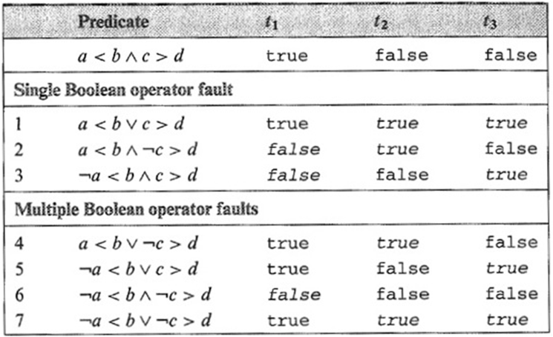
Guaranteeing Fault Detection: In Class Exercise (2)
The following table lists p_{r} and a total of 7 faulty predicates obtained by inserting single and multiple Boolean operator faults in p_{r}
Each predicate is evaluated against the three test cases in T
  Each faulty predicate evaluates to a value different from that of p_{r} for at least one test case in T
Requirements-based Test Generation for Predicate Testing (© 2012 Professor W. Eric Wong, The University of Texas at Dallas)

Slide 31
Guaranteeing Fault Detection: In Class Exercise (3)
Can we delete any of these three test cases in T and still guarantee
the detection of all the Boolean operator faults?
Requirements-based Test Generation for Predicate Testing (© 2012 Professor W. Eric Wong, The University of Texas at Dallas)

Slide 32
Guaranteeing Fault Detection: In Class Exercise (4)
Suppose we remove t₂, then the faulty predicate 4 in the previous
table cannot be distinguished from p_{r} by tests t₁ and t₃ BRO
In fact, if we remove t₂ from T, then T is no longer BOR adequate because the constraint (t, f ) is not satisfied
We can verify that if any column in the previous table is removed,
at least one of the faulty predicates will be left indistinguishable
by the tests in the remaining two columns
Requirements-based Test Generation for Predicate Testing (© 2012 Professor W. Eric Wong, The University of Texas at Dallas)

Slide 33
Cross & Onto Product
The cross product of two sets A and B is defined as
A × B = {(a, b) | a ∈ A and b ∈ B}
The onto product of two sets A and B is defined as
for finite sets A and B, A ⊗ B is a minimal set of pairs (u, v)
such that {(u, v) | u ∈ A, v ∈ B, and each element of A appears
at least once as u and each element of B appears once as v}
Requirements-based Test Generation for Predicate Testing (© 2012 Professor W. Eric Wong, The University of Texas at Dallas)

Slide 34
Set Products: Example (1)
Let A = {t, =, >} and B = {f, <}
A × B = {(t, f ), (t, <), (=, f), (=, <), (>, f), (>, <)}
A ⊗ B = {(t, f ), (=, <), (>, <)}
Any other possibilities for A ⊗ B?
Requirements-based Test Generation for Predicate Testing (© 2012 Professor W. Eric Wong, The University of Texas at Dallas)

Slide 35
Set Products: Example (2)
Let A = {t, =, >} and B = {f, <}
Any other possibilities for A ⊗ B?
A ⊗ B = {(t, <), (=, f ), (>, <)} ⬅ second possibility
A ⊗ B = {(t, f ), (=, <), (>, f )} ⬅ third possibility
A ⊗ B = {(t, <), (=, <), (>, f )} ⬅ fourth possibility
Requirements-based Test Generation for Predicate Testing (© 2012 Professor W. Eric Wong, The University of Texas at Dallas)

Slide 36
Algorithm for Generation of BOR Constraint Sets (1)
We will use the following notation:
p_{r} is a predicate
AST (p_{r}) is its abstract syntax tree
N₁, N₂, …. refer to various nodes in the AST (p_{r})
S_{N} is the constraint set for node N in the syntax tree for p_{r}
S_{N}^{t} is the true constraint set for node N in the syntax tree for p_{r}
S_{N}^{f} is the false constraint set for node N in the syntax tree for p_{r}
S_{N} = S_{N}^{t} ∪ S_{N}^{f}
Requirements-based Test Generation for Predicate Testing (© 2012 Professor W. Eric Wong, The University of Texas at Dallas)

Slide 37
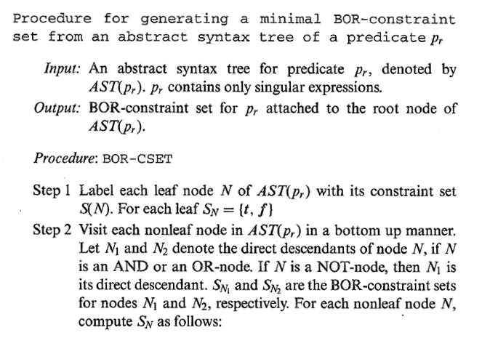
Algorithm for Generation of BOR Constraint Sets (2)
Requirements-based Test Generation for Predicate Testing (© 2012 Professor W. Eric Wong, The University of Texas at Dallas)

Slide 38
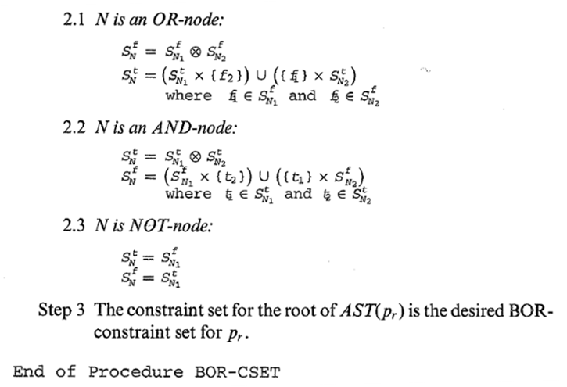
Algorithm for Generation of BOR Constraint Sets (3)
Requirements-based Test Generation for Predicate Testing (© 2012 Professor W. Eric Wong, The University of Texas at Dallas)

Slide 39
Generation of BOR Constraint Set (1)
We want to generate T_{BOR} for p_{r}: a < b ∧ c > d
First, generate syntax tree of p_{r}
∧
a < b
c > d
Requirements-based Test Generation for Predicate Testing (© 2012 Professor W. Eric Wong, The University of Texas at Dallas)

Slide 40
Generation of the BOR Constraint Set (2)
Second, label each leaf node with the constraint set {(t), (f)}
We label the nodes as N₁, N₂, and so on for convenience.
Notice that N₁ and N₂ are direct descendents of N₃ which is an
AND-node
N₃
∧
N₁
N₂
a < b
c > d
S_{N1}= {(t), (f)}
S_{N2}= {(t), (f)}
Requirements-based Test Generation for Predicate Testing (© 2012 Professor W. Eric Wong, The University of Texas at Dallas)

Slide 41
Generation of the BOR Constraint Set (3)
Third, compute the constraint set for the next higher node in the syntax tree, in this case N₃
For an AND node, the formulae used are the following.
S_{N3} = {(t, t), (f, t), (t, f)}
S_{N3}^{t} = S_{N1}^{t} ⊗ S_{N2}^{t} = {(t)} ⊗ {(t)} = {(t, t)}
False constraint
N₃
∧
S_{N3}^{f} = (S_{N1}^{f} × {t₂}) ∪ ({t₁} × S_{N2}^{f} )
N₁
N₂
  = ({(f)} × {(t)}) ∪ ({(t)} × {(f)})
a < b
c > d
{(t), (f)}
{(t), (f)}
= {(f, t)} ∪ {(t, f)}
= {(f, t), (t, f)}
Requirements-based Test Generation for Predicate Testing (© 2012 Professor W. Eric Wong, The University of Texas at Dallas)

Slide 42
Generation of T_{BOR}
As per our objective, we have computed the BOR constraint set for the root node of the AST(p_{r}). We can now generate a test set using the BOR constraint set associated with the root node.
  S_{N3} contains a sequence of three constraints and hence we get a minimal test set consisting of three test cases. Here is one possible test set.
T_{BOR} = {t₁, t₂, t₃}
t₁ = < a = 1, b = 2, c = 4, d = 5 >
t₂ = < a = 1, b = 0, c = 4, d = 5 >
t₃ = < a = 1, b = 2, c = 3, d = 2 >
S_{N3} = {(t, t), (f, t), (t, f )}
N₃
∧
N₁
N₂
a < b
c > d
{(t), (f)}
{(t), (f)}
Requirements-based Test Generation for Predicate Testing (© 2012 Professor W. Eric Wong, The University of Texas at Dallas)

Slide 43
Another Example for T_{BOR} (1)
Generate the BOR-constraint sets for the predicate
(a + b) < c ∧ !p ∨ (r > s)
Requirements-based Test Generation for Predicate Testing (© 2012 Professor W. Eric Wong, The University of Texas at Dallas)

Slide 44
Another Example for T_{BOR} (2)
The abstract syntax tree for (a + b) < c ∧ !p ∨ (r > s)
S₆^{t} = {(t, f, f), (f, f, t)}
S₆^{f} = {(f, f, f), (t, t, f)}
S₄^{t} = {(t, f)}
S₄^{f} = {(f, f), (t, t)}
N₆
N₄
∧
N₅
S₅^{t} = {t}
S₅^{f} = {f}
r > s
N₁
N₃
S₃^{t} = {f}
S₃^{f} = {t}
a + b < c
!
S₁^{t} = {t}
S₁^{f} = {f}
p
N₂
S₂^{t} = {t}
S₂^{f} = {f}
Requirements-based Test Generation for Predicate Testing (© 2012 Professor W. Eric Wong, The University of Texas at Dallas)

Slide 45
Generation of BRO Constraint Set
Recall that a test set adequate with respect to a BRO constraint set for predicate p_{r} guarantees the detection of all combinations of single Boolean operator and relational operator faults.
Requirements-based Test Generation for Predicate Testing (© 2012 Professor W. Eric Wong, The University of Texas at Dallas)

Slide 46
BRO Constraint Set
The BRO constraint set S for relational expression e₁ relop e₂
S = {(>), (=), (<)}
The separation of S into its true (S ^{t}) and false (S ^{f}) components depends in relop
relop: > S ^{t} = {(>)} S ^{f} = {(=), (<)}
relop: ≥ S ^{t} = {(>), (=)} S ^{f} = {(<)}
relop: = S ^{t} = {(=)} S ^{f} = {(<), (>)}
relop: < S ^{t} = {(<)} S ^{f} = {(=), (>)}
relop: ≤ S ^{t} = {(<), (=)} S ^{f} = {(>)}
Note: t_{N} denotes an element of S ^{t} _{N}
f_{N} denotes an element of S ^{f} _{N}
Requirements-based Test Generation for Predicate Testing (© 2012 Professor W. Eric Wong, The University of Texas at Dallas)

Slide 47
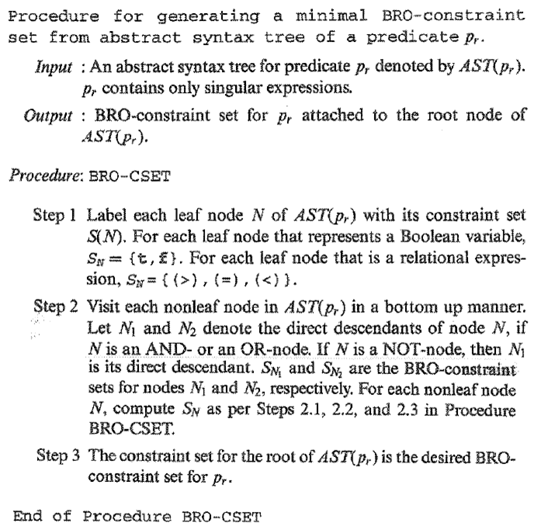
Algorithm for Generation of BRO Constraint Sets
Requirements-based Test Generation for Predicate Testing (© 2012 Professor W. Eric Wong, The University of Texas at Dallas)

Slide 48
BRO Constraint Set: Example (1)
p_{r}: (a + b < c) ∧ !p ∨ (r > s)
Step 1: Construct the AST for the given predicate
N₆
N₄
∧
N₅
r > s
N₁
N₃
a + b < c
!
p
N₂
Requirements-based Test Generation for Predicate Testing (© 2012 Professor W. Eric Wong, The University of Texas at Dallas)

Slide 49
BRO Constraint Set: Example (2)
Step 2: Label each leaf node with its constraint set S
N₆
N₄
∧
N₅
r > s
N₁
N₃
True constraint {>}
False constraint {<, =}
a + b < c
!
True constraint {<}
False constraint {>, =}
p
N₂
True constraint {t}
False constraint {f}
Requirements-based Test Generation for Predicate Testing (© 2012 Professor W. Eric Wong, The University of Texas at Dallas)

Slide 50
BRO Constraint Set: Example (3)
Step 2: Traverse the tree and compute constraint set for each internal node
S ^{t}_{N3} = S_{N2}^{f} = {(f)}
S ^{f}_{N3} = S_{N2}^{t} = {(t)}
S ^{t}_{N4} = S_{N1}^{t} ⊗ S_{N3}^{t} = {(<)} ⊗ {(f)} = {(<, f)}
S ^{f}_{N4} = (S ^{f}_{N1} × {(t_{N3})}) ∪ ({(t_{N1})} × S ^{f}_{N3})
= ({(>, =)} × {(f)}) ∪ ({(<)} × {(t)})
= {(>, f), (=, f)} ∪ {(<, t)}
= {(>, f), (=, f), (<, t)}
Requirements-based Test Generation for Predicate Testing (© 2012 Professor W. Eric Wong, The University of Texas at Dallas)

Slide 51
BRO Constraint Set: Example (4)
True constraint {(<, f )}
False constraint {(>, f ), (=, f ), (<, t)}
N₆
N₄
∧
True constraint {f}
False constraint {t}
N₅
r > s
True constraint {>}
False constraint {<, =}
N₁
N₃
a + b < c
!
True constraint {<}
False constraint {>, =}
p
N₂
True constraint {t}
False constraint {f}
Requirements-based Test Generation for Predicate Testing (© 2012 Professor W. Eric Wong, The University of Texas at Dallas)

Slide 52
BRO Constraint Set: Example (5)
Next compute the constraint set for the root node (this is an OR-node)
S ^{f}_{N6} = S ^{f}_{N4} ⊗ S ^{f}_{N5}
= {(>, f), (=, f), (<, t)} ⊗ {(=), (<)}
= {(>, f, =), (=, f, <), (<, t, =)}
S ^{t}_{N6} = (S ^{t}_{N4} × {(f_{N5})}) ∪ ({(f_{N4})} × S ^{t}_{N5})
= ({(<, f)} × {(=)}) ∪ ({(>, f)} × {(>)})
= {(<, f, =)} ∪ {(>, f, >)}
= {(<, f, =), (>, f, >)}
Requirements-based Test Generation for Predicate Testing (© 2012 Professor W. Eric Wong, The University of Texas at Dallas)

Slide 53
BRO Constraint Set: Example (6)
Constraint set for p_{r}: (a + b < c) ∧ !p ∨ (r > s)
True constraint {(<, f, =), (>, f, >)}
False constraint {(>, f, =), (=, f, <), (<, t, =)}
N₆
True constraint {(<, f )}
False constraint {(>, f ), (=, f ), (<, t)}
N₄
∧
N₅
r > s
N₁
True constraint {>}
False constraint {<, =}
N₃
a + b < c
!
True constraint {<}
False constraint {>, =}
p
N₂
True constraint {t}
False constraint {f}
Requirements-based Test Generation for Predicate Testing (© 2012 Professor W. Eric Wong, The University of Texas at Dallas)

Slide 54
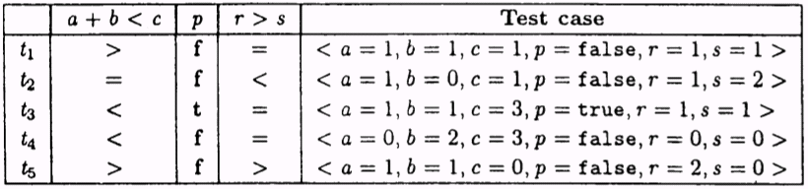
BRO Constraint Set: In-Class Exercise
Given the constraint set for p_{r}: (a + b < c) ∧ !p ∨ (r > s), construct T_{BRO}
{(>, f, =), (=, f, <), (<, t, =), (<, f, =), (>, f, >)}
Requirements-based Test Generation for Predicate Testing (© 2012 Professor W. Eric Wong, The University of Texas at Dallas)

Slide 55
Generating the BRE Constraint Set (1)
We now show how to generate BRE constraints that lead to test cases which guarantee the detection of a single occurrence of
Boolean operator, relation operator, arithmetic expression, or combination fault in a predicate
The BRE constraint set for a Boolean variable remains {t, f} as with the BOR and BRO constraint sets
The BRE constraint set for a relational expression is {(+ε), (=), (−ε)} where ε > 0
Requirements-based Test Generation for Predicate Testing (© 2012 Professor W. Eric Wong, The University of Texas at Dallas)

Slide 56
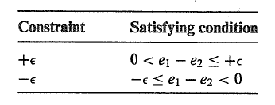
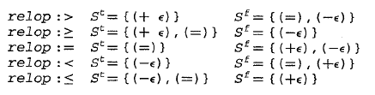
Generating the BRE Constraint Set (2)
The BRE constraint set S for a relational expression e₁ relop e₂ is separated into subsets S ^{t} and S ^{f} based on the following relations
Based on the conditions listed above, we can now separate the BRE constraint S into its true and false components as follows
Requirements-based Test Generation for Predicate Testing (© 2012 Professor W. Eric Wong, The University of Texas at Dallas)

Slide 57
Algorithm for Generation of BRE Constraint Sets (1)
The procedure to generate a minimal BRE-constraint set is similar to that for BRO and BOR. The only difference lies in the construction of the constraint sets for the leaves.
Requirements-based Test Generation for Predicate Testing (© 2012 Professor W. Eric Wong, The University of Texas at Dallas)

Slide 58
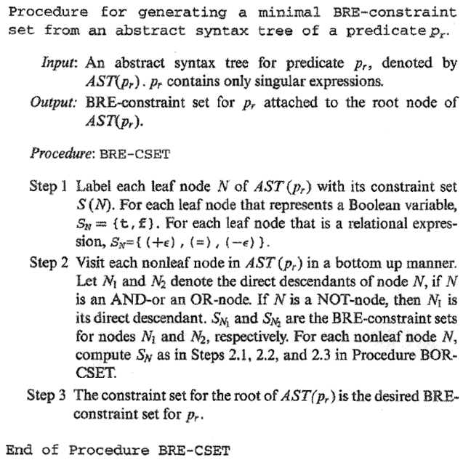
Algorithm for Generation of BRE Constraint Sets (2)
Requirements-based Test Generation for Predicate Testing (© 2012 Professor W. Eric Wong, The University of Texas at Dallas)

Slide 59
BRE Constraint Set: Example (1)
Generate the constraint set for the predicate p_{r}: (a + b < c) ∧ !p ∨ (r > s)
N₆
∨
N₄
∧
N₅
r > s
N₁
N₃
a + b < c
!
N₂
p
Requirements-based Test Generation for Predicate Testing (© 2012 Professor W. Eric Wong, The University of Texas at Dallas)

Slide 60
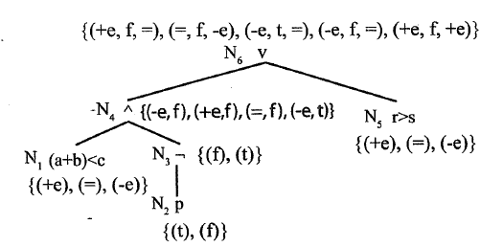
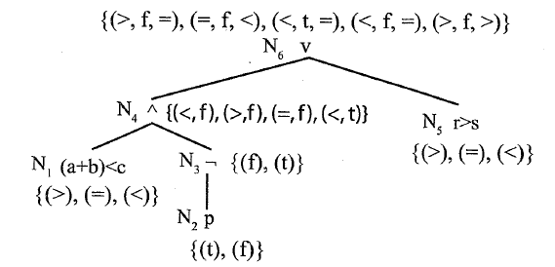
BRE Constraint Set: Example (2)
BRE constraint set
BRO constraint set
Requirements-based Test Generation for Predicate Testing (© 2012 Professor W. Eric Wong, The University of Texas at Dallas)

Slide 61
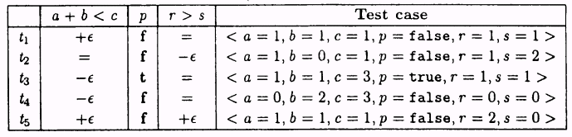
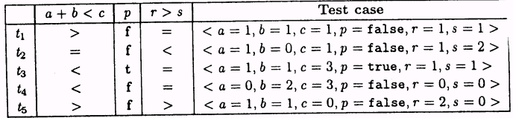
BRE Constraint Set: Example (3)
(ε = 1)
A sample test set (T_{BRE}) that satisfies the BRE constraints
A sample test set (T_{BRO}) that satisfies the BRO constraints
Requirements-based Test Generation for Predicate Testing (© 2012 Professor W. Eric Wong, The University of Texas at Dallas)

Slide 62
Singular Boolean Expressions
Boolean expression: one or more Boolean variables joined by bop
  Example (a ∧ b ∨ !c), where a, b, and c are also known as literals
Singular Boolean expression: When each literal appears only once
  Example (a ∧ b ∨ !c)
Requirements-based Test Generation for Predicate Testing (© 2012 Professor W. Eric Wong, The University of Texas at Dallas)

Slide 63
Mutually Singular Boolean Expressions
Mutually singular: Boolean expressions e₁ and e₂ are mutually singular when they do not share any literal
Expression e_{i} is considered a singular component of E if and only if e_{i} is singular and is mutually singular with each of the other elements of E
Expression e_{i} is considered a non-singular component of E if and only if it is non-singular and is mutually singular with each of the remaining elements of E
Requirements-based Test Generation for Predicate Testing (© 2012 Professor W. Eric Wong, The University of Texas at Dallas)

Slide 64
BOR Constraints for Non-Singular Expressions
Test generation procedures described so far are for singular predicates. Recall that a singular predicate contains only one occurrence of each variable
We will now learn how to generate BOR constraints for non-singular predicates
First, let us look at some non-singular expressions, their respective disjunctive normal forms (DNF), and their mutually singular components
Requirements-based Test Generation for Predicate Testing (© 2012 Professor W. Eric Wong, The University of Texas at Dallas)

Slide 65
Non-Singular Expressions and DNF: Examples
Predicate (p_{r}) | DNF | Mutually singular components in p_{r}
ab(b + c) | abb + abc | a; b(b + c)
a(bc + bd) | abc + abd | a; (bc + bd)
a(bc + !b + de) | abc + a!b + ade | a; bc + !b + de
Requirements-based Test Generation for Predicate Testing (© 2012 Professor W. Eric Wong, The University of Texas at Dallas)

Slide 66
Generating BOR Constraints for Non-Singular Expressions
We proceed in two steps
  First we will examine the Meaning Impact (MI) procedure for generating a minimal set of constraints from a possibly non-singular predicate
  Next, we will examine the procedure to generate BOR constraint set for a
  non-singular predicate
Requirements-based Test Generation for Predicate Testing (© 2012 Professor W. Eric Wong, The University of Texas at Dallas)

Slide 67
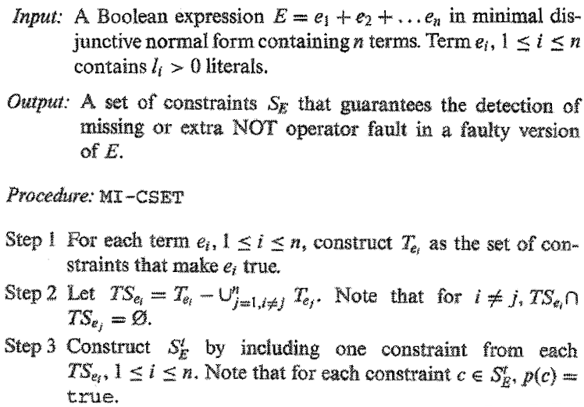
Meaning Impact (MI) Procedure (1)
Requirements-based Test Generation for Predicate Testing (© 2012 Professor W. Eric Wong, The University of Texas at Dallas)

Slide 68
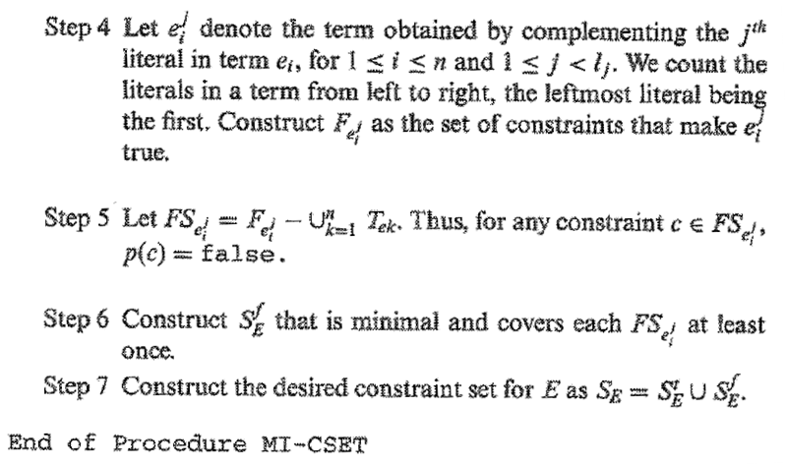
Meaning Impact (MI) Procedure (2)
Requirements-based Test Generation for Predicate Testing (© 2012 Professor W. Eric Wong, The University of Texas at Dallas)

Slide 69
MI Procedure: Example (1)
Consider the non-singular predicate: a(bc + !bd)
Its DNF equivalent is E = abc + a!bd
Note that a, b, c, and d are Boolean variables and also referred to as literals
  Each literal represents a condition
  For example, a could represent r < s
Recall that + is the Boolean OR operator, ! is the Boolean NOT operator, and as per common convention we have omitted the Boolean AND operator. For example bc is the same as b ∧ c
Requirements-based Test Generation for Predicate Testing (© 2012 Professor W. Eric Wong, The University of Texas at Dallas)

Slide 70
MI Procedure: Example (2)
Step 0: Identify the DNF equivalent of E as e₁ + e₂, where e₁ = abc and
e₂ = a!bd
Step 1: Construct a constraint set T_{e1} for e₁ that makes e₁ true.
Similarly construct T_{e2} for e₂ that makes e₂ true
T_{e1} = {(t, t, t, t), (t, t, t, f )}
T_{e2} = {(t, f, t, t), (t, f, f, t)}
  Note that the four t’s in the first element of T_{e1} denote the values of the
  Boolean variables a, b, c, and d, respectively. The second element, and others, are to be interpreted similarly.
Requirements-based Test Generation for Predicate Testing (© 2012 Professor W. Eric Wong, The University of Texas at Dallas)

Slide 71
MI Procedure: Example (3)
Step 2: From each T_{ei} , remove the constraints that are in any other T_{ej} This gives us TS_{ei} and TS_{ej}
Note that this step will lead TS_{ei} ∩ TS_{ej} = ∅
  There are no common constraints between T_{e1} and T_{e2} in our example.
  Hence we get
  TS_{e1} = {(t, t, t, t), (t, t, t, f )}
  TS_{e2} = {(t, f, t, t), (t, f, f, t)}
Requirements-based Test Generation for Predicate Testing (© 2012 Professor W. Eric Wong, The University of Texas at Dallas)

Slide 72
MI Procedure: Example (4)
Step 3: Construct S ^{t}_{E} by selecting one element from each TS
  In our case, selecting one test each from TS_{e1} and TS_{e2}, we obtain a minimal set
  of tests that make E true and cover each term of E as follows
S ^{t}_{E} = {(t, t, t, f ), (t, f, f, t)}
  Note that
    There exist four possible S ^{t}_{E}
    For each constraint x in S ^{t}_{E} we get E(x) = true
Requirements-based Test Generation for Predicate Testing (© 2012 Professor W. Eric Wong, The University of Texas at Dallas)

Slide 73
MI Procedure: Example (5)
Step 4: For each term in E, obtain terms by complementing each literal, one at a time
From each term e above, derive constraints F_{e} that make e true.
We get the following six sets
e¹₁ = !abc e²₁ = a!bc e³₁ = ab!c
e¹₂ = !a!bd e²₂ = abd e³₂ = a!b!d
Requirements-based Test Generation for Predicate Testing (© 2012 Professor W. Eric Wong, The University of Texas at Dallas)

Slide 74
MI Procedure: Example (6)
F_{e}¹₁ = {(f, t, t, t), (f, t, t, f )}
F_{e}²₁ = {(t, f, t, t), (t, f, t, f )}
F_{e}³₁ = {(t, t, f, t), (t, t, f, f )}
F_{e}¹₂ = {(f, f, t, t), (f, f, f, t)}
F_{e}²₂ = {(t, t, t, t), (t, t, f, t)}
F_{e}³₂ = {(t, f, t, f ), (t, f, f, f )}
Requirements-based Test Generation for Predicate Testing (© 2012 Professor W. Eric Wong, The University of Texas at Dallas)

Slide 75
MI Procedure: Example (7)
Step 5: Now construct FS_{e} by removing from F_{e} any constraint that appeared in any of the sets T_{e} constructed earlier.
FS_{e}¹₁ = F_{e}¹₁
FS_{e}²₁ = {(t, f, t, f )}
FS_{e}³₁ = F_{e}³₁
Constraints common with T_{e1} and T_{e2} are removed.
FS_{e}¹₂ = F_{e}¹₂
FS_{e}²₂ = {(t, t, f, t)}
FS_{e}³₂ = F_{e}³₂
Requirements-based Test Generation for Predicate Testing (© 2012 Professor W. Eric Wong, The University of Texas at Dallas)

Slide 76
MI Procedure: Example (8)
Step 6: Now construct S ^{f}_{E} by selecting one constraint from each FS_{e}
Step 7: Now construct S_{E} = S ^{t}_{E} ∪ S ^{f}_{E}
Note: Each constraint in S ^{t}_{E} makes E true and each constraint in S ^{f}_{E} makes E false
S^{f}_{E} = {(f, t, t, f ), (t, f, t, f ), (t, t, f, t), (f, f, t, t)}
S_{E} = {(t, t, t, f ), (t, f, f, t), (f, t, t, f ), (t, f, t, f ), (t, t, f, t), (f, f, t, t)}
Requirements-based Test Generation for Predicate Testing (© 2012 Professor W. Eric Wong, The University of Texas at Dallas)

Slide 77
BOR-MI-CSET Procedure (1)
The BOR-MI-CSET procedure takes a possibly non-singular expression E as input and generates a constraint set that guarantees the detection of Boolean operator faults in the implementation of E
The BOR-MI-CSET procedure using the MI procedure described earlier
Requirements-based Test Generation for Predicate Testing (© 2012 Professor W. Eric Wong, The University of Texas at Dallas)

Slide 78
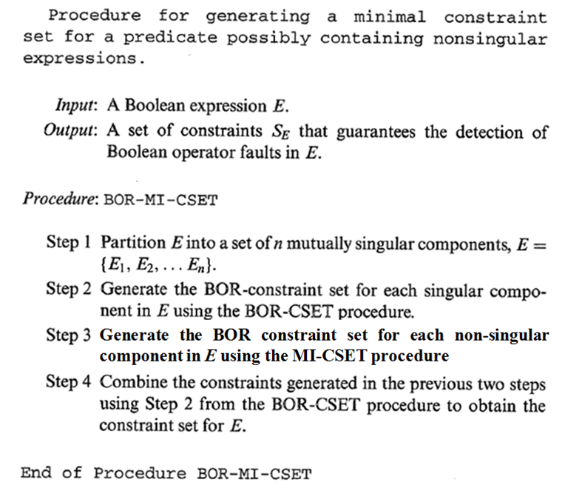
BOR-MI-CSET Procedure (2)
Requirements-based Test Generation for Predicate Testing (© 2012 Professor W. Eric Wong, The University of Texas at Dallas)

Slide 79
BOR-MI-CSET: Example (1)
Consider a non-singular Boolean expression: E = a(bc + !bd)
Mutually singular components of E
e₁ = a ⬅ singular
e₂ = bc + !bd ⬅ non-singular
We use the BOR-CSET procedure to generate the constraint set for e₁ (singular component) and MI-CSET procedure for e₂ (non-singular component)
Requirements-based Test Generation for Predicate Testing (© 2012 Professor W. Eric Wong, The University of Texas at Dallas)

Slide 80
BOR-MI-CSET: Example (2)
For component e₁ we get
S ^{t} _{e1} = {t}. S ^{f}_{e1} = {f}
Recall that S ^{t}_{e1} is true constraint set for e₁ and S ^{f}_{e1} is false constraint set for e₁
Requirements-based Test Generation for Predicate Testing (© 2012 Professor W. Eric Wong, The University of Texas at Dallas)

Slide 81
BOR-MI-CSET: Example (3)
Component e₂ is a DNF expression. We can write e₂ = u + v where u = bc and v = !bd
Let us now apply the MI-CSET procedure to obtain the BOR constraint set for e₂
As per Step 1 of the MI-CSET procedure we obtain
T_{u} = {(t, t, t), (t, t, f )}
T_{v} = {(f, t, t), (f, f, t)}
Requirements-based Test Generation for Predicate Testing (© 2012 Professor W. Eric Wong, The University of Texas at Dallas)

Slide 82
BOR-MI-CSET: Example (4)
Applying Steps 2 and 3 to T_{u} and T_{v} we obtain
Next we apply Step 4 to u and v. We obtain the following complemented expressions from u and v.
Note that u = bc and v = !bd
u₁ = !bc u₂ = b!c
v₁ = bd v₂ = !b!d
TS_{u} = T_{u} = {(t, t, t), (t, t, f)} TS_{v} = T_{v} = {(f, t, t), (f, f, t)}
S^{t}_{e2} = {(t, t, f), (f, t, t)}
One possible choice. Can you think of other alternatives?
Requirements-based Test Generation for Predicate Testing (© 2012 Professor W. Eric Wong, The University of Texas at Dallas)

Slide 83
BOR-MI-CSET: Example (5)
Continuing with Step 4 we obtain
Next we apply Step 5 to the F constraint sets to obtain
FS_{u1} = {(f, t, f )} FS_{u2} = {(t, f, t), (t, f, f )}
FS_{v1} = {(t, f, t)} FS_{v2} = {(f, t, f ), (f, f, f )}
F_{u1} = {(f, t, t), (f, t, f )} F_{u2} = {(t, f, t), (t, f, f )}
F_{v1} = {(t, t, t), (t, f, t)} F_{v2} = {(f, t, f ), (f, f, f )}
Requirements-based Test Generation for Predicate Testing (© 2012 Professor W. Eric Wong, The University of Texas at Dallas)

Slide 84
BOR-MI-CSET: Example (6)
Applying Step 6 to the FS sets leads to the following
S^{f}_{e2} = {(f, t, f ), (t, f, t)}
Combing the true and false constraint sets for e₂ we get
S_{e2} = {(t, t, f ), (f, t, t), (f, t, f ), (t, f, t)}
Requirements-based Test Generation for Predicate Testing (© 2012 Professor W. Eric Wong, The University of Texas at Dallas)

Slide 85
BOR-MI-CSET: Example (7)
Summary
S ^{t}_{e1} = {(t)} S ^{f}_{e1} = {(f )} from BOR-CSET procedure
S ^{t}_{e2} = {(t, t, f ), (f, t, t)} S ^{f}_{e2} = {(f, t, f ), (t, f, t)} from MI-CSET procedure
We now apply Step 2 of the BOR-CSET procedure to obtain the constraint set for the entire expression E
Requirements-based Test Generation for Predicate Testing (© 2012 Professor W. Eric Wong, The University of Texas at Dallas)

Slide 86
BOR-MI-CSET: Example (8)
Obtained by applying Step 2 of BOR-CSET to an AND node
S ^{t}_{N3} = S ^{t}_{N1} ⊗ S ^{t}_{N2}
S ^{f}_{N3} = (S ^{f}_{N1} × {t₂}) ∪ ({t₁} × S ^{f}_{N2})
True constraint: {(t, t, t, f), (t, f, t, t)}
False constraint: {(f, t, t, f), (t, f, t, f), (t, t, f, t)}
N₃
∧
True constraint: {(t, t, f), (f, t, t)}
False constraint: {(f, t, f), (t, f, t)}
N₂
∨
∧
∧
N₁
a
b
c
!b
d
True constraint: t
False constraint: f
Apply MI-CSET
Requirements-based Test Generation for Predicate Testing (© 2012 Professor W. Eric Wong, The University of Texas at Dallas)

Slide 87
Summary (1)
Most requirements contain conditions under which functions are to be executed. Predicate testing procedures covered are excellent means to generate tests to ensure that each condition is tested adequately.
Requirements-based Test Generation for Predicate Testing (© 2012 Professor W. Eric Wong, The University of Texas at Dallas)

Slide 88
Summary (2)
Usually one would combine equivalence partitioning, boundary value analysis, and predicate testing procedures to generate tests for a requirement of the following type:
if condition then action 1, action 2, …action n;
apply predicate testing or BVA
apply equivalence partitioning, BVA, etc., and predicate testing if there are nested conditions
Requirements-based Test Generation for Predicate Testing (© 2012 Professor W. Eric Wong, The University of Texas at Dallas)

