Slide 1
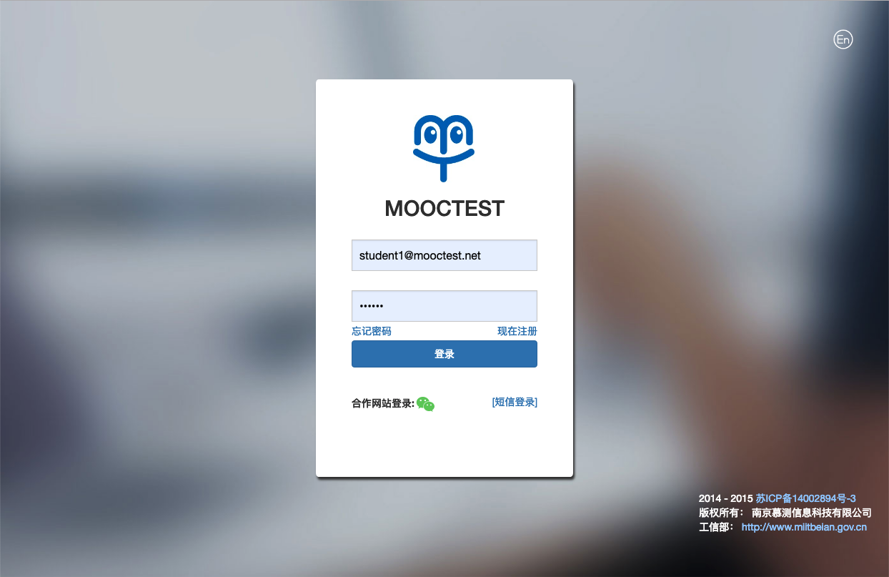
Sign up your account
Access using Chrome http://summer.mooctest.net/login2
Click “En” to switch to English
Switch to English

Slide 2
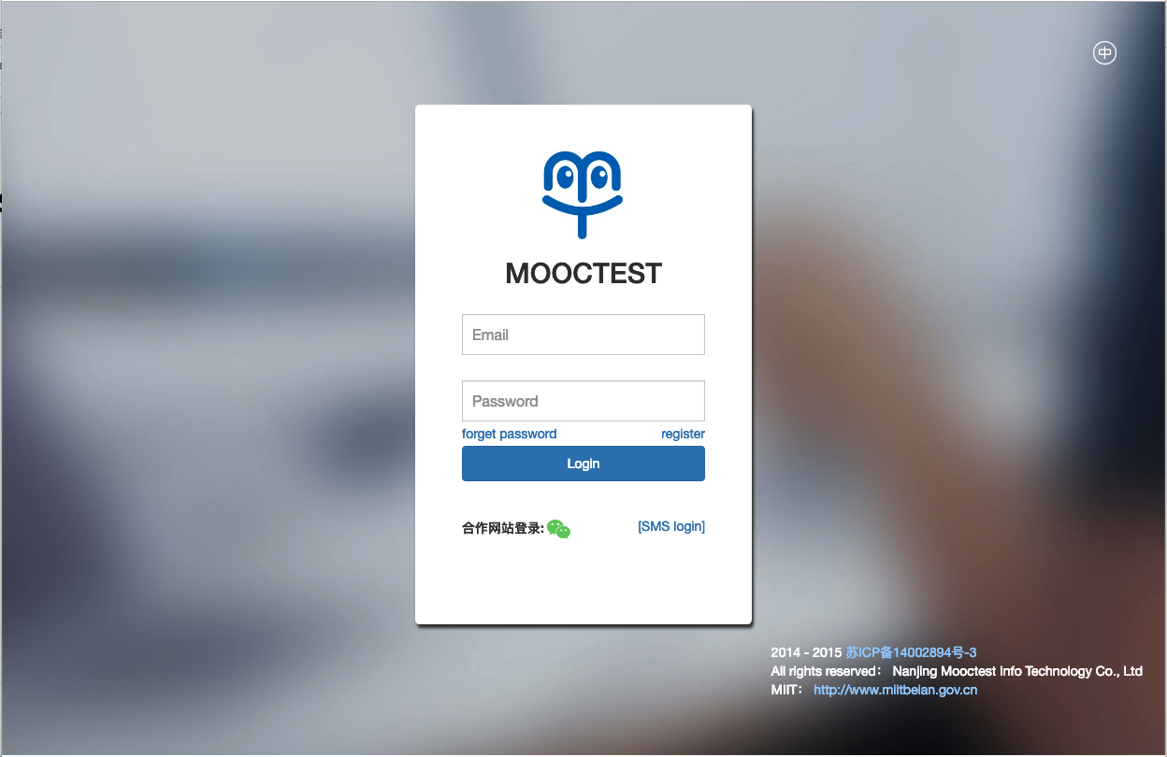
Sign up your account
3. Click “register”
Sign up your account

Slide 3
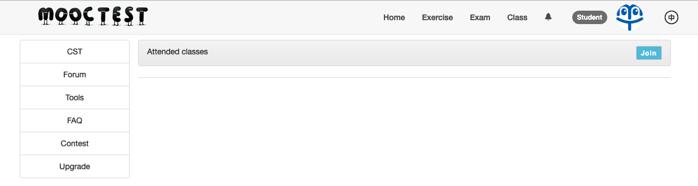
Try the contest exercise
Go to Class > Join

Slide 4
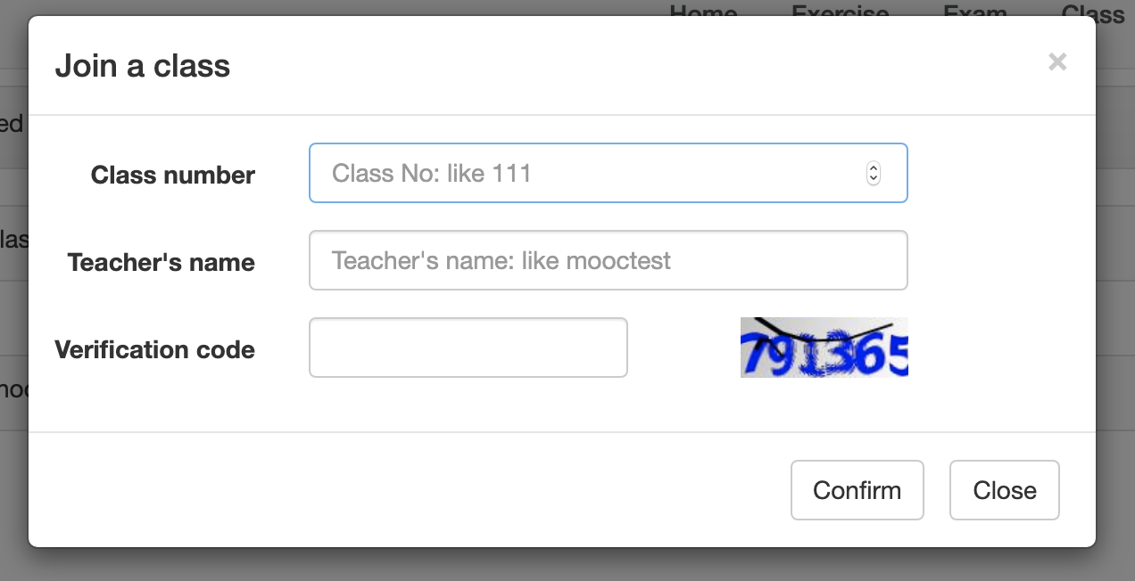
Try the exercise
Class number: 887
Teacher’s name: Mooctest

Slide 5
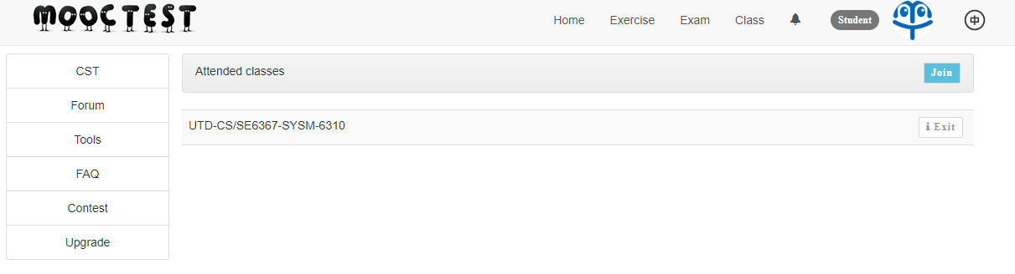
Try the exercise
Verify corresponding classes shows up.

Slide 6
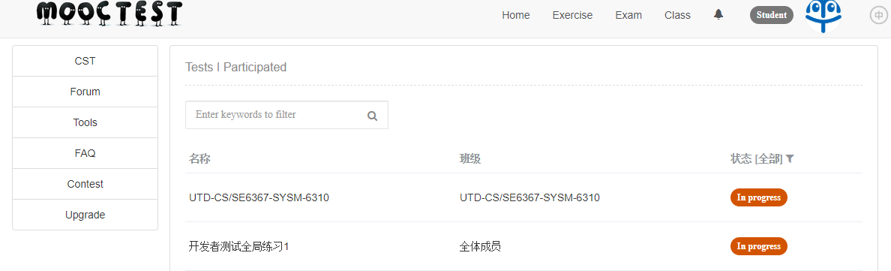
Try the exercise
Go to “Exercise”
Click “UTD-CS/SE6367-SYSM-6310” of “UTD-CS/SE6367-SYSM-6310”

Slide 7
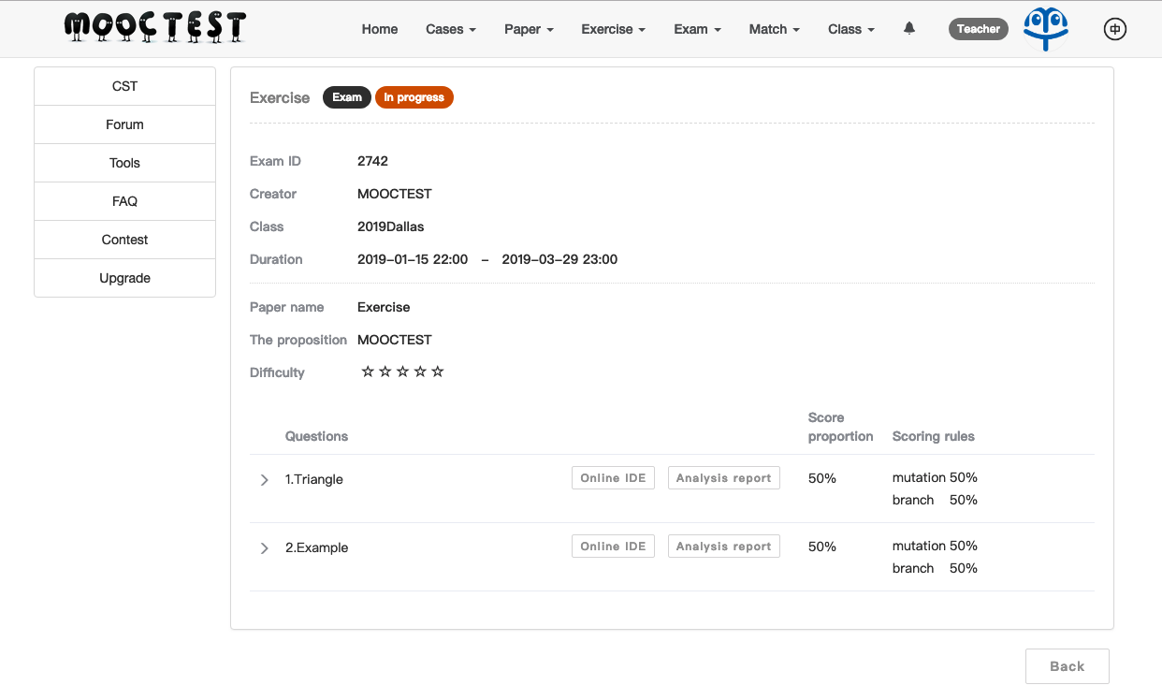
Try the exercise
Click “Online IDE” of either one of the questions to start practice.

Slide 8
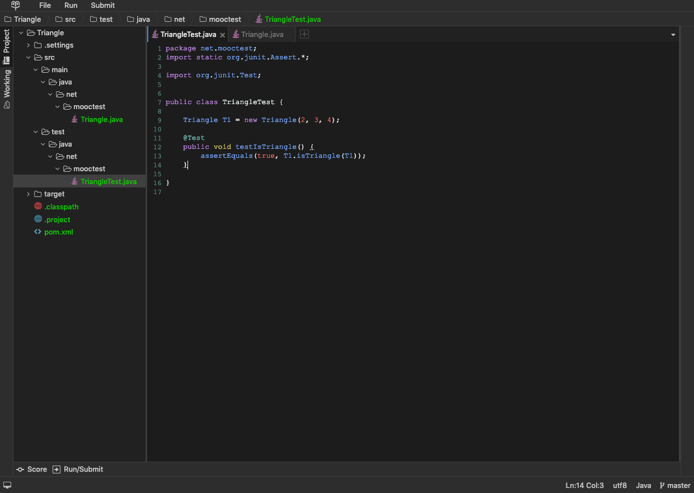
IDE Interface
Run & Submit
The source code of the program you will test
Run vs. Submit
Run = Measure the coverage of your test cases. (Return results faster as it does not save the code to server)
Submit = Save your code to the server & update your score on the leaderboard.
Note: Don’t forget to Submit ! Your final score will be determined by the code of the last Submit.
Your JUnit test code

Slide 9
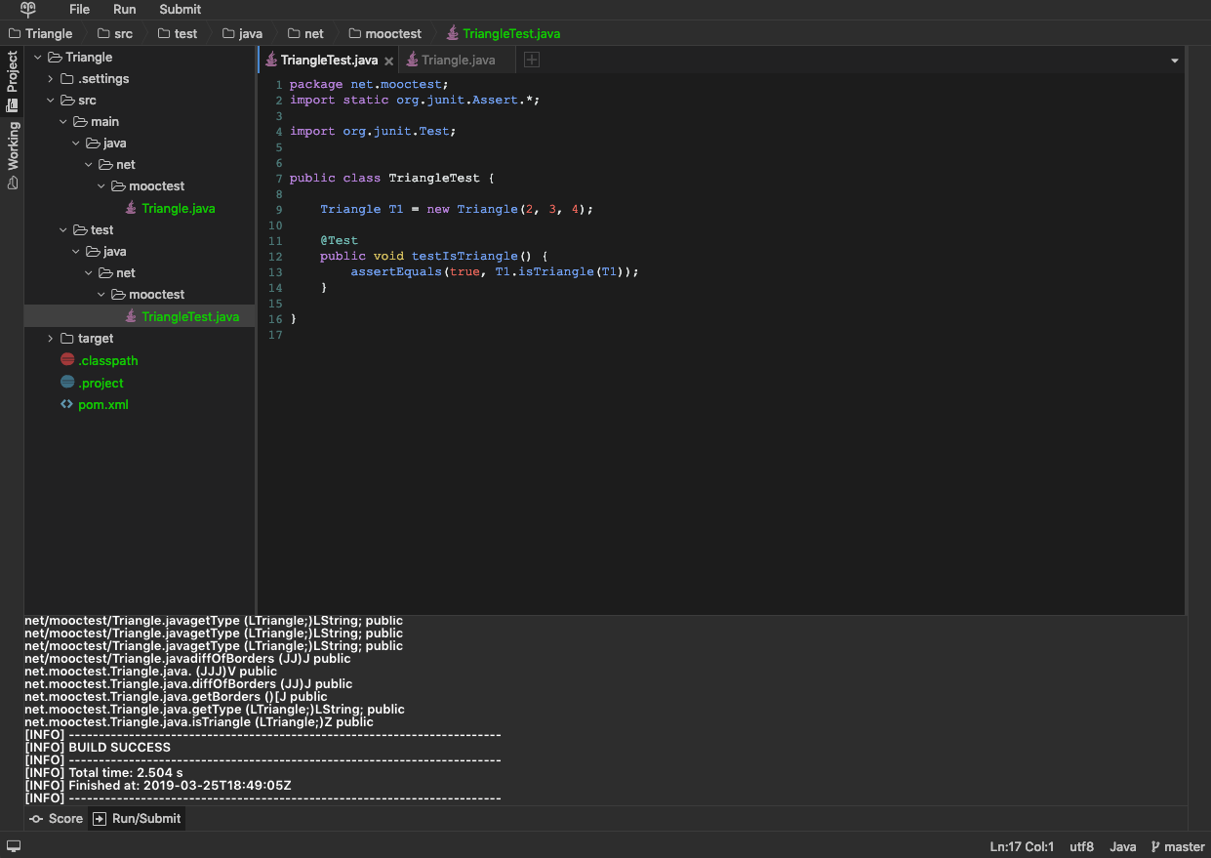
Measure coverage by Run
Click Run
Verify “BUILD SUCCESS” after clicking Run
Click “Score” to check coverage
Click “Score” to check coverage
Verify “BUILD SUCCESS” after clicking Run

Slide 10
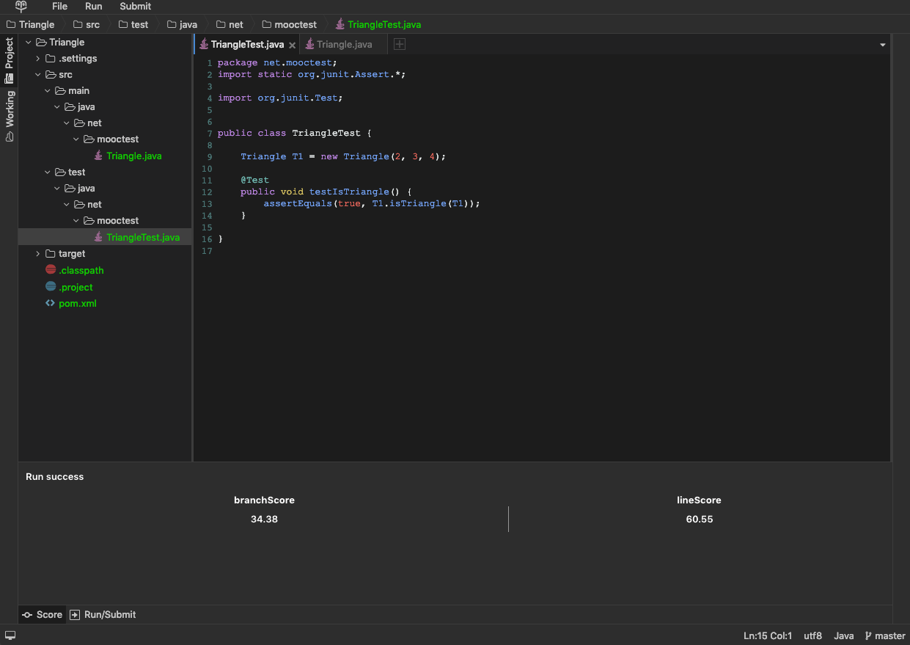
Coverage Measurement
Branch Score = Branch Coverage (https://www.guru99.com/code-coverage.html#6)
Line Score = Statement Coverage

