Slide 1
Getting Started with APIs in R
Reina Chano Murray
R-Ladies Baltimore + Irvine
April 11, 2023
https://bit.ly/3MBht0O

Slide 2
What we’ll use today
Rstudio (Posit)
Packages:
httr
jsonlite
censusapi
US Census Bureau API Key

Slide 3
Agenda
What is an API?
Why use APIs?
Getting started (the general workflow)
Explore the US Census API (creating queries in a web browser)
Demos:
Using httr and jsonlite
Using censusapi

Slide 4
What is an API?

Slide 5


Slide 6
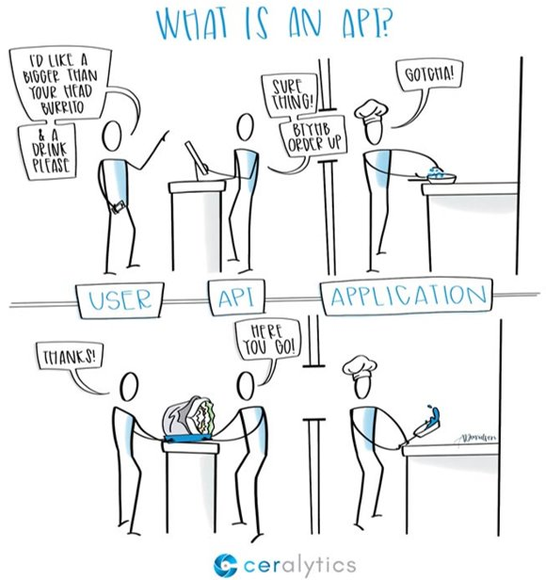
Ordering a Meal
Customer makes an order
Server takes down order, processes it, and passes it to cook
Cook acknowledges order
Cook makes the order, gives it to the server
Server gives the customer their order

Slide 7
APIs
User (client) makes a request
API takes down request​, processes it, ​and passes it to the application​
Application acknowledges request​
Application processes request​ and signals API​
API returns a response to user​

Slide 8
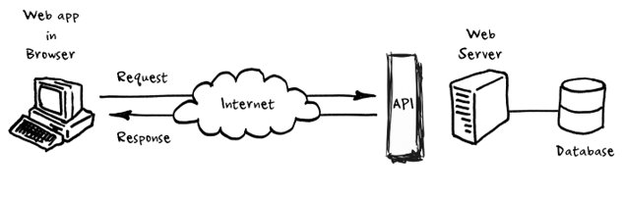
Follows specific programmatic rules
Contains content in a documented and structured format

Slide 9
APIs
Is NOT the database or the server – it is the code that governs the access point(s) for the server
APIs cover a broad category that includes all interfaces that facilitate communication between computer applications
We’re talking about Web APIs – APIs that expose an application’s data and functionality over the internet, allowing two computers (the client and the server) to interact with each other to request and provide data.

Slide 10
4 main types of web APIs
Open / public APIs – no restrictions to access*
Partner APIs – requires specific rights and/or licenses
Internal APIs – designed for internal use within an organization
Composite APIs – combines different data and service APIs
* May need to create an account or request an API key

Slide 11
Why use an API?

Slide 12
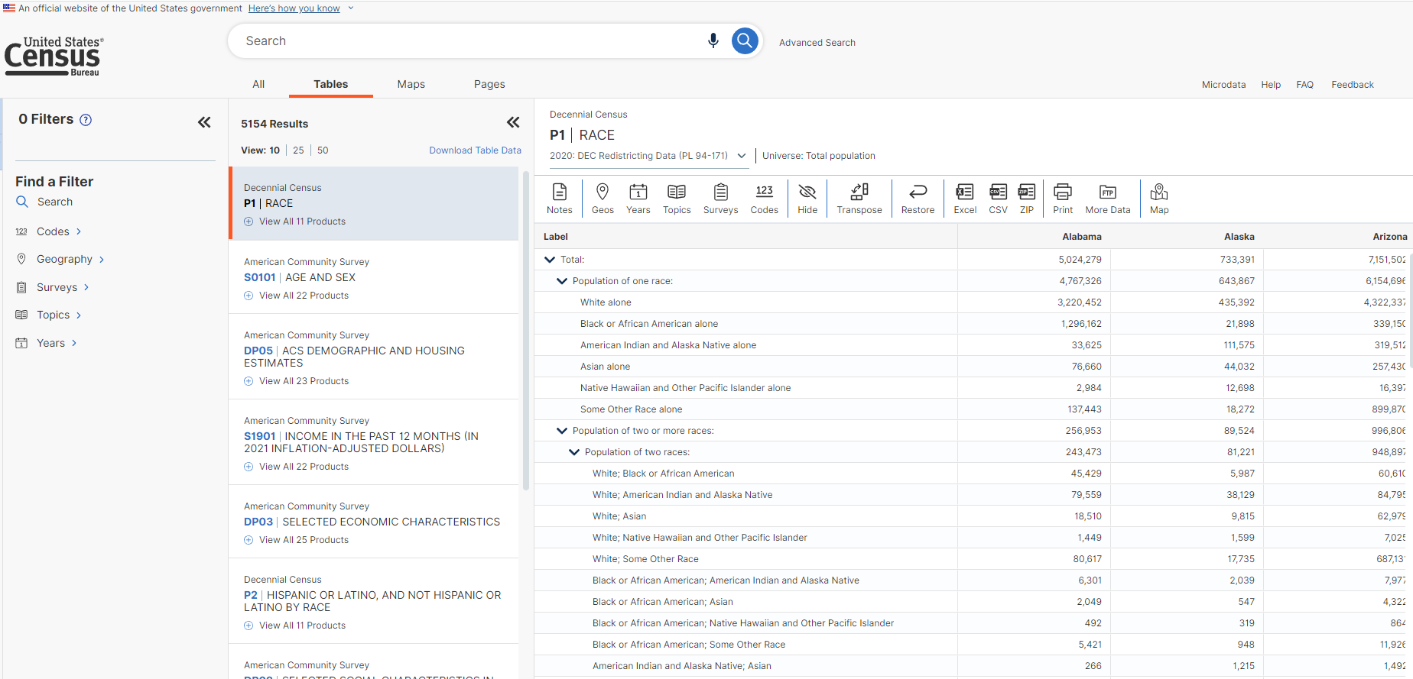

Slide 13
Why Use an API
Get data directly from the source ​
Data pulled from an API is usually formatted to be usable with some cleaning
Get access to most recent, up-to-date data​
Integrate and automate your data collection workflow ​
APIs can let you forgo the process of manually downloading datasets from a website, managing the data in a file management system, and loading it into the software you are using for analysis. ​

Slide 14
Getting Started
The general workflow

Slide 15
1
Explore the documentation for the API
2
Make your request
3
Review response

Slide 16
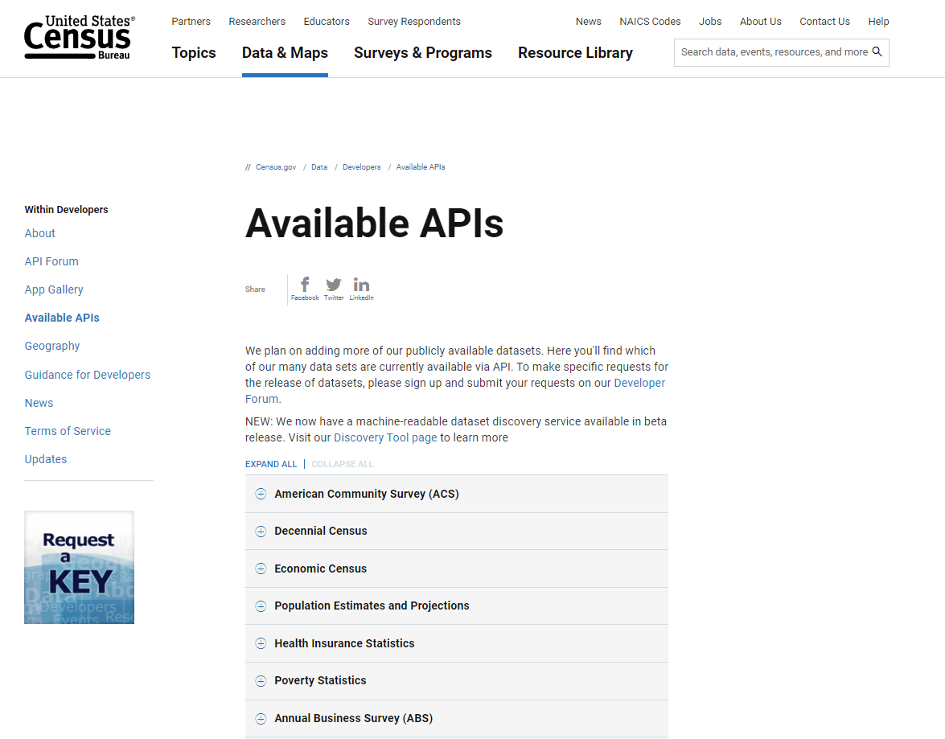
1
Explore the documentation for the API
Do they supply an API that does what you’re looking for?
Review the process for getting access to the API:
Do you need to apply / create an account?
Applying for an API key – unique identifier to authenticate your particular requests
Query limits (if any)
2
Make your request
3
Review response
https://www.census.gov/data/developers/data-sets.html

Slide 17
1
Explore the documentation for the API
Do they supply an API that does what you’re looking for?
Review the process for getting access to the API:
Do you need to apply / create an account?
Applying for an API key – unique identifier to authenticate your particular requests
Query limits (if any)
2
Make your request
Identify the URI/URL (uniform resource identifier/locator)
Prepare your query
Send a GET request to the API
3
Review response
Parse through and clean response
Convert response to a dataframe

Slide 18
Explore the US Census API

Slide 19
US Census Data API
https://www.census.gov/data/developers/guidance.html
Available data
American Community Survey (ACS)​, Economic Indicators Time Series​, Decennial Census, Economic Census​, County Business Patterns and Nonemployer Statistics​, Population Estimates and Projections​, International Trade, etc…​
Query small quantities of data (up to 50 variables in a single query, and up to 500 queries per IP address per day)​
To make more than 500 queries per IP address per day, request an API key

Slide 20
Creating Queries in a Web Browser
https://api.census.gov/data/2018/pep/charagegroups?get=POP,GEONAME,DATE_DESC&DATE_CODE=11&RACE=10&for=county:*&in=state:24

Slide 21
Creating Queries in a Web Browser
https://api.census.gov/data/2018/pep/charagegroups?get=POP,GEONAME,DATE_DESC&DATE_CODE=11&RACE=10&for=county:*&in=state:24
1. Start with the host name

Slide 22
Creating Queries in a Web Browser
https://api.census.gov/data/2018/pep/charagegroups?get=POP,GEONAME,DATE_DESC&DATE_CODE=11&RACE=10&for=county:*&in=state:24
1. host name
2. Add dataset name
(list available at https://api.census.gov/data.html)

Slide 23
Creating Queries in a Web Browser
https://api.census.gov/data/2018/pep/charagegroups?get=POP,GEONAME,DATE_DESC&DATE_CODE=11&RACE=10&for=county:*&in=state:24
1. host name
2. Add dataset name
(list available at https://api.census.gov/data.html)
3. Add variable requests using ?get=

Slide 24
Creating Queries in a Web Browser
https://api.census.gov/data/2018/pep/charagegroups?get=POP,GEONAME,DATE_DESC&DATE_CODE=11&RACE=10&for=county:*&in=state:24
1. host name
2. Add dataset name
(list available at https://api.census.gov/data.html)
3. Add variable requests using ?get=
4. Filter variables using &for=

Slide 25
Creating Queries in a Web Browser
https://api.census.gov/data/2018/pep/charagegroups?get=POP,GEONAME,DATE_DESC&DATE_CODE=11&RACE=10&for=county:*&in=state:24
1. host name
2. Add dataset name
(list available at https://api.census.gov/data.html)
3. Add variable requests using ?get=
4. Filter variables using &for=
5. If needed, add your key using &key=
Click here to see RESULT

Slide 26
Creating Queries in a Web Browser
https://api.census.gov/data/2018/pep/charagegroups?get=POP,GEONAME,DATE_DESC&DATE_CODE=11&RACE=10&for=county:*&in=state:24
1. host name
2. Add dataset name
(list available at https://api.census.gov/data.html)
3. Add variable requests using ?get=
4. Filter variables using &for=
5. If needed, add your key using &key=
Making queries in your browser is a good way to practice and get ​ comfortable with the variables and filters available in the Census Data API​
Works best on Chrome or Firefox​
Use an extension like JSON Formatter, JSON Viewer, or JSONView to make JSON easier to read in your browser
In web browser, right-click and select “Save As” to save results as a csv​
Sample queries: ​ https://www.census.gov/data/developers/guidance/api-user-guide.Example_API_Queries.html

Slide 27
Demo 1
Using httr and jsonlite

Slide 28
Demo 2
Using censusapi

Slide 29
censusapi
Link
R wrapper for US Census Data API. ​
​Covers more datasets than tidycensus (another R package for US Census data) ​
Returns data frames of census data AND metadata

Slide 30
Other Demos
rjsonio demo:
RJSONIO – a package that converts data to and from JSON format
Similar to using httr and jsonlite
tidycensus demo:
Tidycensus - an integrated package that allows users to access decennial census and ACS data as tidyverse-ready data frames. ​
Offers access to less datasets than censusapi: The main intent of the tidycensus package is to return population characteristics of the United States in tidy format allowing for integration with simple feature geometries. Its intent is not, and has never been, to wrap the universe of APIs and datasets available from the US Census Bureau.
Walkthrough

Slide 31
Thank you!
Reina Chano Murray
R-Ladies Baltimore + Irvine
April 11, 2023

