Slide 1
Data Compression
Wim Lamotte

Slide 2
Overview
General overview of data compression
Applied to everyday data (text, images, video, audio)
Approach:
Introductory classes (“hoorcolleges”)
Studying relevant articles / documents
Assignments: arithmetic coding, image and video compression
In groups of 2, self-created through BB
No collaboration / discussion allowed with other students / groups/ externals!

Slide 3
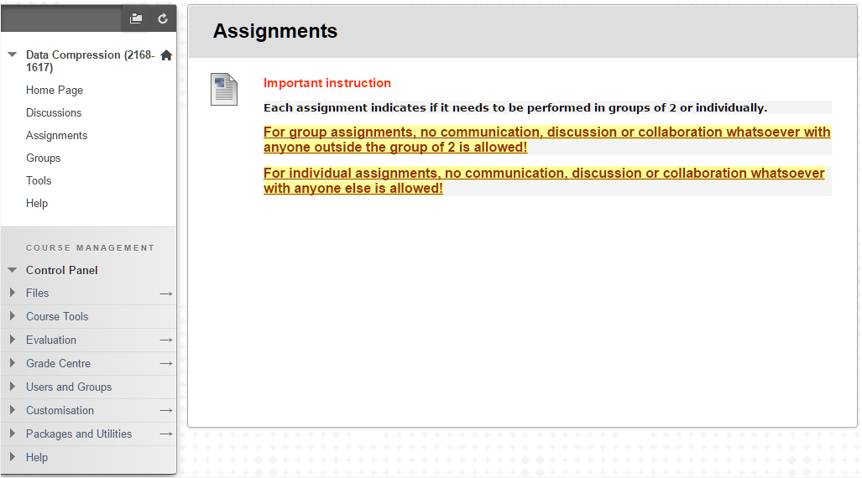
Blackboard

Slide 4
Evaluation
2 parts
Regular written exam 40%
Assignments 60%
IMPORTANT: respect all deadlines!
➔ REQUIRED to be allowed to take the written exam

Slide 5
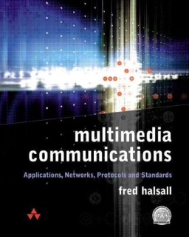


Relevant Reading
Books:
F. Halsall, “Multimedia Communications”, Addison-Wesley, 2001
Z-N. Li & M. Drew, “Fundamentals of Multimedia, 2nd edition”, Prentice-Hall, 2014

Slide 6
Team
Examiner: Wim Lamotte
Guidance of assignments:
Jori Liesenborgs
Peter Quax
Communication:
Blackboard (check your enrollment!)
Slides, assignments and groups, important files and documents, discussion fora, …
1 E-mail: mailto:datacomp@edm.uhasselt.be

Slide 7
Questions?

