Slide 1
Data Compression
1. General principles - Information Theory

Slide 2
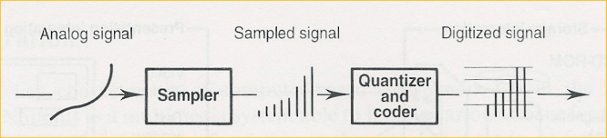
Digitization
= convert analog signals into digital signals
2 steps:
Sampling: obtain discrete values by inspecting the analog signal, at regular intervals
Quantization and coding: assign numerical value to sample values, coded with specified number of bits

Slide 3
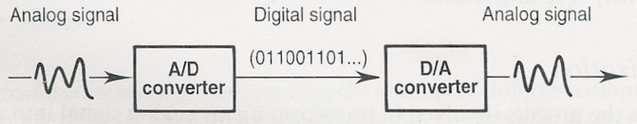
A/D and D/A conversion
A/D conversion: mostly to feed signals from the real world into a computer system
E.g. digitalizing human voice
D/A conversion: for output to human senses
E.g. via sound interface to (analog) speakers

Slide 4
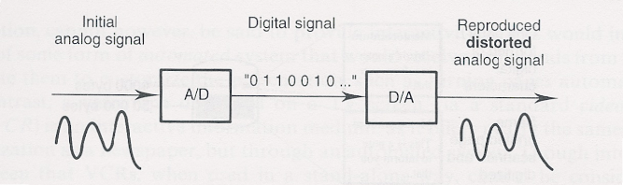
Drawback of digitization
A/D conversion introduces distortion
Can be reduced by
Higher sample frequency
Higher number of bits when coding
=> Higher bitrate, higher storage requirements
=> Compression techniques required!

Slide 5
Compression: basic concepts
Source encoders - destination decoders
Lossless vs. lossy compression
Entropy encoding
Source encoding

Slide 6
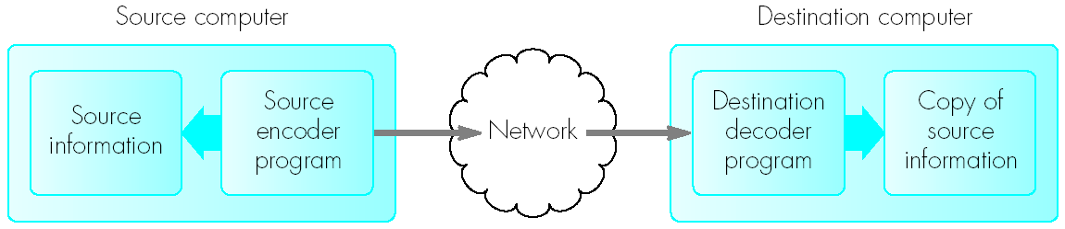
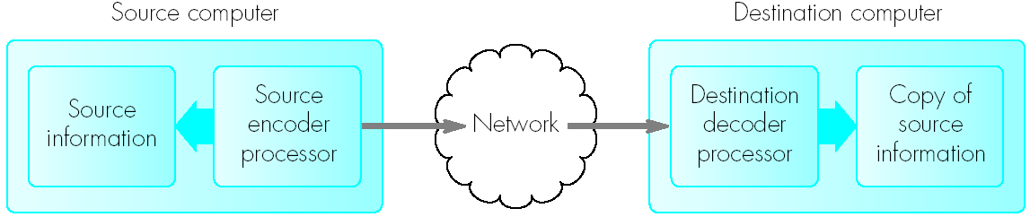
Source encoders – destination decoders
Software-only
Specific processors/hardware

Slide 7
Lossless vs. lossy compression
Lossless (“verliesloos”) = reversible: original data can be reconstructed from compressed data
Only compression, no changes
E.g. Medical images, text files
Lossy (“met verlies”) = not (fully) reversible
Compress with loss of data
Keep differences minimal, so that they are (almost) unnoticeable
E.g. pictures, audio and video streams

Slide 8
Entropy encoding vs. source encoding
Entropy encoding:
Lossles
Independent of knowledge of type of data or semantics
Only takes into account mere digital representation of the data
Source encoding:
Exploit specific properties of the information/data

Slide 9
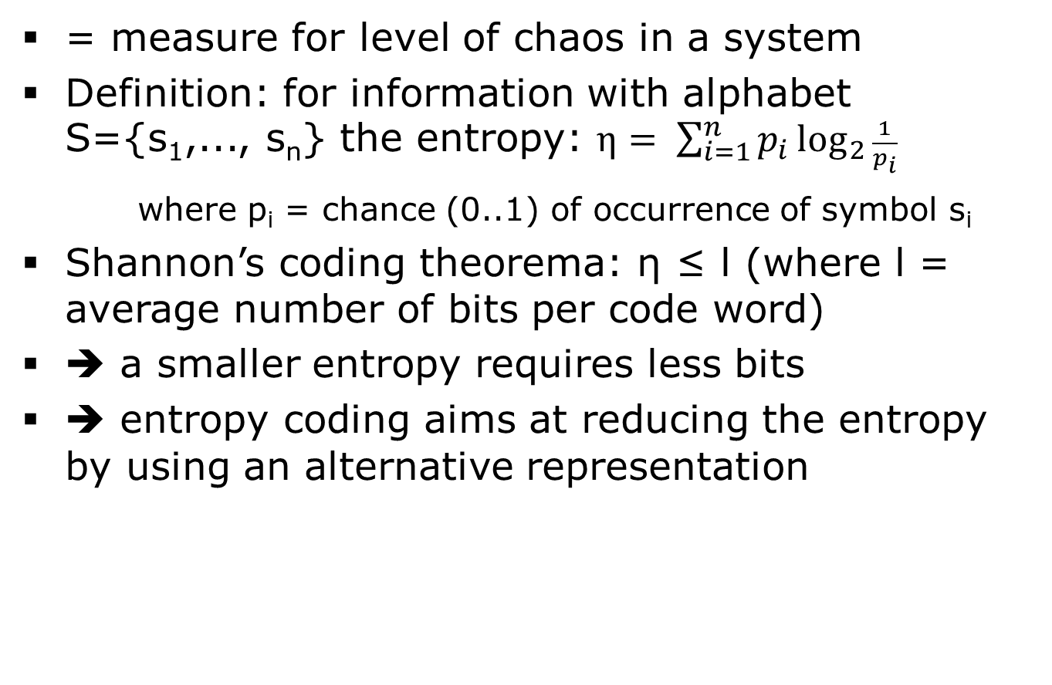
Entropy
= measure for level of chaos in a system
Definition: for information with alphabet S={s₁,..., s_{n}} the entropy: $η= \sum_{i=1}^{n}{p_{i}}\log_{2}{\frac{1}{p_{i}}}$
where p_{i} = chance (0..1) of occurrence of symbol s_{i}
Shannon’s coding theorema: η ≤ l (where l = average number of bits per code word)
➔ a smaller entropy requires less bits
➔ entropy coding aims at reducing the entropy by using an alternative representation

Slide 10
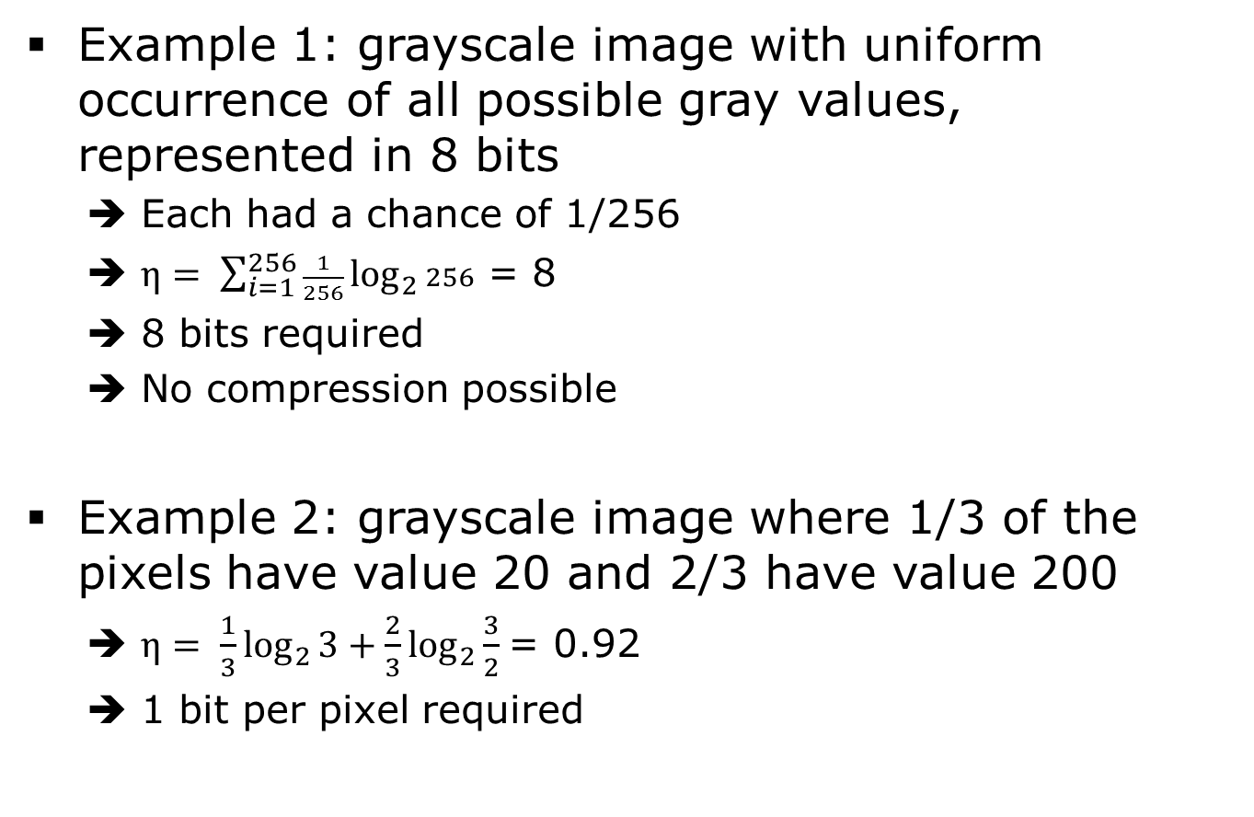
Entropy (2)
Example 1: grayscale image with uniform occurrence of all possible gray values, represented in 8 bits
➔ Each had a chance of 1/256
➔ $η= \sum_{i=1}^{256}{\frac{1}{256}}\log_{2}{256}$ = 8
➔ 8 bits required
➔ No compression possible
Example 2: grayscale image where 1/3 of the pixels have value 20 and 2/3 have value 200
➔ $η= \frac{1}{3}\log_{2}{3}+\frac{2}{3}\log_{2}{\frac{3}{2} }$= 0.92
➔ 1 bit per pixel required

Slide 11
Entropy (3)
Flat chance distribution function (cdf) ➔ larger entropy
p_{i}
p_{i}
1
1/256
2/3
1/3
0
255
i
0
255
i
Cdf example 1
Cdf example 2

Slide 12
Entropy encoding
2 examples:
RLE: Run length encoding
E.g. bitmap encoding: subsequent pixels of same colour coded as one colour value and a repetition count
TGA file format: 24-bit colour values
2 types pixels: raw pixels vs. encoded pixels
Raw = plain colour value
Encoded = repeat count + colour value
Statistical encoding
Code data with variable length codes
Use shorter codes for more frequently occurring data
E.g. take into account frequency of letters in text
Variable length implies that no code may be prefix of another code (why?)
Example algorithm: Huffman coding (see further)

Slide 13
Source Encoding
Exploit specific properties of the information/data
=> generate alternative representation
=> compression or easier to compress
2 typical examples:
Differential encoding
Large variety in possible values (e.g. pixel values), but relatively little difference between subsequent values
Transform encoding
Transform information into a more “compressible” form

Slide 14
Differential Encoding
Reduce coding size by storing subsequent differences
E.g. original data: 12 bits per value, but subsequent values can be coded in max. 3 bits
=> 75% less capacity needed by storing differences
Lossless or lossy?
Depends on resolution used for difference values

Slide 15
Transform Encoding
Transformation of data to another domain
=> more compressible
Mainly used in image compression (e.g. DCT, wavelets, …)
DCT used in JPEG compression (cf. later)
Let’s now apply these basic principles to:
Text compression
Image compression
Video compression

