Slide 1
Data Compression
2. Text Compression

Slide 2
Text Compression
Lossy is not an option
➔ only entropy encoding
➔ only statistical encoding is useful
2 types:
Individual characters
E.g. Huffman coding, arithmetic coding
Words / strings of characters
E.g. Lempel-Ziv-Welch (LZW) algorithm
Important note: all coding algorithms discussed here can also be (and are being) used in other contexts (besides text compression)

Slide 3
Huffman encoding
General principle:
Data stream (e.g. text)
➔ Calculate occurrence (%) of each character
➔ Calculate entropy and hence minimal # bits
➔ Determine optimal coding
➔ Code book
➔ Re-encode data stream with code book

Slide 4
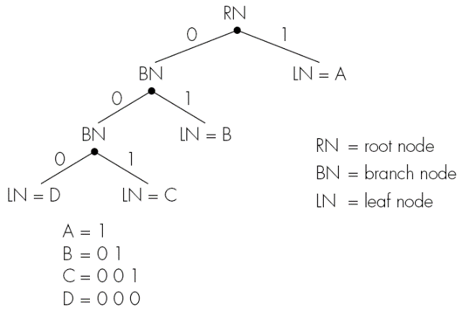
Huffman Code Tree

Slide 5
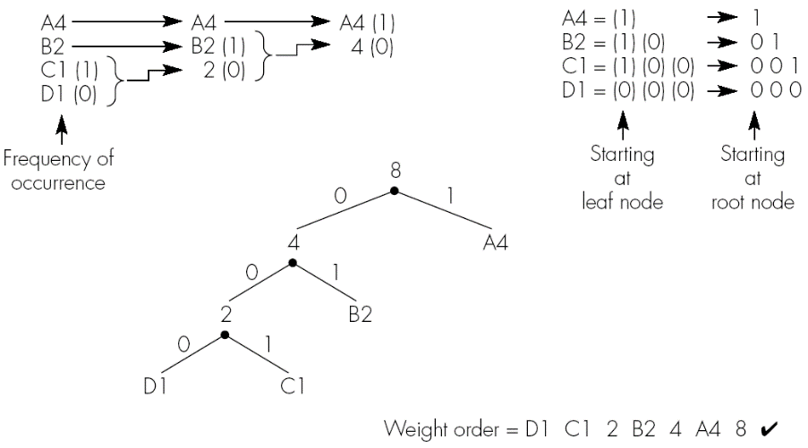
Huffman Code Tree Construction

Slide 6
Huffman Coding: algorithm
Initialization: arrange all symbols in a list, sorted by descending occurrence
Repeat until the list only contains 1 symbol:
Take 2 symbols from list with lowest occurrence
Create subtree with these two symbols as leaves and create new parent node
Give parent node sum of occurrences of two children as combined occurrence
Add parent node to list at the correctly sorted position
Delete children from the list
Assign code word for each leaf, based on path from root to leaf

Slide 7
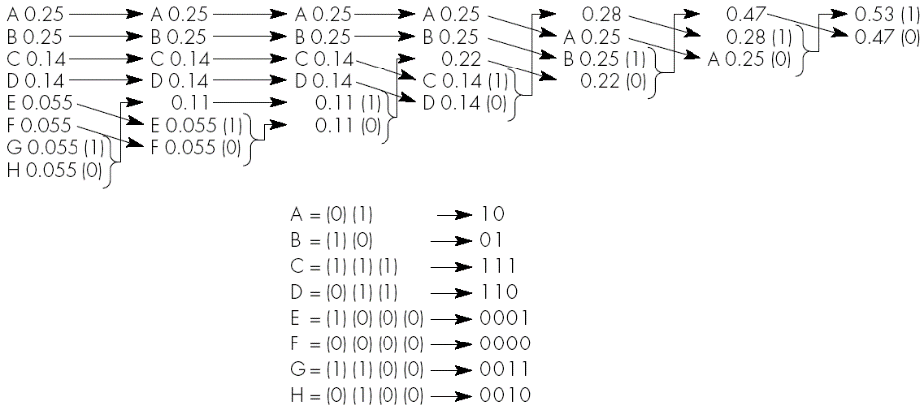
Larger example
Frequencies: A and B: 0.25; C and D: 0.14; E, F, G and H: 0.055

Slide 8
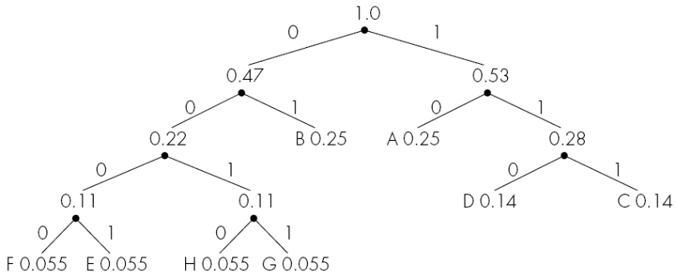
Resulting Huffman code tree

Slide 9
Animated example

Slide 10
Huffman coding: properties
Unique prefix: no code word is prefix of another code
Reason: all symbols are at the leaves of the tree
Advantage: no ambiguity ➔ efficient decoding
Optimal: minimal redundancy
Average code-length l ≤ η + 1

Slide 11
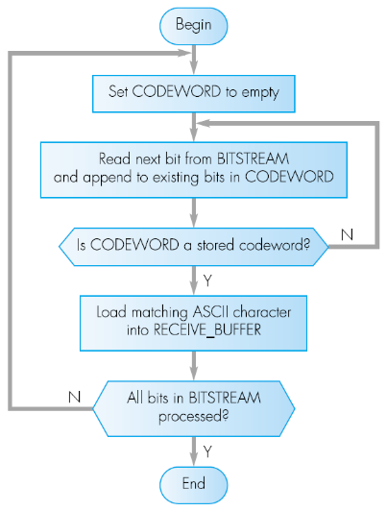
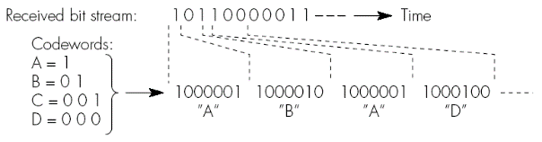
Huffman coding: decoder algorithm
Dynamic data??

Slide 12
Huffman decoding
Problem: receiver/decoder needs to know the code words
Either send before (coded) data
Disadvantage: extra overhead (storage and/or network)
Or code words known in advance
E.g. based on statistical properties of natural language
Better approach for random data: dynamic Huffman coding
Principle: build tree on-the-fly at sender and receiver side
First occurrence of a character: send as is
When repeated: update occurrence, restructure tree and adjust code(s)

Slide 13
Arithmetic coding
Overcomes Huffman’s main limitation (which?)
Already proposed by Shannon in 1948, but mainly developed in 1970’s – 1980’s
Modern versions in JPEG2000, H.264, H.265, …

Slide 14
Arithmetic coding principles
Treat whole message (or a chunk thereof) as a whole, code at once
➔ fractional number of bits per input symbol
Approach:
Message is represented by a half-open interval [a, b[ where a and b are real numbers between 0 and 1
Start with interval [0, 1[
As message becomes longer, length of the interval shortens and number of bits needed to represent the interval increases
We first look at simplistic approach, then extend with scaling

Slide 15
Simple arithmetic coding
BEGIN
low = 0.0; high = 1.0; range = 1.0;
while (symbol != terminator)
{
get (symbol);
low = low + range * Range_low(symbol);
high = low + range * Range_high(symbol);
range = high - low;
}
output a code such that low <= code < high;
END

Slide 16
Example
Alphabet: {A,B,C,D,E,F,$} with following probabilities (and associated ranges):
Q: how will string “CAEE$” be encoded?
Symbol | Probability | Range
A | 0.2 | [0, 0.2)
B | 0.1 | [0.2, 0.3)
C | 0.2 | [0.3, 0.5)
D | 0.05 | [0.5, 0.55)
E | 0.3 | [0.55, 0.85)
F | 0.05 | [0.85, 0.9)
$ | 0.1 | [0.9, 1.0)

Slide 17
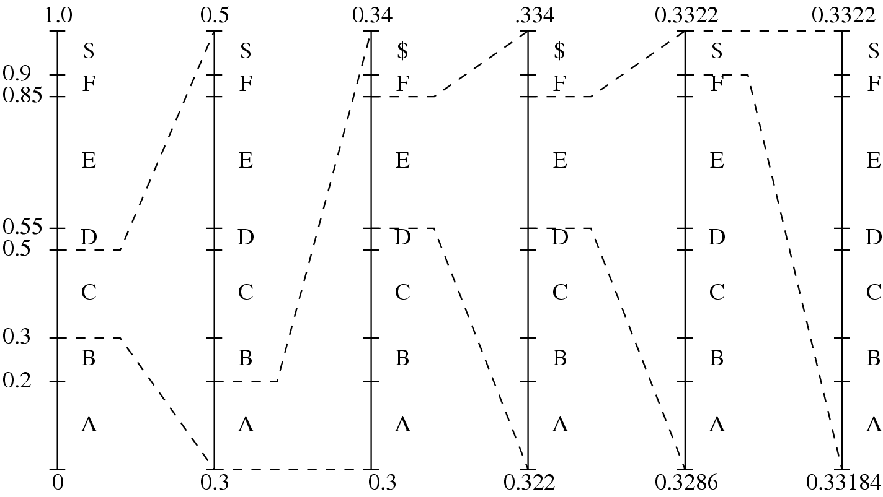
Example
Gradually shrinking range:

Slide 18
Example
Evolution of low, high and range variables
Q: why end with
“output a code such that low <= code < high” ?
Symbol | low | high | range
 | 0 | 1.0 | 1.0
C | 0.3 | 0.5 | 0.2
A | 0.30 | 0.34 | 0.04
E | 0.322 | 0.334 | 0.012
E | 0.3286 | 0.3322 | 0.0036
$ | 0.33184 | 0.33220 | 0.00036

Slide 19
Generating code word for arithmetic encoder
BEGIN
code = 0;
k = 1;
while (value(code) < low)
{
assign 1 to the kth binary fraction bit
if (value(code) > high)
replace the kth bit by 0
k = k + 1;
}
END
➔ Generates shortest codeword in [low,high[
= the bit representing 2^{-k}

Slide 20
Example: encoding CAEE$
Resulting values for CAEE$:
low = 0.33184
high = 0.3322
1 as first decimal bit yields 0.5 > high
➔ assign 0 for 2⁻¹
etc…
Eventually yields 0.01010101
= 2⁻² + 2⁻⁴ + 2⁻⁶ + 2⁻⁸
= 0.33203125 in decimal, which is between low and high

Slide 21
Arithmetic coding decoder
BEGIN
get binary code and convert to decimal value = value(code);
DO
{
find symbol s such that Range_low(s) <= value < Range_high(s);
output s;
low = Range_low(s);
high = Range_high(s);
range = high - low;
value = [value - low] / range;
}
UNTIL symbol s is a terminator
END

Slide 22
Arithmetic coding decoder example
Decoding 0.33203125 yields:
Q: how can we avoid using a terminator symbol?
Value | Output Symbol | Range_low | Range_high | range
0.33203125 | C | 0.3 | 0.5 | 0.2
0.16015625 | A | 0.0 | 0.2 | 0.2
0.80078125 | E | 0.55 | 0.85 | 0.3
0.8359375 | E | 0.55 | 0.85 | 0.3
0.953125 | $ | 0.9 | 1.0 | 0.1

Slide 23
Assignment 1
Write your own (simple) arithmetic encoder and decoder in Python
➔ do not include extensions discussed next
Cf. Blackboard for details

Slide 24
Arithmetic coding: practical limitations
2 limitations:
Long sequences of symbols
➔ intervals shrink to very small range
➔ requires very high precision numbers (see also assignment 1)
No output until entire sequence is processed
+ same for decoder
2 observations:
Low, high, codes require many bits, but share same MSB
Subsequent intervals stay within current interval ➔ we can output MSBs earlier
Solution: scaling and incremental coding

Slide 25
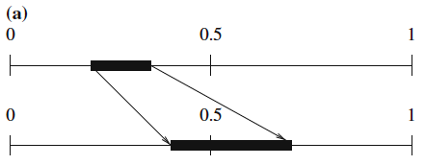
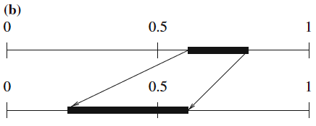
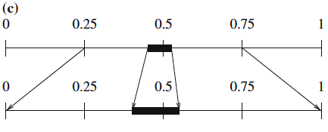
Scaling and incremental coding
3 types of scaling: (a) E1, (b) E2, and (c) E3 scaling

Slide 26
E1 and E2 scaling pseudocode
BEGIN
while (high <= 0.5) OR (low >= 0.5)
{
if (high <= 0.5) // E1 scaling
{
output ‘0’;
low = 2 * low; // realized by <<1 (left-shift)
high = 2 * high;
}
else // E2 scaling
{
output ‘1’;
low = 2 * (low - 0.5); // also <<1, dropping 1
high = 2 * (high - 0.5);
}
}
END

Slide 27
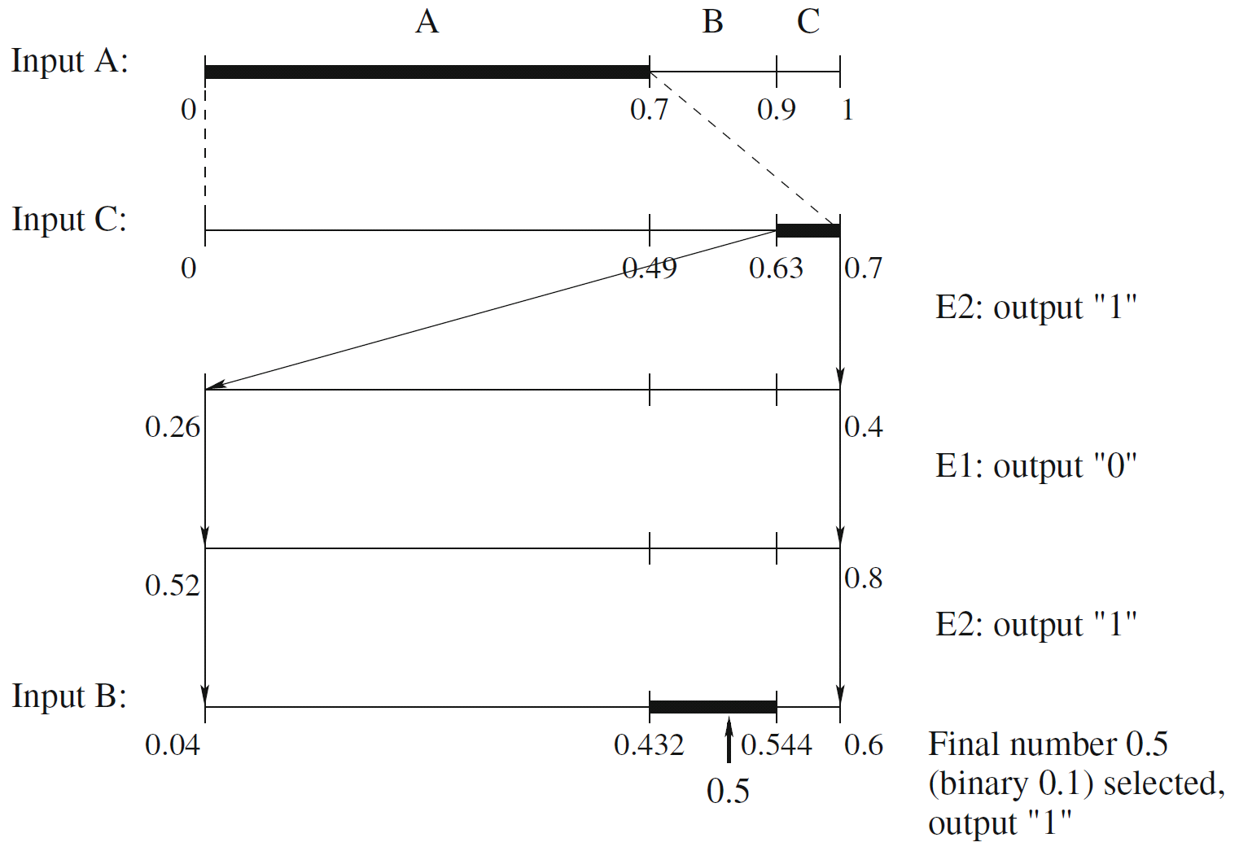
Scaling and incremental coding example
Alphabet: A, B, C
Probabilities: P(A)=0.7, P(B)=0.2, P(C)=0.1
Input: ACB (length known by both sides)
Output: (0.)1011 = 0.6875
(same without scaling)

Slide 28
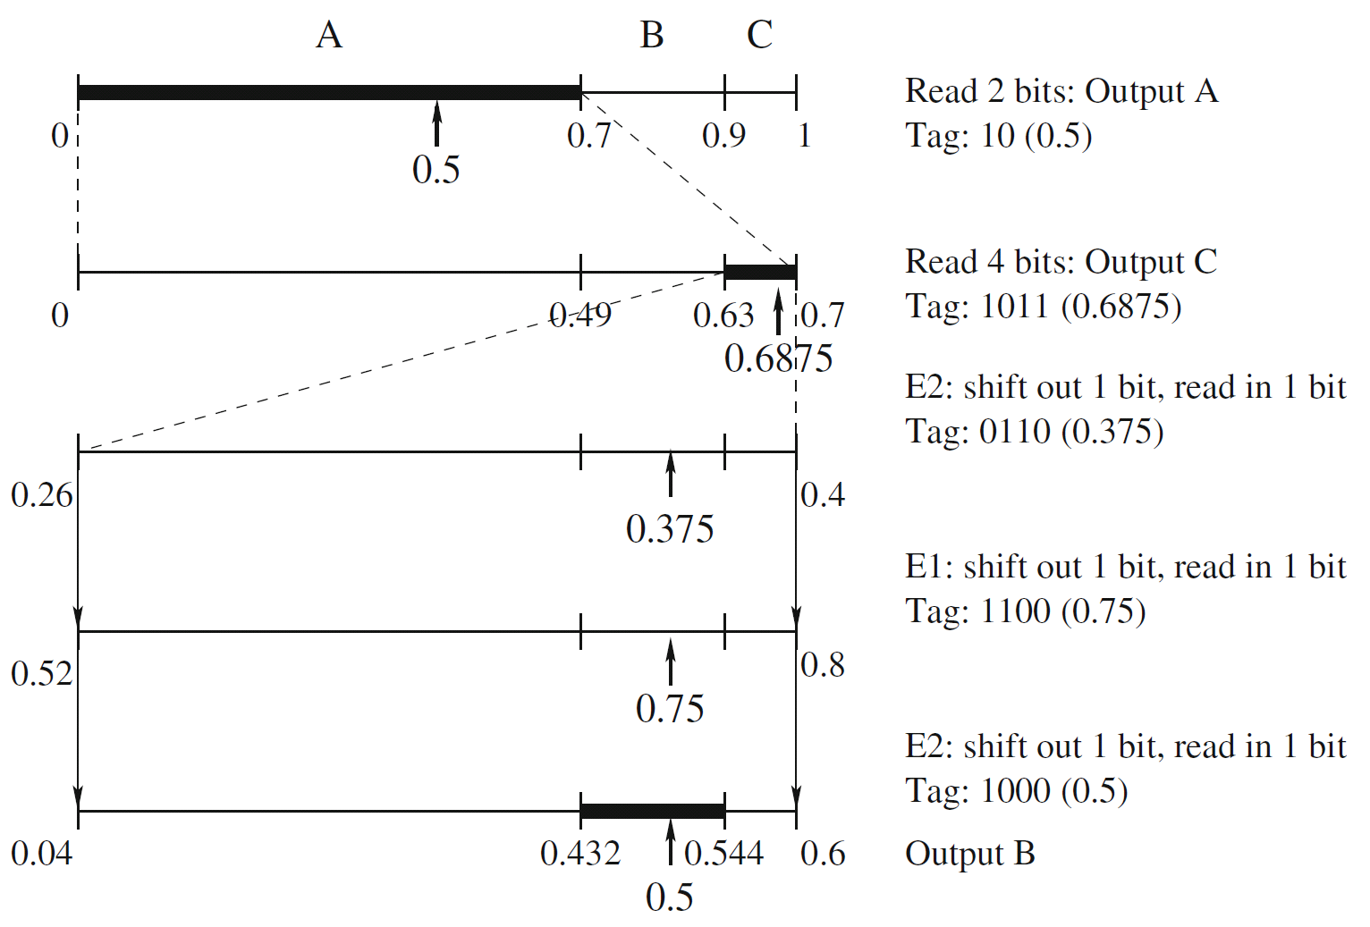
Scaling and incremental coding: decoder
Shown in example: decoding 1011 → ACB

Slide 29
E3 scaling
0.5 inside interval ➔ scale by:
low = 2 * (low – 0.25);
high = 2 * (high – 0.25);
Example: [0.48, 0.51[ → [0.46, 0.52[ → [0.42, 0.53[ → … etc ➔ seems to keep expanding!
After many iterations, we will likely end up in low or high half ➔ E1 or E2 scaling
It can be proven (but we won’t ☺) that:
N E3s followed by E1 = E1 followed by N E2s
N E3s followed by E2 = E2 followed by N E1s
➔ postpone E3 scaling until next E1 or E2
E1: send ‘0’ followed by N ‘1’s
E2: send ‘1’ followed by N ‘0’s

Slide 30
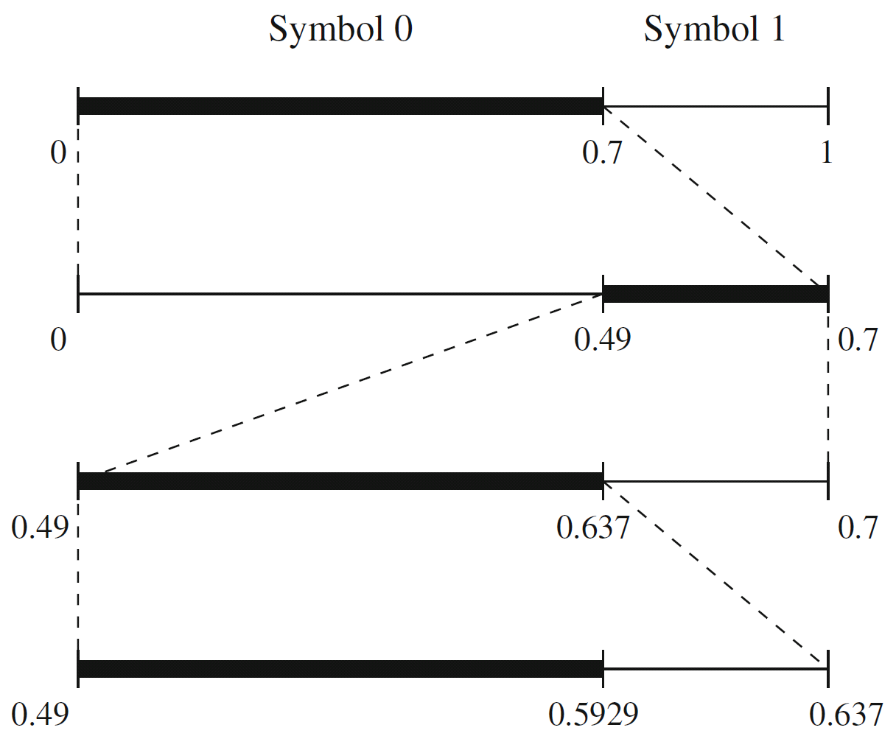
Other extensions of Arithmetic Coding
Integer implementation
Avoids floating point operations (more efficient)
Replaces [0, 1[ with [0, N[ and uses only integers
➔ scaling is definitely needed
Binary Arithmetic Coding
Only 2 symbols: 0 and 1
Simpler decisions while coding
(only 2 intervals)

Slide 31
Other extensions of Arithmetic Coding
Adaptive Arithmetic Coding
We can code incrementally (see earlier)
➔ we don’t need to know the probabilities beforehand
➔ recalculate on the fly (like dynamic Huffman)
ENCODER DECODER
------- -------
Initialization (reset counters) Initialization (reset counters)
while (symbol != terminator) while (symbol != terminator)
{ {
get(symbol); decode(symbol);
encode(symbol); output(symbol);
update stats and interval; update stats and interval;
} }

Slide 32
Dictionary-based coding: LZW compression
Dynamically build a common dictionary at both sides (compression and decompression)
=> Words in dictionary are replaced by their index instead of plain ASCII representation
Starting dictionary: ASCII-table (256 values)
Add increasingly longer strings to dictionary
Used in UNIX compress, GIF images and V.42 bis modem communication

Slide 33
LZW compression algorithm (simplified)
s = next input character;
while not EOF
{
c = next input character;
if s+c exists in the dictionary
s = s+c;
else
{
output the code for s;
add string s+c to the dictionary with new code;
s = c;
}
}
output the code for s;
! Doesn’t search for optimal strings ➔ table grows fast

Slide 34
LZW algorithm: example
Input-string: ABABBABCABABBA
Start-dictionary:
Code string
1 A
2 B
3 C
Result (verify this!)
124523461
=> only 9 codes instead of 14
=> compression ratio 14/9 = 1.56
General text: at least 100 characters needed before compression starts to occur

Slide 35
LZW decompression algorithm
s = NIL;
while not EOF
{
k = next input code;
entry = dictionary entry for k;
output entry;
if (s != NIL)
add string s+entry[0] to dictionary with new code;
s = entry;
}
Apply this to output string of the compression example
=> yields original input string (verify this!)

Slide 36
LZW decompression: problem
Apply encoder and decoder algorithm onto this string: ABABBABCABBABBAB…
=> decoder gets in trouble when it doesn’t know a new code that is coming from the encoder
Assignment:
Find out when this problem occurs
Find a solution

