Slide 1
Data Compression
3. Image Compression

Slide 2
Image compression and file formats
Different image file formats apply different compression methods
GIF
8 bit colour table with 256 most used colours (24-bit values)
Extra compression: LZW coding of 3-pixel colour patterns (each coded as indices in colour table)

Slide 3
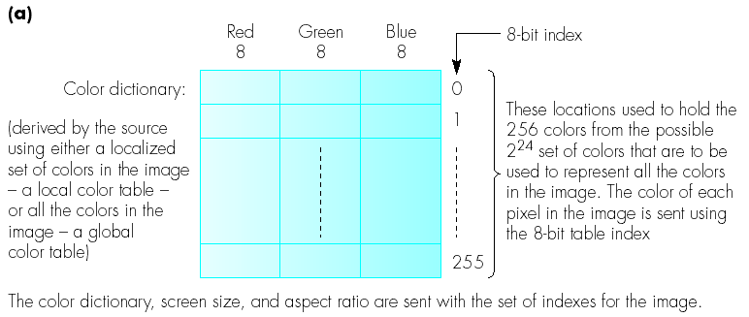
GIF (2)
Colour table

Slide 4
TIFF
Different encoding options, expressed via code number in file header
1 = uncompressed
2, 3, 4 = digitized text documents (fax-format based)
5 = LZW compressed
Resembles GIF: base table of 256 colours – extend with pixel patterns up to 4096 entries

Slide 5
JPEG
Extensive standard, intended for digital photos
Combines many encoding approaches: DCT, quantization, run-length encoding, Huffman encoding
Either lossless or lossy
4 modes

Slide 6
JPEG modes
Sequential encoding (“baseline mode”)
1 scan (left-right, up-down)
Lossy
Progressive encoding
Multiple scans
Lossy
Lossless encoding
Hierarchical encoding
Multiple resolutions, separately decompressible
We only consider mode 1: sequential encoding – others are based on same principles

Slide 7
JPEG - Assumptions
3 observations:
Useful image information varies relatively slowly within the image
Liminance will typically not vary largely over small distance in the image
DCT encodes the variation patterns in an image
Experiments show that people will not really notice loss of high-frequency components (“details”) than loss of low-frequency components (such as luminance variation)
Exploited in quantization step
People are more sensitive to lumincance than to colour
Reason: different number of rods vs. cones (see next slide)
JPEG will typically not use RGB, but YUV, and allocate less resolution to colour information

Slide 8
Colour Representation
RGB
Based on cones in the eye: sensitive to red, green or blue
YUV
Separate between intensity (rods) and colour (cones)
From RGB to YUV:
Intensity (Y) = 0.299R + 0.587G + 0.114B
Colour component Cb (U) = B – Y
Colour component Cr (V) = R – Y
Y component is most important
100M rods vs. 7M cones
Storing Cb and Cr at lower resolution doesn’t yield large quality loss

Slide 9
JPEG sequential mode overview
Compression steps:
Image/block preparation
Source-encoding
DCT (Forward DCT)
Quantisation
Entropy encoding
Decompression steps:
Entropy-decoding
Source-decoding
Dequantisation
Inverse DCT
Recombination into image

Slide 10
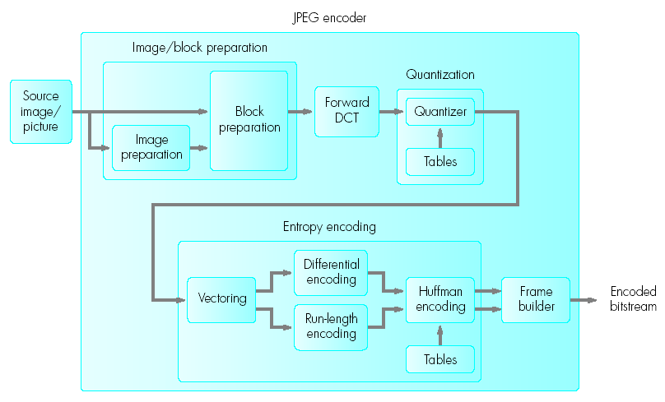
Scheme

Slide 11
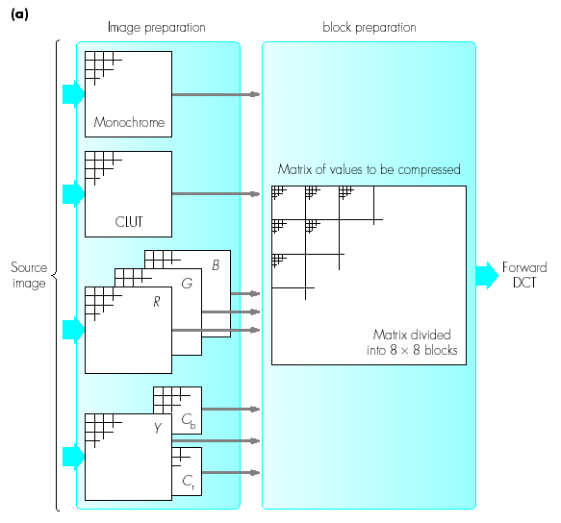
1. Image/block preparation
Choice of image representation

Slide 12
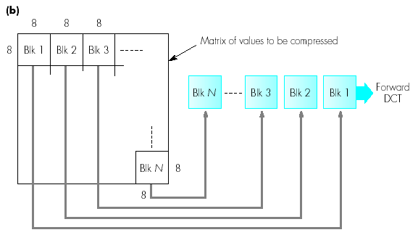
1. Image/block preparation (2)
Split into blocks of 8x8 pixels
Will be sequentially and independently transformed with DCT

Slide 13
2. Source encoding via DCT
DCT: Transformation spatial domain ➔ frequency domain
Transform P[x,y] into F[i,j]
F[0,0] = relates to average of all 64 values
(DC coefficient/component)
F[i,j] = function of all values in P[x,y] – represent spatial variation (frequencies)
(AC coefficients/components)
For most real-life images, pixels vary relatively little spatially => higher-order F-values will have low coefficient
=> compression possible by filtering out these high frequencies (in quantization step)

Slide 14
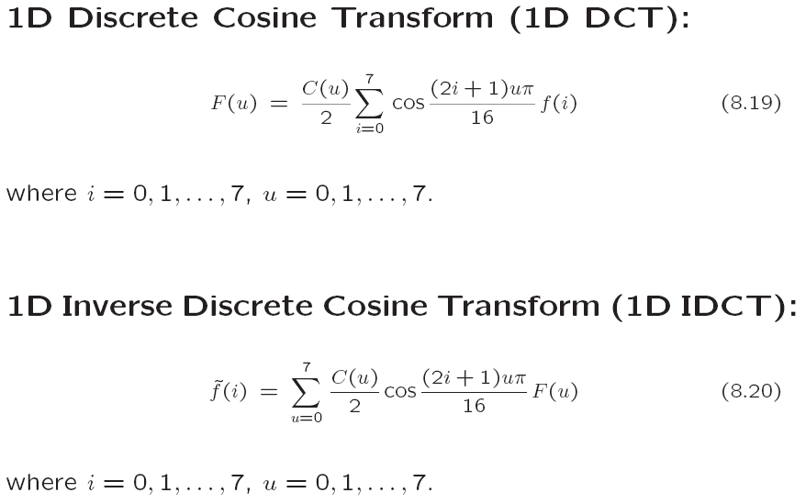
1D DCT

Slide 15
Comparison with Fourier analysis
Fourier analysis: “Each signal can be expressed as an infinite sum of base signals (sines or cosines) of different amplitude and different frequency”
When using cosines: “cosine transformation”
When using a discrete set of values (and hence cosines) : discrete cosine transformation (DCT)
DCT = decomposition of a discrete signal into a linear combination of cosine base functions

Slide 16
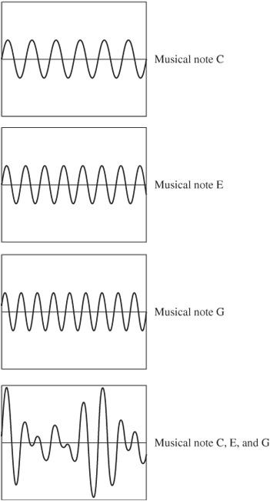
do = 261.63 Hz
mi = 329.63 Hz
sol = 392.00 Hz
C chord (do-mi-sol)

Slide 17
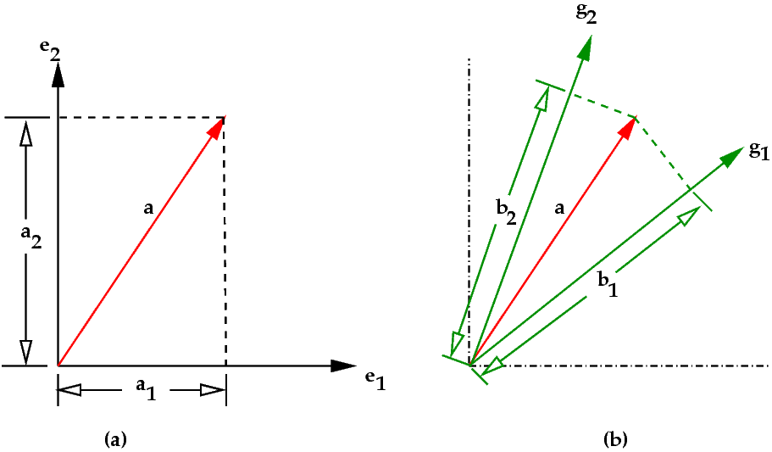
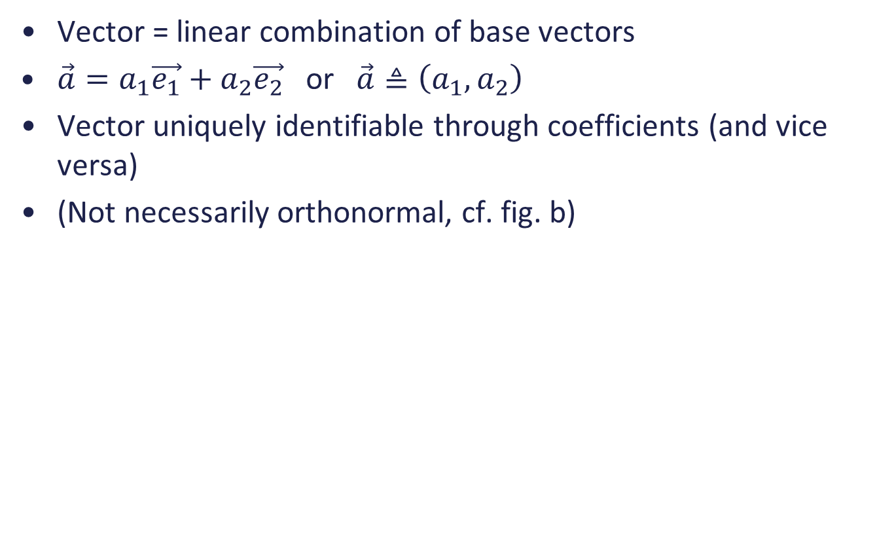
Comparison with 2D vectors
Vector = linear combination of base vectors
$\vec{a}=a_{1}\vec{e_{1}}+a_{2}\vec{e_{2}}$ or $\vec{a}≜\left(a_{1},a_{2}\right)$
Vector uniquely identifiable through coefficients (and vice versa)
(Not necessarily orthonormal, cf. fig. b)

Slide 18
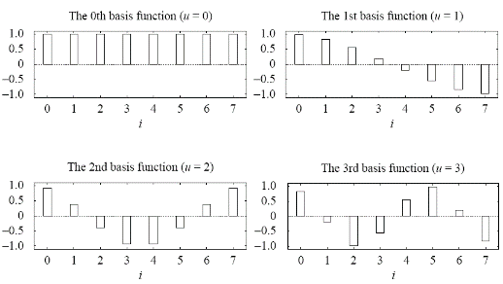
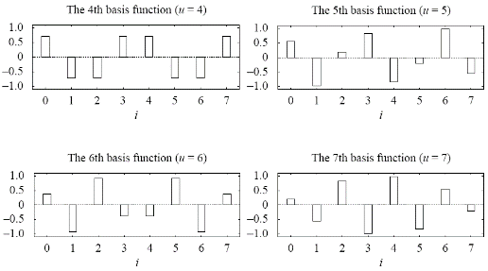
1D DCT base functions

Slide 19
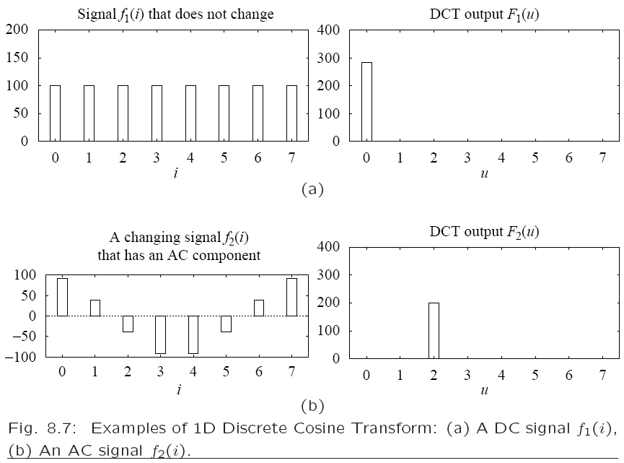
Examples

Slide 20
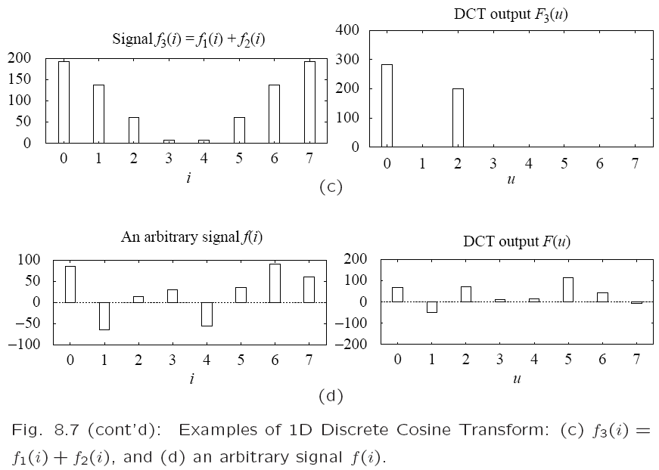
Examples

Slide 21
Properties of (1D) DCT
DCT yields frequency spectrum of a spatial signal
F(0) ≈ average size of the signal (modulo a certain factor) = “DC component”
F(1)..F(7) = size of components with different frequencies = “AC components”
AC components can be zero or even negative!
Cosine base functions are orthonormal
=> signal is not amplified during transformation

Slide 22
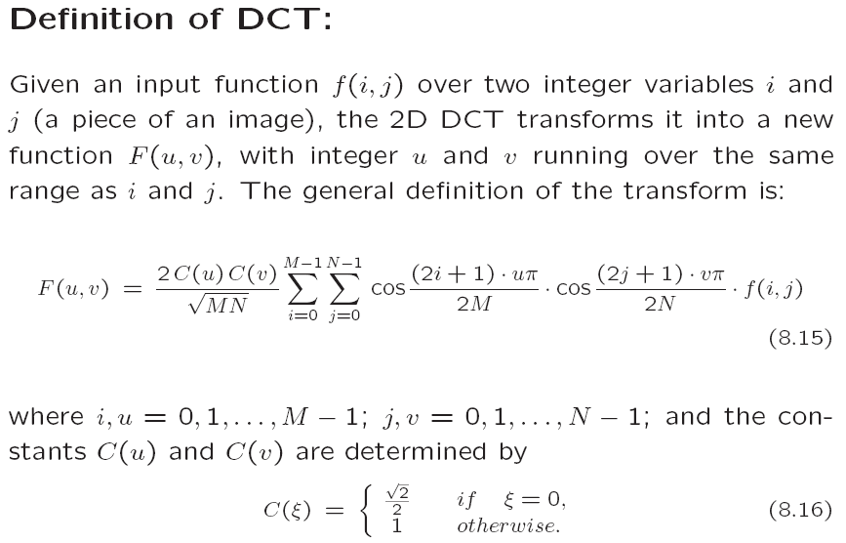
2D DCT

Slide 23
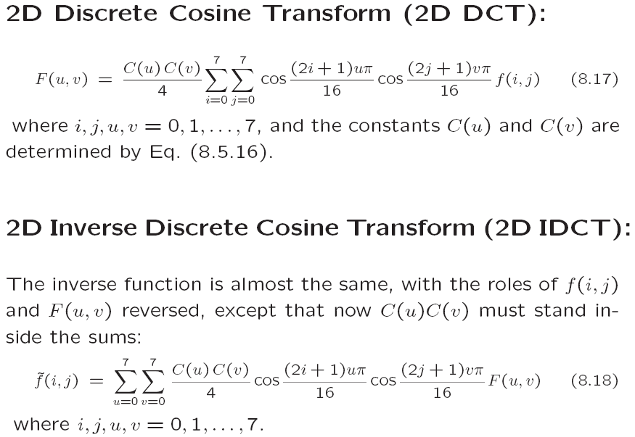

Slide 24
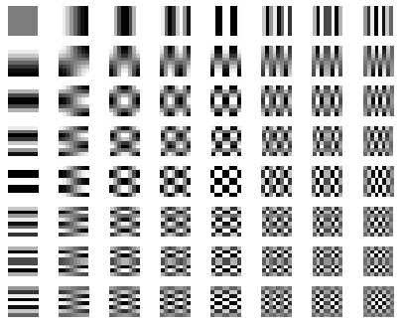
2D DCT
8x8 2D DCT base

Slide 25
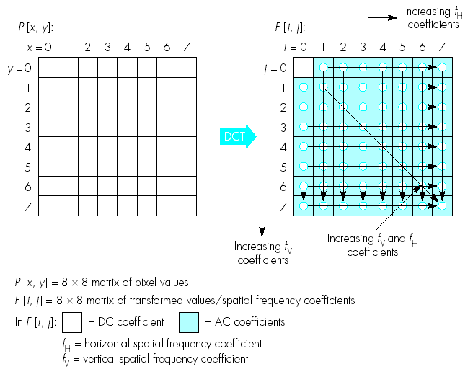
2D DCT

Slide 26
Quantization
In DCT only (minimal) loss of information due to rounding errors
“Real” compression by normalizing DCT components via quantization table (cell-by cell division)
Simplified example:
All elements in quantization table = 1 => no effect
4 elements = 1; all the rest 255 => only 4 coefficients remain
In practice: DC component is (mostly) largest after quantization and highest AC coefficients become (mostly) 0
JPEG employs several standard quantization tables
“Quality” parameter of most software => scale factor for quantization table

Slide 27
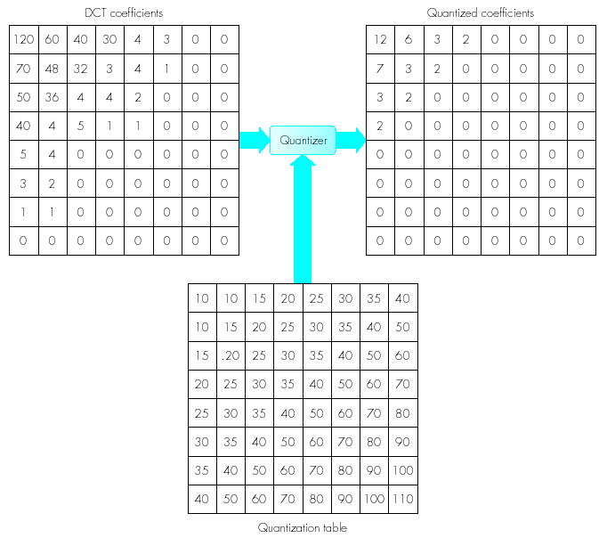

Slide 28
Demo’s DCT:
http://www.site.uottawa.ca/~elsaddik/abedweb/applets/lessons/jpeg/Beginner/Lossy_Compression/lossy_compression.html
http://demonstrations.wolfram.com/JPEGCompressionAlgorithm/
http://www.cs.sfu.ca/CourseCentral/365/mark/interactive-jpeg/Ijpeg.html

Slide 29
JPEG sequential mode overview
Compression steps:
Image/block preparation
Source-encoding
DCT (Forward DCT)
Quantisation
Entropy encoding
Decompression steps:
Entropy-decoding
Source-decoding
Dequantisation
Inverse DCT
Recombination into image

Slide 30
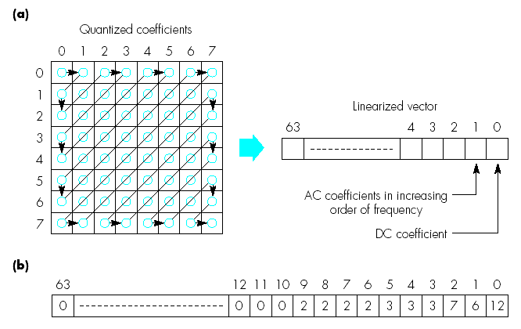
3. Entropy encoding
First put all DCT coefficients in vector

Slide 31
3. Entropy encoding (2)
DC components of all blocks: encoded via differential coding
AC components per block: encoded via special RLE
E.g. (6, -1, -1, 0, -1, 0, 0, 0, -1, 0, 0, 1, 0, …, 0)
=> (0, 6)(0, -1)(0, -1)(1, -1)(3, -1)(2, 1)(0, 0)
Both compressed further with Huffman coding
Highest-frequency numbers represented with least amount of bits

Slide 32
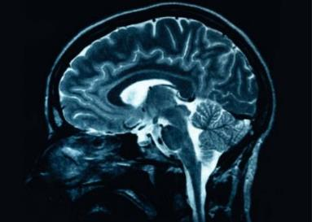
JPEG: conclusion
Application of wide range of coding/compression methods
Mainly applicable to “real life” images
Makes use of human perception
-> Can yield wrong results when fine details are needed (E.g. medical images)

Slide 33
Most recent version: JPEG2000
Low-bitrate compression (JPEG less useful)
Lossless or lossy
Higher resolutions
1 decompression architecture (vs. many modes of JPEG)
Progressive transmission
Region-of-interest coding
More applicable for synthetic images as well
Metadata
Base technology: wavelet transformation instead of DCT

Slide 34
Practicum 2
Implementation of a simplified version of JPEG
Note: DCT on 4x4 pixel blocks instead of 8x8!
Configurable quantization
Zig-zag scanning and (simple) RLE encoding
Binary output with minimal number of bits
Follow the specs: correct names for executables, correct arguments, only parameters from config file, correct file extensions, …!
Take an incremental approach!
Follow the specs and ask questions if anything is unclear!
Deadline + details: BlackBoard

