Slide 1
Investigating the formation of giant hail in the north of Santa Catarina Island
RESEARCH IN PROGRESS
AUGUST 29, 2026 · STATUS AS OF NOVEMBER 9, 2026
Characterization by radar, satellite, lightning, numerical modeling and space weather
Reinaldo Haas · UFSC · abstract submitted to I-SSTS (INPE) · what was done, what stands, what fell and what remains open
Notes:
The title is that of the abstract submitted to I-SSTS. The question is how clouds with mediocre tops, no overshooting top, and ordinary lightning and reflectivity, produced stones of about 6 cm. This is the status of all the work on the hail of August 29, 2026, as of November 9, 2026. It is research in progress: the results are partial and are part of an investigation into the association between severe events and space weather.

Slide 2
The results shown here are partial and part of a larger study
RESEARCH IN PROGRESS
The larger question
This case
How to read it
Is there an association between severe events, such as hail, supercells and extreme rain, and space weather?
The giant hail of Aug 29, 2026 is one of the events in this study, alongside others such as the Rio Grande do Sul rains of May 2024
Preliminary results; speculative hypotheses are marked as such. One event does not prove an association: the test needs many events
Notes:
Before the case itself, the context. This is research in progress, and the results shown here are partial. They are part of a study that seeks to answer whether there is an association between severe events, such as hail, supercells and extreme rain, and space weather. The giant hail of August 29, 2026 is one of the events in this study, alongside others such as the Rio Grande do Sul rains of May 2024. So what follows should be read as preliminary: the speculative hypotheses are marked, and a single event does not prove an association; the test requires many events.

Slide 3
Hail was very common on the Island, then vanished for almost a century
HISTORICAL CONTEXT
until ~1850
~100 years
Aug 29, 2026
Hail extremely common in the Island’s records, at the end of the Little Ice Age, with a colder atmosphere
Almost a century with no hail recorded on the Island
Hail returns, and as giant hail: ~6 cm stones in Biguaçu and the north of the Island
Today large hail is common in the west and on the plateau of Santa Catarina, but rare on the coast: warm maritime air keeps the 0 °C level high, and the stones melt as they fall.
Notes:
The historical record is about hail, not giant hail: it was very common on the Island until the mid-19th century and then was almost never recorded for about a hundred years. On August 29, 2026 hail came back, with stones of about 6 cm. On the coast, warm and humid maritime air keeps the 0 °C level high and a thick warm layer below it, where stones melt before reaching the ground; that is why large hail is much more frequent in the west and on the plateau.

Slide 4
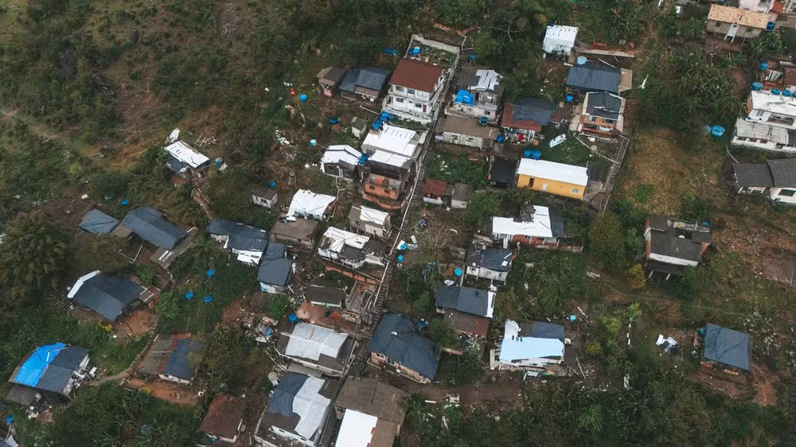
Roofs wrecked by the hail
THE EVENT · AUG 29, 2026
~6 cm stones in the north of the Island and in Biguaçu, around 22 UTC
Emergency declared in Florianópolis and Biguaçu
Image: Biguaçu, after the hail
Notes:
The event seen from above, in Biguaçu. On the hillside, the roofs damaged by the hail are covered with blue tarps. Stones of about 6 cm fell in the north of the Island and in Biguaçu around 22 UTC on August 29, and both municipalities declared an emergency.

Slide 5
From the event to the hypotheses, in seven parts
OUTLINE
1
The question, the key questions and the strategy
5
Space weather, aerosol, microphysics and the hypotheses, the speculative ones included
2
Synoptic and mesoscale diagnosis
6
Answers and status: what stands, what fell and what remains open
3
The supercell outbreak and the Island cell in radar, satellite and lightning
7
Next steps
4
What the model showed: parameterization, resolution and hail
Notes:
The outline in seven parts. First the question and the strategy. Then the synoptic and mesoscale diagnosis, the supercell outbreak and the Island cell as seen by radar, satellite and lightning, and what the model showed. Part five brings together space weather, aerosol, microphysics and the hypotheses, the speculative ones included: the timeline from the solar disturbance to the hail, delayed glaciation, homogeneous nucleation, secondary glaciation and SPLASH. I close with the answers, the status and the next steps.

Slide 6
How did clouds with mediocre tops produce ~6 cm stones?
THE QUESTION
Ordinary top
Ordinary lightning
~6 cm
−62.9 °C, the same as the day’s other cells; no top piercing the tropopause (GOES-19)
Stones in Biguaçu and the north of the Island, around 22 UTC on Aug 29, 2026
No lightning jump of the kind that usually precedes hail; other cells that day had more
Satellite and lightning gave no sign of hail. With no direct explanation in the data, the answer goes through hypotheses, some of them speculative.
Notes:
The question: explain giant hail from clouds with mediocre tops. The Island cell had no overshooting top, its top was the same as the other cells’, there was no lightning jump and the radar did not reach the top of its scale. Even so, stones of about 6 cm fell.

Slide 7
How did giant hail form in such unusual clouds?
THE KEY QUESTION OF THE CASE STUDY
1 · Instability
2 · Rain
3 · Models
Why did so much instability build up in August?
Why so little rain from such long-lived supercells?
Can the models simulate the event? How can they improve?
4 · Hail location
5 · Surface totals
Speculative objective
Where was hail underestimated, and where overestimated?
Did the simulations overestimate rain and hail at the ground?
What role did space weather (Jz) play in the event?
Notes:
The key question is how giant hail formed in such unusual clouds: ordinary top, no overshooting top and no lightning jump. Five questions unfold it: the origin of the instability, the little rain from long-lived supercells, the models’ ability and how to improve them, where the model’s hail was missing or in excess, and whether total rain and hail at the ground were overestimated. There is also an openly speculative objective: the role of space weather, through the vertical current Jz, in the build-up of instability and in the microphysics.

Slide 8
Six hypotheses tested on three fronts
STRATEGY
H | Hypothesis | Front | Tested with
H1 | Coincidence: rare, but possible in today’s climate | A | climatology, inventory
H2 | The environment changed: more vapor and instability | A | ERA5 1940–2026
H3 | Low 0 °C level, as in the Little Ice Age | A and B | ERA5, WRF
H4 | Wildfire smoke altered the microphysics | B | MERRA-2, CAMS, WRF
H5 | Altered ice-nucleating particles (INP) | B | WRF (no data)
H6 | Solar activity through Tinsley’s pathway (Jz) | C | magnetometers, electric field
A observation and statistics · B model: until WRF makes 4–6 cm stones in the right place, causal tests in the model do not count · C space weather, by observation only
Notes:
Each hypothesis predicts something different. Fronts A and C do not depend on the model. On front B, without a configuration that produces the hail, any causal experiment in WRF has no value.

Slide 9
Two lines of work, in parallel
WHAT WAS DONE
Observation
Model (WRF on VLab)
Cell tracks from GLM (224) and MaxCAPPI radar
GOES-19: cloud tops, Rosenfeld technique (24 cells)
ERA5 1940–2026: 0 °C level, CAPE, vapor
Synoptics, IGRA soundings and PV with back-trajectories
Smoke (MERRA-2, CAMS) and Jz from the magnetometer network
9-run ensemble: Kain-Fritsch × Grell-Freitas, MYNN, 06Z, SKEBS
Comparison with IMERG and radar
O1: 3 km d02 out to 58.6° W
O2: NSSL microphysics with hail
GOES-19 assimilation kit ready
Notes:
On the observation side: cell tracking by lightning, radar, satellite, ERA5 climatology, synoptics with soundings and potential vorticity, and the smoke and Jz series. On the model side: the nine-run ensemble, verification against IMERG, runs O1 and O2 and the preparation of GOES-19 assimilation.

Slide 10
Six synoptic phenomena, each with a role
DIAGNOSIS · SYNOPTIC SCALE (THOUSANDS OF KM, DAYS)
# | Phenomenon | Evidence | Role
S1 | Upper-level cyclonic anomaly (potential vorticity streamer) | Crossed Santa Catarina on Aug 27 and moved east (ERA5) | Fuel · central hypothesis
S2 | Strong upper-level jet | 304 km/h at 250 hPa at 12 UTC, at 30–35° S | Organization
S3 | Quasi-stationary front | Stalled near 28° S until ~21 UTC | Trigger
S4 | Low-level jet from the north | 42 mm of precipitable water, more than on 99% of August days | Fuel
S5 | Elevated lid: dry Andean air over warmed Chaco air | Inversion near 630 hPa at Foz; air below 1 g/kg at 500 hPa | Fuel and rain
S6 | High 0 °C level | 4,487 m, higher than on 94% of August days | Brake
Notes:
Roles: fuel builds up moisture and instability; organization gives longevity; trigger sets convection off; brake works against hail. First step of the diagnosis: separate the synoptic-scale phenomena and give each a role. In the central hypothesis, the cyclonic anomaly would have left days of weak rain and the build-up of moisture and instability. The strong jet provides the shear, the stalled front focuses initiation, the low-level jet brings the vapor and the elevated lid stores the instability and, with the dry mid-level air, may also explain the little rain. The high 0 °C level is the only synoptic phenomenon that works against hail.

Slide 11
Six mesoscale phenomena on the 29th
DIAGNOSIS · MESOSCALE (TENS TO HUNDREDS OF KM, HOURS)
# | Phenomenon | Evidence | Role
M1 | First wave: overnight cells in the west | Hail in 7 western municipalities between 03 and 11 UTC | Organization
M2 | Trains of long-lived cells | 156 GLM tracks; 29 longer than 200 km, up to 537 km and 8.7 h | Organization
M3 | Fast eastward motion | ~20 m/s (~70 km/h) in the long-track cells | Rain
M4 | Birth of the Island cell | 20:10 UTC from lightning, at 50.1° W, along the front; 48 min before sunset | Trigger
M5 | Mediocre top, no lightning jump | −62.9 °C, the same as other cells; no overshooting top | Paradox
M6 | ~6 cm hail in Biguaçu and the north of the Island | 22:00–23:00 UTC; strong radar echo crossing the Island | The event
Notes:
At the mesoscale the ingredients become storms: long, fast and with ordinary tops. Second step of the diagnosis: the mesoscale phenomena. There was a first wave of overnight cells in the west, with hail in seven municipalities. Through the day, GLM lightning shows trains of cells that lasted hours and travelled hundreds of kilometers at about 20 meters per second. The Island cell was born at 20:10 UTC along the front, shortly before sunset, and even with an ordinary top and no lightning jump it produced stones of about 6 cm.

Slide 12
Four groups, each tied to a question
DIAGNOSIS · THE PHENOMENA GROUPED
Fuel → question 1
Organization and rain → question 2
S1 cyclonic anomaly, S4 low-level jet, S5 lid. Outside meteorology, as hypotheses: Jz and smoke.
S2 jet and shear, M1 first wave, M2 cell trains, M3 fast motion, S5 dry mid-level air.
Trigger and position → question 3
Stone versus brakes → question 4
S3 stalled front and M4 cell birth: this is where the model depends on the outer grid’s cumulus scheme.
For: shear and vapor. Against: S6 high 0 °C level, nighttime, M5 mediocre top. Outcome: M6.
Notes:
The twelve phenomena fall into four families, and each family answers one of the key questions. Fuel explains the instability. Organization, together with fast motion and dry air, explains long-lived cells with little rain. Trigger and position are the model’s weak point. And hail is the balance between what favors the stone and the brakes. Jz and smoke enter as hypotheses, outside the meteorological diagnosis.

Slide 13
The 0 °C level was high; the extreme was the vapor
THE DAY’S ENVIRONMENT · ERA5 1940–2026
0 °C level, Biguaçu 21 UTC
Precipitable water
CAPE
4,487 m
42 mm
887 J/kg
higher than on 94% of August days
more than on 99% of August days
higher than on 97% of August days
High, the opposite of the Little Ice Age: a longer path for the stone to melt
The most unusual ingredient of the day
High for August, modest for large hail
Since 1940 the August 0 °C level has risen ~24 m per decade; mean August CAPE and vapor have not.
ERA5, 18 and 21 UTC on every August day of 1940–2025; before 1979 the trend is indicative
Notes:
This is the result that refuted hypothesis H3 for this event. The 0 °C level was among the highest for August. What was extreme was the moisture and instability for the season. The stone arrived at 6 cm despite a high 0 °C level.

Slide 14
Almost every sign of large hail was missing
WHY THIS HAIL IS RARE
Factor | Large hail usually has | On the Island on Aug 29
0 °C level | low: the stone melts less | Against: 4,487 m, higher than in 94% of Augusts
Warm layer | shallow | Against: 4.3 km, thicker than on 98% of days
Time of day | afternoon, with heated ground | Against: 22 UTC, after sunset
Cloud top | very cold, piercing the tropopause | Against: −62.9 °C, same as other cells
Lightning | abundant, with a jump before the hail | Against: no jump; other cells had more
Water vapor | plenty | For: 42 mm, more than in 99% of Augusts
Shear | strong, long-lived cells | For: 34 m/s; cells over 400–490 km
Notes:
Of the signs that usually come with large hail, only moisture and storm organization were present. The high 0 °C level and the thick warm layer melt the stone as it falls, the cell formed after sunset, the top was not exceptional and there was no lightning jump. The Joaçaba cell in the west, by contrast, was the most electrically active of the day, with a lightning jump.

Slide 15
Strong jet, stalled front and a lid that ERA5 missed
SYNOPTICS AND SOUNDINGS
Synoptic scale
Soundings (IGRA2)
Zonal jet at 250 hPa: 304 km/h at 12Z, at 30–35° S
Quasi-stationary front near 28° S until ~21Z
Low-level jet from Paraguay
10 m–500 hPa shear of 26–34 m/s
Foz, 12Z Aug 29: warm, dry lid near 630 hPa (inversion of 3.6–5.4 °C)
CAPE at Foz: 1,784 J/kg in the sounding, 513 J/kg in ERA5
Florianópolis: shallow inversion over a saturated layer; warm, dry air at 900–700 hPa on the 28th
Notes:
The synoptic picture has every organizing ingredient: strong jet, nearly stalled front, low-level jet and deep shear. The soundings show an elevated warm, dry lid that stores the instability. ERA5 greatly underestimates CAPE at Foz, an important point for the model, which starts from ERA5.

Slide 16
The cyclonic anomaly crossed Santa Catarina on Aug 27
POTENTIAL VORTICITY AND BACK-TRAJECTORIES
The upper-level cyclonic streamer crossed the state on Aug 27 and moved east. On the 29th, Santa Catarina was on the tropical side of the jet, with a weak, anticyclonic PV anomaly.
Level | Where the air over Santa Catarina at 20Z on Aug 29 came from
200–300 hPa | From the Pacific, along the jet, in under 30 h; θ conserved, weak PV. At 12–18Z it was still over Argentina and Chile
500 hPa | Dry air (q < 1 g/kg) from the Andes, θ of 325 K: the top of the sounding’s lid
700 hPa | From the Chaco, warmed by 3 K
850 hPa | Low-level jet, from the north
If the anomaly and Jz acted, the trace should be in Aug 27–29 (weak rain and moisture build-up), not in the upper-level air of the 29th, which came from the Pacific.
Notes:
Refinement of H6: the effect of Jz would persist in a cyclonic PV anomaly. Back-trajectories with hourly ERA5 on 27 levels show that the upper-level air arrived from the Pacific in under 30 hours. The Eulerian PV budget was inconclusive, dominated by dipoles along the jet.

Slide 17
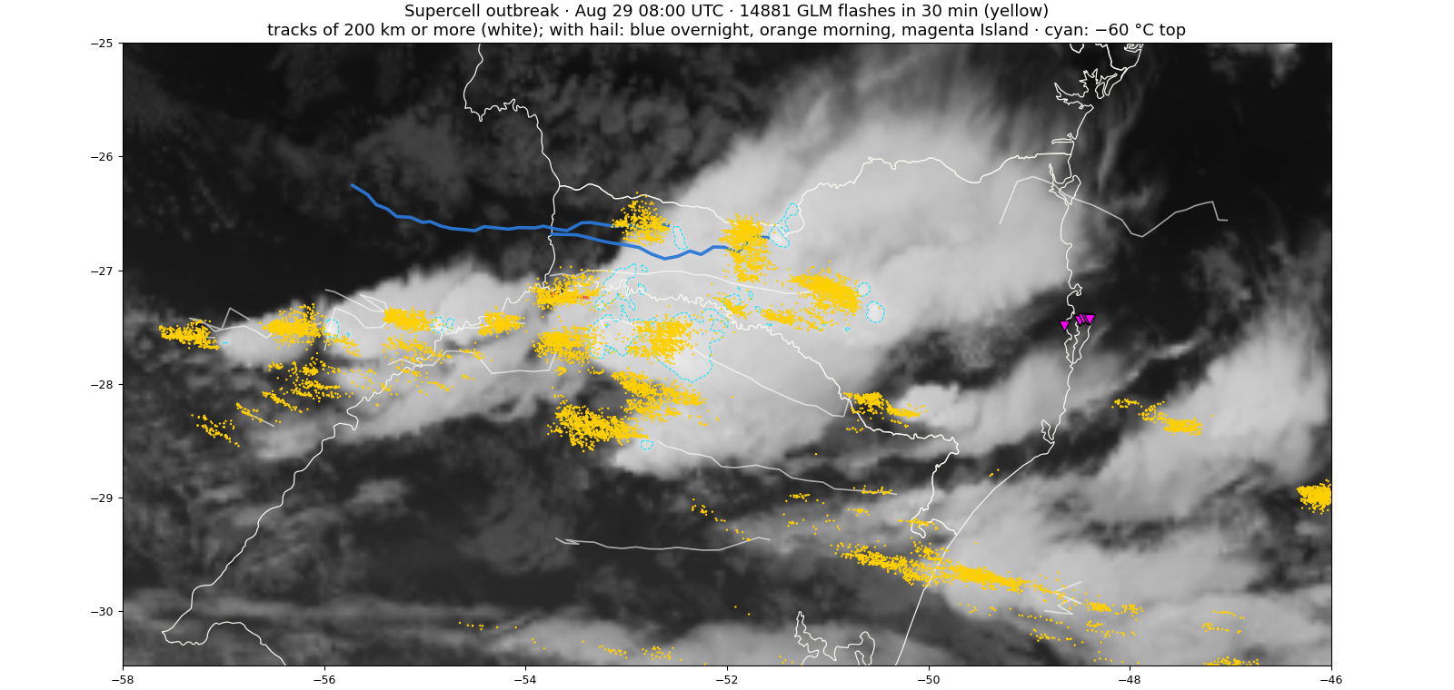
Trains of supercells cross the state all day long
ANIMATION · THE SUPERCELL OUTBREAK · AUG 29 00:00 TO AUG 30 02:00 UTC
Notes:
The supercell outbreak seen by GOES-19 and GLM lightning, every 30 minutes, from Argentina to the coast. Yellow dots are the flashes of the previous 30 minutes; lines are the tracks of 200 km or more, drawn up to the frame’s time. The four tracks with reported hail are in color: blue, the overnight cells in the west; orange, the morning cell in the Midwest; magenta, the Island supercell at night. Cells form in the far west and in Argentina and cross the state at about 20 m/s, in latitude bands that repeat through the day. Rotation is not observed, because the radar has no Doppler: calling them supercells is still an inference.

Slide 18
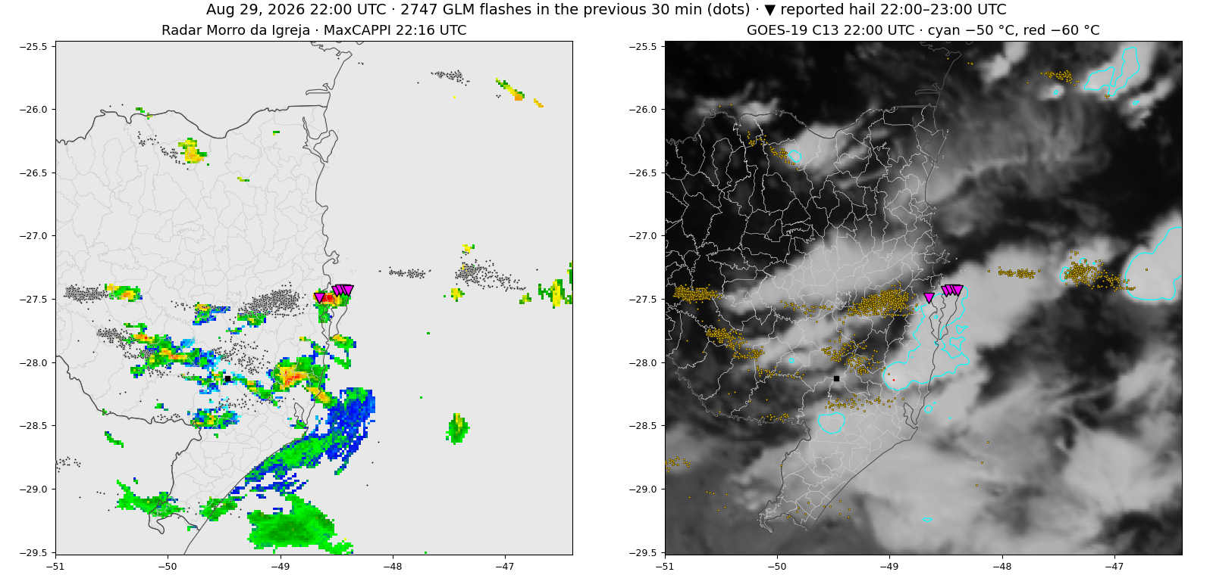
Trains of cells cross Santa Catarina from west to east
ANIMATION · GLM LIGHTNING OVER RADAR AND SATELLITE · 18:00–01:30 UTC
Dots: lightning in the previous 30 min
Dense lightning swaths pass over small radar echoes
▼ reported hail
Notes:
Animation every 30 minutes, from 18:00 to 01:30 UTC, Aug 29 to 30. Left, the MaxCAPPI of the Morro da Igreja radar, nearest frame; right, GOES-19 channel 13, with the −50 °C contour in cyan and −60 °C in red. Dots are GLM flashes in the previous 30 minutes. Cells organize in trains along ~27.5° S and cross the state in a few hours. Dense lightning swaths pass over small radar echoes, a sign consistent with little rain, with the caveat that the radar is far from the west and uncalibrated. GOES has no parallax correction.

Slide 19
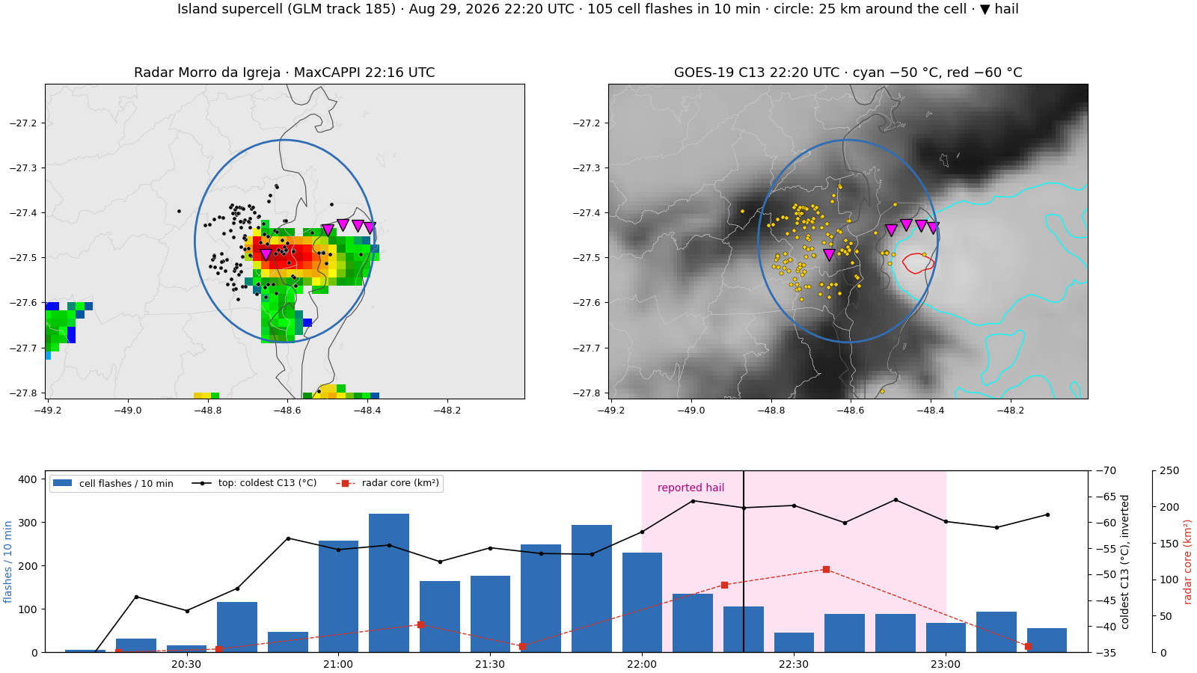
Following the cell: radar, satellite and lightning
ANIMATION · THE ISLAND SUPERCELL, FROM BIRTH TO THE SEA · 20:10–23:20 UTC
Notes:
The animation follows the Island supercell, GLM track 185, every 10 minutes, in a window that moves with it. Left, the Morro da Igreja radar; right, GOES-19 channel 13 with −50 and −60 °C contours; dots are the flashes of the previous 10 minutes and the circle marks 25 km around the cell. Below, the time series: the cell’s flashes, coldest cloud-top temperature and radar core area, with the band of reported hail. The cell forms at 20:10 UTC at 50.1° W, crosses the mainland at ~16 m/s, passes over Biguaçu and the north of the Island between 22:00 and 23:00 and moves out to sea. GOES has no parallax correction.

Slide 20
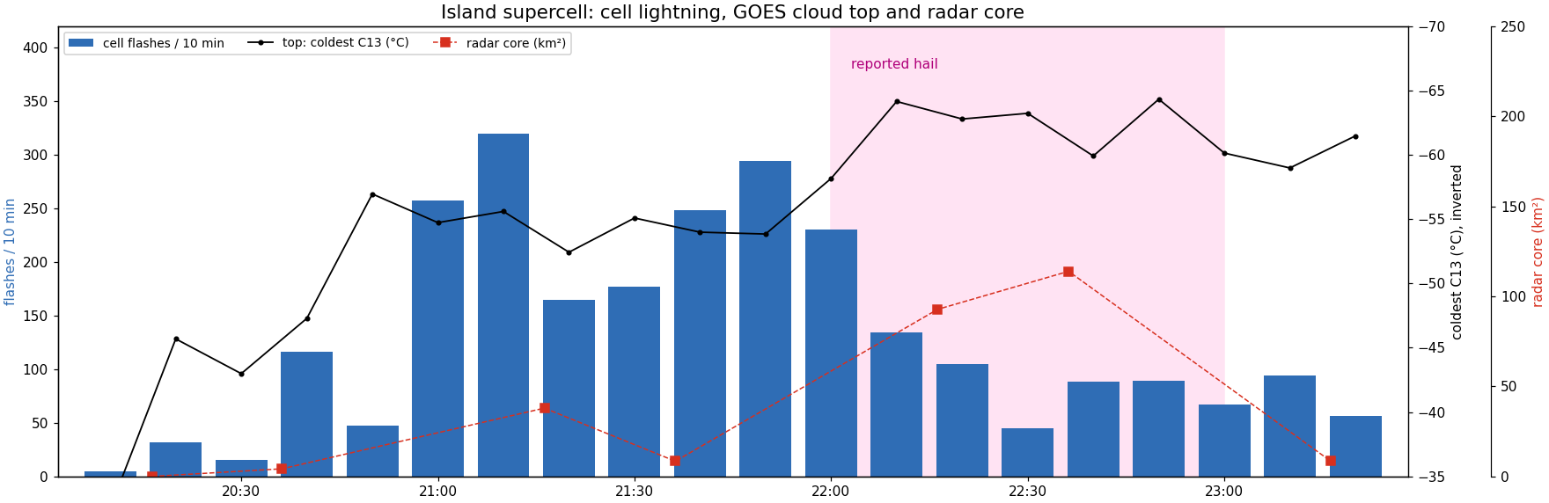
When the hail fell, lightning halved and the top cooled
THE ISLAND SUPERCELL · GLM TRACK 185 · 243 KM IN 4.2 H
Lightning: peaks of 320 and 294 per 10 min at 21:10 and 21:50; 45–135 during the hail
Top: from −54 °C at 21:50 to −64 °C between 22:10 and 22:50
Radar: core from ≤ 46 km² to 93–114 km²
Notes:
The supercell’s time series. The cell’s own lightning had two peaks, 320 flashes in 10 minutes at 21:10 and 294 at 21:50, still over the mainland. When the hail fell, between 22:00 and 23:00, lightning dropped to 45–135 per 10 minutes, while the top cooled to −64 °C and the radar core doubled in area. A drop in lightning together with core growth is a known pattern during hail fallout. A −64 °C top is still ordinary for the day and does not pierce the tropopause; the top alone does not explain the stone. Caveats: the radar core is the area of red MaxCAPPI pixels, uncalibrated, and the top has no parallax correction.

Slide 21
The cells moved fast and through dry air
QUESTION 2 · WHY SO LITTLE RAIN
~20 m/s
< 1 g/kg
Ice
They pass quickly
Dry air at 500 hPa
Water locked in ice
A ~10 km core stays about 10 minutes over each point. The rain spreads into a long, shallow swath.
Andean air is entrained into the cloud and evaporates part of the rain. Under strong shear, precipitation efficiency drops.
Speculative: part of the water became hail and graupel or went into the anvil, not into rain.
IMERG: a 10–20 mm swath along 400–540 km of track; larger isolated cores.
Notes:
Question 2. The longest-lived cells travelled 400 to 540 kilometers in 5 to 9 hours, at about 20 meters per second. At that speed a 10-kilometer core passes over a point in about 10 minutes, so the accumulated rain at each place stays low even with intense rain rates. The very dry 500 hPa air from the Andes is entrained into the cloud and evaporates part of the rain; under strong shear, supercells tend to have low precipitation efficiency. The third explanation, water locked in ice and in the anvil, is speculative. The test is to count how long each cell stayed over the rain gauges and compare with the measured rain.

Slide 22
Subgrid rain to the west decides the Island cell
MODEL · SUBGRID RAIN (CUMULUS) × GRID-SCALE RAIN (MICROPHYSICS)
Grid and runs | Subgrid share of rain, 12–22 UTC | Western corridor (52–49.5° W) until 22 UTC | Consequence
9 km, Kain-Fritsch (4 runs) | 71–74% | E0: 10.8 mm subgrid and 1.6 mm grid-scale | θe at 850 hPa 7 K lower; cell 24–41 km from radar
9 km, Grell-Freitas (5 runs) | 26–34% | E3: 2.4 mm subgrid and 3.3 mm grid-scale | Instability preserved; cell 0–9 km away
3 km and 1 km (all) | 0%: no cumulus |  | All rain comes from microphysics (Morrison)
Kain-Fritsch rains early and at subgrid scale, spending the instability before the cell is born. Grell-Freitas leaves convection to the explicit grid, where the cell forms.
With two-way feedback between grids, the 9 km subgrid share inside the fine grids falls to 1–14%.
Notes:
RAINC is rain from the cumulus scheme, subgrid; RAINNC is rain from the microphysics, grid-scale. Outside the fine grids, in the 9 km d01, Kain-Fritsch produces 71 to 74% of its rain at subgrid scale and Grell-Freitas 26 to 34%. In the corridor that feeds air to the Island cell, Kain-Fritsch rains almost 11 mm of parameterized rain from 13 UTC on and leaves θe at 850 hPa 7 K lower at the birth point. The 3 and 1 km grids have no cumulus scheme. Because feedback is on, d01 inside d02 is overwritten by the fine grids, and there the subgrid share falls to 1 to 14%.

Slide 23
The d01 cumulus scheme decides where the cell is born
MODEL · 9-RUN ENSEMBLE
d01 | Echo to radar, 21:16 | Hail on the Island
KF (4 runs) | 24–41 km | 0 in all
GF (5 runs) | 0–9 km | 30–42 mm in 3
Observed |  | 50–60 mm
Kain-Fritsch rains ~10 mm of parameterized rain in the corridor from 13 UTC and leaves θe at 850 hPa 7 K lower where the Island cell forms.
Grell-Freitas gets the Island right, but 62–86% of its simulated hail ≥ 20 mm lies more than 25 km from any radar core.
With Grell-Freitas the model puts the cell on the Island at the right time and makes 30–42 mm hail, from clouds that the satellite did not show as capable of it.
Notes:
The wind at the d02 boundary separates the two groups with no overlap: every GF run exceeds 6.8 m/s, every KF run stays at or below 6.2. Within each group there is no relationship. With nine runs it is not possible to separate wind and scheme, because they go together. The Morrison scheme used already treated rimed ice as hail, in a single category.

Slide 24
The 1 km grid is what makes rotation and stones
MODEL · THE SAME 9 RUNS SEEN AT 3 KM AND 1 KM · 21–00 UTC
Quantity | 3 km (d02) | 1 km (d03)
Maximum updraft over the Island | 3–28 m/s | 7–37 m/s
Maximum helicity over the Island | 1–9 m²/s² | 11–86 m²/s²
Area with rotation (helicity ≥ 75) | 0–657 km² | 1,239–4,006 km²
Maximum hail in the d03 area | 21–41 mm | 40–55 mm
Hail over the Island | 2 runs: 9 and 28 mm | 3 runs: 23–42 mm
Area with hail ≥ 20 mm | 27–864 km² | 234–1,761 km²
At 9 km the cell does not exist: it is cumulus. At 3 km it appears, but weak. At 1 km the updraft doubles, rotation emerges and the stone approaches 6 cm, with more false hail too.
Notes:
Comparison of the same nine runs on the 3 km and 1 km grids, which run together. Over the Island, between 21 and 00 UTC, the maximum updraft more than doubles at 1 km and helicity rises by an order of magnitude. The area with rotation goes from almost nothing to thousands of square kilometers. Maximum hail rises from 21–41 to 40–55 mm. Over the Island, at 3 km only two runs make hail, of 9 and 28 mm; at 1 km three runs make 23 to 42 mm. Mean rain is the same on both grids because feedback makes the 3 km grid inherit the 1 km rain; only the maxima differ. The cost of higher resolution is more hail where none fell.

Slide 25
The rain swath falls in the right corridor, but weak and displaced
MODEL × IMERG · 18 TO 00 UTC
r 0.0–0.2
⅓ to ½
~50 km
Spatial correlation with IMERG, in every run; near zero between 00 and 02 UTC
of the observed mean rain; none reproduces the southern coast
west of the Island: where KF runs concentrate the 20–40 mm core
IMERG shows an east–west swath of 10–20 mm from 51° W to the Island, but smooths the core: rain gauges measured 50–60 mm.
Notes:
Each run’s d02 rain was regridded to IMERG’s 0.1-degree grid. GF runs come slightly closer to the pattern, but correlations are low in all of them. This result motivated GOES-19 assimilation: correcting the position and timing of convection before 20 UTC.

Slide 26
The model gets where and when convection occurs; stone size is missing
MODEL · RUNS O1 AND O2 (3 KM OUT TO 58.6° W)
Run | Microphysics | Maximum hail (d03) | Where
O1 | Morrison | 24 mm, UH 325 at 21:40 | ~70 km west of the Island
O2 | NSSL 2-moment with hail | 16.5 mm at 21:10 | ~120 km west of the Island
Observed |  | 50–60 mm (~6 cm) | Biguaçu and north of the Island
What it got right
What it got wrong
With the west covered, an echo ≥ 50 dBZ within 1–19 km of every municipality with hail, at the time of the report
No hail near the reports, no rotation within ~200 km, no cell over the Island
Notes:
O2 changed only the microphysics relative to O1: NSSL 18 with hail separate from graupel, predicted density and CCN. It finished on Nov 9 successfully and made smaller hail farther away than O1. The conclusion is that the problem lies in the input environment and the position of convection more than in the microphysics. That is why the next step is GOES-19 assimilation.

Slide 27
Too little hail where it fell, too much where it did not
QUESTION 4 · MODEL HAIL VERSUS OBSERVED
Where | Observed | Model | Verdict
North of the Island and Biguaçu, 22–23 UTC | ~6 cm | Zero with KF; 23–42 mm in 3 GF runs, only at 1 km | Underestimated
Western Santa Catarina, 03–11 UTC (O1, O2) | Hail in 7 municipalities | Strong echo within 1–19 km of the reports, but zero hail near them | Underestimated
Between the mountains and the Island, 18–02 UTC | No reports, no radar core | 234–1,761 km² with hail ≥ 20 mm; 62–100% far from radar cores | Overestimated
O2, NSSL microphysics |  | 16.5 mm, ~120 km west of the Island | Underestimated and displaced
The model misses the stone’s location more than its size.
Notes:
Question 4. Where the hail fell, the model underestimates: on the Island, no Kain-Fritsch run makes hail and three Grell-Freitas runs make 23 to 42 mm, only on the 1 km grid, against about 60 mm observed. In the west, run O1 places a strong echo near every municipality with a report, but no hail near them. Where hail did not fall, the model overestimates: between the mountains and the Island, from 234 to 1,761 square kilometers with hail of 20 mm or more, and 62 to 100% of that area far from any radar core. With Kain-Fritsch almost all simulated hail is false; with Grell-Freitas, most of it.

Slide 28
In total, the model left less rain and almost no ice
QUESTION 5 · TOTAL RAIN AND HAIL AT THE GROUND · 9 RUNS, 1 KM GRID, 18–02 UTC
At the ground | Observed | Model | Verdict
Mean rain in the swath | IMERG, 18–00 UTC | ⅓ to ½ of IMERG | Below
Rain in the north of the Island | Gauges: 50–60 mm | Maximum of 5–23 mm | Below
Ice reaching the ground | ~6 cm stones | Mean of 0.1–0.2 mm water; maximum of 2–5 mm | Below
Area with stones ≥ 20 mm (HAILCAST) | Only where reported | 234–1,761 km², almost all with no radar core | Above
It did not overestimate the totals: it underestimated rain and ice at the ground. What is in excess is the area of large stones in the HAILCAST diagnostic.
Notes:
Question 5. On the 1 km grid, from 18 to 02 UTC, the mean rain of the nine runs is between a third and a half of IMERG, and in the north of the Island the maximum ranges from 5 to 23 mm, against 50 to 60 mm in the rain gauges. The ice reaching the ground, graupel and hail together in the Morrison microphysics, is 0.1 to 0.2 mm of water on average and at most 2 to 5 mm: 1 to 3% of the rain. The only excess is the HAILCAST diagnostic, which estimates stone size, not amount: it flags stones of 20 mm or more over hundreds to thousands of square kilometers where there was no radar core. Total precipitation was underestimated; hail was overestimated in area and underestimated in size where it fell.

Slide 29
The model simulates the event, under three conditions
QUESTION 3 · WHAT THE MODELS CAN DO
Gets right
Depends on
To improve
Where and when convection occurs
Cell trains, and rotation at 1 km
With GF, the cell on the Island at the right time
Cumulus on the 9 km grid: GF yes, KF no
The 1 km grid for the stone
The ERA5 environment, which misses the lid
Assimilate GOES-19 from 15 to 20 UTC
3 km outer grid, no cumulus
1 km over the whole track
Hail microphysics, corrected environment
The models were not bad: they need the right parameterization on the outer grid and resolution on the inner grid.
Notes:
Question 3. The model gets where and when convection occurs, organizes trains of cells and, at 1 km, makes rotation. With Grell-Freitas on the 9 km grid it puts the cell on the Island at the right time. But success depends on three things: the cumulus scheme of the outer grid, the 1 km grid to approach the stone size, and the input environment, which comes from ERA5 and underestimates the lid. To improve, in order: assimilate GOES-19 to correct position and moisture before 20 UTC, use a 3 km outer grid without cumulus to remove the dependence on the scheme, extend the 1 km grid over the whole track, and test hail-predicting microphysics with the environment already corrected.

Slide 30
A peak on the day, but nothing anomalous at hail time
SMOKE AND SPACE WEATHER
Smoke (MERRA-2, CAMS)
Space weather
Pulse on the day: AOD 0.36 (CAMS), smoke 0.13 (MERRA-2)
Normal for the season: in 44% of years since 1980 there was more smoke on these days
August 2026 was clean: 78% of Augusts had more smoke
Kp 4 and Dst −38 nT: a weak disturbance, smaller than on Aug 18
Network Jz, daily cycle removed: the strongest in 41 days between 12 and 18 UTC (−12 nA/m², 1.8σ); quiet between 18 and 24 UTC
By the other method, Aug 29 in the same range as Aug 16 and 18
The magnetometer index is an equivalent ionospheric current, not Tinsley’s conduction current.
Notes:
Smoke peaked for the month, but was normal for the season. In space weather, the Jz pulse came before the Island hail and after the western hail. And the quantity measured is not the one Tinsley’s mechanism requires. The value already has the daily cycle of the ionospheric currents removed: it accounted for more than half of the raw −27 nA/m², and the remaining pulse is −12 to −14, still the largest in 41 days, but at 1.8 standard deviations.

Slide 31
Only the lid and CIN link has support in the data
THE HYPOTHESIS CHAIN
Link | Status | Why
CIN, low clouds and fog building up instability | Strongest | Lid in the soundings; known mechanism; CIN series still to be done
Low-precipitation supercells | Unsupported | Radar without Doppler or calibration; 50–60 mm of rain on the Island
Jz delaying glaciation | No data | Consistent with Tinsley, but no electric field and the pulse is off-time
Iodine (with CO) as ice nuclei | In tension | More ice nuclei give many small stones; giant hail needs few
What fits the event: plenty of smoke as droplet nuclei and few ice nuclei (Rosenfeld), with Jz, if it acted, pushing the same way.
Notes:
Assessment of the chain proposed on Nov 8. CO does not produce iodine; it is a tracer of burning, which emits methyl iodide. Silver iodide nucleates ice through its crystal structure, not through iodine. The ice-nuclei and Jz links point in opposite directions. Without measurements of ice nuclei or the electric field, these two links remain hypotheses.

Slide 32
From the solar disturbance to the giant hail
PROPOSAL · TIMELINE · SPECULATIVE
Aug 26
Aug 27
Aug 28
Aug 29, 00 to 18 UTC
Aug 29, ~22 UTC
In space
Disturbance on the Sun. Earth still quiet: Kp 0.7
Quiet: Kp 1
Solar wind shock in the morning; Kp rises from 1 to 4
Kp 4.3, Dst −38 nT; Jz −12 nA/m² at 12–18 UTC, the largest in 41 days
Field already quiet
In the air
Stable air: CAPE 0, dew point 15 °C, a 4–5 °C lid
Cyclonic streamer over SC; dew point 18 °C, CAPE 387 J/kg
CAPE from 675 to 1,102 J/kg; dew point 20 °C; the lid holds convection back
CAPE 1,510 J/kg at 00 UTC; shear of 26–34 m/s
Vapor 42 mm (p99), CAPE 887 J/kg (p97): ~6 cm hail on the Island and in Biguaçu
THE PROPOSED LINK
Jz → fewer ice nuclei → delayed glaciation and weak rain → moisture and instability build up under the lid → strong updraft with supercooled water → giant hail
Limit: CAPE started rising on Aug 27, a day before Kp, together with the cyclonic streamer; the Jz pulse came 4 h before the cell and is an ionospheric current, not the conduction current
Notes:
Timeline of the hypothesis, from the Sun to the hail, in two lanes. On top, space: the disturbance on the Sun on Aug 26, with Earth still quiet; the solar wind shock on the morning of Aug 28, when Dst rises to +22 nT and Kp goes from 1 to 4; Kp of 4.3 and Dst of −38 nT on Aug 29; and the Jz pulse from the magnetometer network at 12–18 UTC, −12 nA/m² with the daily cycle already removed, the largest in 41 days, at 1.8 standard deviations. Below, the atmosphere over Florianópolis, from the soundings: on Aug 26 stable air, zero CAPE, a 15 °C dew point and a 4 to 5 °C inversion; on Aug 27 the cyclonic streamer passes, dew point rises to 18 °C and CAPE to 387 J/kg; on Aug 28 CAPE goes from 675 to 1,102 J/kg with a 20 °C dew point, but the lid holds convection back; at 00 UTC on Aug 29 CAPE reaches 1,510 J/kg, with 26 to 34 m/s of shear. At the time of the hail, ERA5 at Biguaçu gives 42 mm of vapor, 99th percentile, and 887 J/kg of CAPE, 97th percentile. The CAPE values in the columns are the most-unstable CAPE of the Florianópolis soundings. The proposed link is speculative: Jz would reduce ice nuclei, glaciation would be delayed, rain would be weak, and moisture and instability would build up under the lid until the cell on the night of Aug 29. The limit is that instability began to grow a day before Kp, together with the cyclonic streamer, and that the Jz pulse came hours before the cell and is not the conduction current the mechanism needs.

Slide 33
How Jz would reach the cloud microphysics
PROPOSAL · SPACE WEATHER · SPECULATIVE
1
2
3
4
Solar wind
Charge at cloud edges
Electroscavenging
Delayed glaciation
Modulates the ionospheric potential and cosmic rays, and with them the vertical current Jz of the global electric circuit, ~2 pA/m²
At cloud base and top the air conductivity drops. The current crossing them leaves charge accumulated at those edges
Charged droplets and aerosols collide with a different efficiency. The capture of cloud condensation nuclei and ice nuclei changes (Tinsley)
With fewer ice nuclei acting by contact, water stays liquid and supercooled higher up in the cloud
On the day: the magnetometer-network Jz was the largest in 41 days between 12 and 18 UTC, even with the daily cycle removed (1.8σ), hours before the Island cell
Limit: the measured index is an equivalent ionospheric current, not the conduction current the mechanism requires
Notes:
A proposal for why space weather could act. The solar wind changes the ionospheric potential and the cosmic-ray flux, and with them the vertical current Jz, which flows from the upper atmosphere to the ground everywhere, at about 2 picoamperes per square meter. Crossing a cloud, the current meets a drop in conductivity at the base and the top, and charge accumulates there. Charged droplets and aerosol particles collide with a different efficiency; Tinsley calls this electroscavenging. That changes how many ice nuclei act by contact with droplets, and therefore the height at which the cloud glaciates. The proposal here is that the effect was to delay glaciation. In Tinsley's work the sign depends on particle size and charge and can be the opposite, which is why the proposal is speculative. The test is to measure the electric field and compare several events with and without a Jz pulse.

Slide 34
Water that freezes higher gives more buoyancy and less rain
PROPOSAL · DELAYED GLACIATION · SPECULATIVE
~ −38 °C
+1 to 2 K
~250 J/kg
Without ice nuclei, a droplet only freezes on its own near −38 °C: ~10 km on this day, with 0 °C at 4.5 km
The latent heat of fusion of 3–5 g/kg of water, released at once aloft, warms the parcel
Extra buoyancy over a ~4 km layer, added to the day's CAPE of 887 J/kg (order of magnitude)
Stronger updraft aloft, where the stone grows: the convective invigoration of Rosenfeld and colleagues (2008)
Less rain: water goes up instead of falling. On the previous days, convection that rains little does not use up the instability, which builds up
Ordinary lightning: with little ice between −10 and −20 °C there are fewer ice–graupel collisions, consistent with the missing lightning jump
Notes:
Why delayed glaciation increases instability. Without enough ice nuclei, cloud water stays liquid below 0 °C and only freezes on its own near −38 °C. On this day, with 0 °C at 4.5 km, that is near 10 km. When it freezes, it releases the latent heat of fusion at once: with 3 to 5 grams of water per kilogram of air, the warming is 1 to 2 K, from the latent heat of fusion times the water, divided by the specific heat of air. Over a layer of about 4 km that gives something like 250 J/kg of extra buoyancy, an order-of-magnitude estimate on top of the 887 J/kg of ERA5 CAPE. Three consequences: the updraft becomes stronger precisely aloft, where the stone grows; water goes up instead of raining, which fits the central hypothesis of weak rain building up instability on the previous days; and with little ice in the −10 to −20 °C band there is less charge separation, consistent with ordinary lightning and no jump.

Slide 35
A few large embryos in a reservoir of supercooled water
PROPOSAL · SECONDARY GLACIATION · SPECULATIVE
Giant hail needs
Secondary glaciation
The proposal
Few embryos, so the water is not shared among many stones
Rime splinters (Hallett–Mossop, −3 to −8 °C): needs drops above 24 µm
1. Delayed glaciation stores the liquid water: in T-re, ~5 µm droplets down to −25 °C and ice only near −35 to −45 °C
Plenty of supercooled liquid water
Large drops shattering as they freeze
Time inside the updraft
Ice–ice collisional breakup: no large drops needed
2. A few embryos form late, aloft, by ice–ice breakup, or in a local core with large drops that the satellite does not resolve
3. With few embryos and plenty of water, the stone reaches 6 cm in a single ascent through the tilted updraft
Tension: in the Aug 29 T-re profiles no cell exceeds 14 µm, which argues against Hallett–Mossop and drop shattering. Caveats: the −3 to −8 °C band was not sampled, and the Island cell, with the sun too low, was left out
Test: microphysics with secondary ice production on and off, in WRF with assimilation; stone cross-sections: a frozen-drop embryo needs large drops, a graupel embryo fits the small droplets
Notes:
How secondary glaciation could account for the giant hail, and what the Rosenfeld technique says about it. A 6 cm stone needs few embryos, plenty of liquid water and time in the updraft. Secondary glaciation is the production of new ice from existing ice: rime splinters between −3 and −8 °C, the Hallett–Mossop mechanism, which needs drops above 24 µm in diameter; large drops shattering as they freeze; and breakup in collisions between ice particles, which does not depend on large drops. The Aug 29 T-re profiles, made with the same script as the Rio Grande do Sul case, show the effective radius at the floor of about 5 µm down to −25 to −30 °C and growing only between −35 and −45 °C, never past the 14 µm where Rosenfeld marks the onset of rain. That supports delayed glaciation and argues against Hallett–Mossop and drop shattering. So the proposal becomes: delayed glaciation stores the water, and the few embryos form late, aloft, by ice–ice breakup, or in a local core with large drops the satellite cannot see. Caveats: 5 µm is the floor of the proxy, it is a cloud-top value and not the core, the −3 to −8 °C band was not sampled, the sample is 5 to 9 cells per band, and the Island cell was born at 20:10 UTC with the sun too low. Secondary glaciation also tends to multiply ice and use up supercooled water, so it only helps if late and localized. The test is the microphysics with secondary production on and off, and the stone cross-sections.

Slide 36
With no direct explanation, five possible paths
SPECULATIVE HYPOTHESES
Hypothesis | What supports it | How to test
Cyclonic anomaly (Aug 27) and Jz → weak rain → build-up of moisture and instability | Vapor and CAPE above 97% of Augusts; lid at Foz; Jz the largest in 41 days, daily cycle removed (1.8σ) | Rain and CIN from Aug 27 to 29; conduction-current Jz
Updraft tilted by shear: the stone grows in a single ascent, without a high top | Shear of 26–34 m/s; stones without concentric layers | Cell structure in the model with assimilation
Smoke as droplet nuclei and few ice nuclei: more supercooled water | Smoke pulse on the day; small droplets down to −35/−40 °C | Thompson-Eidhammer varying the nuclei
Jz delaying glaciation | Jz pulse at 12–18 UTC | Measured electric field, several events
Cloud-top cooling after sunset strengthening the updraft | Cell born at 20:10; sunset at 20:58 | Run with and without top radiation
Notes:
Since the data give no direct explanation for giant hail from clouds with mediocre tops, these hypotheses stay open, including the most speculative. They are not mutually exclusive: the build-up of moisture and instability would supply the fuel, the shear would supply the long, tilted updraft, and smoke and Jz would keep supercooled water for the stone to grow. The last hypothesis, nighttime cloud-top cooling, is the most speculative.

Slide 37
Homogeneous nucleation and SPLASH
SPECULATIVE HYPOTHESES · TWO MORE PATHS
Homogeneous nucleation
SPLASH
The idea: with few ice nuclei, water only freezes on its own near −38 °C, at ~10 km. A large reservoir of supercooled water and few embryos remain, and the heat of fusion is released at once aloft
The idea: Storms Producing Large Accumulations of Small Hail: storms that pile a layer of many small stones on the ground. Alongside the giant stones, the cell would have dumped small hail in large amounts
For: in T-re, ~5 µm droplets down to −25/−30 °C and glaciation near −35/−45 °C; lightning with no jump
For: roofs with hundreds of holes; about 600 homes hit in Florianópolis and 250 in Biguaçu
Against: the 2024 Rio Grande do Sul case has the same profile and brought floods; the Island cell was left out of T-re
Against: many stones need many embryos, the opposite of the giant stone; no measurement of the layer on the ground
Test: Thompson-Eidhammer with few ice nuclei, in WRF with assimilation
Test: reports and photos of the ice layer on the ground; accumulated hail in WRF (HAILNC)
How they fit: homogeneous nucleation gives few large embryos; SPLASH needs many. The event may have had both, in different parts of the cell or in different places
Notes:
Two new paths, both speculative. The first is homogeneous nucleation. If ice nuclei are scarce, cloud water only freezes on its own near −38 °C, which on that day was near 10 km. That leaves a large reservoir of supercooled water, few embryos and the heat of fusion released at once aloft. The T-re profile supports it: droplets of about 5 µm down to −25 to −30 °C and glaciation only near −35 to −45 °C, with no lightning jump. Against it: the May 2024 Rio Grande do Sul case has the same profile and brought floods, and the Island cell was left out of T-re because it formed with the sun too low. The test is the Thompson-Eidhammer scheme with few ice nuclei, in WRF with assimilation. The second is SPLASH, storms producing large accumulations of small hail, studied in Colorado. The idea is that, besides the giant stones, the cell dumped a lot of small hail. Supporting it are the roofs with hundreds of holes and the number of homes hit, about 600 in Florianópolis and 250 in Biguaçu. Against it: many stones need many embryos, the opposite of what favors a giant stone, and there is no measurement of the ice layer on the ground. The test is to gather reports and photos of the accumulation and to look at the accumulated surface hail in WRF. The two ideas pull in opposite directions on the number of embryos; the event may have had both, in different parts of the cell or in different places.

Slide 38
Current answer to each question
THE QUESTIONS · WHERE WE STAND
Question | Current answer | Status
1 · Instability | Vapor and CAPE above 97–99% of Augusts, under the lid; origin via the cyclonic anomaly and weak rain | Measured; origin open
2 · Little rain | Fast cells (~20 m/s) and dry mid-level air | Plausible
3 · Models | With GF on the 9 km grid and a 1 km grid, the cell and 23–42 mm stones | Stands
4 · Hail location | Missing where it fell (Island, west); in excess between the mountains and the Island | Stands
5 · Surface totals | Not overestimated: rain and ice at the ground below observed | Stands
Space weather | Jz the largest in 41 days at 12–18 UTC, daily cycle removed, but only 1.8σ; the mechanism needs the conduction current, not measured | Speculative
Notes:
The instability is measured; its origin, in the central hypothesis, would be the cyclonic anomaly with days of weak rain. The little rain has a plausible explanation in fast motion and dry air. The models simulate the convection and, with the right parameterization and resolution choices, the cell and the hail. The model’s hail is missing where it fell and in excess where it did not, and surface totals were below observed. The role of space weather remains a speculative objective.

Slide 39
What the data refuted
STATUS · REFUTED
Idea | What refuted it
Low 0 °C level on the day (H3) | 4,487 m: higher than on 94% of August days
Anomalous smoke day | Normal for the season: in 44% of years there was more smoke
Grell-Freitas predicts hail better | 62–86% of its hail far from any radar core
Only what a piece of data directly contradicted goes here. The cyclonic anomaly, Jz and the microphysics remain open.
Notes:
Three ideas that fell, each with the data that refuted it. The 0 °C level result holds for this event; the model experiment with the Little Ice Age 0 °C level is still in the plan. The cyclonic anomaly and Jz are not here: the central hypothesis is that they produced the weak rain and the build-up of moisture and instability, and that has not yet been tested. The microphysics had only one test.

Slide 40
What still stands
STATUS · STANDING
Result | Basis
Extreme moisture and instability for August | Vapor and CAPE higher than on 97–99% of August days
Elevated lid that ERA5 underestimates | Foz: inversion near 630 hPa; CAPE 1,784 versus 513 J/kg
Organized, long-lived storms | Cell trains over 400–490 km (GLM); shear 26–34 m/s
The d01 cumulus consumes the instability | KF: θe850 7 K lower where the cell forms
WRF gets where and when convection occurs in the west | O1: echo ≥ 50 dBZ within 1–19 km of reports
The August 0 °C level is rising | ~24 m per decade since 1940
Notes:
The six results say the day had extreme moisture and organization ingredients, stored under a lid that the reanalysis represents poorly, and that the model inherits this error through the outer grid.

Slide 41
What still has no answer
STATUS · OPEN
Cyclonic anomaly and Jz → weak rain → extreme moisture and instability
Central hypothesis. For: the cyclonic streamer crossed the state on Aug 27, the Jz pulse was the largest in 41 days, even with the daily cycle removed and the expected outcome happened: vapor and CAPE higher than on 97–99% of August days. Missing: the rain of Aug 27–29 and the conduction-current Jz.
Microphysics
H1 and H2
H4 and H5
A single test (NSSL in O2), without the corrected environment; other schemes still missing
Rare event or new climate: counting extreme days and the event inventory still to do
Smoke and ice nuclei: the model test depends on WRF reproducing the hail
Notes:
The central hypothesis is that the cyclonic anomaly and Jz would have produced weak rain and, with it, the build-up of extreme moisture and instability that ERA5 shows. The expected outcome happened; what is missing is linking cause and effect, with the observed precipitation of the previous days and a measurement of the conduction current. The microphysics had only one test, without the corrected position of convection.

Slide 42
Fix the environment before testing causes
NEXT STEPS
Step | What it answers | Status
GOES-19 assimilation (EnKF, 20 members, 15–20 UTC) | With the right position and moisture, does the model make the hail? | Kit ready; ABI hydrotable missing
Series of CIN and low clouds on the previous days | Did the lid build up instability? | To do; cheapest
3 km outer grid, no cumulus | Was GF’s success an inherited environment? | Planned
Giant hail inventory | Rare event or new climate (H1, H2, H6) | Planned
Little Ice Age 0 °C level; aerosol (Thompson-Eidhammer) | H3 in the model; H4 and H5 | After assimilation
Notes:
GOES-19 assimilation already has the 43 images turned into superobservations, ERA5 as a per-member ensemble, the PREPBUFR downloaded and the kit assembled and checked. Only the RTTOV hydrometeor table for ABI is missing, to be downloaded from NWP SAF. If even with assimilation the model makes no hail, the microphysics becomes the main suspect again.

Slide 43
A POSSIBLE EXPLANATION · SPECULATIVE
Satellite and lightning gave no sign of hail. The fuel came earlier: days of weak rain under the cyclonic anomaly and a Jz pulse let extreme moisture and instability build up under a lid.
Strong shear gave a long, tilted updraft, where the stone grew in a single ascent; smoke and Jz may have kept supercooled water available. The models, with parameterized convection on the outer grid, already put the cell on the Island and make 30–42 mm hail.
Notes:
This is a speculative narrative, consistent with what the data show, but with no direct proof of each link. The models were not bad: they need convective parameterization on the 9 km grid, and with Grell-Freitas they get the cell and make hail close to what was observed. The next tests are the rain and CIN of Aug 27 to 29, GOES-19 assimilation and the microphysics with the corrected environment.

