Slide 1
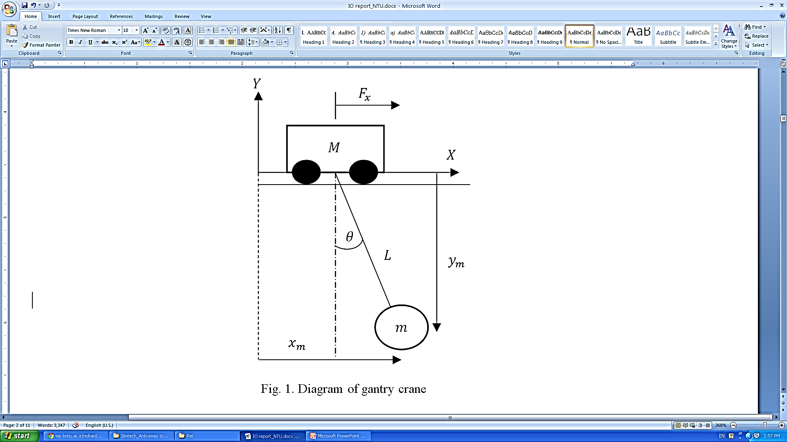
Anti-Sway Control of Overhead Cranes
Background of gantry cranes:
Used in several industries: ports, steel mills, nuclear power plant, etc.
Can deliver any bulky loads.
Controlled manually by operator.
Swaying of load decreases productivity, safety, and requires very skillful operator.
Swaying motion caused by:
Acceleration
External disturbance: wind
Objectives:
Anti-sway control aims to minimize the sway of load during the operation of an overhead crane. In this internship, the crane system is derived by Lagrangian mechanics. Several control techniques in sway angle control are tested and compared in software simulation and a test-bed model is designed using CAD drawing software. Motor, motion interface, and suitable sensors are incorporated to test-bed for future study. The feasibility of a closed-loop anti-sway control is studied and developed for outdoor crane implementation.
Methodology:
Two available method tested:
Input shaping (feedforward open-loop)
Anti-sway term feedback control
Proposed new controller:
Payload’s position feedback control with anti-sway
Findings & Achievements:
Input shaping method works perfectly in indoor environment where minimum disturbance exist.
Anti-sway term in closed loop control are able to damp payload’s oscillation even at the presence of wind.
By using payload position as feedback, safety can be ensured as its position converges to trajectory.
Fig. 2. Trajectory tracking results of proposed control scheme under wind’s presence
Team Members:
Reinaldo Maslim
Dr. Chen Silu
For enquiries, please contact:
Dr. Chen Silu, Scientist
Group/Programme/Section:PM/MCH
Tel: 65 6793 8469| Fax: 65 6791 6377
Email: slchen@SIMTech.a-star.edu.sg

