Slide 1



GIT

Slide 2
Summary
Background
Why git?
Basics commands
Git with Visual Studio Code
Gitlab
GitKraken
GitFlow

Slide 3
Background
Version control
In computer software engineering, version control, also known as revision control or source control, is any kind of practice that tracks and provides control over changes to source code.
Software developers sometimes use revision control software to maintain documentation and configuration files as well as source code.

Slide 4

Background
As teams design, develop and deploy software, it is common for multiple versions of the same software to be deployed in different sites and for the software's developers to be working simultaneously on updates.

Slide 5

GIT
Git is a version-control system for tracking changes in computer files and coordinating work on those files among multiple people.
Git was created by Linus Torvalds in 2005 for development of the Linux kernel, with other kernel developers contributing to its initial development.

Slide 6
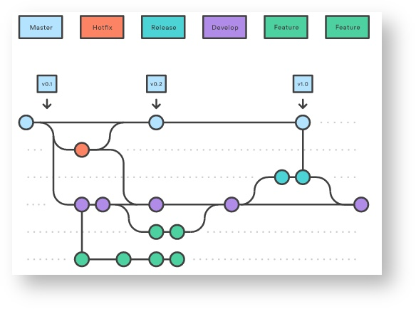
GIT
Strong support for non-linear development
Characteristics
Distributed development
Compatibility with existent systems and protocols (FTP, HTTP, SSH)
Efficient handling of large projects
Pluggable merge strategies

Slide 7
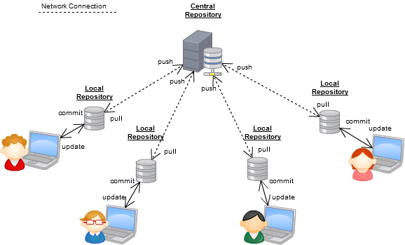
GIT
Team using Git

Slide 8
Basics commands
git init Create an empty Git repository
git clone Clone a repository into a new directory
git add Add file contents to the index
git commit Record changes to the repository
git log Show commit logs
git status Show the working tree status
git push Update remote repositories
git fetch Download changes from remote repositories
git remote Manage remote repositories

Slide 9
Example
Hello World example with GitHub

Slide 10
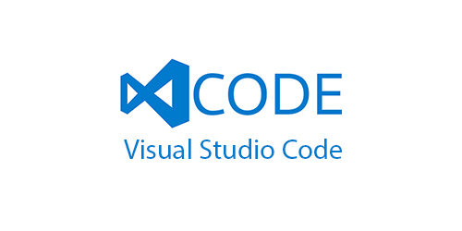
Git with Visual Studio Code
Extensions:
Git History
Git Lens
Hello Wdna example with GitHub and Visual Studio Code

Slide 11

Gitlab
WDNA Git Repository
http://gitlab.wdna.com/
Tips for working with Gitlab
Add the SSH key
Store credentials in local
git config --global credential.helper store
Work with different branches
Try using Gitflow

Slide 12
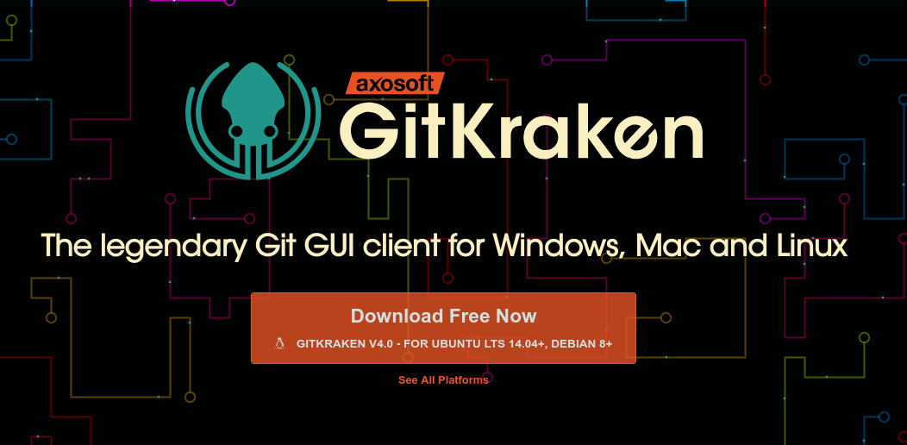
GitKraken
GUI Client for Git
https://www.gitkraken.com/

Slide 13
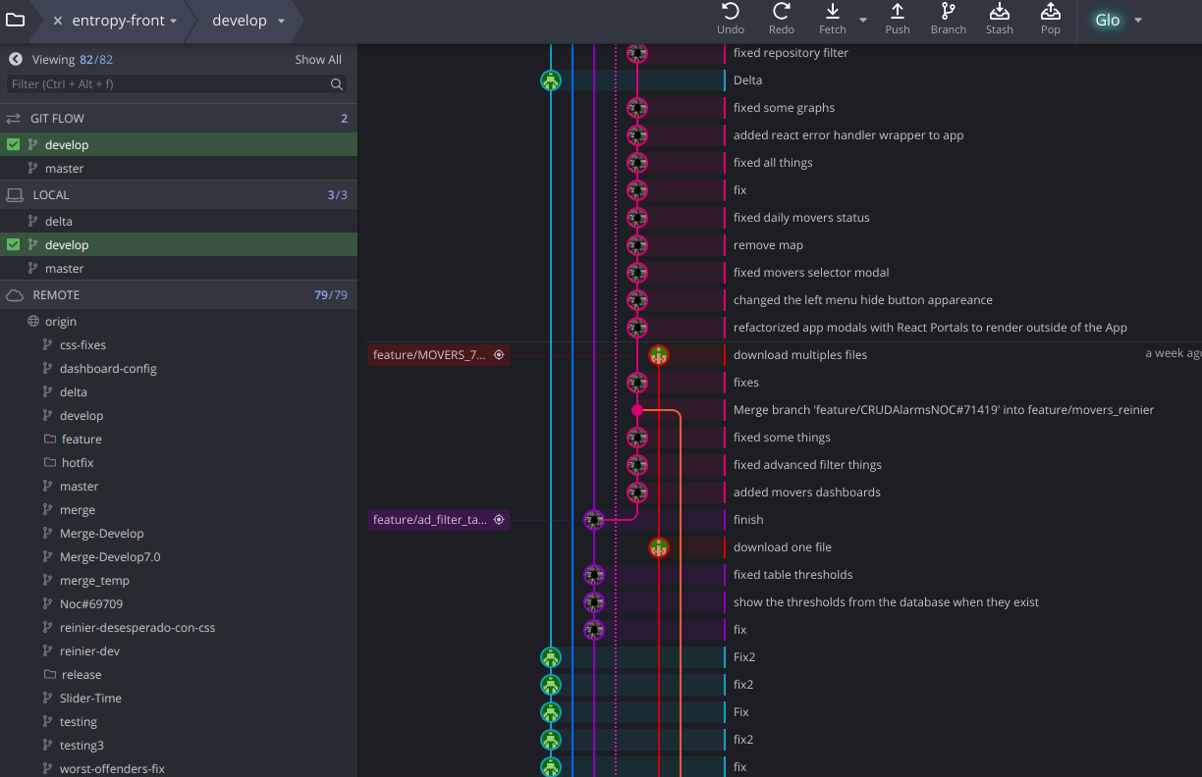
GitKraken
Main view

Slide 14
GitKraken
Hello Wdna create a develop branch and push to GitHub using GitKraken

Slide 15
GitFlow
Gitflow is a Git workflow, it’s defines a strict branching model designed around the project release. This provides a robust framework for managing larger projects.

Slide 16
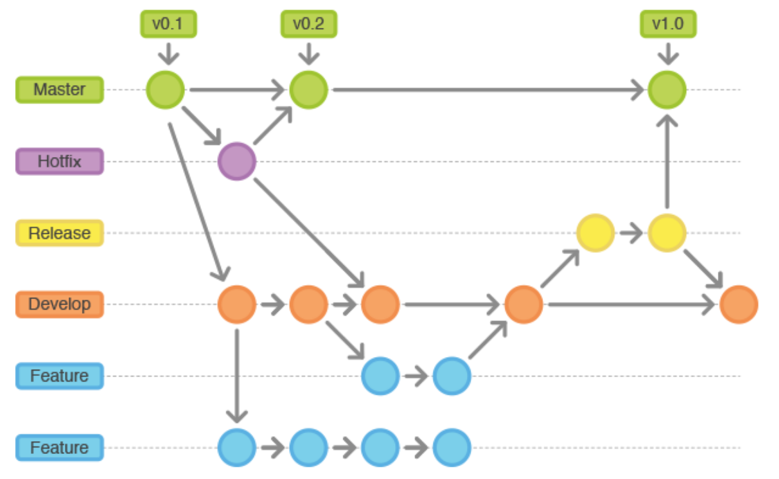
GitFlow Workflow

Slide 17
GitFlow + GitKraken
Example Hello Wdna init GitFlow with GitKraken and create a new feature.

Slide 18
Finish
Thanks!

