Slide 1
Analyzing the Connection Between Early-Childhood Participation in WIC and Later Academic Performance
12/4
2025
Team Members: Lily Trinh, Ella M, Natalia Reinoso

Slide 2
What is WIC?
WIC: Special Supplemental Nutrition Program for Women, Infants, and Children
Purpose
  Improve nutrition
  Promote healthy growth and development in infants and children
  Provide nutrition education and support for mothers
Eligibility
  Pregnant, Postpartum or Breastfeeding women
  Infants and Children under 5
  Those who already receive Medicaid, SNAP, TANF
Benefits
  Lower childhood obesity rates. (Daepp, M. et al. (2019). WIC Food Package Changes. Pediatrics.)
  Reduced behavioral issues. (Chorniy et al. (2020), American Journal of Health Economics)
Notes:
WIC is a federal Special Supplemental Nutrition Program for Woman, Infant, and Children. This program is designed to improve nutrition and support healthy development during pregnancy, infancy, and early childhood, specifically up to age 5. WIC provides nutritious foods, health screenings, breastfeeding support, and nutrition education to families who are financially eligible. Most participant automatically qualify if they already receive benefits from programs like Medicaid, SNAP, or TANF.
The program has been widely studied and links to short-term benefits, such as lowerin rated of childhood obesity, better infant health outcomes, and better behavioral or development concerns. Because WIC targets such a crucial developmental window, it plays a major role in shaping early physical and cognitive growth. Therefore were in interested in studying whether early nutriotion support can influence later academic performance.

Slide 3
PROPOSED QUESTION:
Does broader child participation in WIC correspond to stronger long term academic performance?
Where we:
Research whether changes in the state-level WIC Coverage Rate ((Children Participating in WIC)/(Children Eligible for WIC) ) is associated with stronger 4th grade standardized reading and math test scores?
Why 4th Grade?
WIC care ends after 5 for children, 4th grade is the closest in age that has available test scores out
Notes:
Our research question specifically is whether broader participation in WIC actually shows up later in a child’s academic performance. We would examine whether increase in a state’s WIC coverage rate for 4 year olds, meaning the share of eligible children who actually take part in WIC, are associated with higher 4th grade math and reading scores. Our study would use 4th grade NAEP scores because WIC benefits typically end at the age of 5, so 4th grade is the closest point at which national, standardized academic outcomes are widely available. What makes our research important is that most research focuses on the short term benefits, while long term academic effects are still understudied. Our study would link early childhood nutrition exposure to later test scores. We hope to see whether nutrition policy has a downstream cognitive impacts. If we find that there is a strong correlation, this would mean that WIC’s aid extends beyond just early health and affect actual learning for years later.

Slide 4
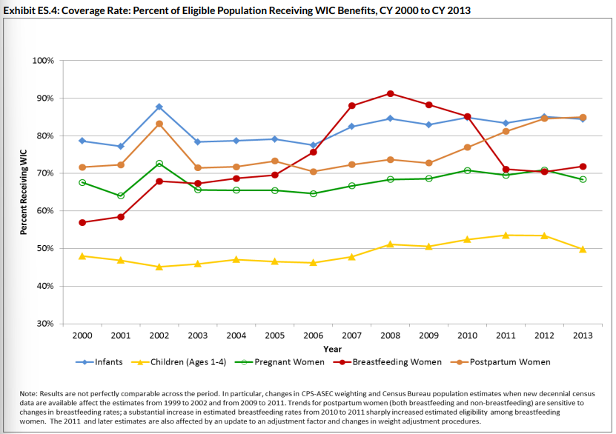
Division in Eligible WIC Population vs Actual WIC Participants
SIGNIFICANCE of Research
1. Division between the amount of WIC participants ages 1-4 vs potential children eligible yet not participating, demonstrating low coverage rates for this group.⁴
2. Reasons why WIC eligible children 1-4 don’t participate
Not lack of funding ⁵
Mothers Compliance Costs perceived to be higher than potential benefit of WIC ⁶
Utilized more for infants (formula) ⁶
After achieving a certain socioeconomic status participants quit early ⁷
3. This demonstrates a need for more information about benefits in the long run for children 1-4 (those most likely to underutilize WIC participation)
Notes:
Notion that though there is a ton of benefits there is a still a massive eligibility gap especially among children 1-4
issues with the mom
socioeconomic, when parents get better of they think they dont need to be on WIC any more
Moms dont like WIC food options
Cost of WIC is greater than its benefits
how can we convince them otherwise on providing information on the benefits of WIC
One of the biggest motivations for our project is that there is a large gap between children who are eligible for WIC versus those who actually participate in the program, especially for ages 1-4. National data shows that a significant share of the eligible toddlers and pre-schoolers are not enrolled, even though infants tend to have higher participation rates. Prior studies suggest this isn’t because of funding shortages, but because parents often perceive compliance costs, such as appointments and paperwork, as too high compared to the benefits once the child ages out. Families who also experience socio economic improvements in status also tend to leave the program early. This demonstrates a key question as to what long-term benefit could these families be missing out on? By showing whether earlier WIC participation leads to better academic performance years later, we can provide evidence to support expanded outreach and reduce informational barriers for families with younger children.l
Lily

Slide 5
LITERATURE: Effect of WIC Participation on Academic Outcomes
Effect of in utero and early childhood exposure to WIC,and its benefits, on academic performance
Research examining an estimated relationship between WIC participation in short term cognitive development and long term reading/math achievements. Concluded there was a persisting learning advantage associated with WIC participation even into school years. ¹
  Short Run: Children, age 2, receiving WIC exposure scored a higher standard deviation (0.062) on the Bayley Mental development (BMD) assessment than their similar peers not receiving WIC.
  Long Run: Older children, age 11, who had received WIC exposure in prenatal or early childhood years perform better, up to 0.3 of a standard deviation, on reading achievement z scores, from CDS data, in comparison to their siblings (Jackson).
Analysis using several SC state agencies finding prenatal WIC participants having a 5% lower probability of being diagnosed with ADHD and a 5.1% lower probability of being diagnosed with more mental health conditions later on.²
  There is a relationship between having less mental health conditions in later school years with grade repetition, demonstrating WIC participation could potentially lower amount of school days missed & frequency of grade repetition by almost 8% (Currie).
Studies demonstrate food insecurity can affect academic and psychosocial functioning of preschool and school aged children.³
  Children 1-5 get headaches, stomachaches, and overall sicknesses more often, leading to higher potential of missed school days or falling behind academically
  There is a relationship between food insecurity and changes in reading/math test performance, showing lower mathematic scores in kindergarteners - especially among girls (Cook and Frank).
Notes:
Research examines …
To measure short term, used early childhood longitudinal study (ECLS-B) following children between 9 months (2001) and kindergarten (2008), BMD: used to identity children with developmental delay; assess cognitive language, motor, social-emotional, and adaptive skills : scores below 85 indicate mild impairment
To measure long term used analysis based on child development supplement (CDS) of the panel study of income dynamics (PSID): which provided broad reading z scores and whether children had siblings - using 2002 data participants were 11
LIMITATIONS:
Sibling comparisons don't control for factors that vary between siblings - such as economic circumstance around time of birth of different parenting behavior towards siblings : Bias estimates if there were observed process related to the outcome of why one sibling was exposed vs not in the program
Data measured takes place prior to 2009, when a major altercation was made to WIC regarding the type of food they provided
Limitations:
Postnatal WIC participation only for cohorts born in 2009 and 2013
Only collects data from South Carolina
Sample children aged 6 to 11 born between 2004 and 2009 but followed up to 2015 in medicaid and education data
Mother fixed effect models restrict sample to children with sibling in the data - loss of lone children from data set

Slide 6
CONTRIBUTIONS
Our Study Provides Novel research that analyzes the relationships between test scores and state WIC Coverage rates
Limitations of Previous studies vs How our research adjusts for them
Long term data difficult with WIC since the program started 1960s and a change occurred in 2009: Our data utilizes children WIC participants from 2011 and 2013 and looks at their test scores from 2015 and 2017
Sibling data comparison: Our study avoids bias from familial relationship and instead performs a broader analysis
Privacy laws & Geographical constraints: Our research does not require surveys from mothers or information from individual states, instead using standardized testing across the US
What our Study has the Potential to Provide
We provide an alternative manner of analyzing the effects of WIC on cognitive development that is easy to replicate overtime
If our findings demonstrate a significant relationship we provide greater reasoning and possible advoation for children to participate in WIC even after prenatal or infant stage
What Major Problem our Data can Potentially Combat
Our findings could provide stronger evidence to combat compliance costs faced by families on WIC by demonstrating greater academic benefits for children participants ages 1-4. By providing insight on a potential positive externality not considered by eligible WIC participants who leave early, we tackle misconceptions / incomplete information primarily in families who left after formula stopped being provided or due to higher socioeconomic status.
Notes:
our study does... we do... our research does
testing the relationship between associations (not correlation)
if we provide research that provides new info about wic participation and test scores we can provide information about the relationship

Slide 7
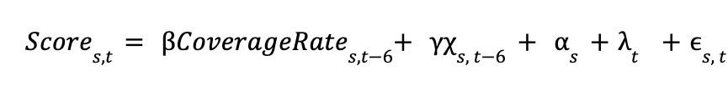
Proposed Methodology
Question: Is improved state-level WIC Coverage Rate for eligible children age 4 from 2011 to 2013 associated with stronger fourth-grade educational outcomes from 2017 to 2019?
Score - State-level NAEP 4th average math or reading score (2017, 2019)
CoverageRate = WIC Coverage Rate for children age 4 (2011, 2013)
ϒ𝜒 - vector of state-level controls (demographics, poverty, income, urbanization, educational funding )
𝞪 - state fixed effects
λ-year fixed effects
Coefficient of Interest (β) - measures if within-state changes in WIC Coverage Rate (2011-> 2013) are associated with within-state changes in 4th-grade NAEP scores,
s=state
t=2017, 2019
t-6=2011, 2013 (WIC Coverage years)
2011 WIC cohort→ tested in 2017
2013 WIC cohort→ tested in 2019
Notes:
. Panel regression- 50 states, 2 outcome years (100 observations) …..Coefficient of interest..math and english tested separately
State controls – additional time-varying factors that would likely impact early childhood nutritional environments, WIC uptake, etc
State- fixed effects- time-invariant state-level characteristics li
Year fixed effects- accounts for national shocks nad policy changes
State-level controls- time-varying controls that change from year to year such as demographics, poverty, income

Slide 8
Panel Construction & Data Sources
Construct a 2-period panel that incorporates data from each of the 50 states
Independent Variable- WIC Coverage Rate (Children age 4), 2011 and 2013
  Coverage Rate=(Children Participating in WIC)/(Children Eligible for WIC) for each state
  Source: USDA Food & Nutrition Service National & State-Level Estimates of WIC Eligibility & Program Reach, 2011 and 2013
Dependent Variable- Later Educational Outcomes, 2017 and 2019
  State-level 4th grade NAEP average mathematics & reading assessment scores in 2017 and 2019
  Source: National Center for Education Statistics
Exposure-year controls
  Median household income
  Child poverty rate
  Unemployment rate
  Racial Composition
  %Urban/Rural Population
  Source: American Community Survey, United States Census Bureau
Outcome-year controls
  Per-Pupil K-12 Spending (US Census Bureau)
Notes:
USDA Food & Nutrition…contains number of eligible children per state, number of participating children per state, and also coverage rates per state, for the range years 1-4, infants, and also coverage rates for each year- so they have coverage rates per state for children age 4 already in the reports. NAEP contains average scale scores for each state and the percentage of students within the state at or above ‘proficiency’ level….utilizing math and reading scores because data much spottier for all states for science and writing assessments per year. Chose 2011 and 2013 based on comprehensive data availability. USDA methodology/sourcing changes around 2018 and directly states that it is not comparable to early years…however earlier years are comparable to each other..and for educational outcomes..avoiding endogeneity concerns that would arise for including 2020, because of COVID …time varying state characteristics that would also likely affect educational outcomes…https://fns-prod.azureedge.us/sites/default/files/WICEligibles2011Volume2.pdf. Exposure-year controls account for additional factors that would influence WIC coverage- –. Outcome year controls - K-12 spending wold influence it, additional factors for outcome-year primarily accounted for through state and year fixed effects

Slide 9
Limitations & Potential Insights
Measures within-state relationships/associations, but does not establish causality
Only able to compare 2 cohorts b/c of methodological/data constraints
Cohort matching is not exact
Possible omitted state-level changes
Potential Benefits of WIC
Whether nutritional environment may impact childhood math/english outcomes differently
Impetus for further research, obtaining permission to access individual data
Notes:
If our results show a positive association, this study could help clarify how early nutritional environment shape specific academic outcomes. One insight we might gain is whether nutrition affects reading and math differently, which could reveal something about how cognitive development responds to early dietary stability. Another potential insight is how WIC interacts with school resource levels. Some states may see stronger effects because their schools are better equipped to capitalize on early advantages. In general, our research can highlight the long-run benefits of staying enrolled in WIC beyond infancy, especially for families who often leave once WIC benefits end. Finally our work would motivate further research using individual level data or longitudinal tracking, helping policymakers better understand not just whether WIC works, but how and for who it can impact most.

Slide 10
Thank You

Slide 11
References
Jackson, Margot I. “Early Childhood WIC Participation, Cognitive Development and Academic Achievement.” Social Science & Medicine, vol. 126, Feb. 2015, pp. 145–53, https://doi.org/10.1016/j.socscimed.2014.12.018. Accessed 4 Nov. 2019.
Currie, Janet. “Does Prenatal WIC Participation Improve Child Outcomes?” American Journal of Health Economics, vol. 6, no. 2, 30 Dec. 2019, https://doi.org/10.1086/707832.
Cook, John T., and Deborah A. Frank. “Food Security, Poverty, and Human Development in the United States.” Annals of the New York Academy of Sciences, vol. 1136, no. 1, July 2008, pp. 193–209, https://doi.org/10.1196/annals.1425.001.
“National and State-Level Estimates of WIC Eligibles and Program Reach 2013 | Food and Nutrition Service.” Usda.gov, 2025, www.fns.usda.gov/research/wic/eer/2013.
Neuberger, Zoë, et al. “WIC’s Critical Benefits Reach Only Half of Those Eligible | Center on Budget and Policy Priorities.” Center on Budget and Policy Priorities, 21 Feb. 2024, www.cbpp.org/research/food-assistance/wics-critical-benefits-reach-only-half-of-those-eligible.
Barnes, Carolyn, et al. “‘I Used to Get WIC . . . But Then I Stopped’: How WIC Participants Perceive the Value and Burdens of Maintaining Benefits.” RSF: The Russell Sage Foundation Journal of the Social Sciences, vol. 9, no. 5, Sept. 2023, pp. 32–55, https://doi.org/10.7758/RSF.2023.9.5.02.
Lora, Karina R., et al. “Factors That Influence Children’s Exits from the Special Supplemental Nutrition Program for Women, Infants, and Children: A Systematic Review.” Nutrients, vol. 15, no. 3, Feb. 2023, p. 766, https://doi.org/10.3390/nu15030766.
U.S. Census Bureau. 2017 Public Elementary-Secondary Education Finance Data. Census.gov, 12 Aug. 2025, https://www.census.gov/data/tables/2017/econ/school-finances/secondary-education-finance.html.
U.S. Census Bureau. 2019 Public Elementary-Secondary Education Finance Data. Census.gov, 12 Aug. 2025, https://www.census.gov/data/tables/2017/econ/school-finances/secondary-education-finance.html.
U.S. Department of Agriculture, Food and Nutrition Service. National and State-Level Estimates of Special Supplemental Nutrition Program for Women, Infants, and Children (WIC) Eligibles and Program Reach, 2011. By Paul Johnson, Lina Gianarelli, Erika Huber, and David Betson. Mar. 2014. https://fns-prod.azureedge.us/sites/default/files/WICEligibles2011Volume1.pdf.

