Slide 1



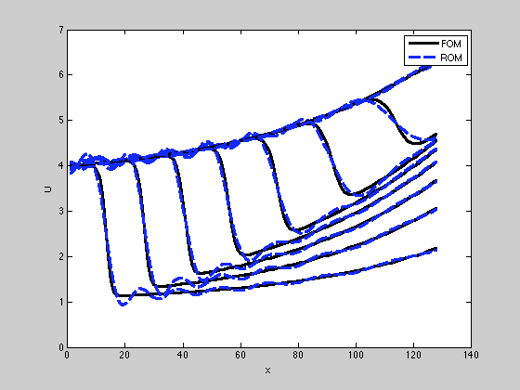
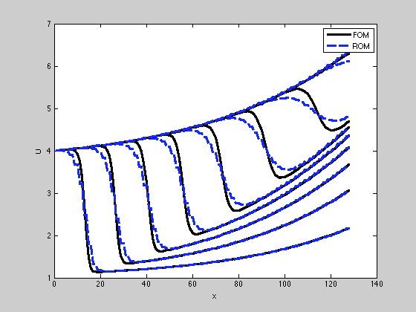






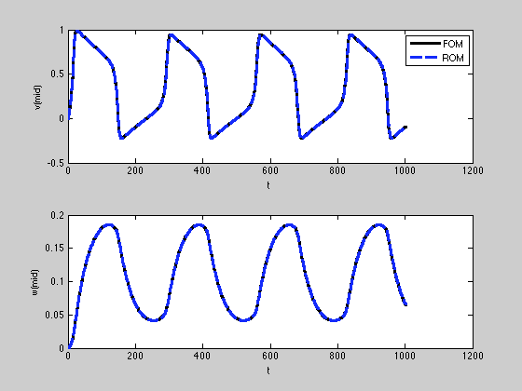
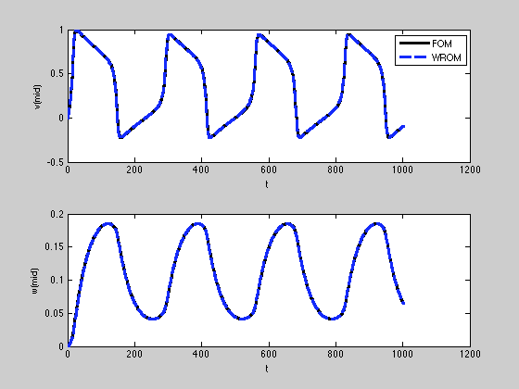
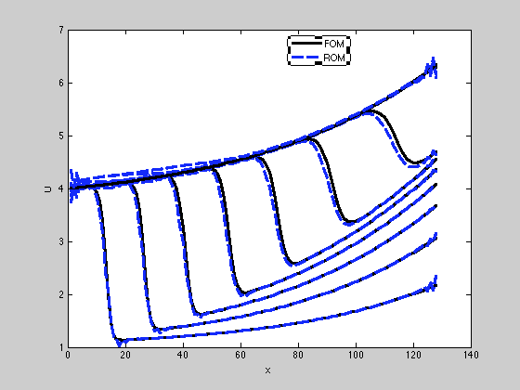





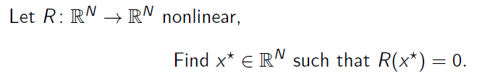
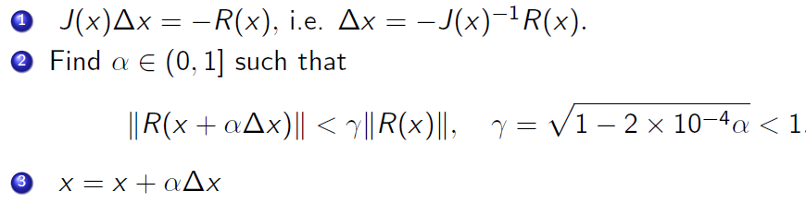



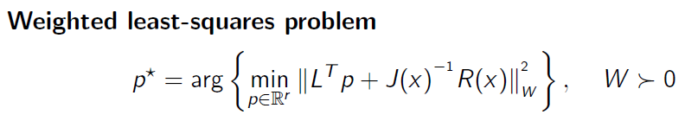

Using Wavelet Transformations for Reduced-Order Modeling
Investigators:
Miguel Argaez, Martine Ceberio, Reinaldo Sanchez-Arias, and Leobardo Valera
Introduction and Motivation
Wavelet Reduced-Order Model (WROM) framework
Reliable under-body blast simulations are of special interest to Army operations as they allow to assess impacts on vehicles and personnel safety, as well as to study configurations critical in the design and decision-making stages. Models available for such simulations are very complex involving millions of variables involved and high fidelity models of the under-body blast problem yield significant CPU time issues. Consequently, models of reduced order (ROM) need to be formulated, which still capture the main behavior of the system of interest and yield a drastic CPU time reduction to allow real time decisions.
Traditionally, this problem has been attacked through offline/online stages: offline intensive computations to gain insight in the expected solution using a high-fidelity model and compute a lower dimensional basis from that; and online computations of approximate solutions in the low-dimensional manifold that best captures the dynamics of the solution.
High Fidelity Model (HFM) of a nonlinear dynamical system: offline computations, intensive simulations ✗
Wavelet, level of decomposition, and dimension defined by user.
No intensive simulations. HFM used to analyze behavior of solution.
Wavelet family and low-pass filter: reduced-order wavelet basis L_{k} with k << N
L_{k}^{T} R(L_{k} x; μ ) = 0
Several transformations available. Potential to build tailored wavelet.
Reduced-order model: Petrov-Galerkin projection in L_{k}^{T} wavelet subspace, residual minimization
online computations, many simulations ✓
Our work aims at savings in offline computations. Our proposal is to use wavelet transformations, thereby exploring ideas from data compression in image processing, for their fast implementations and appropriate projections into lower dimensional spaces capturing the behavior of the solution of interest. The main goal is to enable real-time reliable parametric studies, in a cheap manner, that can help survivability decision making and predictions in the battlefield.
Although model reduction borrows techniques typically found in image processing, model reduction using wavelets has not been adequately addressed in the literature.
Can wavelets be used for model reduction?
Numerical Experimentation
Experiments on MORTestbed [3] using an implementation of the WROM methodology
1D Burgers’ equation
Av. Rel. Error
ROM = 0.021469 %
WROM = 0.027782 %
FOM dim = 128
ROM dim = 16
WROM dim = 64
ROM time = 11.48 s WROM time = 1.82 s Wavelet = Haar
FitzHugh-Nagumo Equations
Av. Rel. Error
ROM = 0.017672 %
WROM = 0.028817 %
FOM dim = 1024
ROM dim = 10
WROM dim = 4
ROM time = 15.77 s WROM time = 3.78 s Wavelet = Haar
Using multiple wavelet families idea:
Adjust low-pass filter according to simulation process
for better accuracy and treatment of discontinuities, in
a dynamic approach.
Test-case: Burgers’ equation using WROM with
2 families of wavelets (rbio.3.7 and dmey)
Average Relative L2 WROM Error = 0.019975 %
WROM time = 1.9877 seconds.
Original
Dimension: 512 x 512
Total pixels: 262,144
Wavelet dec. L
Dimension: 256 x 256
Total pixels: 65,536
Perfect Reconstruction
Dimension: 512 x 512
Total pixels: 262,144
Relative error = 2.8355e-16
Model Reduction and Data Compression
For data compression, we look for a transformation that projects the object to a lower dimensional space such that the compressed version captures most of the energy of the original object. For instance, an image is compressed using a wavelet transform and is reconstructed using only the low-low pass components of the wavelet [1].
Collaborations
The wavelet which best concentrates energy in the low-pass vector will yield the smallest error (energy compaction property)
Charbel Farhat and Matt Zahr: model order reduction for the under-body blast problem (Stanford University)
Craig Barker: reduced-order and parameter estimation for an ATD model (SLAD/ARL in Aberdeen, MD).
Chris Kees: reduced-order models of groundwater hydraulics using orthonormal wavelets (ERDC Corps of Engineers).
A Wavelet Reduced Order Model
Conclusions and Research Questions
- Reduced-order parameter:
- Root-finding problem:
- Newton’ s method:
Accomplishments
A novel technique for reduced-order models using wavelet transformations.
Advantages of this approach: no snapshots (savings in offline stage), memory efficient implementation, both offline and online reduced computation time.
Future Directions
Validation of our approach on realistic models of Army applications (e.g., underbody blast simulations).
Online adaptation of dimension of reduced space induced by wavelet transform.
Gappy approximation through sparse representations for data reconstruction [2] and fast computations.
A priori projection error estimators and multiple wavelets reduced models.
References
[1] Hernandez IV, M. , “Reduced-Order Modeling Using Wavelet Transformation”. PhD Dissertation, 2013 (supervised by M. Argaez)
[2] Argaez M., Sanchez R., Ramirez C., “Face Recognition from Incomplete Measurements via l₁ minimization", American Journal of Computational Mathematics AJCM, vol. 2, no. 4, pp 287- 294. 2012.
[3] Zahr M., “MORTestbed User Guide”, Model Order Reduction Testbed. Stanford. 2013.
r x r system of equations, r << N

