Slide 1
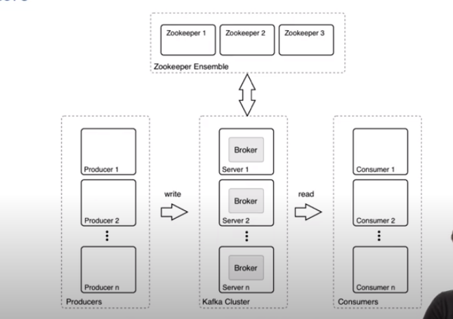
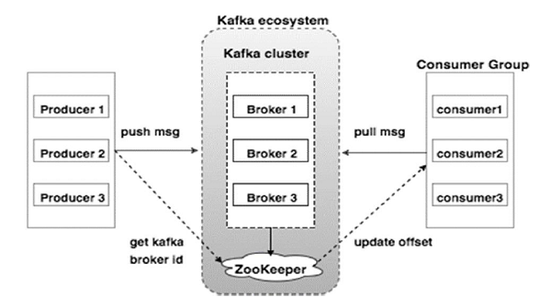
producer 0
broker 0
consumer 0
producer 1
broker 1
consumer 1
...
...
...
producer n
broker n
consumer n
producers
kafka cluster
consumers

Slide 2
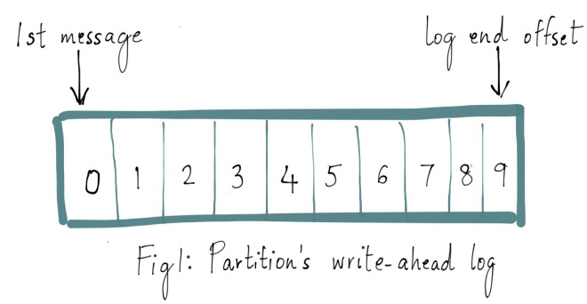
message 9
headers
first message
key
value
0
1
2
3
4
5
6
7
8
9
timestamp
write-ahead log

Slide 3

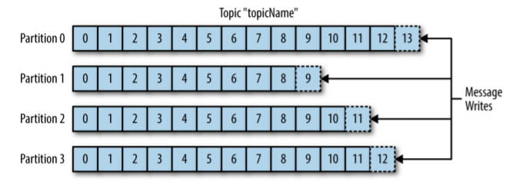
topic t0
part 0
0
1
2
3
4
5
6
7
8
part 1
0
1
2
3
4
5
6
writes
part 2
0
1
2
3
4
5
6
7
8
9
older
new

Slide 4
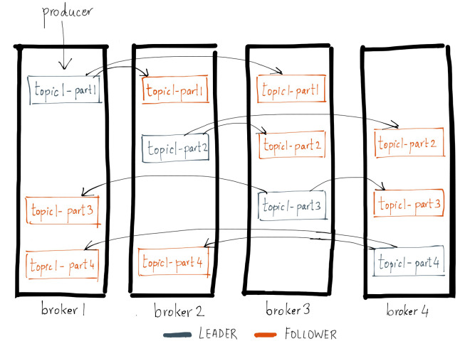
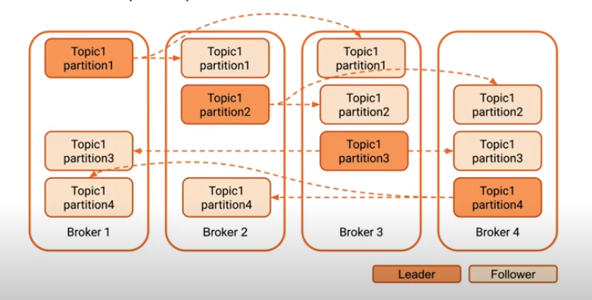
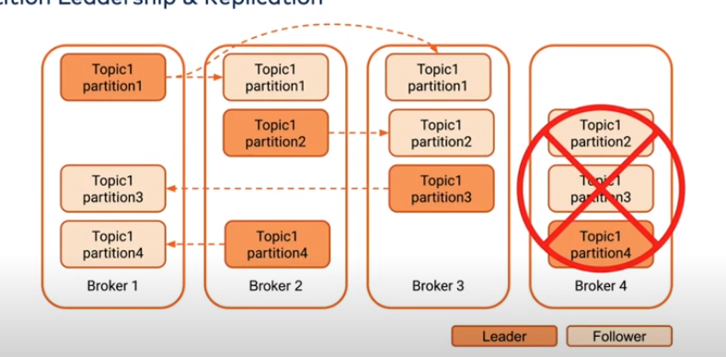
part 0 (L)
part 0 (F)
part 0 (F)
part 1 (L)
part 1 (F)
part 1 (F)
part 2 (F)
part 2 (L)
part 2 (F)
part 3 (F)
part 3 (F)
part 3 (L)
broker 0
broker 1
broker 2
broker 3
number of partitions = 4
replication factor = 3
topic 0 partitions

Slide 5
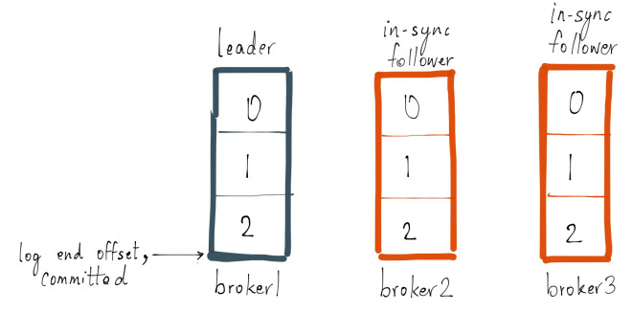
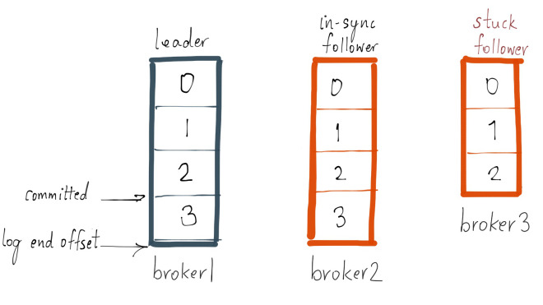
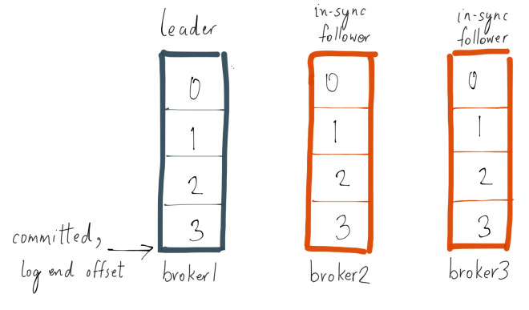
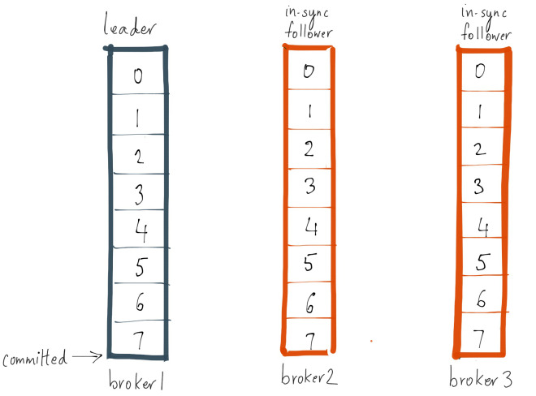
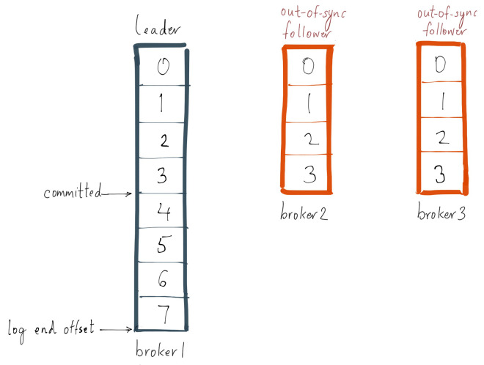
committed
log end offset
leader
0
1
2
3
4
5
6
7
8
in-sync
0
1
2
3
4
5
6
7
8
lagging
0
1
2
3
4
5

Slide 6
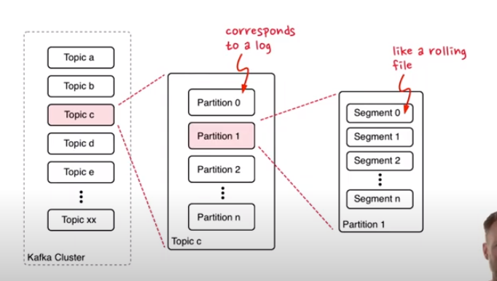

Slide 7
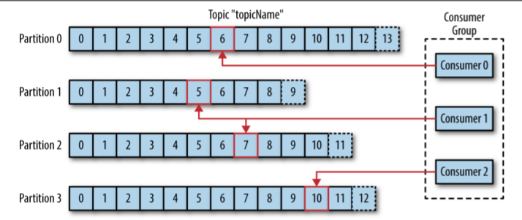
part 0
0
1
2
3
4
5
6
7
8
consumer 0
part 1
0
1
2
3
4
5
6
consumer 1
part 2
0
1
2
3
4
5
6
7
8
9
consumer 2
part 3
0
1
2
3
4
5
6
7
8

Slide 8
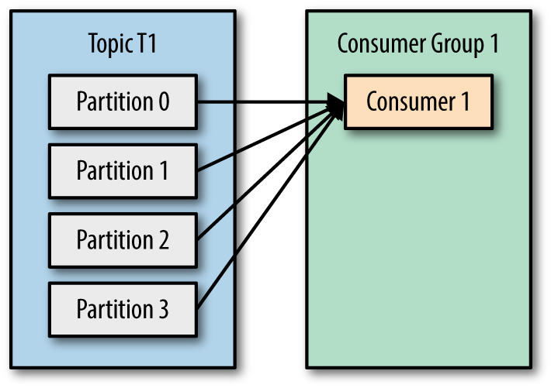
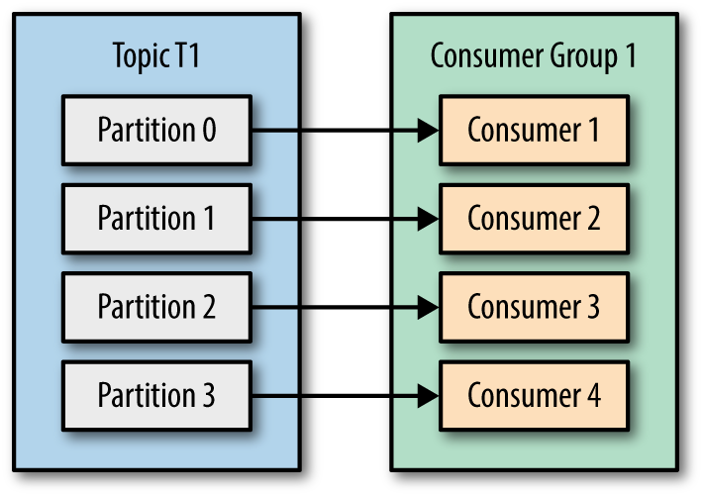
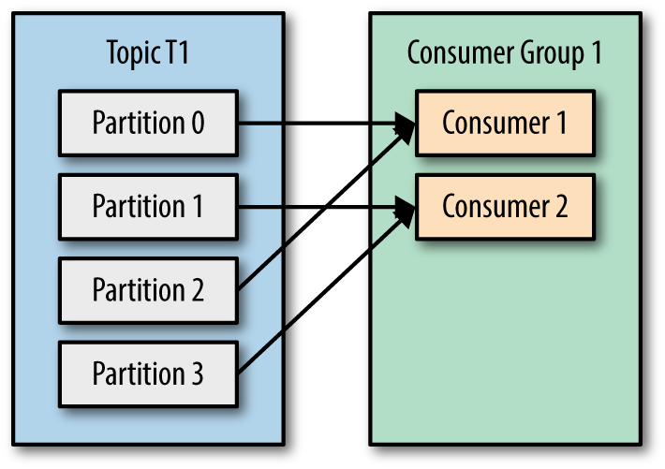
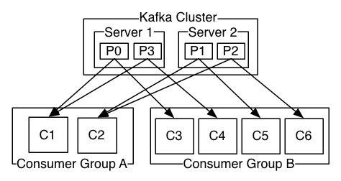

group 2
group 0
consumer 0
consumer 0
topic 0
consumer 1
consumer 1
partition 0
consumer 2
consumer 2
partition 1
consumer 3
partition 2
group 1
consumer 4
partition 3
consumer 0
group 3
consumer 1
consumer 0

Slide 9
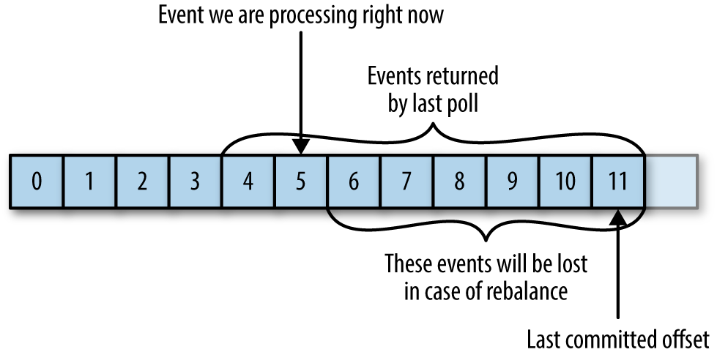
Consumer offsets
last committed
offset
events returned by
last poll
0
1
2
3
4
5
6
7
8
9
10
11
12
events will be lost in
case of rebalance
event currently
Being processed

Slide 10
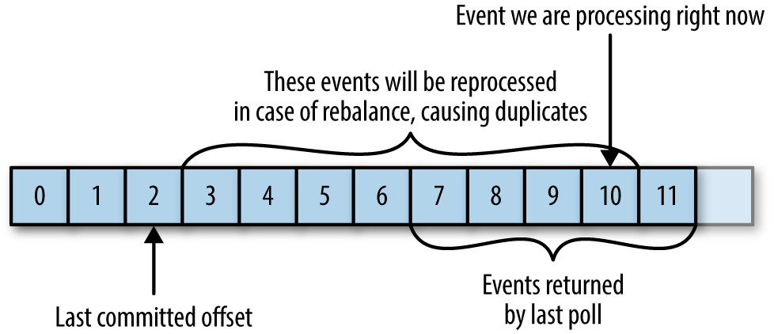
Consumer offsets
last committed
offset
events returned by
last poll
0
1
2
3
4
5
6
7
8
9
10
11
12
events will be lost in
case of rebalance
event currently
Being processed

Slide 11
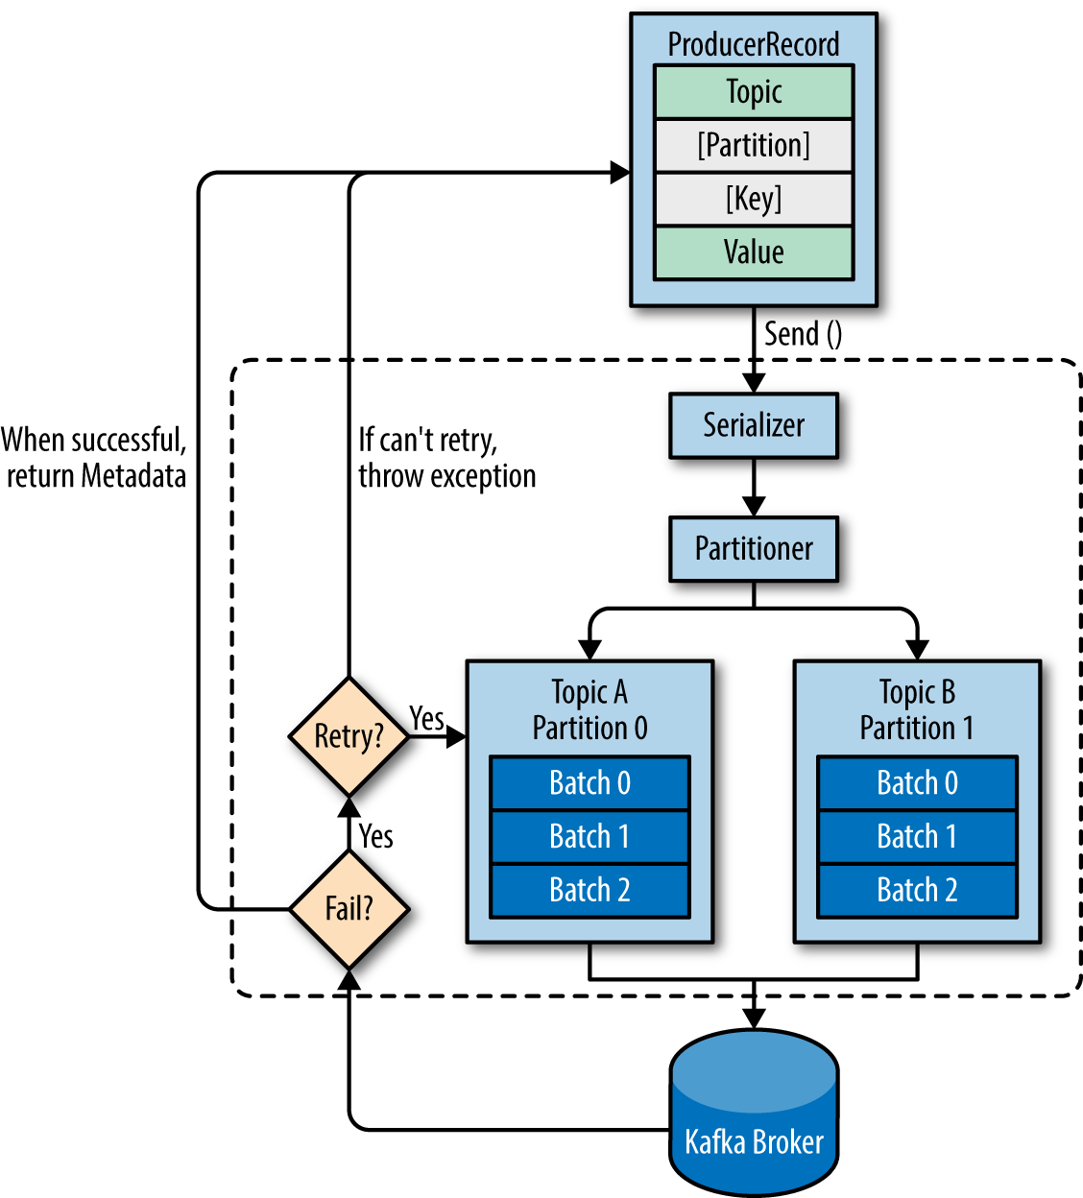
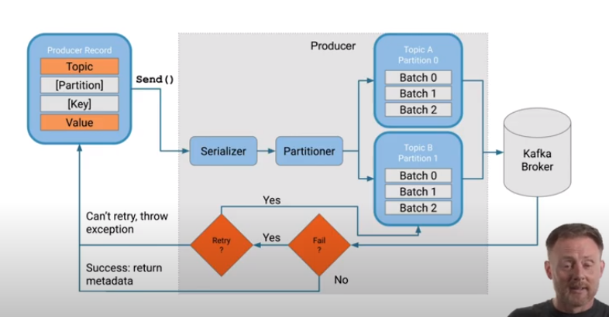

Slide 12
