Slide 1

Care and Feeding of Advisors
Brown bag
4th April 2006
Steve Chong

Slide 2
What this talk is and is not
Discuss issues about
  Selecting an advisor
  Maintaining healthy relationship with advisor
Raise awareness
  Prevent advisor/advisee conflicts
  Resources for resolving advisor/advisee conflicts
Not a gripe session
  Not right forum for solving specific problems
  See available resources later in talk…

Slide 3
What is an advisor?
Role of an advisor
  Guiding research
  Involved in community/networking
  Financial
  After graduation
Help set and achieve realistic long- and short-term goals
Advice for personal/family/other issues?
Notes:
Guiding research: helping you do novel/significant research
Involved in community: getting you involved in research community, e.g., sending you to conferences, introducing you, internships, etc.
Financial: research assistantships, teaching assistantships, informing you of scholarships/fellowships.
After graduation: preparing you for academic life after grad school, helping you with job search, information about How Things Work (e.g., funding, conferences, etc)
Your relationship with your advisor will probably be long term, continuing after grad school.
Your advisor may or may not be able or willing to give advice on other issues (e.g., personal, family).

Slide 4
Relationship with advisor
Relationship w/ advisor will change
  with transition from undergrad to grad
  less a student, more a junior colleague
You can have additional mentors!
  Other students
  Other faculty
    e.g., more senior, same or complimentary research area
    may be on committee
  Can advise on research, navigating grad school, life…

Slide 5
Advisees selecting advisors
“Student, 21, seeks advisor for LTR”
Issues to think about when choosing advisor
  Academic
    Research area
    Career maturity/tenure/fame
    How long do students take? What have they done since?
  Style
    Close supervision vs. hands-off?
    “Authoritarian” vs. “coach” vs. “laissez-faire”? *
    Large/active research group vs. just two of you?
    How busy are they?
  Personal
    4 year+ relationship. Will you get on?
*Prof Joanne Martin, Stanford
Notes:
These are issues that are worthwhile thinking about. There are pros and cons to every side of each issue, and this slide is oversimplifying a lot of the issues, so think about them for yourself.
Research area: is advisor working on stuff that you are interested? will they be interested in the stuff you want to work on? (You may also want to think about where that research area will lead you career-wise, e.g., how hot, how crowded/competitive, industry applications, etc.)
Career maturity/tenure: A more junior professor, being “young and hungry” they may have more time to spend working with you, and may expect more from you. An untenured professor may not gain tenure, and may leave during your time at grad school. A more senior professor will be better connected, may have a broader view of the field, what’s hot, etc., but may have less time to spend directly with you, but will have more experience doing research in the field, in getting students through grad school, etc.
Previous students: What have previous students of the professor gone on to do? What was their first job? How famous are they now? How long did they take to graduate? Do the previous (or current) students have any advice for you?
Style: There are many different approaches, none necessarily right or wrong, but some more or less appropriate for you.
Close supervision vs. hands-off: Is the advisor closely involved in doing research with you, meeting regularly, working together to solve problems, or more hands-off, letting you work independently/without close guidance. Which do you think would suit you better?
Authoritarian vs Coach vs. Laissez-faire: Categories devised by Joanne Martin, professor of organizational behavior in the Graduate School of Business at Stanford University: (taken from “Getting What You Came For”, by Robert L. Peters, Harper Collins 1992).
The authoritarian adviser is likely to set the goals and lay out tasks for the research, usually in some detail. Such advisers welcome conflict, expect you to speak up, and are active throughout the research process.
The coach, on the other hand, will seek to set goals jointly with the student. There may be a lot of guidance in the beginning or planning phase, but not much during the research itself. "Active in the planning stage, passive during the process, and active in the evaluation stage," is how Ms. Martin puts it.
Laissez-faire advisers are friendly and constantly supportive but it's not certain you will learn much from them. They will be relatively inactive on the research task unless you take the initiative but supportive throughout and generally available. Attractive as they may first appear, working with a laissez-faire adviser is a high-risk strategy and is only likely to work if you have strong research skills, are independent, and know what you want.
Research group vs. Just two: Large research group may mean your piece of work is contributing to a much bigger whole, less to distinguish your work from the group’s; large research group may mean more collaboration, senior grad students to act as mentors, more opportunities to learn.

Slide 6
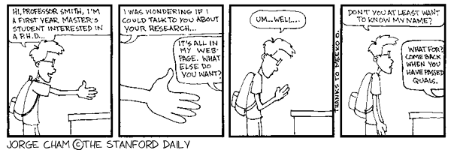
Some things to do
Take classes from potential advisor
Talk to students of potential advisor
  Current and previous
Talk to potential advisor
Be proactive
OK to “shop around”
  i.e., talk to/work with different people
  But be open and clear about it!
“Piled Higher and Deeper”
by Jorge Cham
www.phdcomics.com
Notes:
“Shop around” means actively talking to/working with professors. Make sure that the professors you are working with are aware that you are also working with others.
If you talk to many professors, you’ll probably need to “break up” with some, i.e., stop working with them. Again, make sure this is done openly, clearly, and amicably.
No official rule on when a student needs to have an advisor. But end of 1st year or during 2nd year is good…

Slide 7
Advisors selecting advisees
“Young-at-heart seeks available grad with similar interests”
Things an advisor may be considering
  Worthwhile investment?
    Interests coincide, work well together, bright student
  Time/energy/funding for another student?

Slide 8
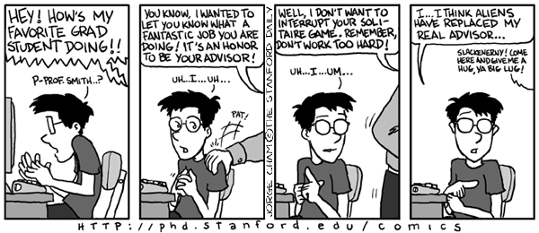
Expectations a student may have
Time
  Balancing research, courses, teaching, vacation, life, …
Working style
  Frequency of interaction
  Independence
  Front loading vs. back loading
Research questions
  yours or theirs?
… and probably many more
“Piled Higher and Deeper”
by Jorge Cham
www.phdcomics.com
Notes:
Time: How much time are you expecting to spend on research? How many courses are you planning on taking? How much time are your teaching responsibilities taking? Are you planning on disappearing back to your home country for a month in the middle of the semester? Over the winter break? Don’t forget to have a life outside of work too!
Working style:
Frequency of interaction: do you expect to meet daily with your advisor? Weekly? Monthly? On a regular basis, or just when you have stuff you need to talk about?
Independence: do you expect to be working closely with your advisor, solving problems together, or do you expect to work very independently, reporting back on progress?
Front loading vs back loading: given a deadline, are you expecting/planning to do the work as late as possible, as early as possible, or something in between?
Research questions: Do you expect on your advisor giving questions/problems to pursue? do you expect to come up with your own questions/problems, and if so, how closely related will these be to your advisors research?
Many more… e.g.,
delegation of work in writing papers,
what kind of feedback you get from your advisor,
detailed technical, positive vs. negative
amount of work needed for A exam/B exam
Be aware of the expectations you have.

Slide 9
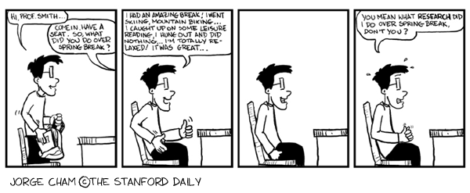
Expectations an advisor may have
Time, working style, research questions, …
  Same things you may have expectations about…
  Vacations/conference deadlines
  Courses vs. research balance
“Piled Higher and Deeper”
by Jorge Cham
www.phdcomics.com

Slide 10
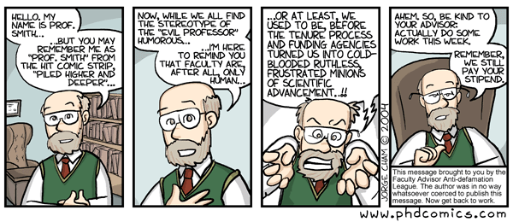
Constraints an advisor may have
Funding
  boom and bust cycles
  fungibility/restrictions
    summer funding, students, equipment, travel
Advisors are people too
  Other things in their life, other pressures
“Piled Higher and Deeper”
by Jorge Cham
www.phdcomics.com

Slide 11
Communication
Mismatched expectations can lead to problems…
Discuss expectations with advisor
  Make sure yours and theirs are realistic
  Clarify unspoken assumptions
Communication is an ongoing process
  Need to keep working at it
  Be proactive!
Notes:
Examples of mismatched expectations:
Author order on paper
You may have expectations about the author order.
Advisor probably has system/protocol for author order. (Typically, sub-communities have custom for author order: who did the work, alphabetical, or students first.)
You can ask advisor what their system is. Can be non-confrontational, not specific to a particular paper.
If you disagree with it (in context of particular paper), can discuss it.
Key point: Communicate! Talk about it! You don’t need to let your and their unspoken expectations lead to conflict.
Who gives a conference talk, who attends conference
Again, sub-communities may have customs: student gives the talk, or giving talk is an honor
Advisor probably has some system for who gives talk/conference attendance. (Remember, advisor may be financially constrained!)
What if you want to attend a conference for a paper on which your advisor is not a co-author? Do you expect them to pay for the travel and conference attendance?
Key point: Communicate! Ask about it. Request support for attending a conference where advisor not a co-author BEFORE submitting to the conference.
(Note: the Grad School has some funding for students to attend conferences, and some conferences can give travel grants to students.)

Slide 12
Resources @ Cornell
More info, and where to go if you’re having problems
Other students/faculty/mentors
DGS (Director of Graduate Studies)
  Joe Halpern
  Past DGSs: Éva Tardos, Ken Birman
EARS (Empathy, Assistance, and Referral Service)
  www.dos.cornell.edu/ears
CAPS (Counseling and Psychological Services)
  Part of Gannett Health Services
  www.gannett.cornell.edu/CAPS
Graduate School
  Grievance procedure
  www.gradschool.cornell.edu

Slide 13
More resources
Many books and articles
  e.g.,
    “How to be a Good Graduate Student” by Marie desJardins
    “Getting What You Came For” by Robert Peters
  See www.cs.cornell.edu/People/czars/mentor for some links
More brown bags? Ongoing discussion?
Thanks to Vicky Weissman, Eric Breck, Joe Halpern, Daisy Fan, Éva Tardos, Fred Schneider, Andrew Myers, Victoria Blodgett, Jan Talbot

