Slide 1
How to write a great research paper
Simon Peyton Jones
Microsoft Research, Cambridge

Slide 2
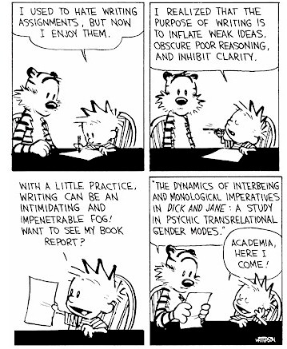
Why bother?
Good papers and talks are a fundamental part of research excellence
Fallacy
we write papers and give talks mainly to impress others, gain recognition, and get promoted

Slide 3
Papers communicate ideas
Your goal: to infect the mind of your reader with your idea, like a virus
Papers are far more durable than programs (think Mozart)
The greatest ideas are (literally) worthless if you keep them to yourself

Slide 4
Writing papers: model 1
Idea
Do research
Write paper

Slide 5

Writing papers: model 2
Idea
Do research
Write paper
Idea
Write paper
Do research
Forces us to be clear, focused
Crystallises what we don’t understand
Opens the way to dialogue with others: reality check, critique, and collaboration

Slide 6
Do not be intimidated
Fallacy You need to have a fantastic idea before you can write a paper or give a talk. (Everyone else seems to.)
Write a paper,
and give a talk, about
any idea,
no matter how weedy and insignificant it may seem to you

Slide 7
Do not be intimidated
Write a paper, and give a talk, about any idea, no matter how insignificant it may seem to you
Writing the paper is how you develop the idea in the first place
It usually turns out to be more interesting and challenging that it seemed at first

Slide 8
The purpose of your paper

Slide 9

The purpose of your paper is...
To convey
your idea
...from your head to your reader’s head
Everything serves this single goal

Slide 10
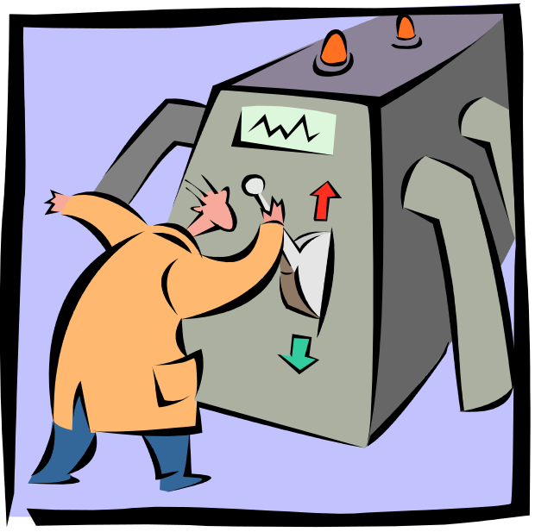
The purpose of your paper is not...
To describe the WizWoz system
Your reader does not have a WizWoz
She is primarily interested in re-usable brain-stuff, not executable artefacts

Slide 11

Conveying the idea
I wish I knew how to solve that!
Here is a problem
It’s an interesting problem
It’s an unsolved problem
Here is my idea
My idea works (details, data)
Here’s how my idea compares to other people’s approaches
I see how that works. Ingenious!

Slide 12
Structure
Abstract (4 sentences)
Introduction (1 page)
The problem (1 page)
My idea (2 pages)
The details (5 pages)
Related work (1-2 pages)
Conclusions and further work (0.5 pages)

Slide 13
The abstract
I usually write the abstract last
Used by program committee members to decide which papers to read
Four sentences [Kent Beck]
  State the problem
  Say why it’s an interesting problem
  Say what your solution achieves
  Say what follows from your solution

Slide 14
Example
Many papers are badly written and hard to understand
This is a pity, because their good ideas may go unappreciated
Following simple guidelines can dramatically improve the quality of your papers
Your work will be used more, and the feedback you get from others will in turn improve your research

Slide 15
Structure
Abstract (4 sentences)
Introduction (1 page)
The problem (1 page)
My idea (2 pages)
The details (5 pages)
Related work (1-2 pages)
Conclusions and further work (0.5 pages)

Slide 16
The introduction (1 page)
Describe the problem
State your contributions
...and that is all

Slide 17
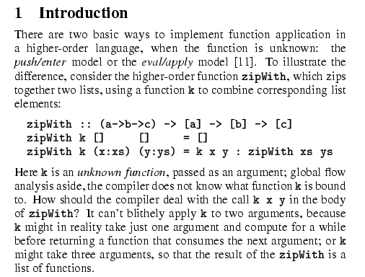
Describe the problem
Use an example to introduce the problem

Slide 18
State your contributions
Write the list of contributions first
The list of contributions drives the entire paper: the paper substantiates the claims you have made
Reader thinks “gosh, if they can really deliver this, that’s be exciting; I’d better read on”

Slide 19
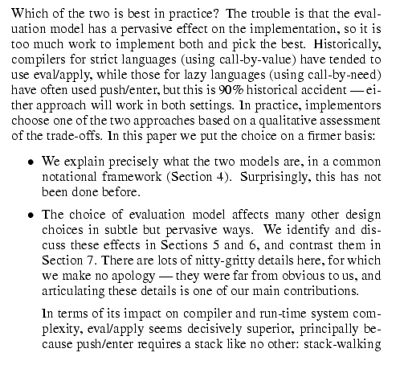
State your contributions
Bulleted list of contributions
Do not leave the reader to guess what your contributions are!

Slide 20
Contributions should be refutable
We describe the WizWoz system. It is really cool. | We give the syntax and semantics of a language that supports concurrent processes (Section 3). Its innovative features are...
We study its properties | We prove that the type system is sound, and that type checking is decidable (Section 4)
We have used WizWoz in practice | We have built a GUI toolkit in WizWoz, and used it to implement a text editor (Section 5). The result is half the length of the Java version.

Slide 21
No “rest of this paper is...”
Not:
Instead, use forward references from the narrative in the introduction.
The introduction (including the contributions) should survey the whole paper, and therefore forward reference every important part.
“The rest of this paper is structured as follows. Section 2 introduces the problem. Section 3 ... Finally, Section 8 concludes”.

Slide 22
Structure
Abstract (4 sentences)
Introduction (1 page)
The problem (1 page)
My idea (2 pages)
The details (5 pages)
Related work (1-2 pages)
Conclusions and further work (0.5 pages)

Slide 23

No related work yet!
Related work
Your reader
Your idea
We adopt the notion of transaction from Brown [1], as modified for distributed systems by White [2], using the four-phase interpolation algorithm of Green [3]. Our work differs from White in our advanced revocation protocol, which deals with the case of priority inversion as described by Yellow [4].

Slide 24
No related work yet
Problem 1: describing alternative approaches gets between the reader and your idea
Problem 2: the reader knows nothing about the problem yet; so your (carefully trimmed) description of various technical tradeoffs is absolutely incomprehensible
I feel tired
I feel stupid

Slide 25
Instead...
Concentrate single-mindedly on a narrative that
  Describes the problem, and why it is interesting
  Describes your idea
  Defends your idea, showing how it solves the problem, and filling out the details
On the way, cite relevant work in passing, but defer discussion to the end

Slide 26
The payload of your paper
Consider a bufircuated semi-lattice D, over a hyper-modulated signature S. Suppose pi is an element of D. Then we know for every such p_{i} there is an epi-modulus j, such that p_{j} < p_{i}.
Sounds impressive...but
Sends readers to sleep
In a paper you MUST provide the details,
but FIRST convey the idea

Slide 27
The payload of your paper
Introduce the problem, and your idea, using
EXAMPLES
and only then present the general case

Slide 28
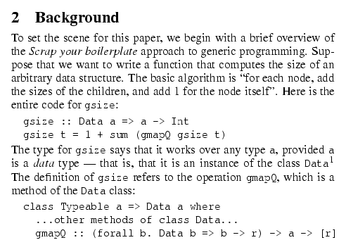
Using examples
The Simon PJ question: is there any typewriter font?
Example right away

Slide 29
Conveying the idea
Explain it as if you were speaking to someone using a whiteboard
Conveying the intuition is primary, not secondary
Once your reader has the intuition, she can follow the details (but not vice versa)
Even if she skips the details, she still takes away something valuable

Slide 30
Evidence
Your introduction makes claims
The body of the paper provides evidence to support each claim
Check each claim in the introduction, identify the evidence, and forward-reference it from the claim
Evidence can be: analysis and comparison, theorems, measurements, case studies

Slide 31
Structure
Abstract (4 sentences)
Introduction (1 page)
The problem (1 page)
My idea (2 pages)
The details (5 pages)
Related work (1-2 pages)
Conclusions and further work (0.5 pages)

Slide 32
Related work
Fallacy To make my work look good, I have to make other people’s work look bad

Slide 33
The truth: credit is not like money
Giving credit to others does not diminish the credit you get from your paper
Warmly acknowledge people who have helped you
Be generous to the competition. “In his inspiring paper [Foo98] Foogle shows.... We develop his foundation in the following ways...”
Acknowledge weaknesses in your approach

Slide 34
Credit is not like money
Failing to give credit to others can kill your paper
If you imply that an idea is yours, and the referee knows it is not, then either
  You don’t know that it’s an old idea (bad)
  You do know, but are pretending it’s yours (very bad)

Slide 35
Making sure related work is accurate
A good plan: when you think you are done, send the draft to the competition saying “could you help me ensure that I describe your work fairly?”.
Often they will respond with helpful critique
They are likely to be your referees anyway, so getting their comments up front is jolly good.

Slide 36
The process
Start early. Very early.
  Hastily-written papers get rejected.
  Papers are like wine: they need time to mature
Collaborate
Use CVS to support collaboration

Slide 37
Getting help
Get your paper read by as many friendly guinea pigs as possible
Experts are good
Non-experts are also very good
Each reader can only read your paper for the first time once! So use them carefully
Explain carefully what you want (“I got lost here” is much more important than “wibble is mis-spelt”.)

Slide 38
Listening to your reviewers
Every review is gold dust
Be (truly) grateful for criticism as well as praise
This is really, really, really hard
But it’s really, really, really, really, really, really important

Slide 39
Listening to your reviewers
Read every criticism as a positive suggestion for something you could explain more clearly
DO NOT respond “you stupid person, I meant X”. Fix the paper so that X is apparent even to the stupidest reader.
Thank them warmly. They have given up their time for you.

Slide 40
Language and style

Slide 41
Basic stuff
Submit by the deadline
Keep to the length restrictions
  Do not narrow the margins
  Do not use 6pt font
  On occasion, supply supporting evidence (e.g. experimental data, or a written-out proof) in an appendix
Always use a spell checker

Slide 42
Visual structure
Give strong visual structure to your paper using
  sections and sub-sections
  bullets
  italics
  laid-out code
Find out how to draw pictures, and use them

Slide 43
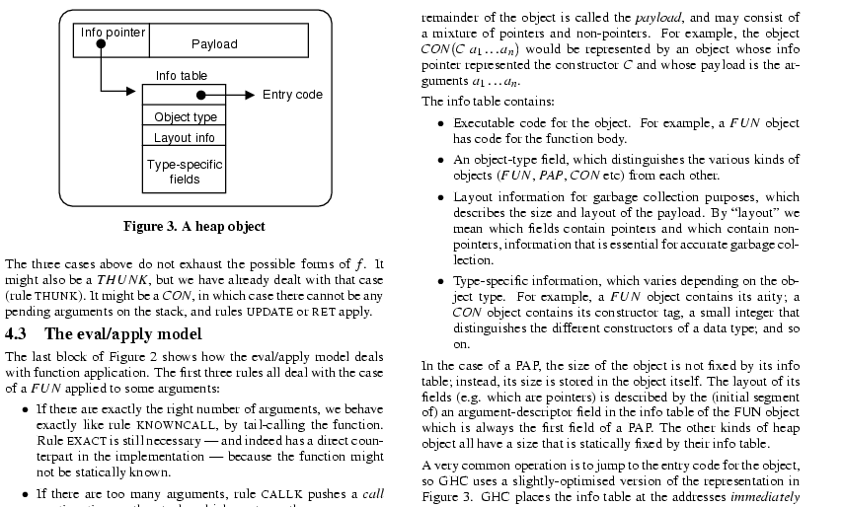
Visual structure

Slide 44
Use the active voice
The passive voice is “respectable” but it DEADENS your paper. Avoid it at all costs.
“We” = you and the reader
NO | YES
It can be seen that... | We can see that...
34 tests were run | We ran 34 tests
These properties were thought desirable | We wanted to retain these properties
It might be thought that this would be a type error | You might think this would be a type error
“We” = the authors
“You” = the reader

Slide 45
Use simple, direct language
NO | YES
The object under study was displaced horizontally | The ball moved sideways
On an annual basis | Yearly
Endeavour to ascertain | Find out
It could be considered that the speed of storage reclamation left something to be desired | The garbage collector was really slow

Slide 46
Summary
If you remember nothing else:
Identify your key idea
Make your contributions explicit
Use examples
A good starting point:
“Advice on Research and Writing”
http://www-2.cs.cmu.edu/afs/cs.cmu.edu/user/
mleone/web/how-to.html

