Slide 1



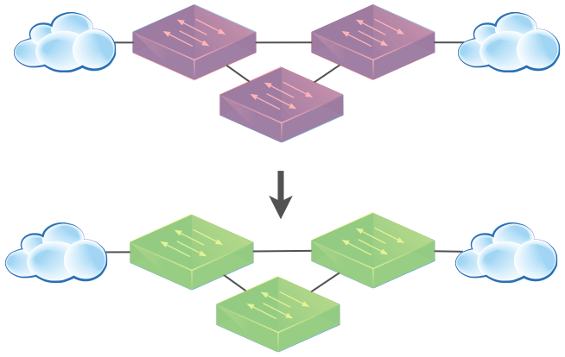
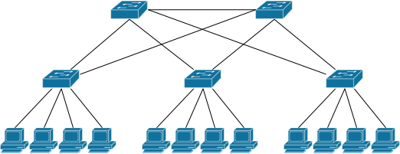
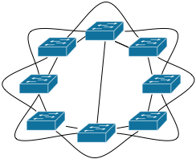
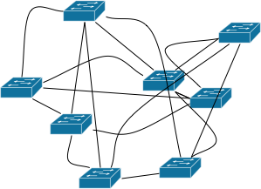
Abstractions for Network Update
Nate Foster
Mark Reitblatt
Jen Rexford
Cole Schlesinger
Dave Walker
Notes:
Hi. This talk is about how to perform configuration changes in a running network. There are two things you should take-away from this talk. First, when you perform updates, you should use a network update abstraction. By this I mean a tool that will implement the update while providing you with a semantic guarantee about how your will behave during the update. The second take-away is that you should use an update abstraction with strong semantics like the ones I'll present later.

Slide 2
Take-away
Use a network update abstraction
Specifically, the per-packet consistency abstraction

Slide 3


Updates Happen
Network Updates
Maintenance
Failures
ACL Updates
Desired Invariants
No black-holes
No loops
No security violations
Notes:
Updates are a fact of life for network administrators. Configuration changes happen whenever an administrator brings device down for maintenance, performs traffic engineering, or does essentially anything on the network.

Slide 4
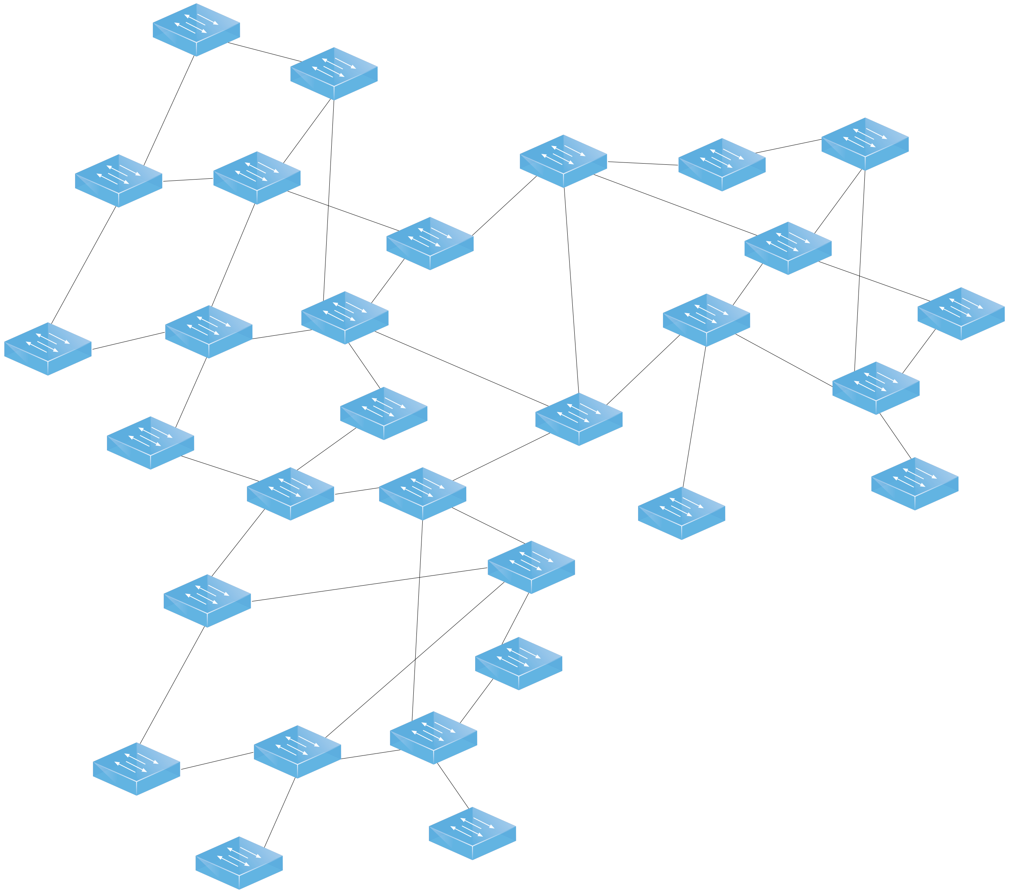
Network Updates Are Hard
Notes:
Unfortunately, performing updates is quite tricky. Networks are large distributed systems and completing an update can take some time. Changes on one part of the network can begin affecting traffic before the full update has been rolled out, introducing forwarding loops, blackholes or worse.

Slide 5
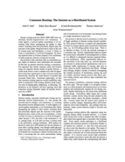

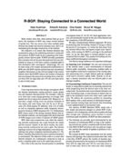

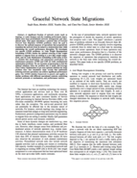
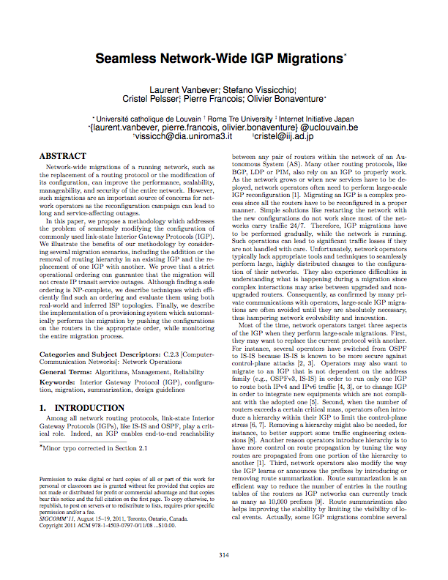
Prior Work
Consensus Routing
Consensus Routing
Reliable BGP
Consensus Routing
Reliable BGP
Consensus Routing
Reliable BGP
Reliable BGP
Graceful Migration
Seamless Migration
Graceful Migration
Seamless Migration
Graceful Migration
Seamless Migration
Graceful Migration
Seamless Migration

Slide 6

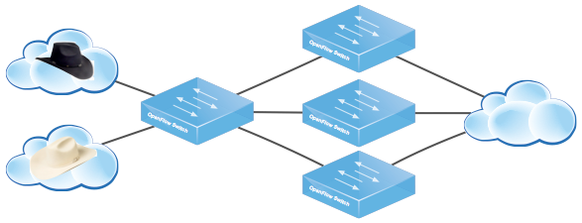
Network Update Abstractions
Goal
Tools for whole network update
Our Approach
Develop update abstractions
Endow them with strong semantics
Engineer efficient implementations
Notes:
Instead of having network administrators sit down and work out how to perform an update rule by rule, switch by switch, we instead propose they should use a simple abstraction that updates the entire network in one fell swoop. The abstraction will provide powerful, reasonable semantics that allow administrators to understand how the network will behave during update, and leave the exact implementation details to a runtime that figures out the most efficient way to perform the actual update.

Slide 7
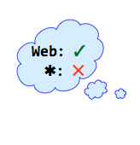
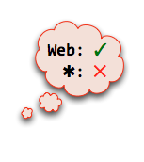
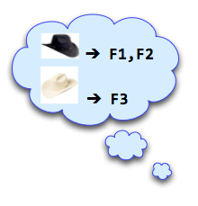
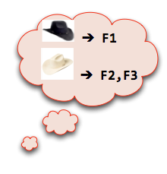
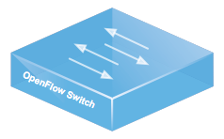
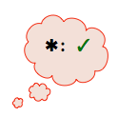



Example: Distributed Access Control
Security Policy
Src | Traffic | Action
 | Web | Allow
 | Non-web | Drop
 | Any | Allow
F1
I
F2
F3
Traffic

Slide 8


Naive Update
Security Policy
Src | Traffic | Action
 | Web | Allow
 | Non-web | Drop
 | Any | Allow
F1
I
F2
Order
F1
F2
F3
I
F3
Traffic

Slide 9

Use an Abstraction!
Security Policy
✓
UPDATE
✓
✓

Slide 10
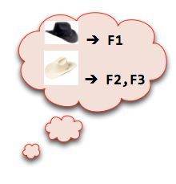
Atomic Update?
Security Policy
Src | Traffic | Action
 | Web | Allow
 | Non-web | Drop
 | Any | Allow
F1
I
F2
F3
Traffic
Notes:
“As-if all the switches moved to the new configuration at the same time” Atomic Updates lead to Nuclear explosions

Slide 11
Per-Packet Consistent Updates
Per-Packet Consistent Update
Each packet processed with old or new configuration, but not a mixture of the two.
Security Policy
Obeys policy:
Src | Traffic | Action
 | Web | Allow
 | Non-web | Drop
 | Any | Allow
Obeys policy:

Slide 12
Universal Property Preservation
Theorem: Per-packet consistent updates preserve all trace properties.
Trace Property
Any property of a single packet’s path through the network.
Examples of Trace Properties:
Loop freedom, access control, waypointing ...
Trace Property Verification Tools:
Anteater , Header Space Analysis, ConfigChecker ...
Notes:
Emphasize universal guarantee: programmers don’t need to write down specific properties or specifications. ANY path property is preserved, without having to tell us what property you want “As it turns out”

Slide 13
Formal Verification
Corollary: To check an invariant, verify the old and new configurations.
Security Policy
Analyzer
Security Policy
Analyzer
✓
✓
Verification Tools
Anteater [SIGCOMM ’11]
Header Space Analysis [NSDI ’12]
ConfigChecker [ICNP ’09]

Slide 14
MechanismS

Slide 15
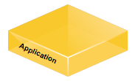

2-Phase Update
Overview
Runtime instruments configurations
Edge rules stamp packets with version
Forwarding rules match on version
Algorithm (2-Phase Update)
Install new rules on internal switches, leave old configuration in place
Install edge rules that stamp with the new version number
update(config,topo)
Calculate rules,
generate messsages
Notes:
The natural question is: when can we perform a per-packet update? Is it always possible?
It turns out the answer is yes: we can always perform a per-packet update between configurations. There is a general mechanism, the 2-phase update mechanism, that always works, regardless of the configuration or topology.
The mechanism works by instrumenting the entire network configuration with version numbers. The rules are then predicated upon a packet having a specific version number.
To perform the update, first install the new configuration rules on the internal switches. Then, install rules on the edge switches that stamp incoming packets with the new version. Then, when all the old version packets are gone, delete the old configuration.

Slide 16
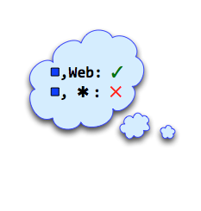
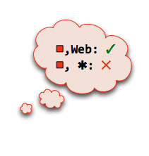
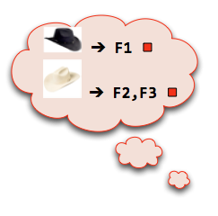
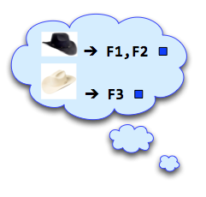
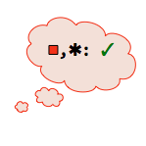
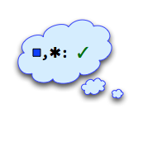
2-Phase Update in Action
F1
I
F2
F3
Traffic

Slide 17

Optimized Mechanisms
Optimizations
Extension: strictly adds paths
Retraction: strictly removes paths
Subset: affects small # of paths
Topological: affects small # of switches
Runtime
Automatically optimizes
Power of using abstraction
update(config,topo)
Calculate rules,
generate messsages
Notes:
Pronounce optimizations and explain that they reduce overhead in common situations

Slide 18
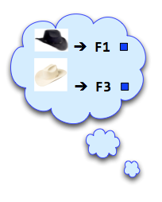
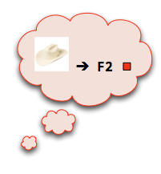
Subset Optimization
F1
I
F2
F3
Traffic
Notes:
To make all of this concrete, lets consider the simple network here. It has 4 switches: an ingress switch on the left and 3 switches in the middle that perform filtering. Traffic flows from left to right and it’s connected to two external networks: a trusted white-hat network and an untrusted black-hat network. The network has a security policy that allows trusted white-hat traffic unrestricted access to the internal network on the right, and restricts the untrusted black-hat network to only send web traffic.
Note: Make example completely graphical (add ingress routing), remove text configurations

Slide 19
Correctness
Question: How do we convince ourselves these mechanisms are correct?
Solution: We built an operational semantics, formalized our mechanisms and proved them correct
Example: 2-Phase Update
Install new rules on internal switches, leave old configuration in place
Install edge rules that stamp with the new version number
}
Unobservable
}
One-touch
Theorem: Unobservable + one-touch = per-packet.
Notes:
To answer this question, we used a common technique from the PL community and built a formal model...
Maybe Q, Solution, Insight

Slide 20
Implementation
&
Evaluation

Slide 21
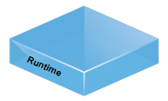

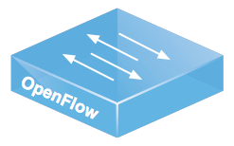
Implementation
Runtime
  NOX Library
  OpenFlow 1.0
  2.5k lines of Python
  update(config, topology)
  Uses VLAN tags for versions
  Automatically applies optimizations
Verification Tool
  Checks OpenFlow configurations
  CTL specification language
  Uses NuSMV model checker
update(config,topo)
Notes:
Make other boxes more transparent/gray out

Slide 22
Evaluation
Question: How much extra rule space is required?
Setup
  Mininet VM
Applications
  Routing and Multicast
Scenarios
  Adding/removing hosts
  Adding/removing links
  Both at the same time
Topologies
Fattree
Small-world
Waxman
Notes:
Thought: are these useful opts in practice? Ran simulations to test. Make set-up graphical, illustrate topos + set-up structure etc

Slide 23
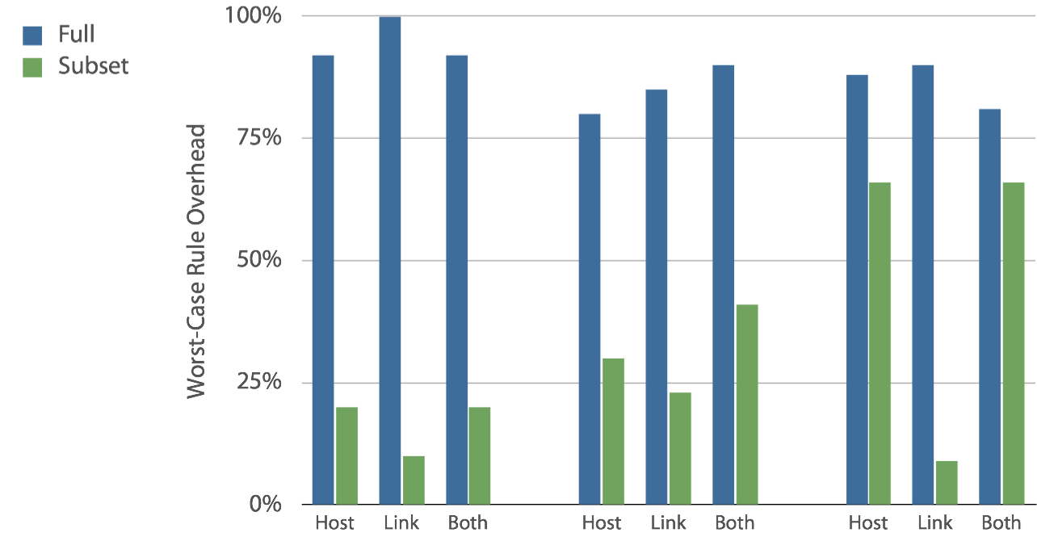
Results: Routing Application
Fattree
Small-world
Waxman

Slide 24
WRAP UP

Slide 25
Conclusion
Update abstractions
  Per-packet
  Per-flow
Mechanisms
  2-Phase Update
  Optimizations
Implementation
  Runtime
  Verifier
Formal model
  Network operational semantics
  Universal property preservation
Notes:
Without an update abstraction, you have two choices: either work very hard to figure out how to implement your update to preserve the properties you care about, or just throw your update at the network and hope it will work. With an update abstraction, you can just throw your update at the runtime and know it will work.

Slide 26

Thank You!
Collaborators
Shrutarshi Basu (Cornell)
Arjun Guha (Cornell)
Stephen Gutz (Cornell)
Rob Harrison (West Point)
Nanxi Kang (Princeton)
Naga Praveen Katta (Princeton)
Chris Monsanto (Princeton)
Josh Reich (Princeton)
Cole Schlesinger (Princeton)
Robert Soulé (Cornell)
Alec Story (Cornell)
Nate Foster (Cornell)
Mike Freedman (Princeton)
Jen Rexford (Princeton)
Emin Gün Sirer (Cornell)
Dave Walker (Princeton)
http://frenetic-lang.org

Slide 27
Backup Slides

Slide 28

Beyond Per-Packet
Per-flow consistent updateEach set of related packets processed with old or new configuration, but not a mixture of the two.
Use Cases
Load balancer
Flow affinity
In-order delivery
Mechanism
2-Phase Update + “flow tracking”
Notes:
Transition: we’ve been focusing on per-packet, you might wonder if this always suffices
We’ve also identified a stronger notion that we call per-flow consistency. This enriches per-packet consistency from one that applies to single packets to one that applies to sets of packets...

