Slide 1
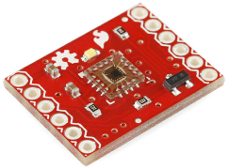
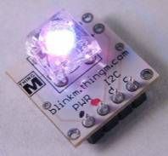
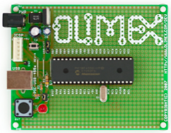
Fiber
PWM
PWM
RC Filter
RC Filter
RC Filter
Color
Sensor
BlinkM
I2C
Analog
µC
µC
ADC
ADC
ADC
RS232
PC
RS232
PC

