Slide 1
Android studio workshop
Get started by forming a group of 5 and having one person download Android Studio: https://developer.android.com/studio
Feel free to grab some snacks while we wait for everyone to come in!
Start time 3:05 pm

Slide 2
Today’s workshop goals & topics
(20 to 30 mins)
Learn why / how to become an Android developer, industry overview, sample internship / new grad job listings.
Average salary $90,928, Average starting Salary $72,447. According to five salary-reporting websites, an Android developer makes an average base salary of $90,928 to $127,151 yearly in the United States.
Overview of the layout & mechanics / vocabulary of an android app
Fundamentals of Kotlin programming language
What an app looks like, programmatically-- Files, how not to feel overwhelmed by the app making process.
How the files can all connect together to make an app project.
Open Q&A and snacking throughout.
(30 to 40 mins)
Start to make an example app together in the workshop, that you can add to your resume when seeking internships. Please form teams of 5. :D

Slide 3
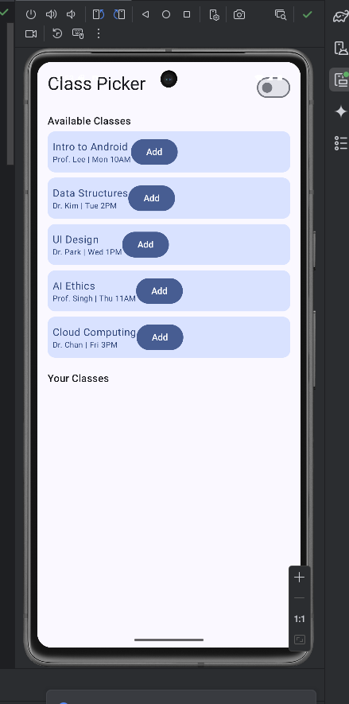
FAQ
How does android differ from iPhone? Tooling, Android Studio.
What if I don’t have an android phone? Device emulation!
What programing language does android use? Kotlin.
What is Kotlin? Java with some small differences!

Slide 4
Android overview
Key Terms
Why work with android?
Supply and demand.
Demand:
Most companies these days, whether it’s fast food, grocery stores, movie theaters, and more, have a mobile app already or would benefit from creating one.
The .com era, while having elements of an economic ‘bubble’ saw long term explosive growth in wealth and businesses’ ability to make money. Much of the entire world’s economy is underpinned by the United States’ ‘Mag 6’ (Apple, Nividia, Amazon, Microsoft, Google, Netflix)
The app era is still growing and expanding, and to put it simply every company needs an app that works on both platforms. (IOS and Android)
Supply:
Android development skills are specialized, using Kotlin, which is not quite like anything else; but which does build on Java, which you might be comfortable with via our coursework. Leading to strong fundamental job security and growth.
SDK (Software Development Kit)—Fundamental set of libraries to make an android app.
Jetpack — Fundamental set of libraries built ontop of the SDK. Can control everything from UI with Jetpack Compose, (Today’s focus) to liveData, StateFlow, ViewModel, DataStore, notifications, camera, and permissions.
Kotlin — Programming language, used within the IDE, Android studio to make Apps.

Slide 5
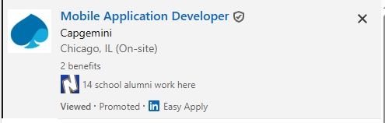

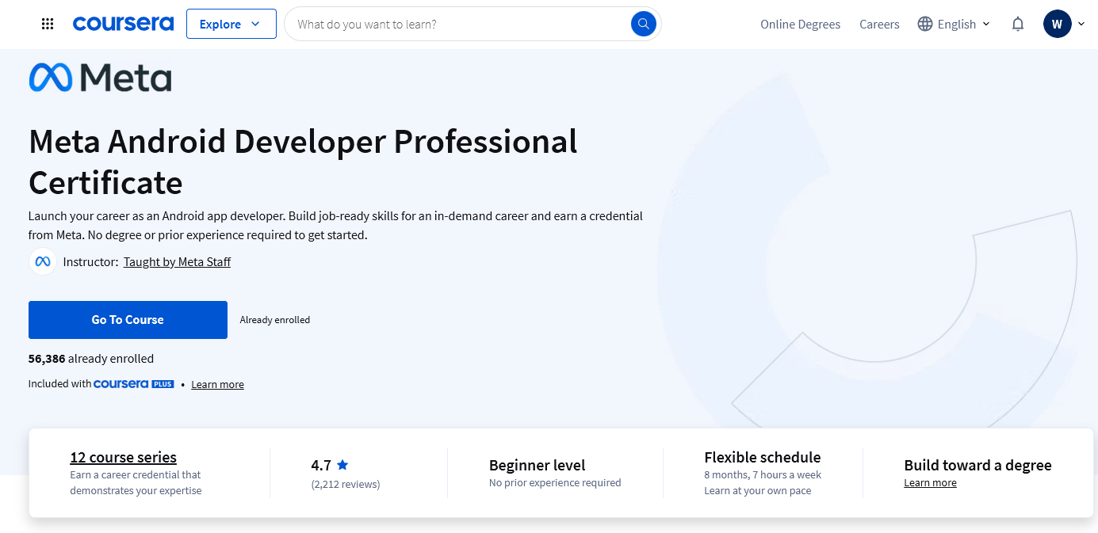
Job listings and notable learning resources to get there

Slide 6

What is Kotlin?
Kotlin is a very modern programming language in terms of it’s creation and features. Having been made by Jetbrains (the creators of PyCharm and intelJ) in 2016.
Key Features
Kotlin compiles using the JVM (Java Virtual Machine) and shares many things in common with Java. In fact they are interoperable– Which means they can blend together seamlessly in the same app or project, and both languages can call one another at will.
Type inference
Reduced Boiler plate
Semi colons are optional
Functions can be variables, which is very unique and opens a lot of possibilities.
-Kodee
Kotlin’s official mascot

Slide 7
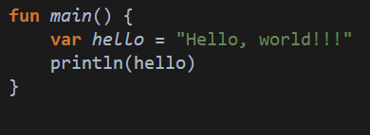
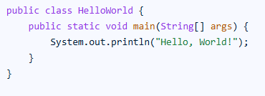
Kotlin VS Java
Hello World
Kotlin
Java
????
Made primarily of functions (fun)
Typing your variables is inferred. String type is inferred.
var hello: String = "Hello, world!!!" to statically type the variable as a String, Instead– if you want.
Semi Colons optional. Line breaks are significant
Variables must have specific data type ie
String hello = “Hello, world.”
Semicolons everywhere.
Worst boiler plate of almost any language.

Slide 8
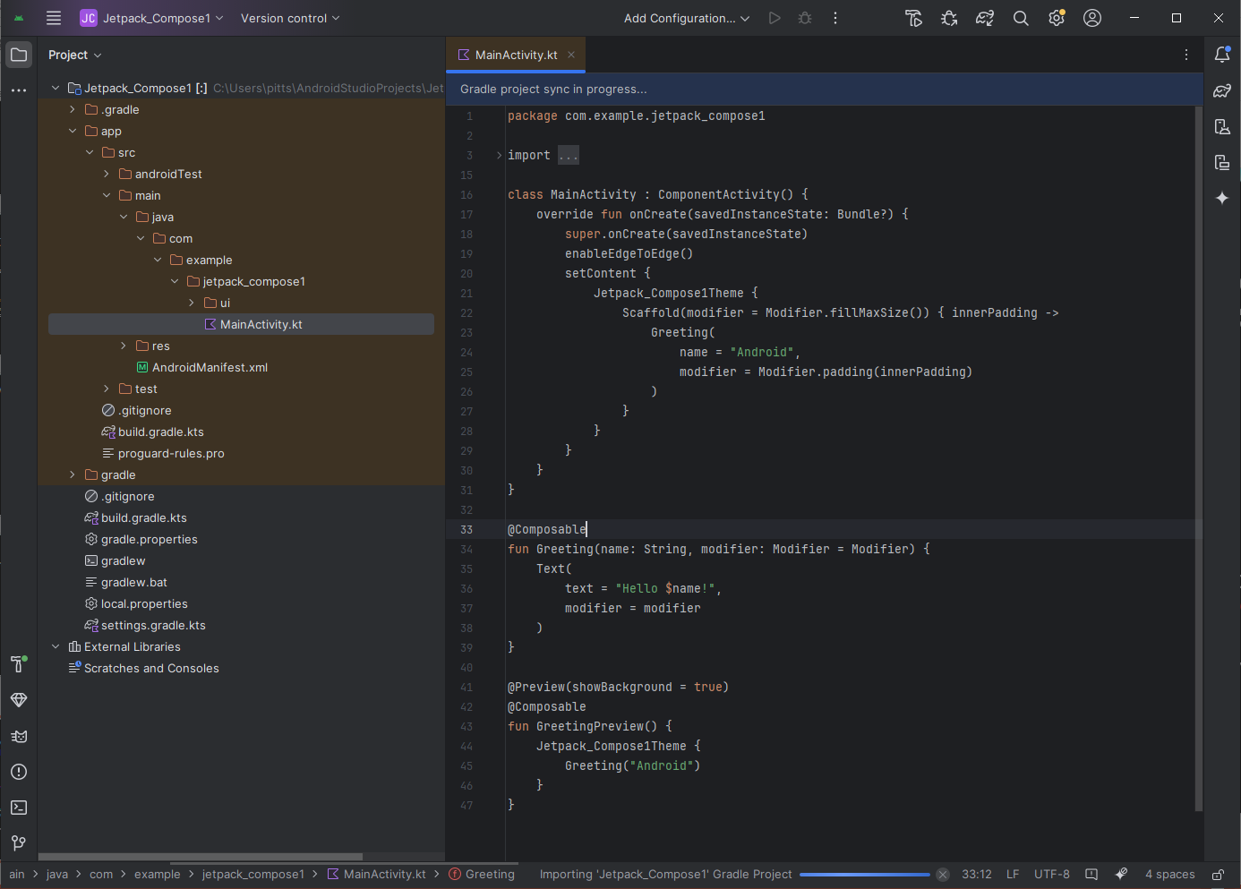
What is an app project and why does it look so complicated? ☹
What is this black magic?
Are you trying to summon a demon to murder us?
Students at UIC, Loyola, University of Chicago, and Northwestern eat this for breakfast and are competing with YOU for the same jobs.
Despite that, we aren’t going to back down, give up, nor surrender. Many of us are first generation, non-traditional students, working full time while doing classes. That is a feat of strength and ingenuity, not a weakness.
Focus on key files in our target language, .kt , ignore the noise. We’re here to only work on a few files, most of the files on the screen are configuration files that we rarely need to touch.

Slide 9
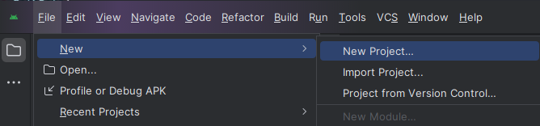
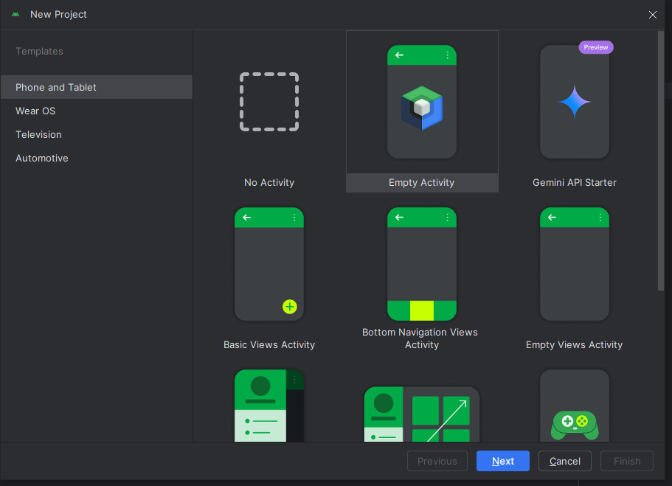
Let’s jam
Step 1. Start a new project
Next we need to touch up a few config files, to allow us to make a viewmodel.

Slide 10
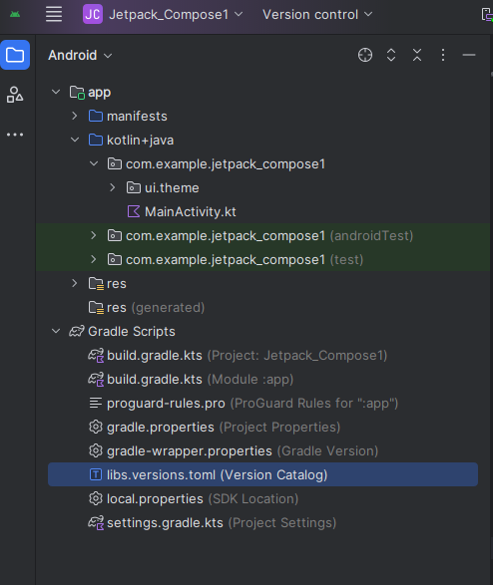
Step 2
Replace this with the one from the Github

Slide 11
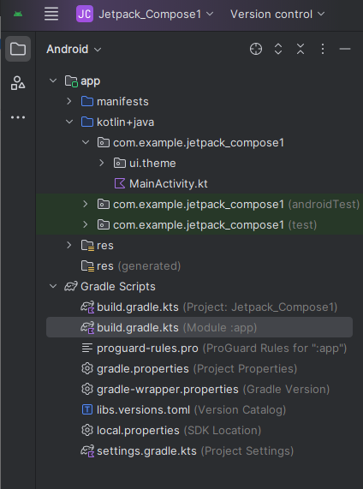
Step 3
Replace this with the one from the Github

Slide 12
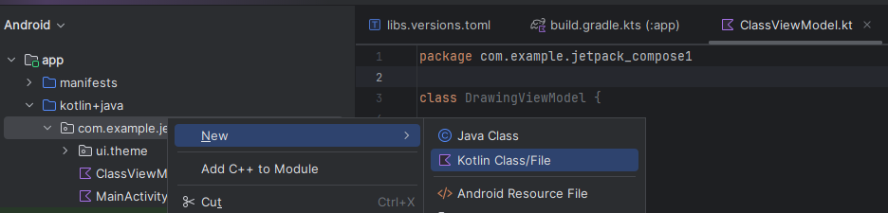
Step 4
Make a new file here—
ClassViewModel.kt

Slide 13
We have now have two files to work with:
ClassViewModel.kt is the back end.
Mainactivity.kt is the front end.
That’s all, don’t worry about other files again.
Tips!: use ‘import object’ feature to import easily Use autocomplete (Tab key) to help you type

