Slide 1
Lending Club Case Study
Presented By:
Vivek Singh
Rejeesh Sathyavrathan
Batch: ML C45

Slide 2
Problem Statement
Lending Club is a marketplace for personal loans that matches borrowers who are seeking a loan with investors looking to lend money and make a return.
When the company receives a loan application, the company has to make a decision for loan approval based on the applicant’s profile. Two types of risks are associated with the bank’s decision:
If the applicant is likely to repay the loan, then not approving the loan results in a loss of business to the company
If the applicant is not likely to repay the loan, i.e., he/she is likely to default, then approving the loan may lead to a financial loss for the company
Company wants to understand the driving factors (or driver variables) behind loan default, i.e., the variables which are strong indicators of default. The company can utilize this knowledge for its portfolio and risk assessment.

Slide 3
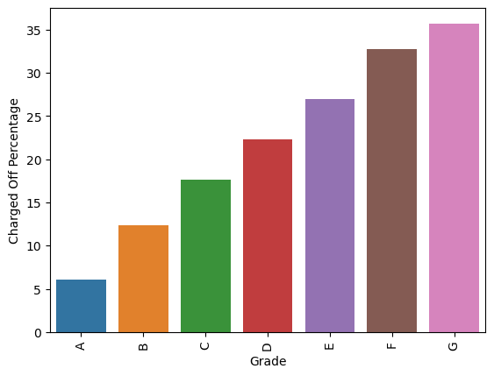
Grade
Loans with Grades D, E, F, G are Charged off for more than 20%.

Slide 4
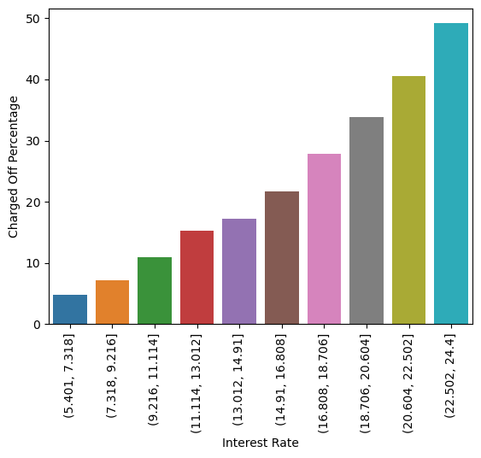
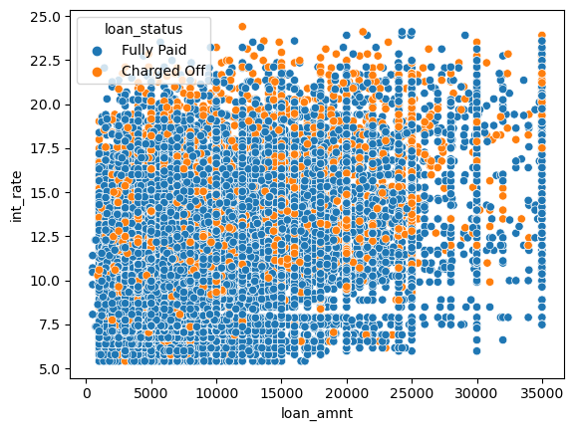
Interest Rate
Loans with interest rate higher than 14.91 will Charged Off more than 20 %.
Scatter plot between int rate and loan amount, we can observe that the number of defaulters increases as interest rate increases, irrespective of the loan amount.
People pay off loans on time when interest and loan amount are low.

Slide 5
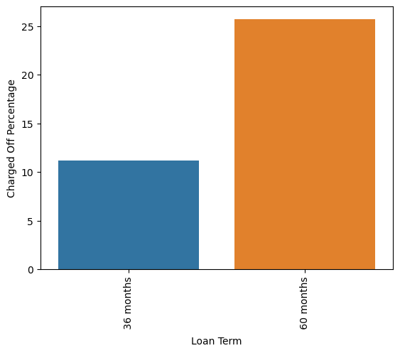
Loan Term
Loans with Loan Term '60 months’ has more than 25% chance to be Charged Off.

Slide 6
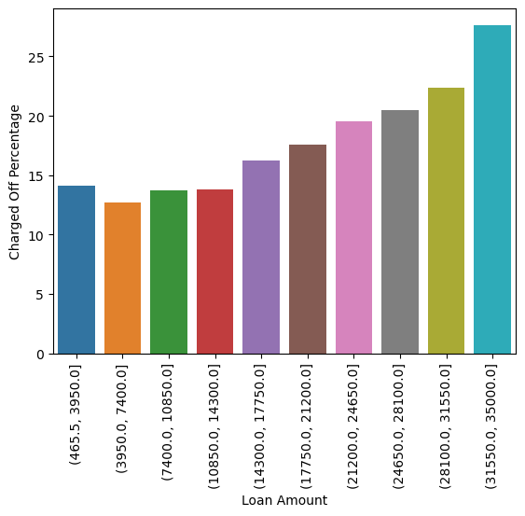
Loan Amount
Possibility of loan being Charged Off increases as the loan amount goes high.
Loan amounts above 24,650 has more than 20% chance to be Charged Off

Slide 7
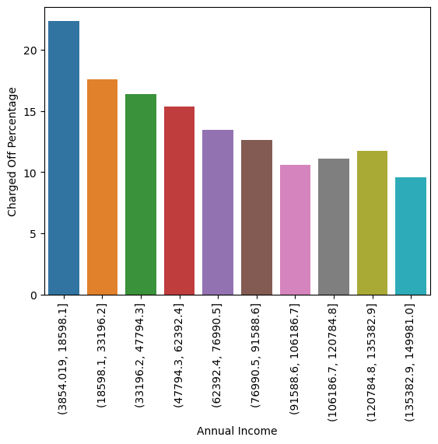
Annual Income
Loan applicants with Annual Income less than 3854 has more than 20% chance of becoming Charged Off.

Slide 8
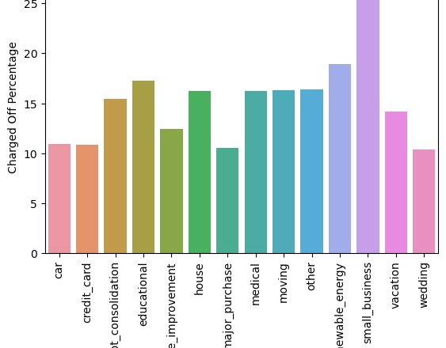
Purpose
Loans for the purpose of Small Business will Charged off more than 20%.

Slide 9
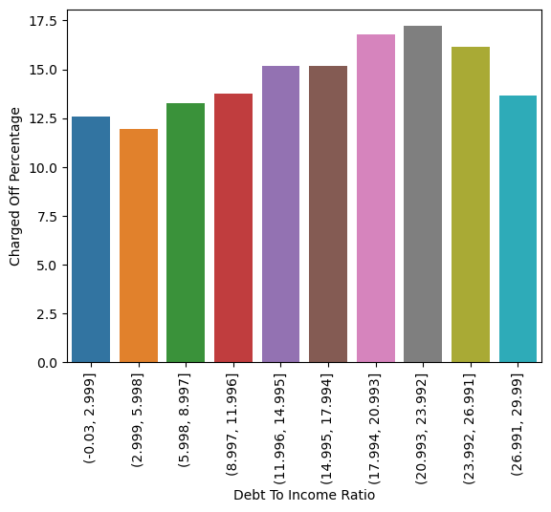
Debt To Income Ratio(dti)
As the dti ratio goes up, percentage of Charged Off loans also increases.

Slide 10
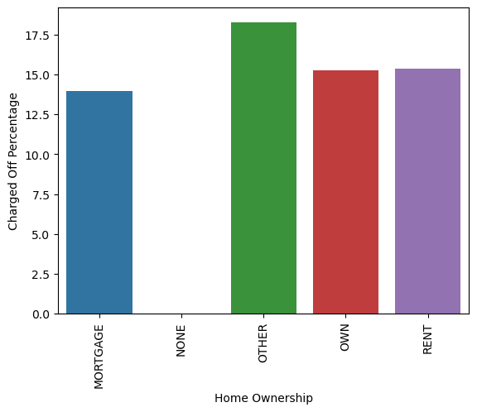
Home Ownership
Chances of Charged off is slightly higher when Home Ownership falls in 'Other’ category.

Slide 11
Recommendations
Major considerations to reduce number of Charged Off loans are
Avoid loans with Grade D, E, F, G.
Avoid when interest rate is more than 14.9.
Prefer loans with 30 months as term.
Avoid loans with amount more than 24,650
Avoid loans when applicant has an annual income less than 3854

