Slide 1
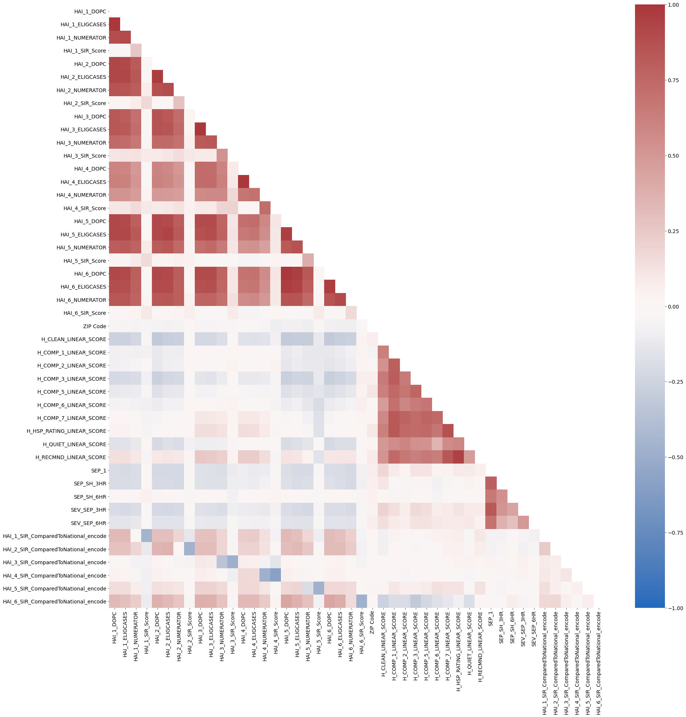
Healthcare Associated Infections
MRSA (Target)
Survey
Sepsis care
MRSA (Target)
Sepsis care
Healthcare Associated Infections
Survey

