Slide 1
Electronics
Torso Stabiliser Prototype

Slide 2
4 PCB boards
Existing boards
Custom board
Adafruit ESP32 S3-Feather TFT https://learn.adafruit.com/adafruit-esp32-s3-tft-feather/overview
Adafruit LSM6DSOX+LIS3MDL FeatherWing https://www.adafruit.com/product/4565
DFROBOT DFR0564 (7.4V battery charger) https://uk.farnell.com/dfrobot/dfr0564/usb-charger-board-lipo-battery/dp/3879649
https://wiki.dfrobot.com/USB_Charger_for_7.4V_LiPo_Battery_SKU__DFR0564
Voltage regulator VBAT –> +3.7V (Power for Adafruit ESP32-S3)
STSPIN250 to drive solenoid
Battery connector (JST connector)
ESP32 board power connector (soldered)
Solenoid connector 2x (JST 2 pins)

Slide 3
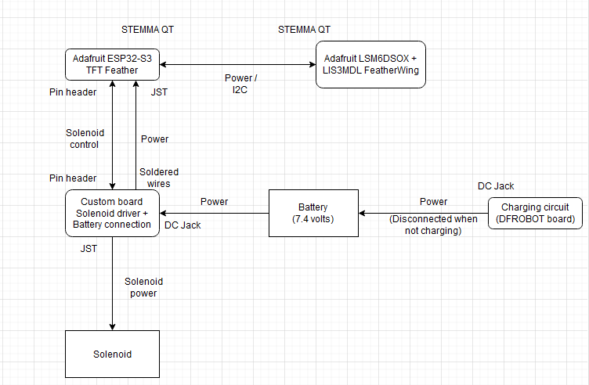
Electronics main
Can I let the charging circuit connected all the time?
Would need to split the battery wires into two
-> All good

Slide 4
Battery
Solenoid needs 6V and around 900mA to be driven
Use a 7.4V battery: https://uk.rs-online.com/web/p/rechargeable-battery-packs/1449410?cm_mmc=UK-PLA-DS3A-_-google-_-CSS_UK_EN_PMAX_RS+PRO-_--_-1449410&matchtype=&&gad_source=1&gclid=CjwKCAiA98WrBhAYEiwA2WvhOs6-wUJgJwwETTHcqYAVZaAaic-IthWP80fDwqkevUuxdFFfgoHDdxoCNg8QAvD_BwE&gclsrc=aw.ds
If we want to use two solenoids, we need to provide 2A -> ok with STSPIN250
Note: charged via an existing board (just solder the battery wires on it)? https://uk.farnell.com/pro-power/ppw01008/2-1mm-dc-plug-lockable/dp/3383697

Slide 5
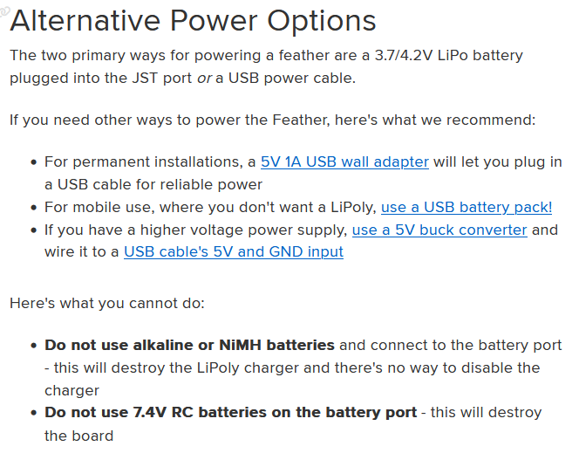
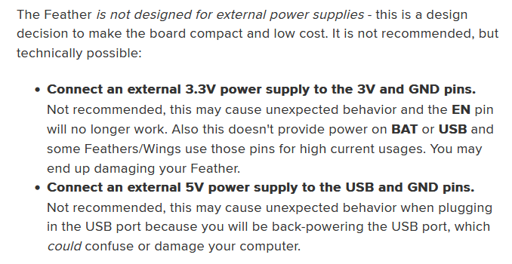
How to power Adafruit ESP32-S3 Feather TFT
Source: https://learn.adafruit.com/adafruit-esp32-s3-tft-feather/power-management
Voltage regulator 7.2V -> 3.7V on the custom board and use two wires (soldered on custom board, JST on Adafruit board)

Slide 6
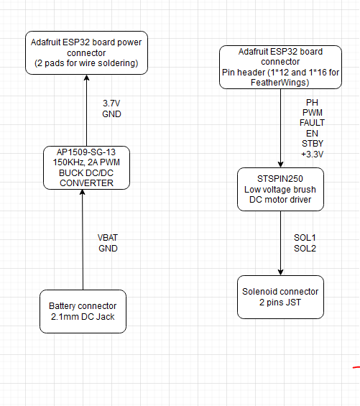
Custom board – Idea 3 (No charging circuit)
Ok to solder the pads?
-> Yes
https://www.lcsc.com/product-detail/DC-DC-Converters_Diodes-Incorporated-AP1509-SG-13_C151822.html
https://www.lcsc.com/product-detail/Motor-Driver-ICs_STMicroelectronics-STSPIN250_C155561.html
https://www.lcsc.com/product-detail/DC-DC-Converters_HGSEMI-AP1509-5-0M-TR_C360642.html
https://www.lcsc.com/product-detail/Wire-To-Board-Wire-To-Wire-Connector_JST-S2B-PH-SM4-TB-LF-SN_C295747.html
https://www.lcsc.com/product-detail/AC-DC-Power-Connectors_GANGYUAN-DC-470-2-1GP_C194407.html

Slide 7
STSPIN250 - Pinout
No | Name | Type | Function | Connection | Notes
1 | PH | Logic input | Phase input | Pin header PH
2 | PWM | Logic input | PWM input | Pin header PWM
3 | OUTA1 | Power output | Power bridge | OUTB1, Solenoid con.
4 | SENSEA | Power output | Sense output A | SENSEB | R(SNS) = 330mΩ
5 | OUTA2 | Power output | Power bridge | OUTB2, Solenoid con.
6 | GND | Ground | Device ground
7 | VS | Supply | Device supply voltage | +3.3V | C(s) = 2.2uF, C(SPOL) = 22 uF
8 | OUTB2 | Power output | Power bridge | OUTA2, Solenoid con
9 | SENSEB | Power output | Sense output B | SENSEA | R(SNS) = 300mΩ
10 | OUTB1 | Power output | Power bridge | OUTA1, Solenoid con
11 | REF | Analog input | Reference voltage for current limiter | Voltage divider | R1 = 40k, R2=10k, C = 10nF
12 | TOFF | Analog input | OFF time adjustment | 2 R and 1 C circuit | C(RCOFF) = 22nF, R(RCOFF) = 1k, R(OFF) = 47k
13 | EN\FAULT | Logic input | Power stage enable | Pin header EN | R(EN) = 18k, C(EN) = 10nF
14 | STBY\RESET | Logic input | Low consumption mode | Pin header STBY | R(EN) = 18k, C(EN) = 1nF
15 | TEST0 | - | Reserved pin | GND
16 | TEST1 | - | Reserved pin | GND

Slide 8
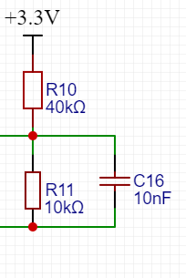
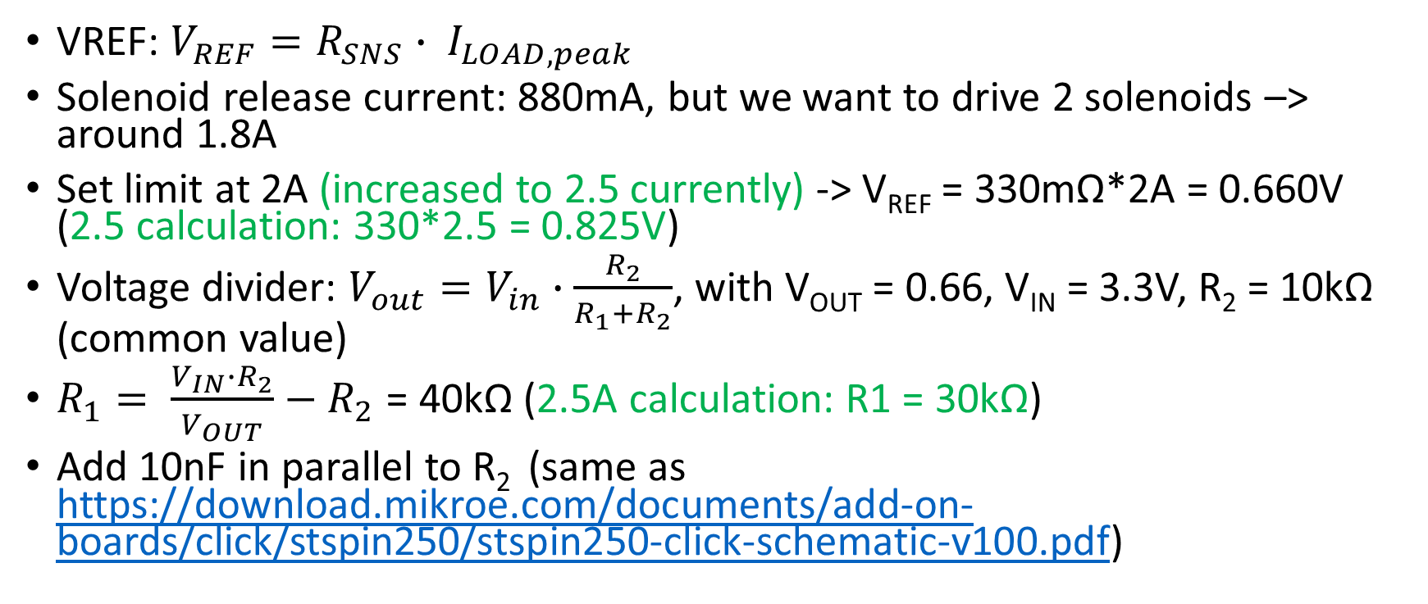
STSPIN250 - VREF
VREF: $V_{REF}=R_{SNS}∙ I_{LOAD,peak}$
Solenoid release current: 880mA, but we want to drive 2 solenoids –> around 1.8A
Set limit at 2A (increased to 2.5 currently) -> V_{REF} = 330mΩ*2A = 0.660V (2.5 calculation: 330*2.5 = 0.825V)
Voltage divider: $V_{out}=V_{in}∙\frac{R_{2}}{R_{1}+R_{2}}$, with V_{OUT} = 0.66, V_{IN} = 3.3V, R₂ = 10kΩ (common value)
$R_{1}= \frac{V_{IN}∙R_{2}}{V_{OUT}}−R_{2}$ = 40kΩ (2.5A calculation: R1 = 30kΩ)
Add 10nF in parallel to R₂ (same as https://download.mikroe.com/documents/add-on-boards/click/stspin250/stspin250-click-schematic-v100.pdf)

Slide 9
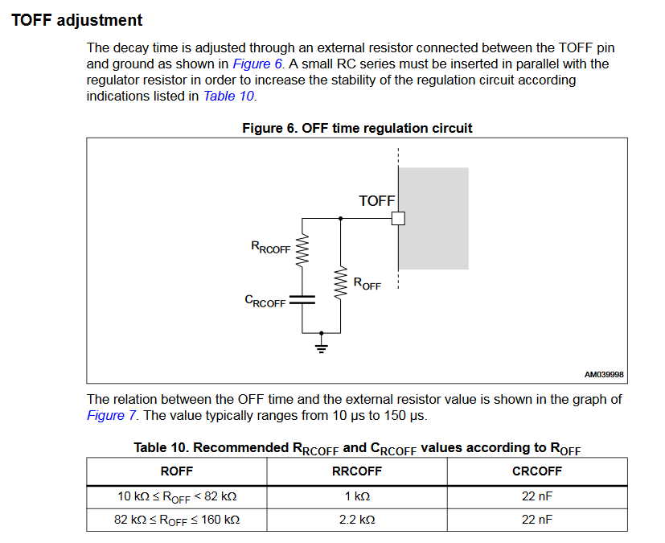
STSPIN250 - TOFF
Same as example circuit
R(RCOFF) = 1k
R(OFF) = 47k
C(RCOFF) = 22nF

Slide 10
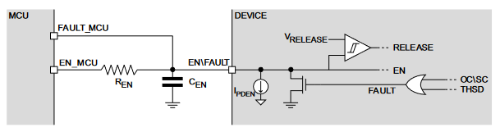
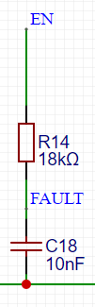
STSPIN250 – EN\FAULT
Fault for interrupt in MCU in case of problem (forced at low)
Keep EN high to enable
Both connected to ESP32 via pin header

Slide 11
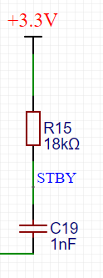

STSPIN250 – STBY\RESET
Forced high by a pull-up resistor

Slide 12
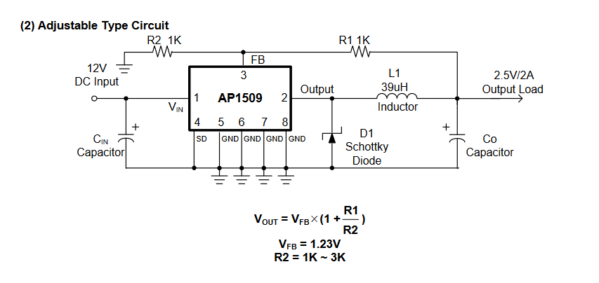
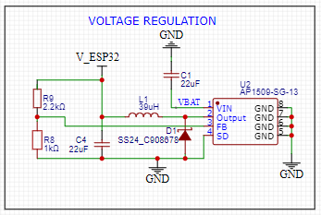
AP1509 – Adjustable version
Schottky Diode which spec? -> estimate the current, otherwise take 2-3A and we should be fine https://www.lcsc.com/product-detail/Schottky-Barrier-Diodes-SBD_GOODWORK-SS24_C908678.html
C(IN) and C(OUT) from ChatGPT + Buck converter of Adafruit (not AP1509 though)
Choose an inductance that can handle up to 2A (max provided by the voltage regulator) https://www.lcsc.com/product-detail/Power-Inductors_YJYCOIN-YDRH104R-390M_C339965.html
From the Vout formula, with R2 = 1K and R1=2.2k we get Vout=3.9V (Adafruit supports 3.7V or 4.2V Lithium batteries) -> should

Slide 13
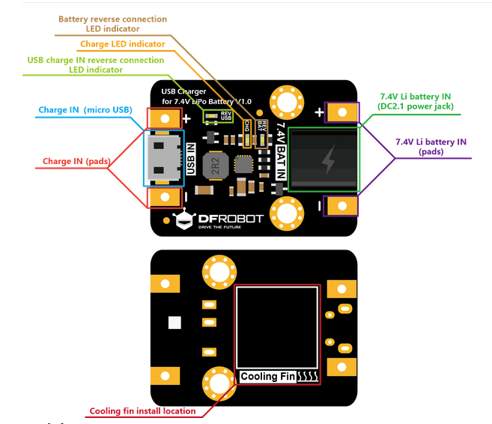
Battery charger circuit
DFROBOT DFR0564 (7.4V battery charger) https://uk.farnell.com/dfrobot/dfr0564/usb-charger-board-lipo-battery/dp/3879649
https://wiki.dfrobot.com/USB_Charger_for_7.4V_LiPo_Battery_SKU__DFR0564
Would it be possible to solder the battery to the pads and leave all the time, even when using the battery? -> Yes

Slide 14
Connectors
Solenoid connectors: https://www.lcsc.com/product-detail/Wire-To-Board-Wire-To-Wire-Connector_JST-S2B-PH-SM4-TB-LF-SN_C295747.html
Pin headers corresponding to Adafruit Feather board to stack with ESP32 board
Battery connector (2.1mm Power Jack) https://uk.farnell.com/pro-power/ppw01008/2-1mm-dc-plug-lockable/dp/3383697

Slide 15
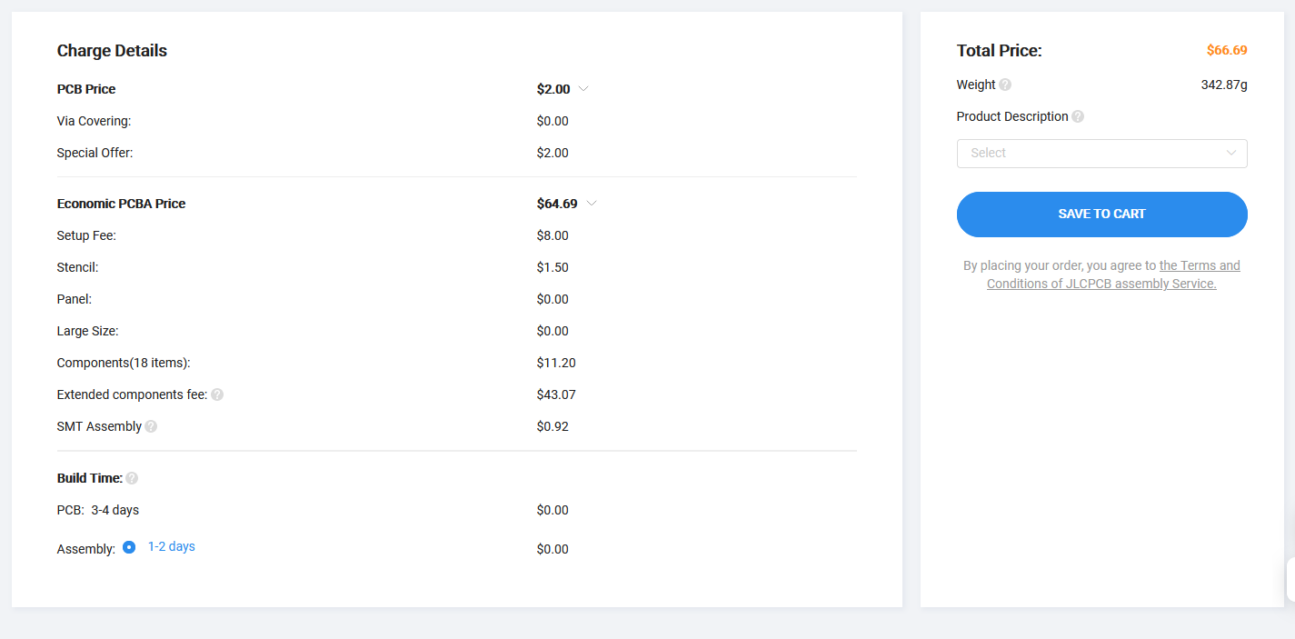
Assembly
High price because extended parts? Easy way to replace them by basics one?
Ok to solder the 2.1mm Power DC Jack ourselves? https://www.dnatechindia.com/dc-female-power-jack-pcb-panel-cabinet-mounting.html
https://electronics.stackexchange.com/questions/141897/dc-power-supply-jack-connector-pinout

Slide 16
BOM
Adafruit ESP32 board
IMU board
Charger board
Custom PCB
Stacking header for Feather (ESP32 board to custom PCB) –> Pimoroni
Stemma QT wire (ESP32 board to IMU board) -> Pimoroni
2mm 2pins JST cables (2x Solenoid, 1x VBAT ESP32 board) -> Pimoroni
DC power connector adapter (maybe for battery to charger, to be changed latter) –> Amazon

