Slide 1
Agenda - Aviation Cloud Native Solution Demo Dev. Plan
 | Our Understanding - Use Case
 | Approach – Phase 1 & Phase 2
 | Use Case Functional Flows and Wireframes
 | Logical Architecture
 | Illustrative Phase 1 Resourcing
 | Assumptions
 | Next Steps

Slide 2
Our Understanding - Aviation Cloud Native Solution Demo Scope
Scope
Build an Aircraft component performance analysis system with a near future requirement of predictive analysis of components performance.
Phase 1 : Dynamic User Interface(UI) screens which enable the performance tracking of aircraft components, based on Component (unit)performance history and Component history by aircraft position
Phase 2 : Predictive analysis of aircraft component performance that enables cost savings through increased performance and decreased maintenance cost and operational disruption.

Slide 3
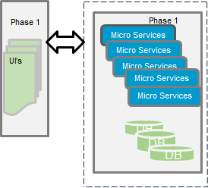
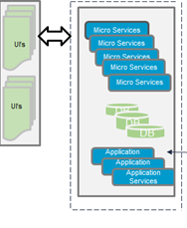
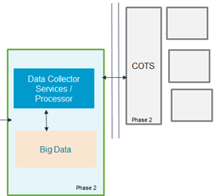
Approach – 2 Phased Approach with Phase 1 implementation to start 09/23
Phase 1
Data Aggregation
Visualization
Reporting
Analysis
Phase 2
Real-time alerting based on complex event processing
Predictive analytics
Alerts / Predictions
*x - Iterations
Demo: 5 - 6 Weeks.

Slide 4
Phase 1 - Use Case Elaboration
Functional Flow
Major Functionalities:
Initial login page and launch buttons for screens to navigate to splash screen and component performance screen.
Filter editor screens for Unit based, aircraft position based and System- aircraft based selection of components.
Screen to display the performance of the components based on the parameters set in the filter editor.

Slide 5
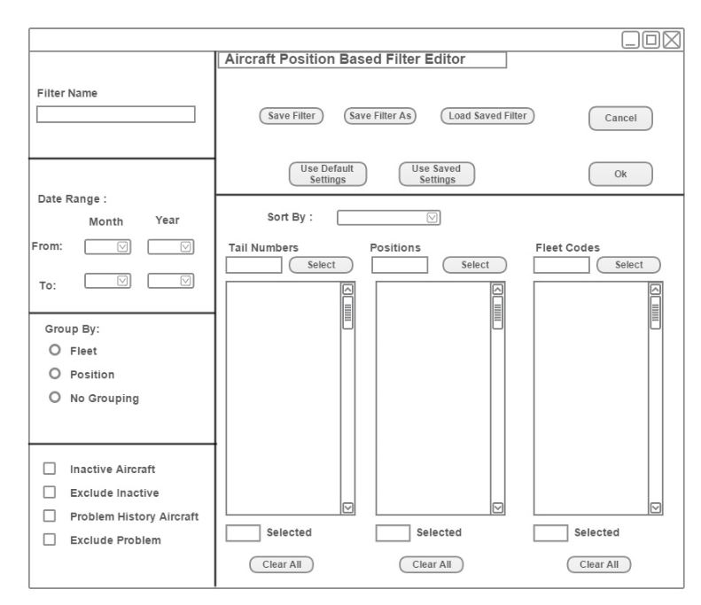
Phase 1 – Screen A - Wireframes / Mockups - Filter Editor Screen
Text boxes
Buttons
Functionalities:
Grouping / filtering options for components viz, installed, new, active units etc.
Settings options for save, edit or load earlier saved filters
Grouping and sorting options based on date range, Mfg. part no. and Serial numbers.
Select or deselect serial numbers based on set filters and save the filter
Dropdowns
Filters & groupings
Lists
Checkboxes

Slide 6
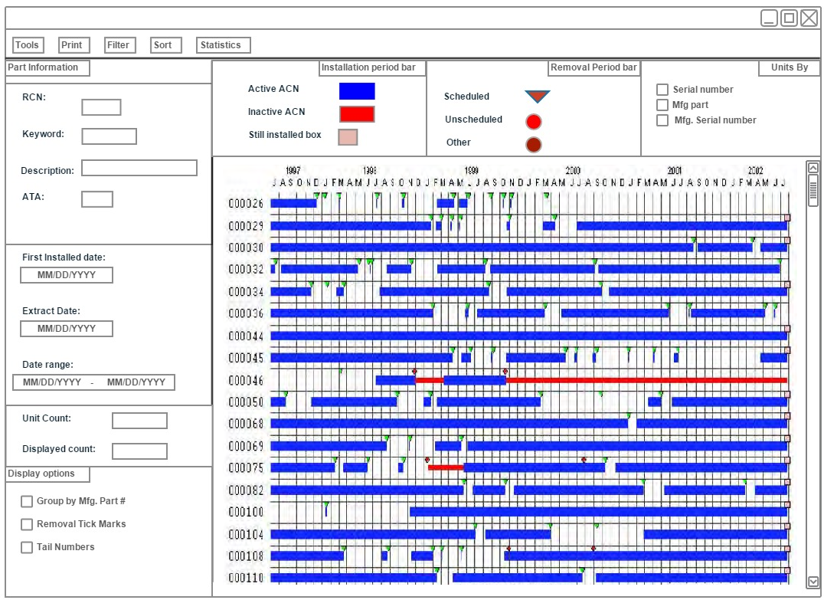
Phase 1 – Screen A- Wireframes / Mockups - Component Removal Analysis Screen
Analysis Dashboard
Part Info.
Dropdowns
Dynamic display
Functionalities:
Toolbar with print, sort, filter, statistics dropdowns
Auto populated part information
Auto populated time duration based on filter editor
Check boxes to enable / disable display options
Installation period bars to indicate the revenue service duration of the components
Tick marks to show scheduled/ unscheduled removals of the components
Display of component serial numbers vs timeline to show the component performance
Display
options

Slide 7
Phase 1 - Logical Architecture including Cloud based Microservices architecture with a DevOps/PaaS Foundation
Setting Widget
Component Dashboard
Unit Service History Graph Widget
Aviation –Settings & Splash UI micro services
API Gateway
Aviation UI micro services
Component infra micro services
Jenkins CloudBees Pipeline
DB
Aviation-Component History UI micro services
Component API micro services
Aviation Live Data Platform
Phase 2
Pivotal Platform
Spring Cloud Config
Spring Cloud Service registry

Slide 8
Illustrative Phase Staffing and Key Assumptions
Phase 1 – Four Offshore resources including one UI Analyst and three Cloud Developer
Resource | Location | Level | Role | Man-days (Phase 1)
Parag | Offshore | SC | UI Analyst | 28
Suman | Offshore | C | Cloud Developer | 28
Abhilash | Offshore | C | Cloud Developer | 28
Balaji | Offshore | SE | Cloud Developer | 28
Assumptions:
Onshore resource time will be non-billable and will be optimized
Require sample data with hierarchy for Phase 1 within first week
Any functional clarifications / context will be provided in one business day
PCF environment will be made available.
.Earliest approval by end of 23rd September since the resources are multi-proposed.

Slide 9
Next Steps
Submit Staffing & Budget (Pankaj)
Approve build cost and confirm logistics for Phase 1 Demo (Mike, Peter)

