Slide 1
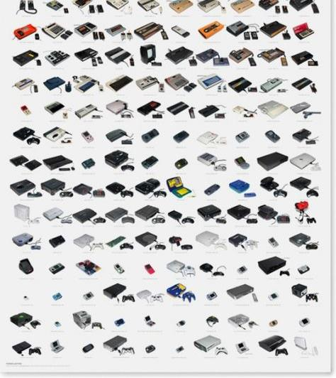
Historical Console Video Game Sales
Robert Johnson

Slide 2

Content
History of Consoles Sales
Game Sales by Platform
Game Sales by Genres

Slide 3



GAMING CONSOLE HISTORY
Video gaming has come a long way since the early days of Pong and Pac-man.
The aggressive competition between gaming companies has driven the technological leaps to superior features and video gaming quality we see today.

Slide 4
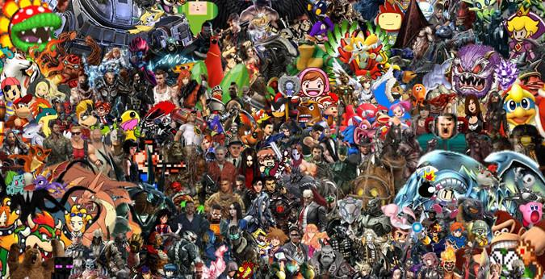
GAMING CONSOLE HISTORY
The more than 70 gaming consoles has produced 100’s of memorable characters that are embedded into international culture.

Slide 5
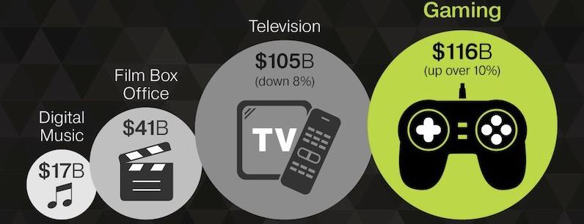
GAMING CONSOLE TODAY
$116
Billion
Today, video games are a more than $116 billion global industry, and nearly two-thirds of American homes have household members who play video games regularly.
The game industry is also often at the forefront of computer technology and drives popular culture.
2/3
U.S.
Household

Slide 6
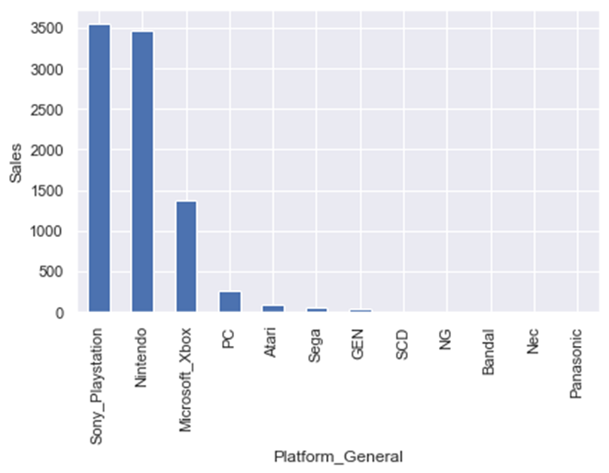
SALES BY PLATFORM
Video game historically have been spread out across the various consoles. With most of the success being concentrated with Nintendo, PlayStation, and Xbox

Slide 7

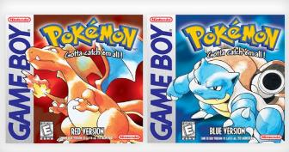
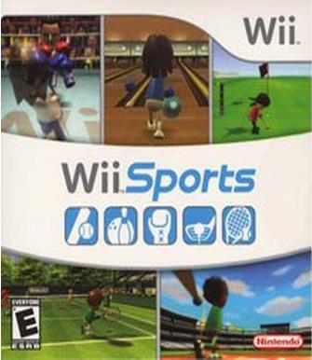




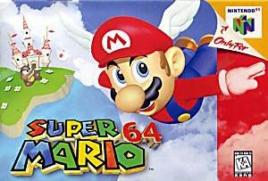



SALES BY PLATFORM
BEST SELLING GAMES FOR NINTENDO CONSOLES
40 Million Sold

Slide 8
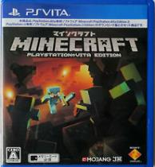

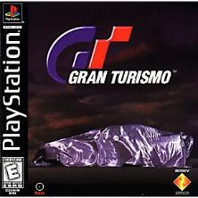
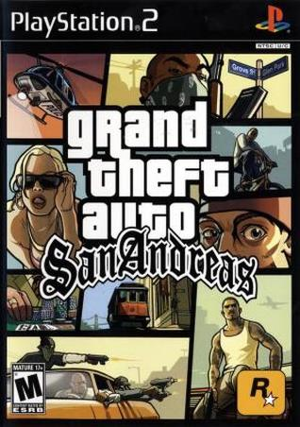



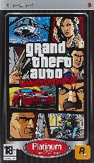
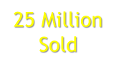


SALES BY PLATFORM
BEST SELLING GAMES FOR PLAYSTATION CONSOLES
40 Million
Sold

Slide 9
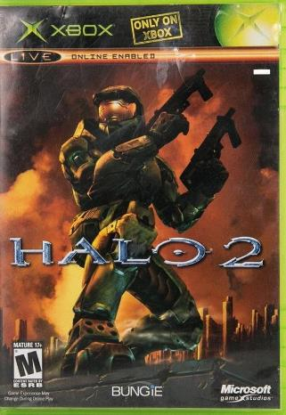




SALES BY PLATFORM
BEST SELLING GAMES FOR XBOX CONSOLES
20 Million
Sold

Slide 10




Slide 11
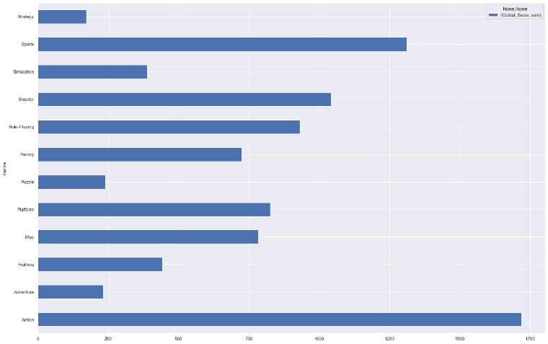
Historically Action games are the best-selling genre followed closely by sports

Slide 12
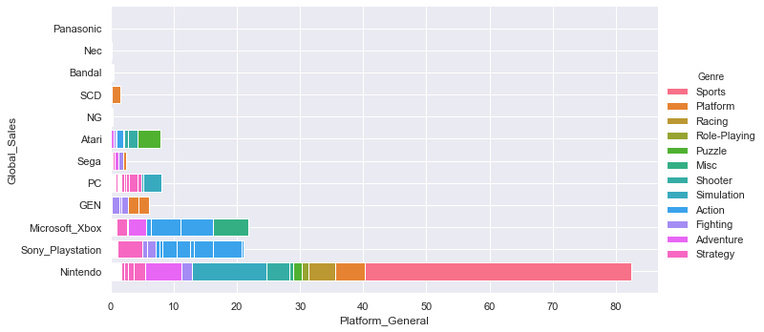
BEST SELLING GENRE BY CONSOLES

Slide 13




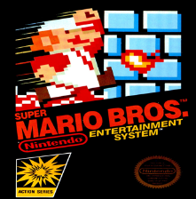


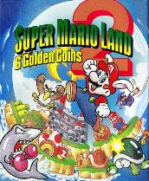








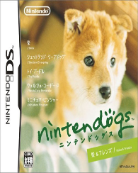

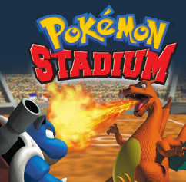
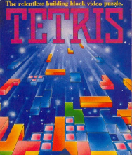
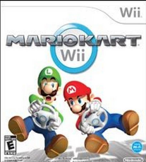
BEST SELLING GAME FOR EACH GENRE
ACTION
ADVENTURE
FIGHTING

Slide 14
DATA SET SUMMARY
While there have been more than 70 company to make gaming consoles three companies domninate the game sales market, Nintendo, PlayStation, Xbox.
Nintendo has the overall sales lead because they focus on children and casual gamer, thus they have no direct competitor. From a market position, they are in the best place to differentiate themselves and experience exponential growth.
PlayStation and Xbox are chasing the same customers. PlayStation has been wining since 2011.

Slide 15
DATA SET SUMMARY
The 30 years of data in this set shows the historical trend of the console industry is toward growth.
Action games are the best-selling genre for console games.
Nine of the 12 best selling games by genre are exclusive to Nintendo.
This data set lends itself better for historical analyses instead of predictive model building.

