Slide 1
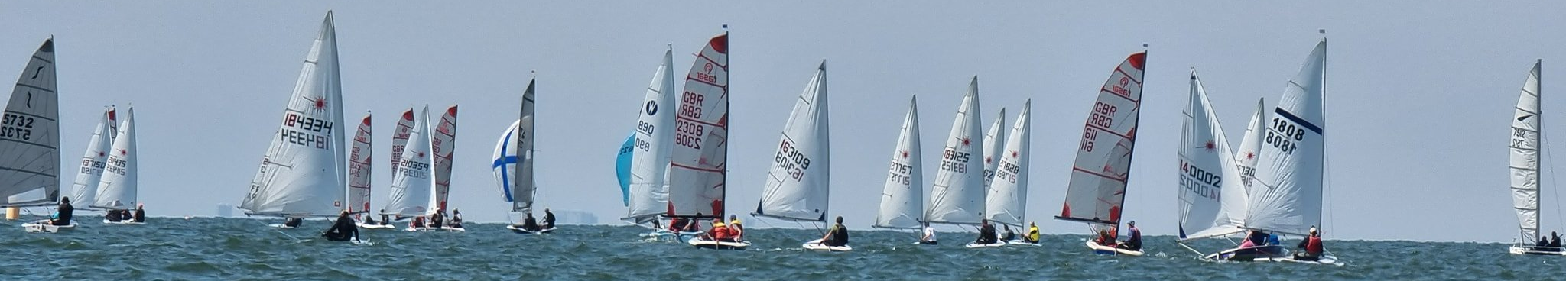
xl2cal
x2cal is a simple tool to convert a schedule, such as a sailing club racing calendar, from a spreadsheet to an iCalendar that can be imported into Apple Calendar, Google Calendar, etc.
Select spreadsheet…
2023

Slide 2
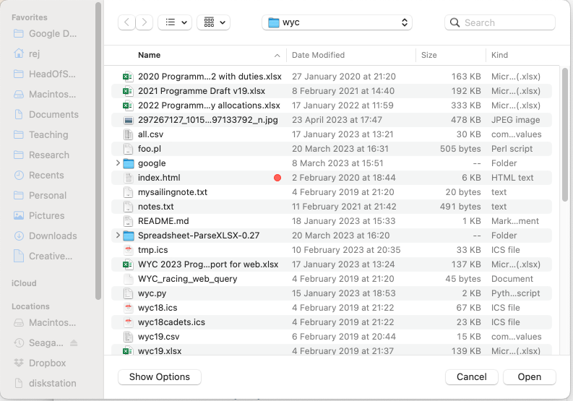

Slide 3
xl2cal
x2cal is a simple tool to convert a schedule, such as a sailing club racing calendar, from a spreadsheet to an iCalendar that can be imported into Apple Calendar, Google Calendar, etc.
wyc2023
2023
Select columns to export.
?
Select… | Select… | Select… | Select… | Select… | Select… | Select… | Select… | Select… | Select…
Day | Day number | Month | Month number | Date | Start | End | Duration | Event | Calendar
Sunday | 12 | March | 3 | Sunday 12 March | 1100 | 1230 | 0130 | April Showers 1 | Club race
Export

Slide 4
xl2cal
x2cal is a simple tool to convert a schedule, such as a sailing club racing calendar, from a spreadsheet to an iCalendar that can be imported into Apple Calendar, Google Calendar, etc.
wyc2023
2023
Select columns to export.
?
Select… | Day | Select… | Month | Select… | Start | Select… | Select… | Event | Calendar
Day | Day number | Month | Month number | Date | Start | End | Duration | Event | Calendar
Sunday | 12 | March | 3 | Sunday 12 March | 1100 | 1230 | 0130 | April Showers 1 | Club race
Export

Slide 5

Select calendars to include:
Both
Cadet
Main
Cancel
Export

Slide 6
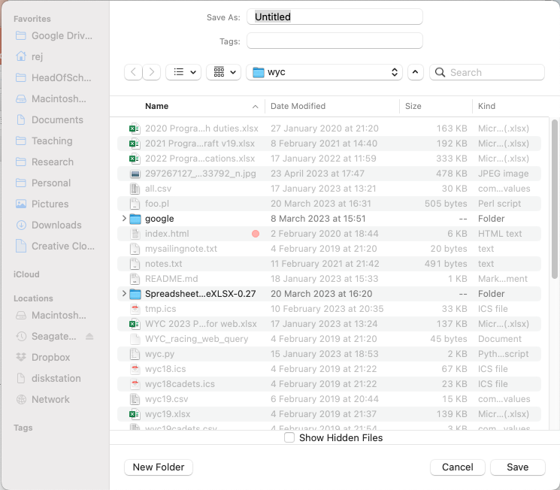

Slide 7
xl2cal
About
x2cal is a simple tool to convert a schedule, such as a sailing club racing calendar, from a spreadsheet to an iCalendar that can be imported into Apple Calendar, Google Calendar, etc.
(c) Richard Jones, 2023
github

Slide 8
xl2cal
Spreadsheet restrictions
Spreadsheet restrictions

Slide 9
xl2cal
Selecting columns
Use the column heading buttons to select the columns to be used.
Mandatory columns
The date column(s) of the event must be specified by EITHER a Day number column and a Month number column OR a Date column. If Days are specified, the Day column may contain either cardinal (e.g. 6) or ordinal (e.g. 6th) numbers. If Months are specified, the Month column may contain either cardinal numbers (e.g. 6), or month name or prefix (e.g. June or Jun). If a Date is specified, almost any format is acceptable.
A Start column. Entries in the start column should usually be times using a 24-hour clock. Acceptable entries include 1400, 14:00 and 14.00. However, TBA, TBC, NA and N/A are also accepted. Lines without valid Start times (such as headers, blank lines) are ignored.
An Event column, describing the event.

Slide 10
xl2cal
Selecting columns
Use the column heading buttons to select the columns to be used.
Optional columns
A high-water (HW) column. An entry in this column (e.g. 1500), if any, will be appended to the entry in the Event column (e.g. Race 1) to give e.g. (Race 1, HW=1500).
An End or Duration column. If neither is provided, events are given a default duration.
A Calendar column. This is intended to allow separate calendars to be generated from a single spreadsheet. If no Calendar column is specified, all events are generated. Otherwise, you must also provide a list of the event types to include in the exported calendar.

