Slide 1
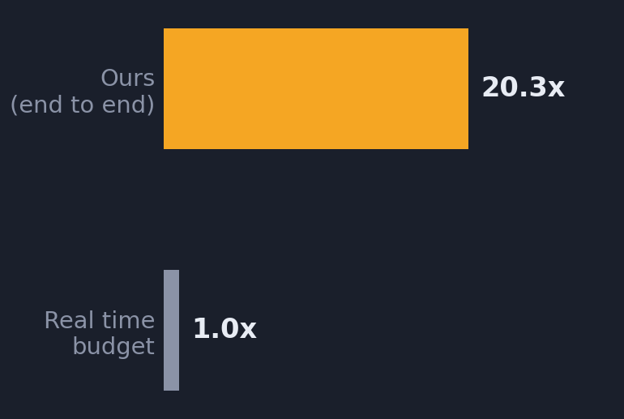
Video anomaly detection on a 4 GB laptop GPU
54.8 / 100
Frozen vision-language encoder + two small trained heads · 11 classes · 20.3x real time on an RTX 3050 Laptop
PRIVATE EVALUATION SET
PIPELINE
Drone / CCTV / dashcam video
Sample 2 fps downsize on decode
SigLIP-2 base FROZEN, fp16
4 s windows mean/max/std/drift
Two MLP heads window + clip
Hysteresis decoder relative to baseline
OpenCV
78 fps · 1.03 GB
2 s hop
trained, <1 min
merge · gate
Encode once, reuse forever.
The encoder is frozen, so all 3,207 videos are embedded once into a cache. Retraining a head then takes under a minute, which is what made same-day iteration on windowing and thresholds possible.
WHY NOT RUN A VLM PER FRAME
SPEED, MEASURED END TO END
4 GB rules out fine-tuning a 2B VLM locally. So we froze one and trained only what sits on top.
The always-on stage is, in the end, a 12-way decision — orders of magnitude cheaper as a head over frozen embeddings than as generative decoding. The open-vocabulary semantics still come from the VLM; only the task-specific part is learned.
Explanations use nearest-neighbour retrieval over training descriptions in the same embedding space — one dot product per event, no generative model.
3,391 s
of video
167 s
to process, incl. decode
Decode is the bottleneck, not the GPU.
Encoding 2 fps costs 1.03 GB and leaves headroom for many streams.

Slide 2
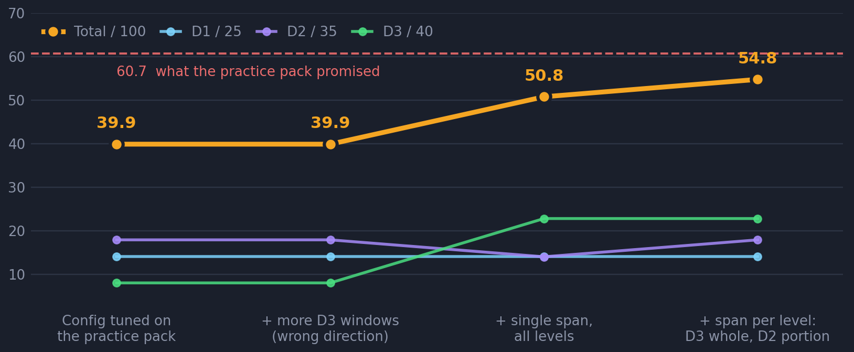
What moved the score, and what didn't
Private evaluation set, 28 videos. D1 is worth 25, D2 35, D3 40.
THREE THINGS THAT MATTERED
Score against each video's own baseline
The head, trained on short clips where the event fills the frame, reports a high flat pedestal on long footage — baselines ranged 0.55 to 0.88, so no absolute threshold transfers. Thresholding on the rise above each video's own median found the events.
L2 +0.12 · L3 +0.10
Use each head for its own question
The window head answers where; the clip head answers what. Letting the clip head classify each detected span, instead of pooling window votes, fixed whole videos at once.
FINAL, BY DIFFICULTY TIER
L3 0.296 → 0.414
Difficulty 1
Difficulty 2
Difficulty 3
Annotation granularity beat every tuned threshold
56.2%
51.0%
57.0%
Overlap is scored against the WHOLE ground-truth span, so our short windows each fell under the 0.5 gate and scored nothing. One span per video lifted D3 from 8.0 to 22.8 marks - after ~15,000 tuned configs had barely moved it.
14.1 / 25 marks
17.9 / 35 marks
22.8 / 40 marks
class confusion is the wall
event is part of the clip
one span beat 4 windows
D3 20% -> 57%; total 39.9 -> 54.8
Honest caveat.
A decoder tuned to 60.7 on the practice pack scored 39.9 on the private set — thresholds fitted to 10 videos did not transfer, and the gain that mattered came from reading the scoring rule rather than from search. Class accuracy is now the binding constraint: stalled, road_spill, blocking and wrong_way are all 0% found, and no timing change fixes a wrong label.
WHAT WE TRIED AND DROPPED
Contrast-to-baseline features: +0.8% held-out, but test AUC collapsed 0.86→0.53 · logit adjustment for rare classes: zero lift · TTA: zero lift

