Slide 1
Screebit Social Media
Karnes, Garcia, Graham

Slide 2

Project Overview
Develop a social media site
Allow users to
Upload Profile picture
Search for friends
Post messages to their page
Follow each other
Up vote posts
Down vote posts

Slide 3

WHAT DO WE USE?
Well..what don’t we want?
Death by language
Ability to prototype rapidly
Leverages our existing knowledgebase
Deploys easily
Many available frameworks and packages to speed up development
Doesn’t suck.
Golang
NodeJS
Angular
Python
PHP
React

Slide 4





What We Selected
Postgresql
Powerful free open source database.
Pure Javascript
Easy to use without having to learn a new framework or library such as react or angular
Many many packages available to speed development such as bootstrap.js, animate.js, Jquery, etc.
Golang
Relatively, new language but powerful with good resources available for backend work.
Goland By Jetbrains
Excellent IDE for golang development. Integrates database management and web development tools into one environment. Can be a bit resource intensive.
Git Kraken
Another powerful tool but for managing our project repository

Slide 5

Version Control System

Slide 6


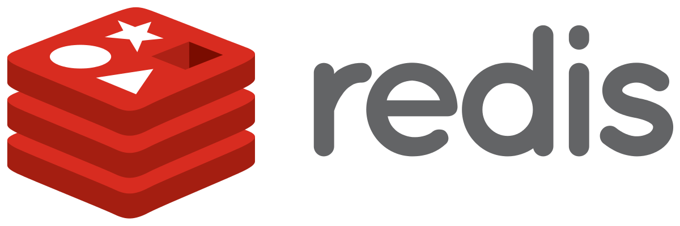
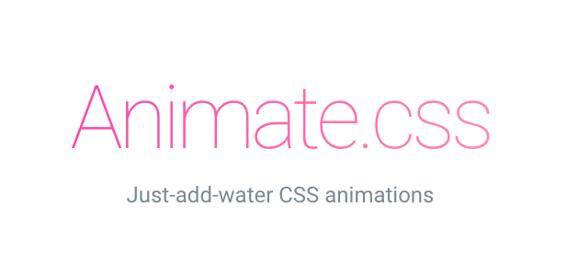





Anything else?

Slide 7

Challenges
Many moving parts a lot of ways to implement our desired feature
Different time and resource constraints for each team member.
UI design and implementation work always talks 2-3 times longer than coding alone.
Javascript bugs!
Javascript bugs!!
Javascript bugs!!!

Slide 8

Solutions?
Starting out with a naïve approach first to a problem and then adding features.
Knowing when to abandon a feature that isn’t working the way we want for the sake of time.
Looking to see if a someone has developed a tool or framework that would make a feature easier to implement. Why reinvent the wheel.

Slide 9

Testing
Unit tests and continuous integration made up our testing strategy.
This allowed us to put out fires quickly without losing development time.
Given our time constraints this was the most efficient approach for our group.

Slide 10
Deployment
Used Google Cloud instead of Heroku
Easy to deploy
Really cheap to use ($3/month)
Easy to Manage
It’s google
Ubuntu/NGINX/REDIS

