Slide 1
GDPR –Coming Soon!
Microsoft Corporation

Slide 2
Providing clarity and consistency for the protection of personal data
The General Data Protection Regulation (GDPR) imposes new rules on organizations that offer goods and services to people in the European Union (EU), or that collect and analyze data tied to EU residents, no matter where they are located.
Enhanced personal privacy rights
Increased duty for protecting data
Mandatory breach reporting
Significant penalties for non-compliance
Goes into Effect May 2018

Slide 3
What are the key changes with the GDPR?
Personal privacy
Individuals have the right to:
Access their personal data
Correct errors in their personal data
Erase their personal data
Object to processing of their personal data
Export personal data
Controls and notifications
Strict security requirements
Breach notification obligation
Appropriate consents for data processing
Confidentiality
Recordkeeping
Transparent policies
Transparent and easily accessible policies regarding:
Notice of data collection
Notice of processing
Processing details
Data retention/deletion
IT and training
Need to invest in:
Privacy personnel and employee training
Data policies
Data Protection Officer (larger organizations)
Processor/Vendor contract

Slide 4
The Skinny on GDPR for Partners
Potential Global Impact | Operational Complexity | Significant Fines | Need for privacy professionals
The regulation | GDPR policies require | Fines for non- | There will be a
applies to companies | privacy-by-design | compliance can | serious resource
that trade products or services with European customers or in the European market.1. | and by-default. Partners can become privacy consultants or implementers to support customers' GDPR journeys. | be "up to 4% of an organization's global revenues or €20 million, whichever is greater. A fine of this | shortfall of Privacy Professionals. Professional Services vendors will pick up the slack 2.
 |  | magnitude could put
 |  | many companies out
 |  | of business." 1

Slide 5
GDPR Resources

Slide 6

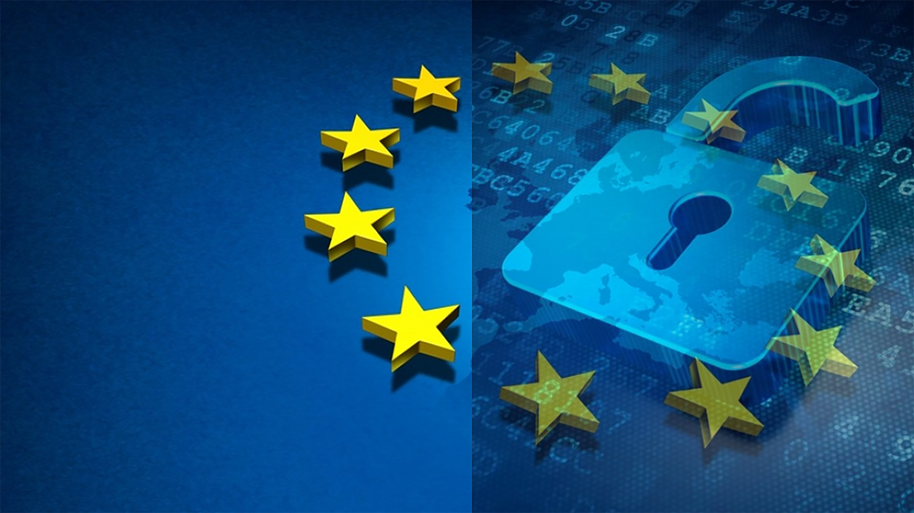
Microsoft GDPR Detailed Assessment
<your name>
This presentation is intended to provide an overview of the Microsoft GDPR Detailed Assessment and is not a definitive statement of the law.

Slide 7
Microsoft GDPR Detailed Assessment
Workshop | Description | Workshop Resources
Engagement setup
Engagement Kick-off | Provides an overview of the 2-day on-site agenda and goals as well as an opportunity to cover Q&A and project governance. | 01 - Microsoft GDPR Detailed Assessment – Engagement Overview (this deck)
Engagement Flow
On-site Engagement Overview | Provides an overview of the 2-day on-site agenda and goals as well as an opportunity to cover Q&A and project governance. | 02 - Microsoft GDPR Detailed Assessment – Kickoff Presentation
Microsoft GDPR Detailed Assessment | Complete discussion of the questions contained within the Microsoft GDPR Detailed Assessment | 03 - Microsoft GDPR Detailed Assessment – Delivery Guide 04 - Microsoft GDPR Detailed Assessment – Detailed Assessment
Microsoft GDPR Detailed Assessment Remediation Checklist | Complete the Microsoft GDPRMaturiy Asessment Remediation Checklist | 05 - Microsoft GDPR Detailed Assessment – Remediation Checklist
Microsoft GDPR Detailed Assessment Closeout Presentation | Deliver recomentations and priortize next steps | 06 - Microsoft GDPR Detailed Assessment – Closeout Presentation
Notes:
Recommendation:

Slide 8

The Approach
Discover
Identify what personal data you have and where it resides
1
Manage
Govern how personal data is used and accessed
2
Protect
Establish security controls to prevent, detect, and respond to vulnerabilities & data breaches
3
Report
Keep required documentation, manage data requests and breach notifications
4
Notes:
Presenter guidance:
Use this slide to educate how customers can get started on their journey to GDPR compliance.
Key takeaways:
The GDPR contains many requirements about how you collect, store and use personal information. This
means not only how you identify and secure the personal data in your systems, but also how you
accommodate new transparency requirements, how you detect and report personal data breaches, and
how you train privacy personnel and employees.
Given how much is involved, you should not wait until the regulation takes effect in May 2018 to prepare. You need to begin reviewing your privacy and data management practices now. Failure to comply with the GDPR could prove costly, as companies that do not meet the requirements and obligations could face substantial fines and reputational harm. We recommend companies begin their journey to GDPR compliance by focusing on four key pillars of an effective data protection regime:
Discover—Identify what personal data you have and where it resides.
Manage—Determine how personal data is used and accessed.
Protect—Establish security controls to prevent, detect, and respond to vulnerabilities and data breaches.
Report— Execute on data requests, report data breaches, and keep required documentation.

Slide 9



Assessment Opportunities
Identify GDPR compliance gaps
Identify maturity along key GDPR scenarios
Customer education on Microsoft security + compliance features and identify gaps
Provide an overview of security and compliance controls as well as guidance + additional readiness content
Identify potential data security + compliance challenges
Determine the current state of personal data security. Discuss and create an actionable data security roadmap for the customer
Notes:
This assessment will not discover personal

Slide 10




Assessment objectives
Understand Customer GDPR compliance objectives
Gain a common understanding of compliance objectives and GDPR requirements
Assess Customer GDPR maturity level
Assess customer’s preparedness to execute on Discover, Manage, Protect, & Report activities
Create a GDPR compliance roadmap
Provide a prioritized and actionable GDPR remediation checklist and roadmap, ready for legal/advisory review

Slide 11



Microsoft GDPR Detailed Assessment Workshop
Kick Off
Assessment
Remediation
Project scope
Requirements
Stakeholders
Complete Microsoft GDPR Detailed Assessment
Identify gaps
Provide detailed remediation checklist as prescribed by Microsoft GDPR Detailed Assessment
Identify customers remediation roadmap and next steps
Partner opportunity to help remediate

Slide 12
CELA Extras

Slide 13
Cloud Services Due Diligence Checklist
Cloud Services Due Diligence Checklist
A move to the cloud raises important strategic issues for an organization:
How will data be secured, where will it be located, and how available will it be when it is no longer on premises?
How will the organization continue to meet regulatory obligations? How will the privacy of sensitive customer and employee data be protected?
The critical first step for organizations, before they can assess and compare the level of service offered by different cloud service providers, is to clearly identify their own objectives and requirements.
Microsoft created the Cloud Services Due Diligence Checklist to meet the business need for a standardized approach.
https://www.microsoft.com/en-us/trustcenter/compliance/due-diligence-checklist

